Slide 1
Assignment 0
Mean 86.5, Std deviation 9.6
Two examples of outstanding papers are on moodle
Many students did not follow table format we specified
Task 1
  15 points off for not handling missing data correctly (i.e., wrote “0” or “-”); less if some explanation given
  5 points off for not explaining/justifying classification rule
Task 2
  Only a few errors, mostly minor (once Shirly was able to determine what the errors were)
Task 3
  Important key words: independence, missing data, data set size, generalization

Slide 2
Review
Notes:
SEE KEVIN MURPHY NOTES on gaussians

Slide 3
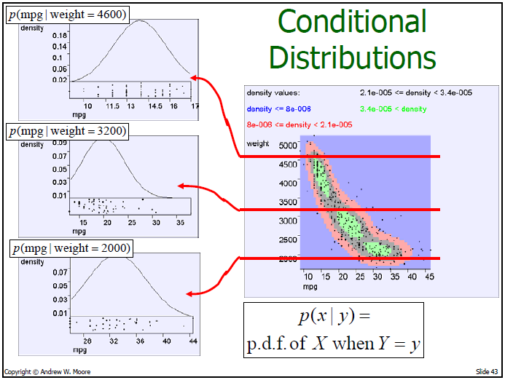
Notes:
P(x|y)=P(x&y)/p(y)

Slide 4
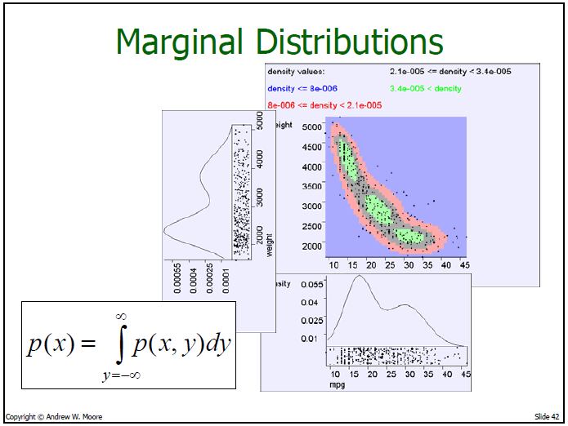

Slide 5
Gaussian Densities
CSCI 5822
Probabilistic Models of Human and Machine Intelligence
Spring 2018
Professor Michael Mozer

Slide 6
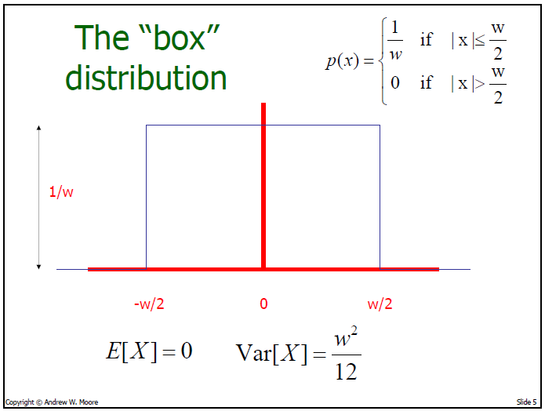
Notes:
What’s probability that you sample from this distribution and get 0?
Between -.1 and +.1?
Why Var[X]? Var[X] = E(x^2)-E(x)^2 with E(x)=0

Slide 7
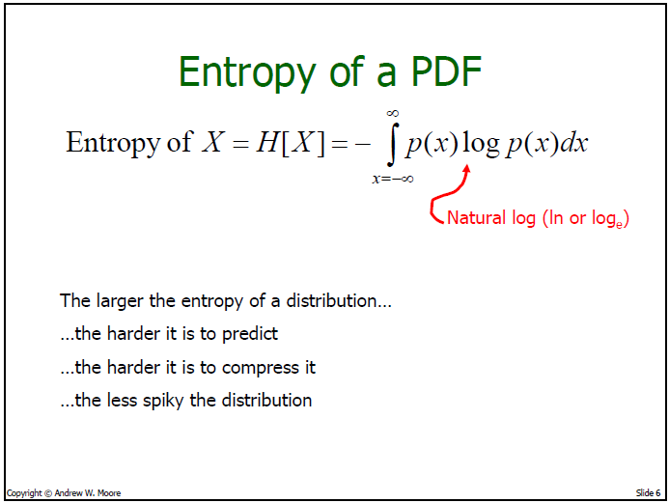

Slide 8
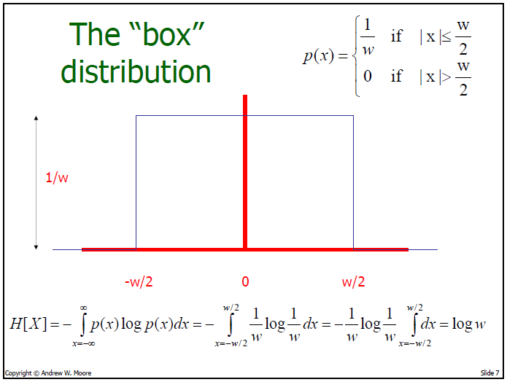

Slide 9
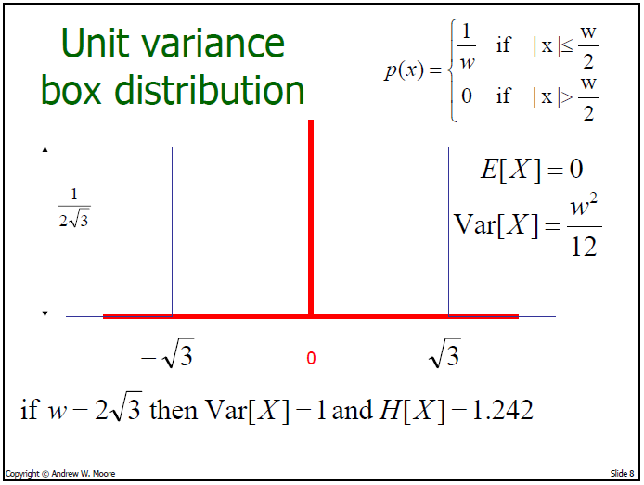
Notes:
Entropy for Var[X]=1

Slide 10
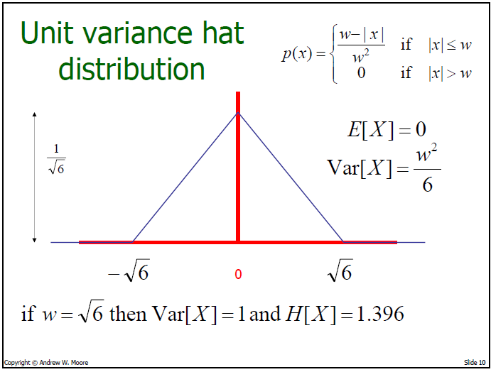
Notes:
Why normalize by w^2?
I said before that box (uniform) distribution was maximum entropy in range [a,b]: how to reconcile with fact that unit variance hat has greater entropy? [a,b] range is larger here

Slide 11
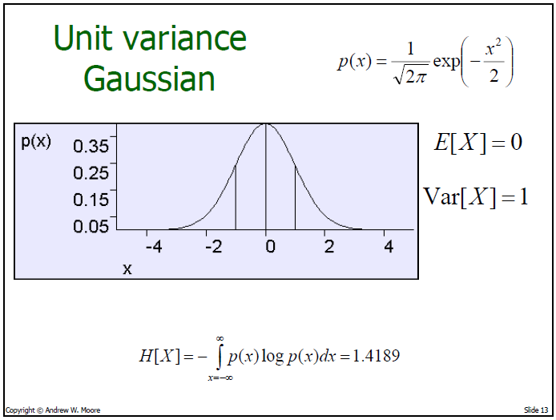
Largest possible entropy of
any unit-variance distribution
Notes:
var = 1 -> SD = 1. +/- 1SD 68% of cases, +/-2SD 95% of cases, +/-3SD 99.7% of cases

Slide 12
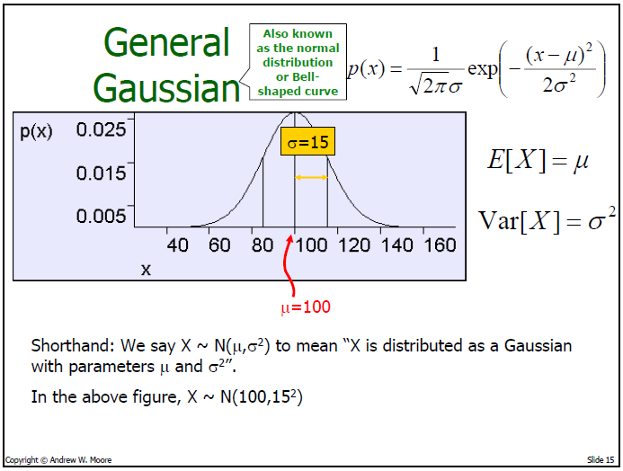
Notes:
NOTE YET ANOTHER MEANING OF ~

Slide 13
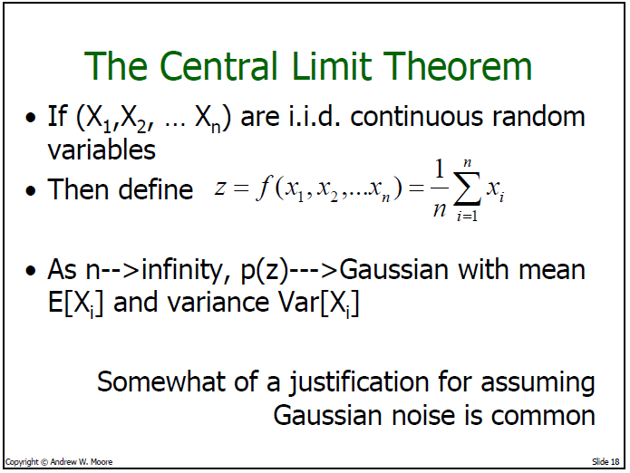
/n
Note: variables need only be independent, not identically distributed.
Notes:
Needn’t be IID, just independent
Usually n=6 or so gives reasonable approximation to gaussian

Slide 14
Empirical Validation of CLT
nmax = 20;
ncol = 5;
for n = 1:nmax
num = rand(n,1000000)*2 - 1;
g = mean(num,1);
subplot(nmax/ncol, ncol,n)
hist(g,40)
title(sprintf('%d var = %f\n',n, n*var(g)));
end

Slide 15
Notes:
Var of sum is sum of variances

Slide 16
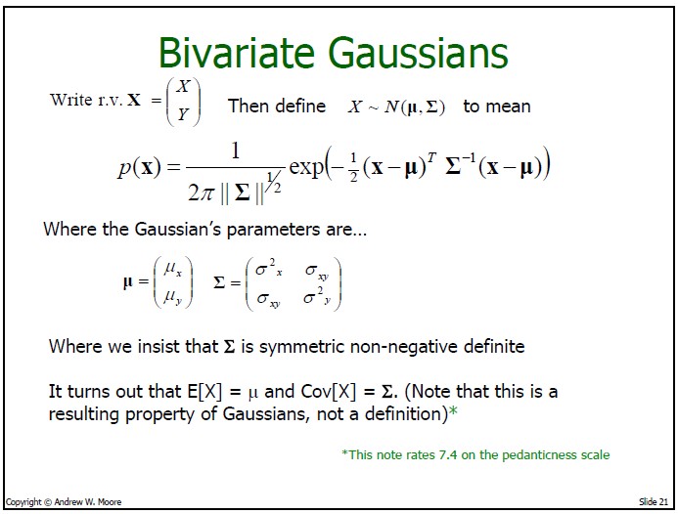
Notes:
non-negative definite: whatever x-mu is, the product is non-negative. used to seeing positive definite. ‘nonneg definite’ allows the product to be zero.
nonnegative definite if all eigenvalues are zero or larger

Slide 17
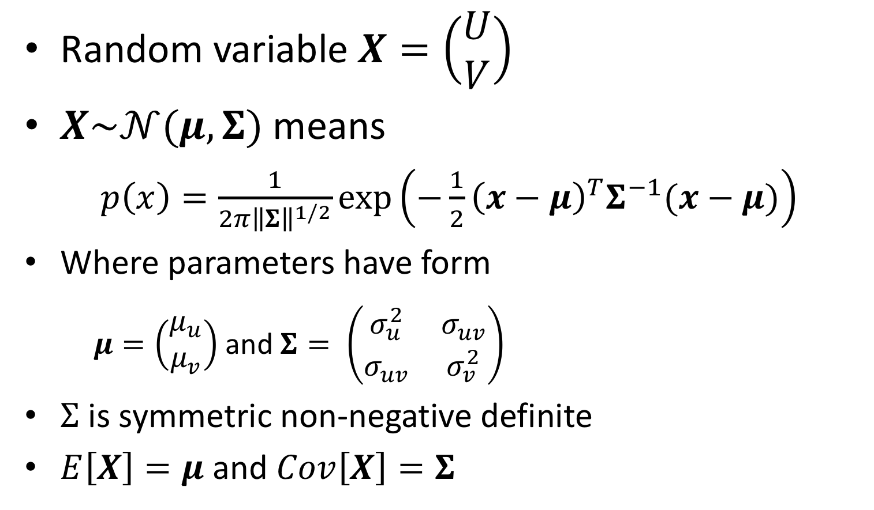
Bivariate Gaussians
Random variable $X=\left(\begin{matrix}U \\ V\end{matrix}\right)$
$X\sim 𝒩(μ,Σ)$ means
$p\left(x\right)=\frac{1}{2π{\left\|Σ\right\|}^{1/2}}exp⁡\left(−\frac{1}{2}{\left(x−μ\right)}^{T}Σ^{−1}(x−μ)\right)$
Where parameters have form
  $μ=\left(\begin{matrix}μ_{u} \\ μ_{v}\end{matrix}\right)$ and $Σ= \left(\begin{matrix}σ_{u}^{2} & σ_{uv} \\ σ_{uv} & σ_{v}^{2}\end{matrix}\right)$
$Σ$ is symmetric non-negative definite
$E\left[X\right]=μ$ and $Cov\left[X\right]=Σ$
Property of Gaussians,
not a definition
Notes:
non-negative definite: whatever x-mu is, the product is non-negative. used to seeing positive definite. ‘nonneg definite’ allows the product to be zero.
nonnegative definite if all eigenvalues are zero or larger

Slide 18
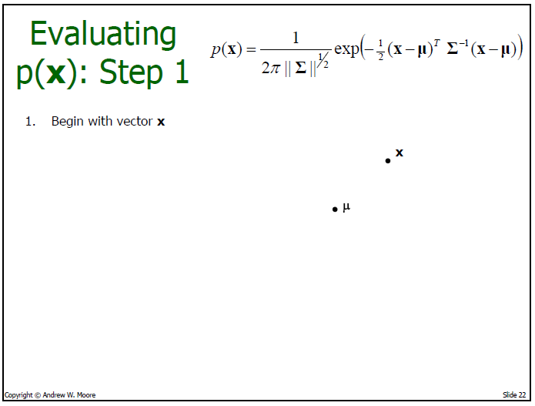

Slide 19
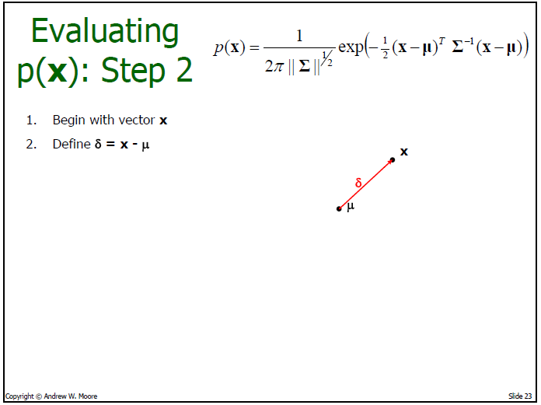

Slide 20
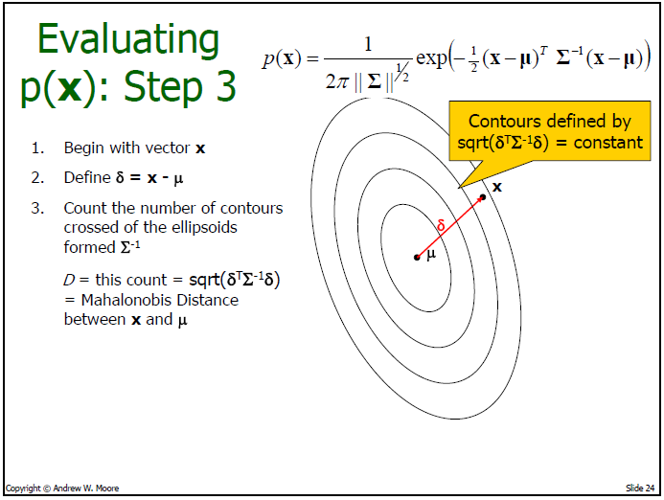

Slide 21
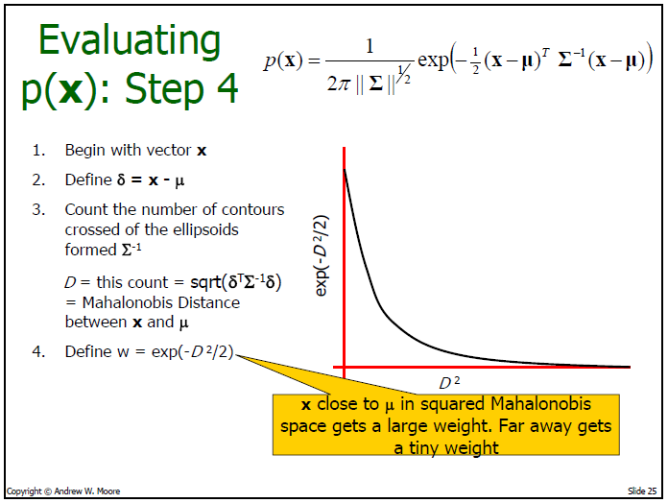

Slide 22
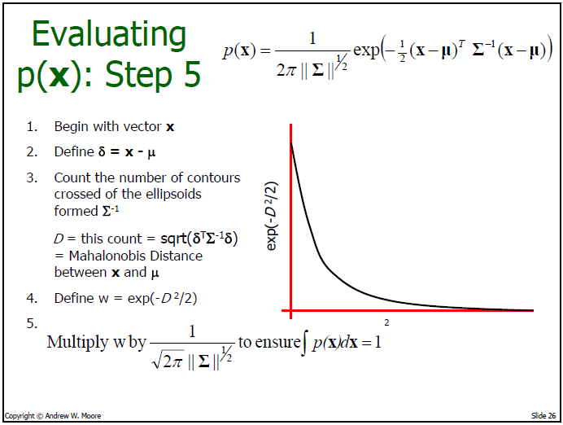

Slide 23
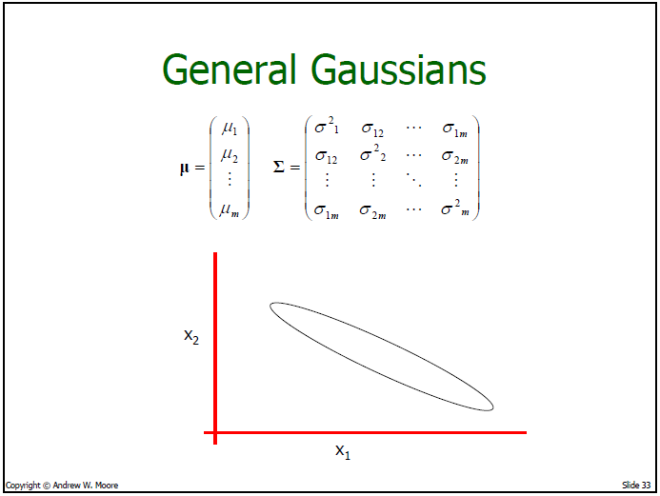

Slide 24
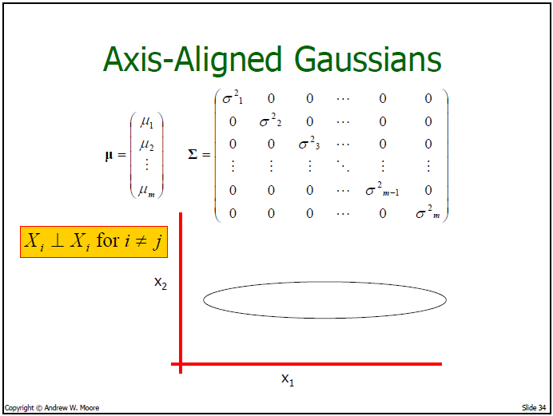

Slide 25
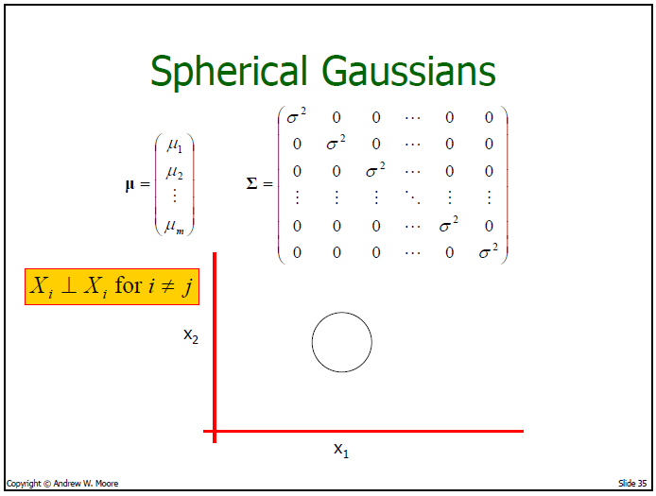

Slide 26
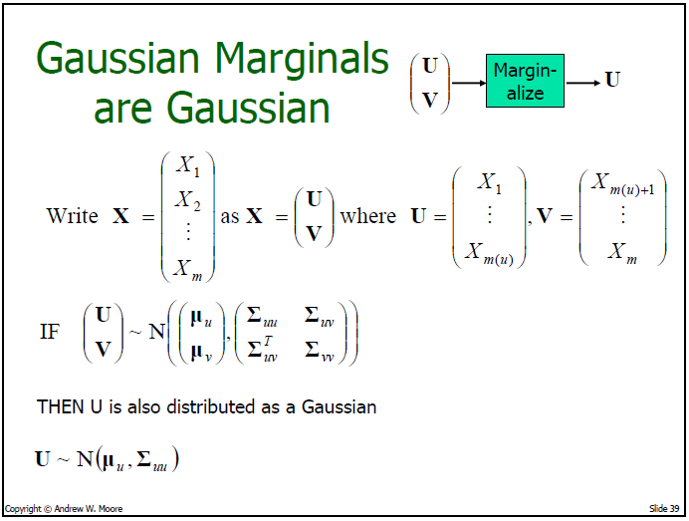


Slide 27
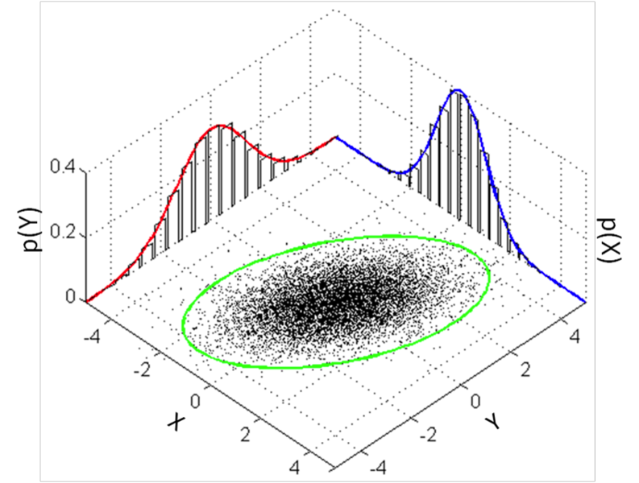

Slide 28
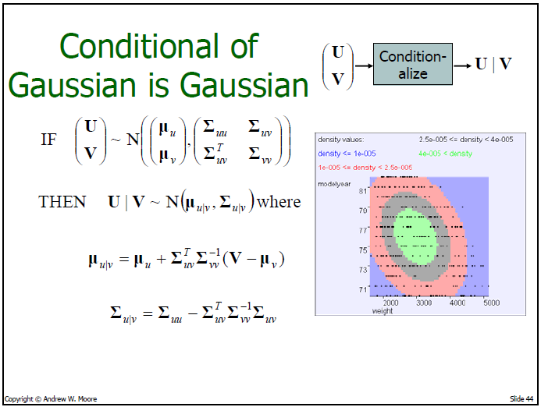
Notes:
What does this rule for conditionals imply for this joint distribution?

Slide 29
Matlab code to experiment
mu = [1 -1];
sigma = [ 1 -.9
-.9 2 ];
xRange = -4:.1:5;
yRange = -7:.1:7;
[X Y] = meshgrid(xRange, yRange);
F = mvnpdf([X(:) Y(:)],mu,sigma);
F = reshape(F, length(yRange), length(xRange));
figure(1)
imagesc(xRange, yRange, F);
axis square
xlabel('X');
ylabel('Y');
% take a slice
xVal = 1;
yVal = 0;
figure(2)
subplot(1,2,1)
yValIx = find(yRange == yVal);
plot(xRange,F(yValIx,:))
xlabel('Y')
title(sprintf('P(X & Y=%.1f)',yVal));
subplot(1,2,2)
xValIx = find(xRange == xVal);
plot(yRange,F(:,xValIx));
xlabel('Y')
title(sprintf('P(Y & X=%.1f)',xVal));

Slide 30
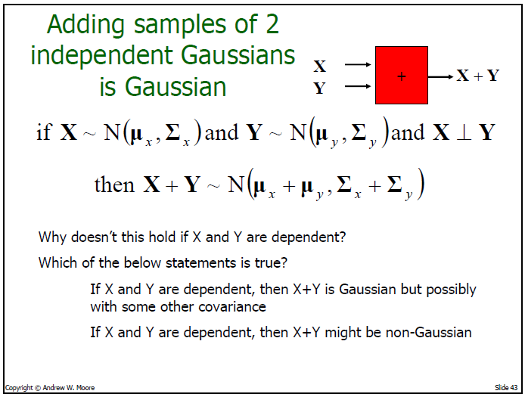

Notes:
X+Y is still gaussian, with mean mu_x + mu_y but sigma depends on covariance: in simplest case with x and y scalar, [REVEAL EQUATION AT BOTTOM OF SCREEN]

Slide 31
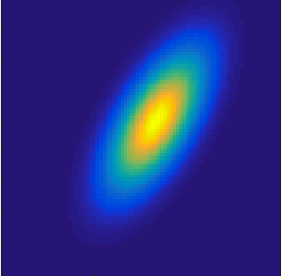
Sum of Non-Independent
Gaussian Random Variables
Suppose X and Y are jointly Gaussian but correlated?
X+Y is Gaussian but with a
covariance that depends on
nature of correlations
E.g., case where X, Y scalars

Slide 32
Not All Sums Of Dependent Gaussians Are Gaussian
E.g.,
  X ~ N(0,1)
  Y ~ N(0,X)
X+Y

