Slide 1
Bayesian Optimization

Slide 2
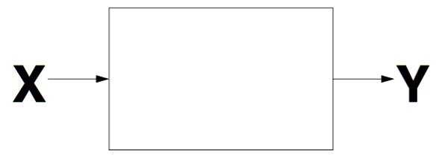
Problem Formulation
Goal
  Discover the X that maximizes Y
  Global optimization
Active experimentation
  We can choose which values of X we wish to evaluate
When is Bayesian optimization particularly useful?
  Function evaluations are expensive
  Function evaluations are noisy
Notes:
black box function

Slide 3
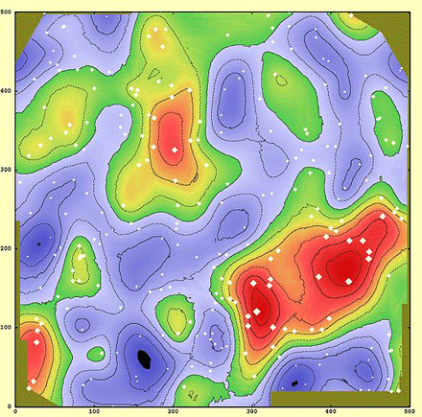
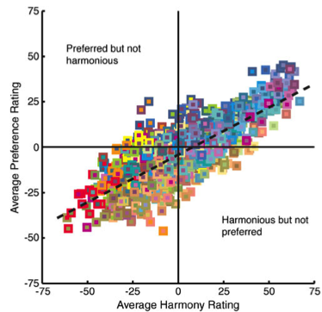
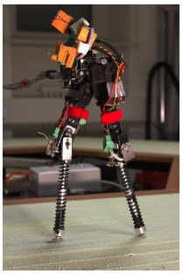
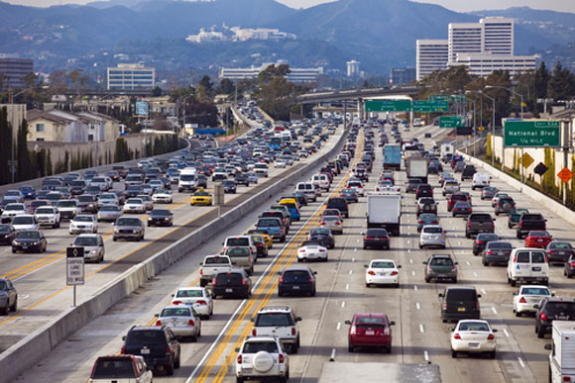
Application Areas
Geostatistics (Kriging)
Expanded A/B testing
  e.g., game design, interface design,
  human preferences
Robotics
  e.g., robot gait
Environment monitoring and control
  e.g., traffic congestion
Notes:
Geostatistics: some resource that is geographically distributed (e.g., oil underground)
traffic congestion: where along highway is the point of minimum speed?

Slide 4
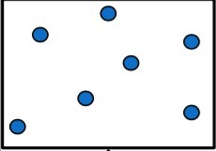
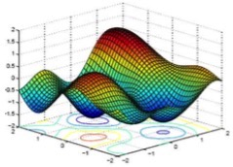


Overview
Suppose we’ve collected some data points
Construct a surrogate model from data
Select a single experiment to run
  acquisition function
Run experiment
figures from J. Azimi slides

Slide 6


Optimal Teaching
Robert V. Lindsey, Michael C. Mozer, William Huggins
Institute of Cognitive Science
Department of Computer Science
University of Colorado, Boulder
Harold Pashler
Department of Psychology
UC San Diego

Slide 7
Traditional Approach To Studying Category Learning
Compare two alternative training policies, A vs. B
Test many participants under each policy
Perform statistical analyses to
establish reliable difference
between conditions
Test Accuracy (%)
A
Training Policy
B

Slide 8
What Researchers Really Want To Do
Find the best training policy
Abscissa: space of all policies
Performance function defined
over policy space
Test Accuracy (%)
A
Training Policy
B
Notes:
At this point build up to punch : it would seem hopeless to optimize because you’d have to run hundreds of subjects at each of a very large number of policies.

Slide 9
Approach
Perform noisy experiments at selected points in policy space (o)
Use curve fitting (function
approximation) techniques
to estimate shape of the
performance function
Given current estimate,
select promising policies
to evaluate next.
  promising = has potential
  to be the optimum policy
Gaussian
process
regression
linear
regression
Notes:
There are much fancier nonlinear techniques from machine learning and statistics like Guassian process surrogate-based regression.
Allows functions of arbitrary shape with only constraint being smoothness

Slide 10
Gaussian Process Regression
Assumes only that functions are smooth
    How smooth is determined by the data
Uses data efficiently
Accommodates noisy data
Produces estimates of both function
shape and uncertainty
Notes:
Bayesian technique

Slide 11
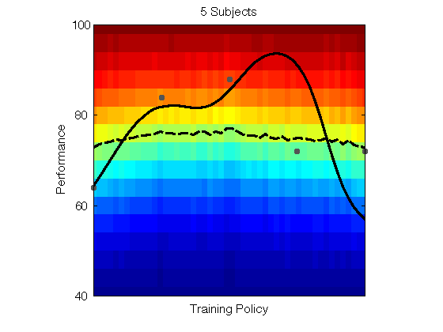
Simulated Experiment

Slide 12

Rob Lindsey

Slide 13
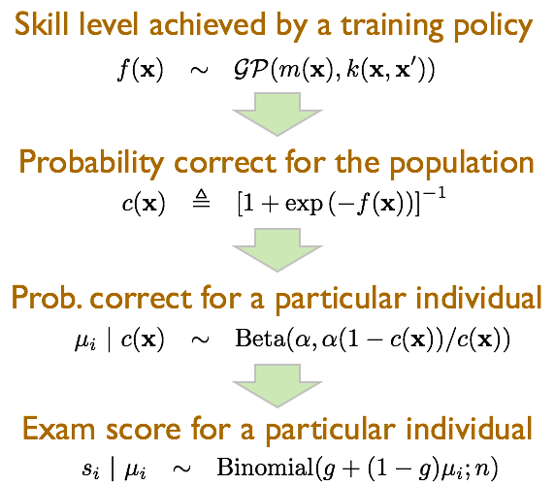
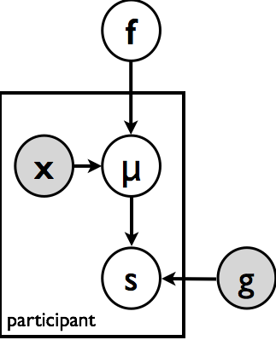
Weak Model Of Human Behavior
−∞ ➔ +∞
0 ➔ 1
Chance-
corrected
beta
binomial
0 ➔ 1
0, 1, … n
Notes:
fit model parameters with hierarchical bayesian inference

Slide 14
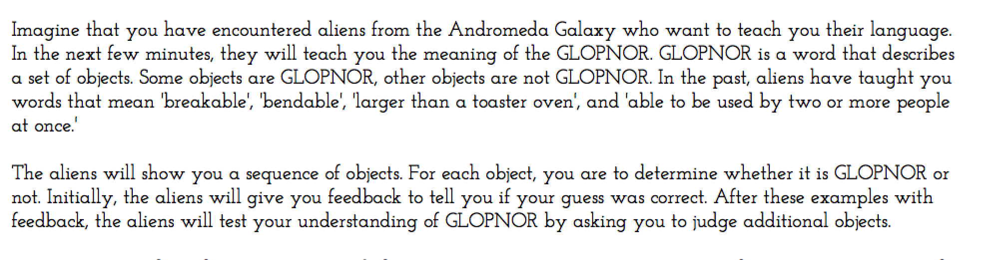
Concept Learning Experiment

Slide 15
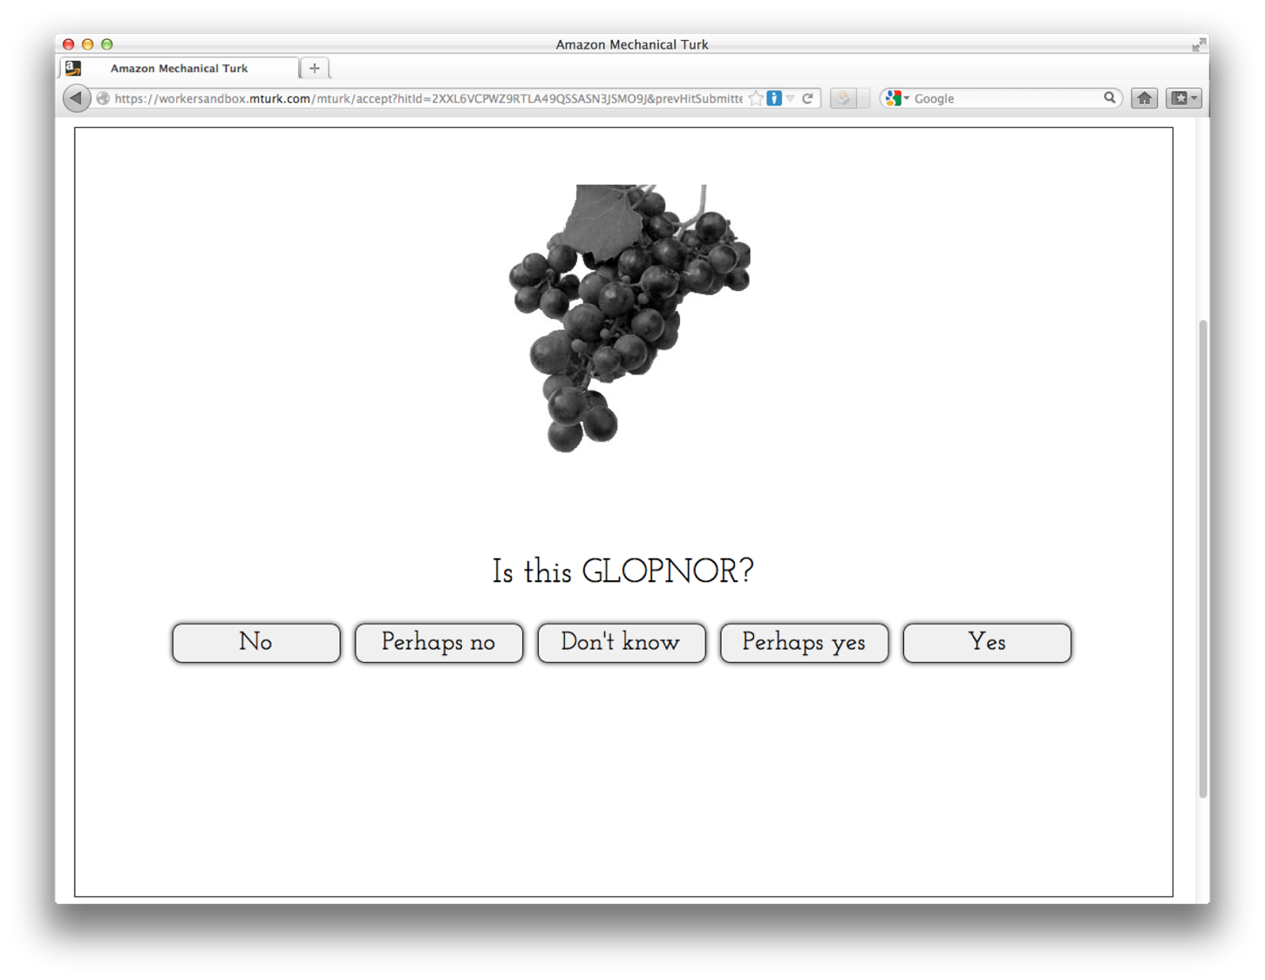

Slide 16
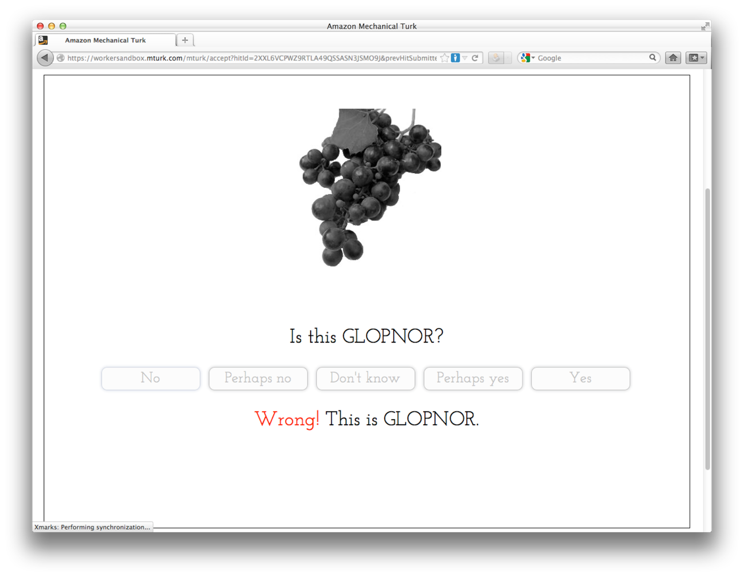

Slide 17
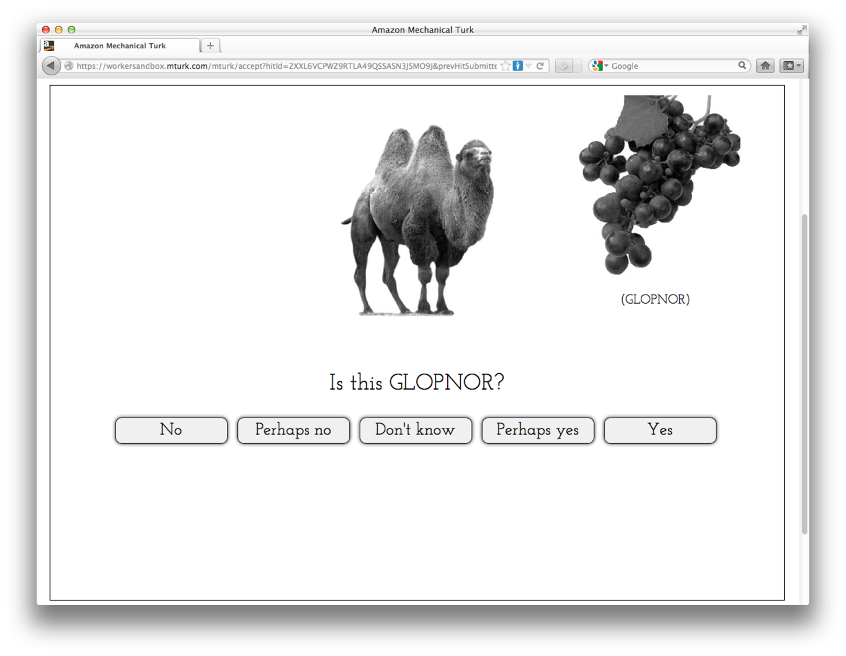

Slide 18
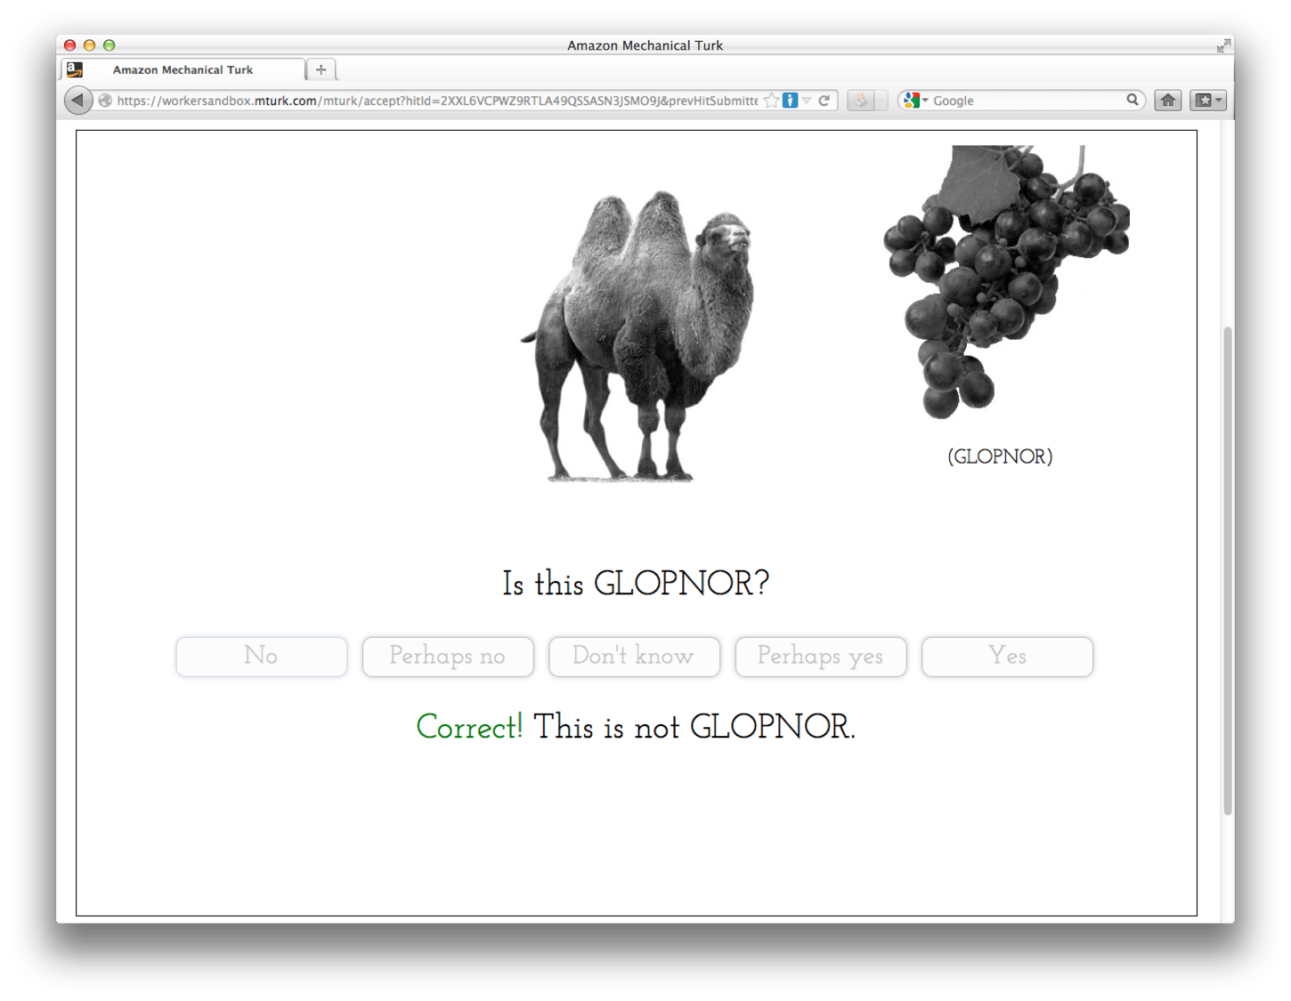

Slide 19
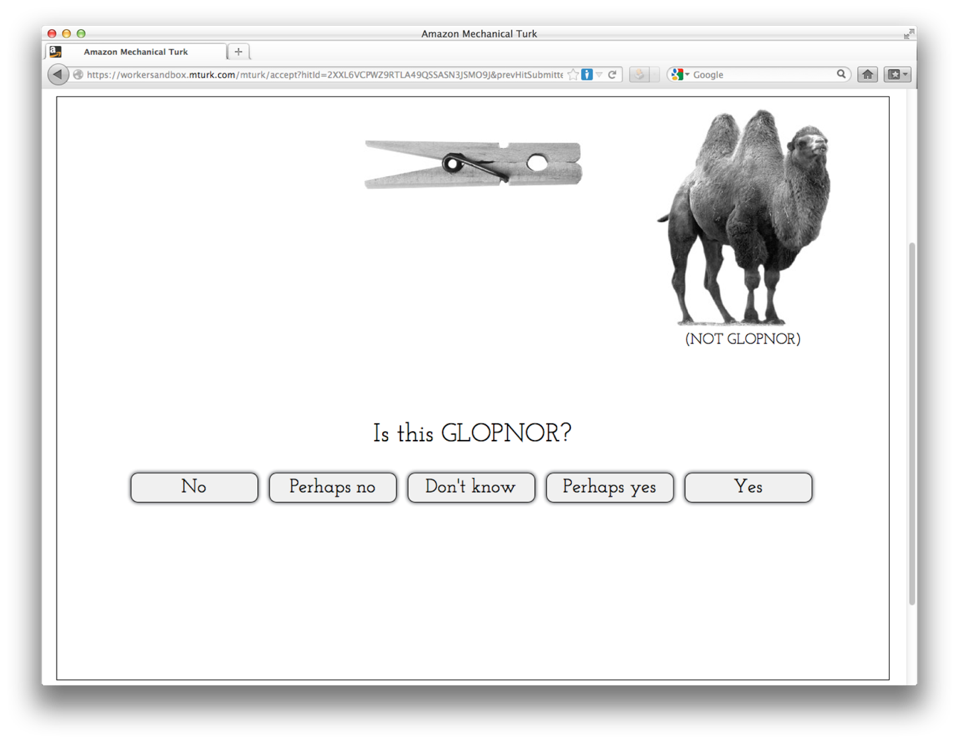

Slide 20
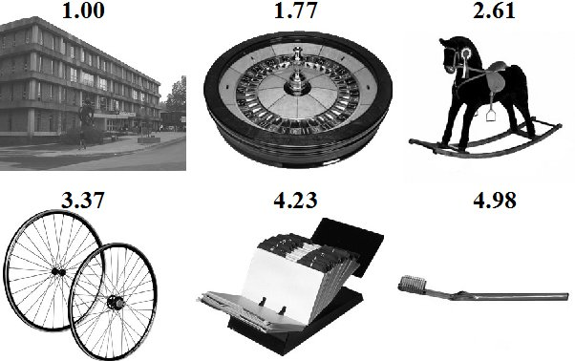
GLOPNOR = Graspability
Ease of picking up & manipulating object with one hand
Based on norms from Salmon, McMullen, & Filliter (2010)
Notes:
1-5 scale / GLOPNOR : rating > 3
JERRY KNOWS THIS DATA SET

Slide 21
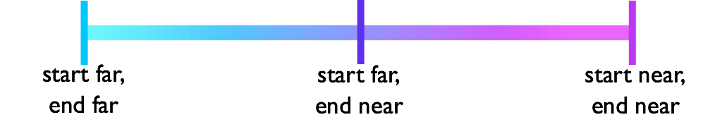
Fading
Pashler & Mozer
(2013)
Notes:
fading studies from the animal literature; less so with human
Pashler & Mozer with artificial stimuli

Slide 22
Blocking vs. Interleaving
    + + + + − − − −
    + − + − + − + −
    mostly
    repetitions
    mostly
    alternations
Carvalho and Goldstone (2014, 2015)

Slide 23
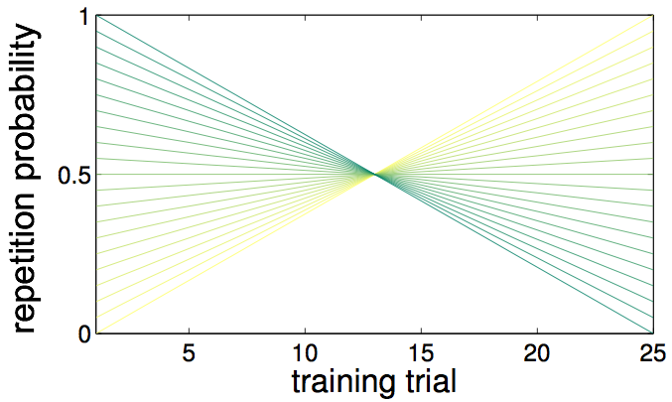



Blocking
interleave early,
block late
no blocking or
interleaving
block early,
interleave late

Slide 24
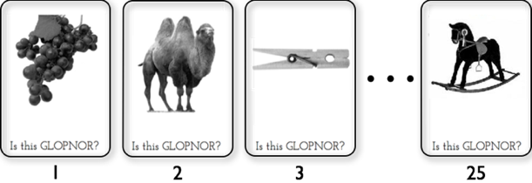
Concept Learning Experiment
Training
  25 trial sequence generated
  by chosen policy
Testing
  24 test trials, ordered randomly
  No feedback, forced choice
Amazon Mechanical Turk participants
Notes:
13 pos, 12 neg (?)

Slide 25
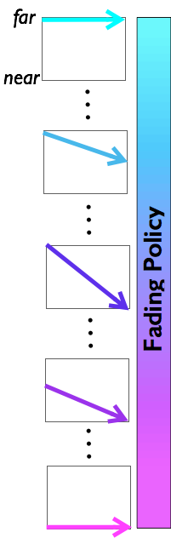
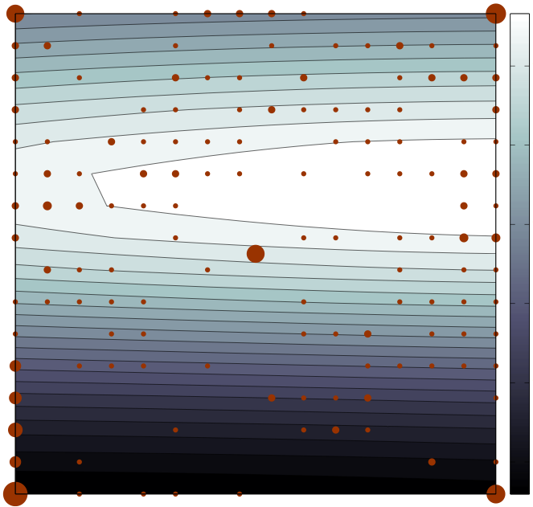
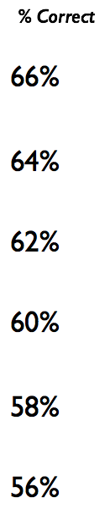

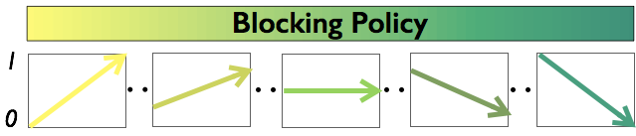
Results
Notes:
optimum:
fade from easy to semi-hard
repetitions early , alternations late

Slide 26
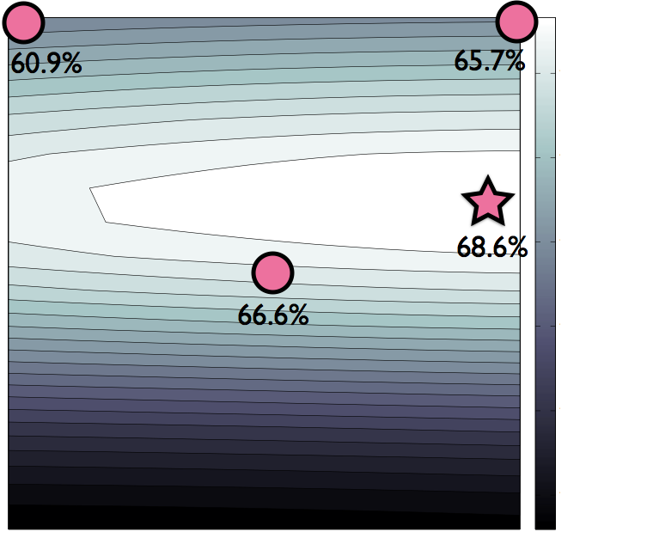
Notes:
Been using this method to test many ideas,
most recently with Karen: can we nudge choice with color?
with WootMath: can we manipulate the design of educational games to maximize engagement?
looking for more ideas about spaces to explore for concept learning

Slide 27
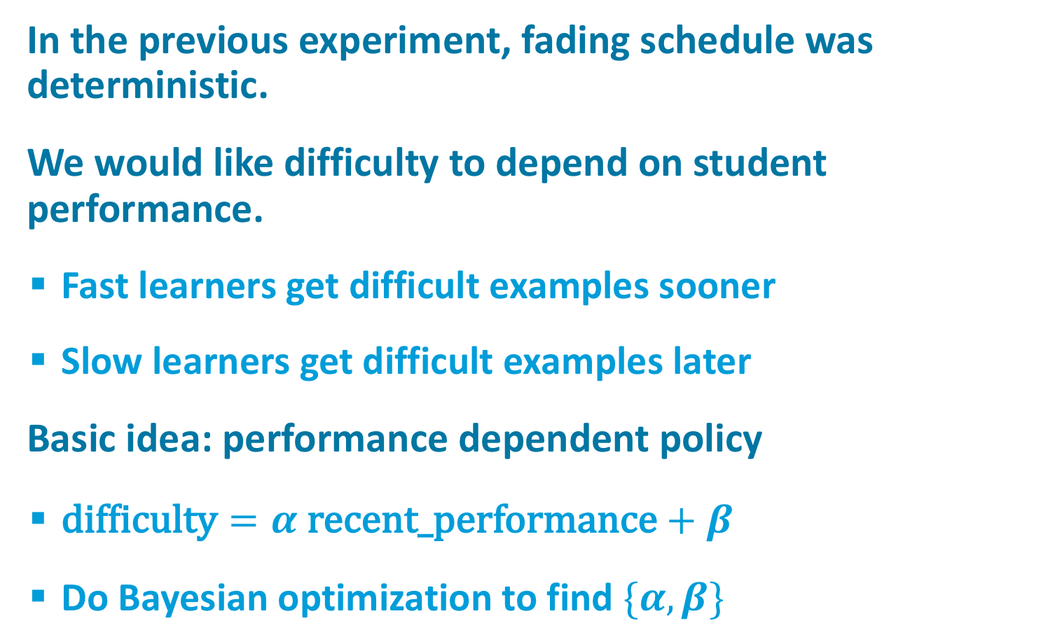
Project Idea 2018
In the previous experiment, fading schedule was deterministic.
We would like difficulty to depend on student performance.
  Fast learners get difficult examples sooner
  Slow learners get difficult examples later
Basic idea: performance dependent policy
  $\text{difficulty}=α \text{recent}\text{_}\text{performance}+β$
  Do Bayesian optimization to find $\{α,β\}$

Slide 28

Interesting Domain
(Robert Goldstone, Indiana)
http://www.indiana.edu/~pcl/rgoldsto/curvemorph/bezier-curve.html

Slide 29

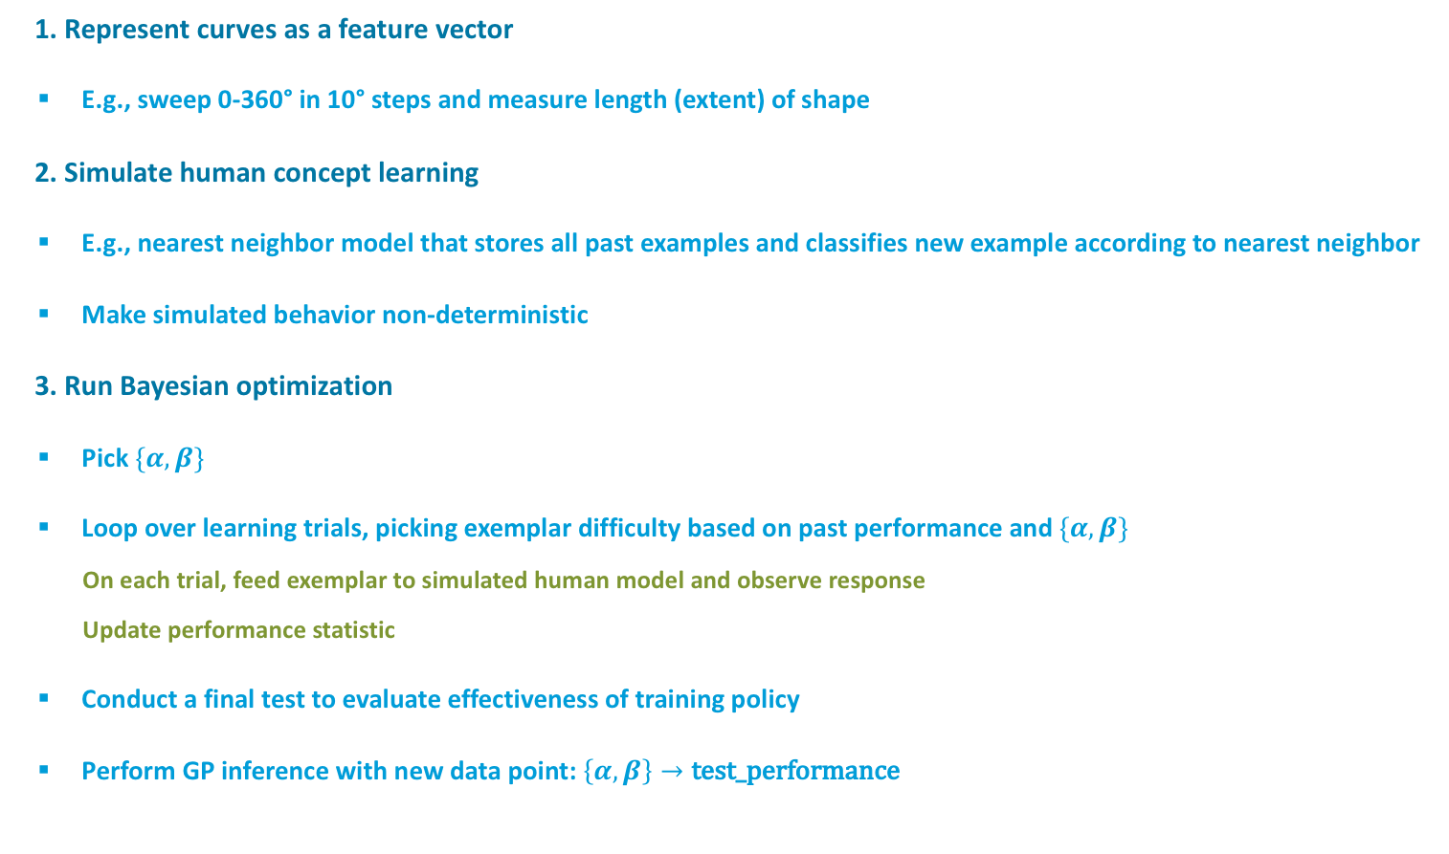
What Project Would Involve
1. Represent curves as a feature vector
  E.g., sweep 0-360° in 10° steps and measure length (extent) of shape
2. Simulate human concept learning
  E.g., nearest neighbor model that stores all past examples and classifies new example according to nearest neighbor
  Make simulated behavior non-deterministic
3. Run Bayesian optimization
  Pick $\{α,β\}$
  Loop over learning trials, picking exemplar difficulty based on past performance and $\{α,β\}$
    On each trial, feed exemplar to simulated human model and observe response
    Update performance statistic
  Conduct a final test to evaluate effectiveness of training policy
  Perform GP inference with new data point: $\left\{α,β\right\}→\text{test}\text{_}\text{performance}$

Slide 30
Project Idea #2
Can we use Bayesian optimization to transform images in a way that makes them easier to interpret for a given task?
  E.g., medical diagnosis
  E.g., visually impaired
Traditional methods
  Contrast enhancement
  Low- or high-pass filtering
Suppose we had a library of methods and were trying to decide
  Which to apply
  What order
  What parameterization?
Evaluate with human latencies or accuracies
Notes:
ALLIE: NSF Grad Fellowship

Slide 31
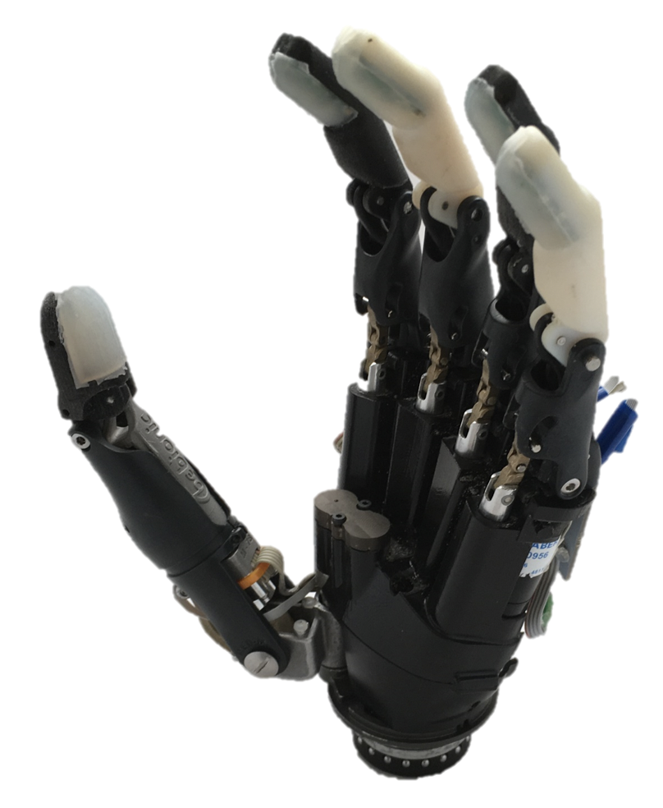
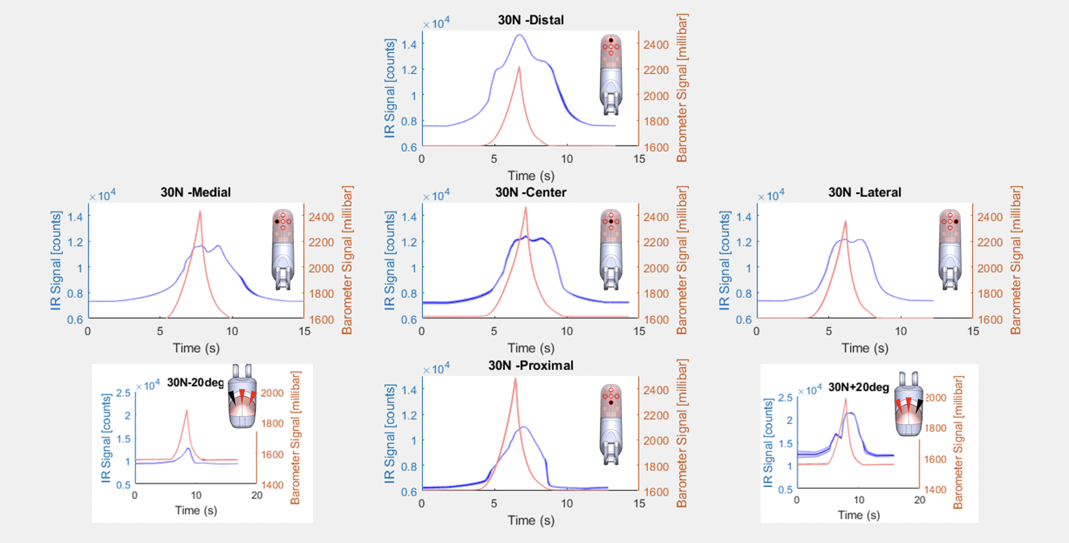
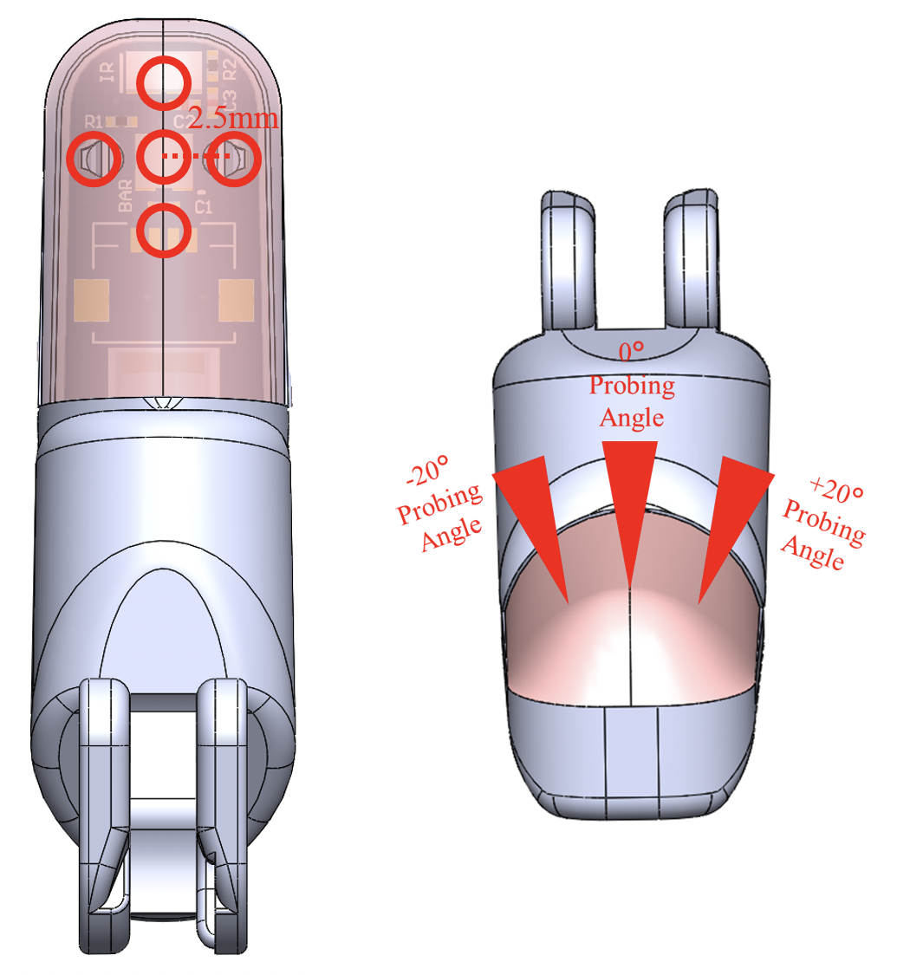
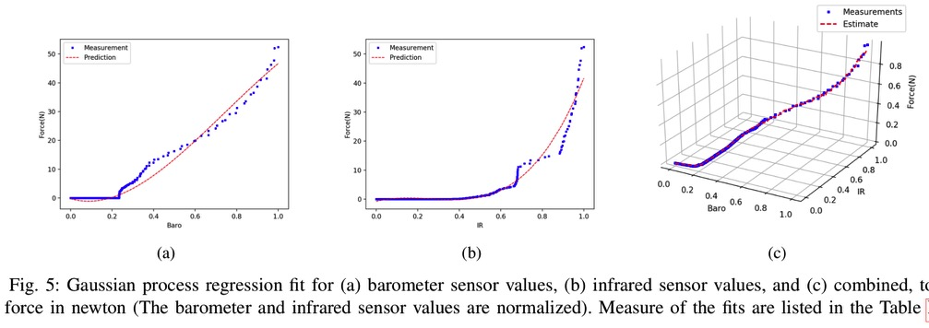
Project #3: Radhen Patel
asdsd

Slide 32
Project #4: Taruni Muruganandan

Slide 34
Acquisition Functions
Random
Maximum mean
Upper confidence bound
Probability of improvement
Expected improvement
Thompson sampling

Slide 35
Random
Naïve idea
  Pick the point x at random
  As n➝∞, global optimum will be found
Problem
  Very inefficient
  Doesn’t minimize cost of data collection
Notes:
What guarantees global optimum? nonparmetric function approximation of GP -> arbitrary accuracy of fit given enough data

Slide 36
Maximum Mean
Naïve idea
  Pick the point with the highest expected value
Problem
  Very high chance of falling into a local optimum
Notes:
Acquisition function a

Slide 37
Exploration Versus Exploitation
Random is an exploration-only strategy
  ignores what has learned already about function
Maximum mean is an exploitation-only strategy
  ignores what isn’t currently known about function
exploration-exploitation continuum
random
?
maximum
mean

Slide 38
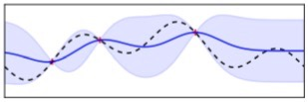
Upper Confidence Bound
Leverages uncertainty in GP prediction
  GP yields an uncertainty distribution
  Use an optimistic estimate of function value
σ
μ

Slide 39
Upper Confidence Bound
How do we select k?
Constant k controls exploration-exploitation trade off
  k=0
    Maximum mean acquisition function (pure exploitation)
  k➝∞
    Uncertainty minimization (pure exploration)
General strategy
  Use large k initially and anneal as more data are collected
  Principled annealing schedules have been proposed (Srinivas et al, 2010), but not sure how well they work in practice

Slide 40
Probability Of Improvement
Given a target value, , we’re trying to obtain
  e.g., quantity of oil, student test score
Identify the point in the input space most likely to achieve or beat this value
If target unknown, can be set to beat empirical max:
Problem
  Target too small -> exploit; target too large -> explore

Slide 41
Expected Improvement
Given a target value, , that we want to beat
  Define improvement function:
  Pick the point with the greatest expected improvement
Target value can be set to empirical max
Tends to better balance exploration & exploitation than PI
Notes:
Weighted version of probability of improvement (PI): WEIGHTING BY AMOUNT OF IMPROVEMENT
we are computing (mu-y*) because we expect mu to be above y*

Slide 42
Thompson Sampling
Draw a function from the GP posterior
Select the maximizer in input space
Automatic switch from explore to exploit as knowledge is gained.
Seems to be the method of choice
if goal is to maximize summed return
Unlike EI, PI, UCB, there are no free parameters
Notes:
Ask mohammad for more details on thursday

Slide 43
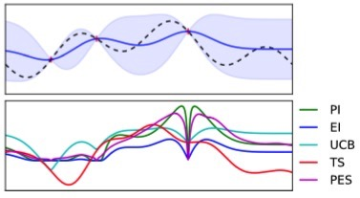
Comparison From Shahriari et al.
predictive entropy search
Notes:
TS = thompson sampling
PES = predictive entropy search: what data point will tell you the most about which input is the optimum

Slide 44
Caveat
I’ve assumed that observations lie in the range of the GP, i.e., [-∞,∞]
If we have a non-identity observation model,
i.e., p(y|f(.)), need to decide:
  Do we perform selection in observation space, y, or in latent GP space, f(.)?

Slide 45
Generalizing The Approach
Bayesian Optimization relies on having a measure of uncertainty over the latent space we’re evaluating.
  i.e., y(x) is a random variable
This approach can therefore be generalized to any situation in which quantities to be inferred are random variables
  e.g., arbitrary parameter vector w

Slide 46
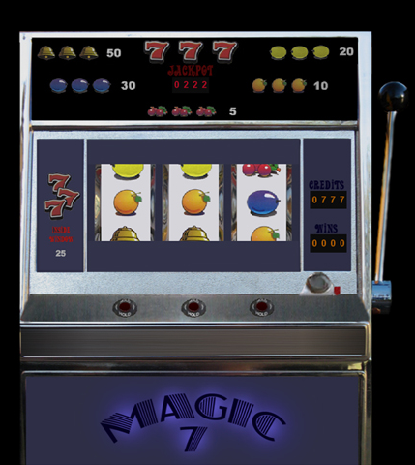
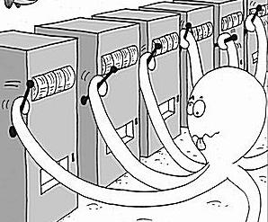
Multiarm Bandits
Generalizing a one-armed bandit
  K arms
  w_{a}: win probability of arm a
  Entire system described by
  vector
Examples
  medical treatments
  web advertisements
Notes:
Usually this is taught as a warm up to using GPs as it’s a simpler case

Slide 47

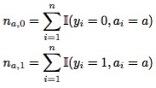
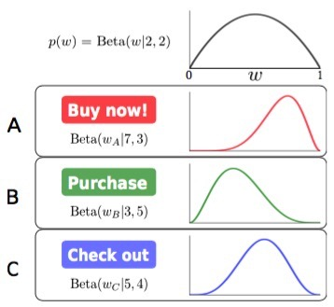

Beta-Bernoulli Bandit Model
Suppose we have a prior on the weights
We have n past observations in which we count # successes and failures for each arm
Posterior distribution on weights
Notes:
Suppose we’re doing Thompson sampling…what would that entail: draw W values for each arm from posterior

Slide 48
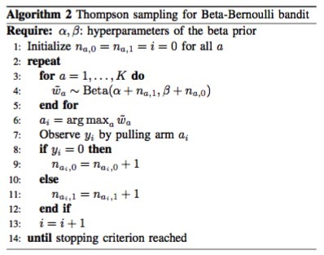
Selecting Next Arm To Pull

Slide 49
Multiarm Bandits Vs. Gaussian Processes
With large K, multiarm bandits are not efficient.
  They assume that each arm is unrelated to the other arms.
  Contrast with GPs in which the y = f(x) mapping has strong dependencies among the x’s.
E.g., suppose goal is to decide how much of a drug to administer
  multiarm bandit
    a = 1, 2, 3, 4, or 5 pills
    w_{a} = probability that pill will cure patient
    no relation between w_{i} and w_{j}
  GP
    x = # pills
    f(x) = strength of effect
    strong dependence between f(x) and f(x+1)
Notes:
If the arms aren’t independent, but you can predict the outcome of one arm from the outcome of another arm, multiarm bandits are not the ideal solution

Slide 50


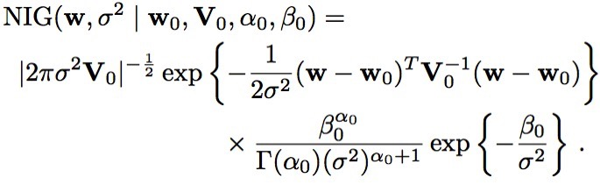
Hybrid Approach:
Linear Bandits
Each arm a has an associated feature vector
Expected payout of each arm has form
And observations for arm a are drawn from
Unknowns have a conjugate prior:
Notes:
NIG -- Normal – inverse gamma
GPs: same idea with x mapped to higher dimensional space -> linear model in x_expanded has more flexibility than linear model in x

