Slide 1
Next Semester
CSCI 5622 – Machine learning (Matt Wilder)
  great text by Hastie, Tibshirani, & Friedman
ECEN 5018 – Game Theory
ECEN 5322 – Analysis of high-dimensional datasets
  FALL 2014
  http://ecee.colorado.edu/~fmeyer/class/ecen5322/

Slide 2
Project
Assignments 8 and 9
Your own project or my ‘student modeling’ project
Individual or team

Slide 3
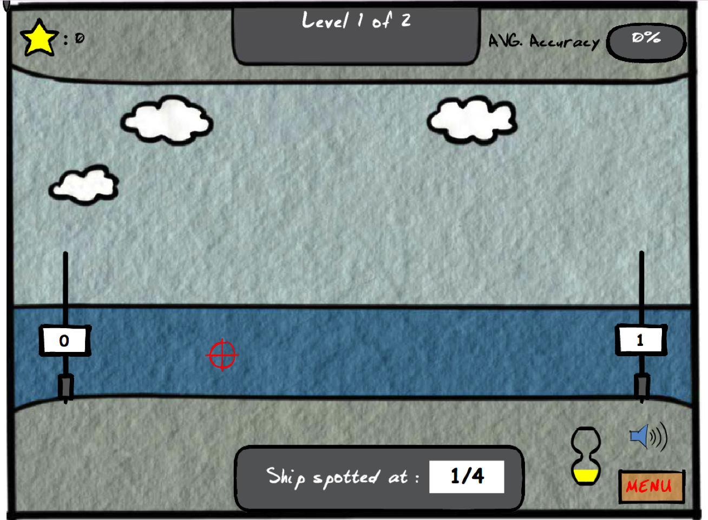
Battleship Game
link to game

Slide 4
Data set
51 students
179 unique problems
4223 total problems
~ 15 hr of student usage

Slide 5
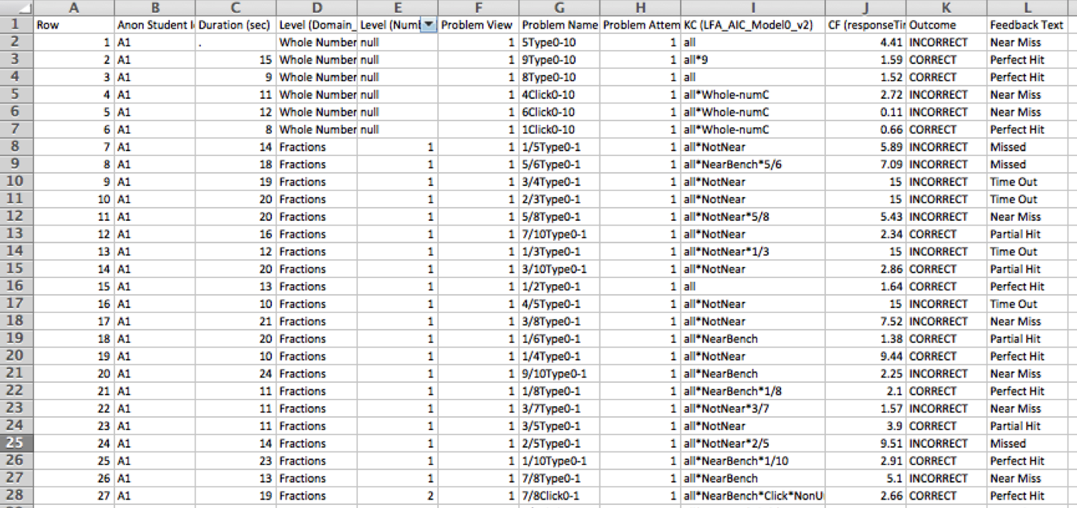
Data set

Slide 6
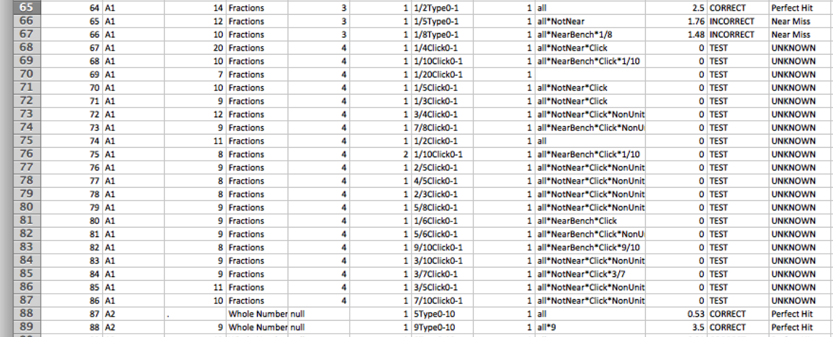
Test set embedded in spreadsheet

Slide 7
Bayesian Knowledge Tracing
Students are learning a new skill (knowledge component) with a computerized tutoring system
  E.g., manipulation of algebra equations
Students are given a series of problems to solve.
Solution is either correct or incorrect.
  E.g., 0 0 1 0 0 1 1 0 0 0 0 0 1 0 0 0 1 1 0 1 0 1 1 1
Goal
  Infer when learning has taken place
  (Larger goal is to use this prediction to make inferences about other aspects of student performance, such as retention over time and generalization to other skills)

Slide 8
All Or Nothing Learning Model
(Atkinson, 1960s)
Two state finite-state machine
Just learned
Don’t Know
Know
c₀
Just forgotten
c₁

Slide 9
Bayesian Knowledge Tracing
Assumes No Forgetting
Very sensible, given that sequence of problems is all within a single session.
Just learned
Don’t Know
Know
ρ₀
ρ₁

Slide 10
Inference Problem
Given sequence of trials, infer the probability that the concept was just learned
    T: trial on which concept was learned (0…∞)
0 1 0 0 1 1 0 1 1
T < 1
T = 2
T = 6
T > 8

Slide 11
Just learned
Don’t Know
Know
c₀
c₁
    T: trial on which concept was learned (0…∞)
    X_{i}: response i is correct (X=1) or incorrect (X=0)
    P(T | X₁, …, X_{n})
    S: latent state (0 = don’t know, 1 = know)
    ρ_{s}: probability of correct response when S=s
    L: probability of transitioning from don’t-know to know state
0 1 0 0 1 1 0 1 1
T < 1
T = 2
T = 6
T > 8

Slide 12
What I Did

Slide 14
Observation
If you know the point in time at which learning occurred (T), then the order of trials before doesn’t matter.
Neither does the order of trials after.
What matters is the total count of number correct
-> can ignore sequences

Slide 15
Notation: Simple Model

Slide 16
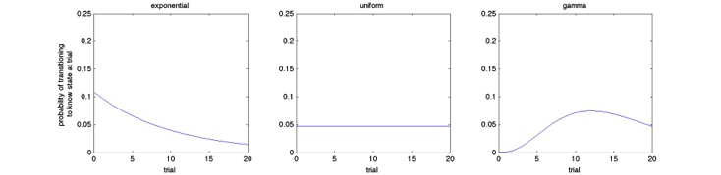
What We Should Be Able To Do
  Treat ρ₀, ρ₁, and T as RVs
  Do Bayesian inference on these variables
    Put hyperpriors on ρ₀, ρ₁, and T, and use the data (over multiple subjects) to inform the posteriors
  Loosen restriction on transition distribution
  Principled handling of ‘didn’t learn’ situation
Geometric
Uniform
Poisson or Negative Binomial

Slide 17
What CSCI 7222 Did In 2012
k₀
θ₀
θ₁
k₁
α₀
α₁
ρ₀
ρ₁
β
γ
k₂
λ
T
X
θ₂
trial
student

Slide 18
Most General Analog To BKT
k₀
θ₀
θ₁
k₁
k₁
θ₁
θ₀
k₀
α_{0,0}
α_{0,1}
α_{1,0}
α_{1,1}
ρ₀
ρ₁
β
γ
k₂
λ
T
X
θ₂
trial
student

Slide 19
Sampling
Although you might sample {ρ_{0,s}} and {ρ_{1,s}}, it would be preferable (more efficient) to integrate them out.
    See next slide
    Never represented explicitly (like topic model)
It’s also feasible (and likely more efficient) to integrate out T_{s} because it is discreet.
If you wanted to do Gibbs sampling on T_{s},
    See next slide
How to deal with remaining variables (λ,γ,α₀,α₁)?
    See 2 slides ahead

Slide 20
Key Inference Problem
If we are going to sample T (either to compute posteriors on hyperparameters, or to make final guess about moment-of-learning distribution), we must compute P(T_{s}|{X_{s,i}},λ,γ,α₀,α₁)?
    Note that T_{s} is discrete and has values in {0, 1, …, N}
Normalization is
feasible because
T is discreet

Slide 21
Remaining Variables (λ, γ, α₀, α₁)
Rowan: maximum likelihood estimation
    Find values that maximize P(x|λ,γ,α₀,α₁)
    Possibility of overfitting but not that serious an issue considering the amount of data and only 4 parameters
Mohammad, Homa: Metropolis Hastings
    Requires analytic evaluation of P(λ|x) etc. but doesn’t require normalization constant
    Note: product is over students, marginalizing over T_{s}
all data

Slide 22
Remaining Variables (λ, γ, α₀, α₁)
Mike: Likelihood weighting
    Sample λ, γ, α₀, α₁ from their respective priors
    For each student, compute data likelihood given sample, marginalizing over T_{s} , ρ_{s,0}, and ρ_{s,1}
    Weight that sample by data likelihood
Rob Lindsey: Slice sampling

Slide 23
Latent Factor Models
Item response theory (a.k.a. Rasch model)
  Traditional approach to modeling student and item effects in test taking (e.g., SATs)
difficulty of item i
ability of student s

Slide 24
Extending Latent Factor Models
Need to consider problem and performance history

Slide 25
Bayesian Latent Factor Model
ML approach
  search for α and δ values that
  maximize training set likelihood
Bayesian approach
  define priors on α and δ, e.g., Gaussian
Hierarchical Bayesian approach
  treat the σ_{α}² and σ_{δ}² as random variables, e.g., Gamma distributed with hyperpriors

Slide 26
Khajah, Wing, Lindsey, & Mozer model
(paper)

