Slide 1
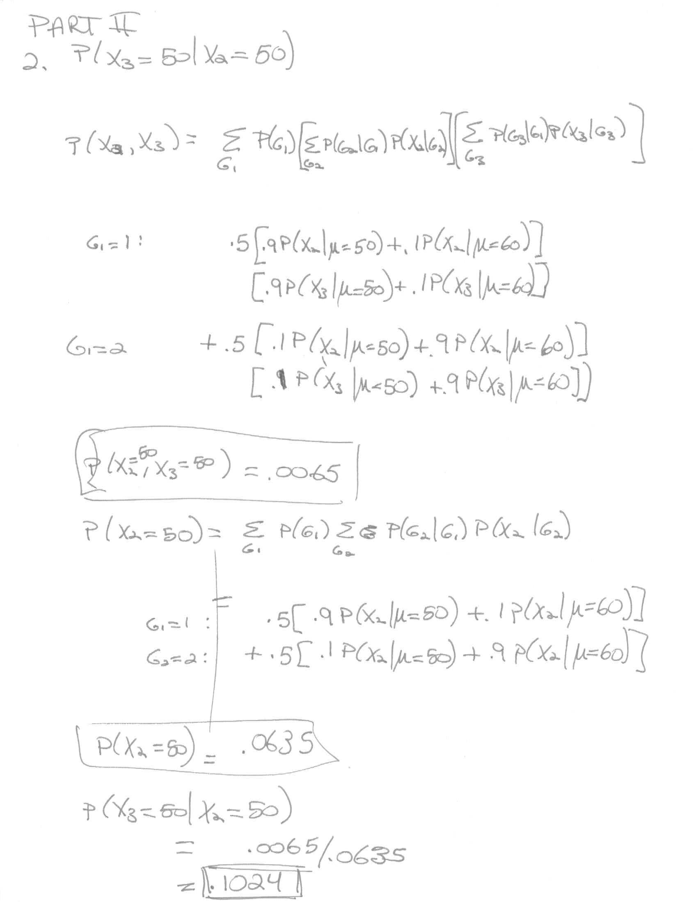
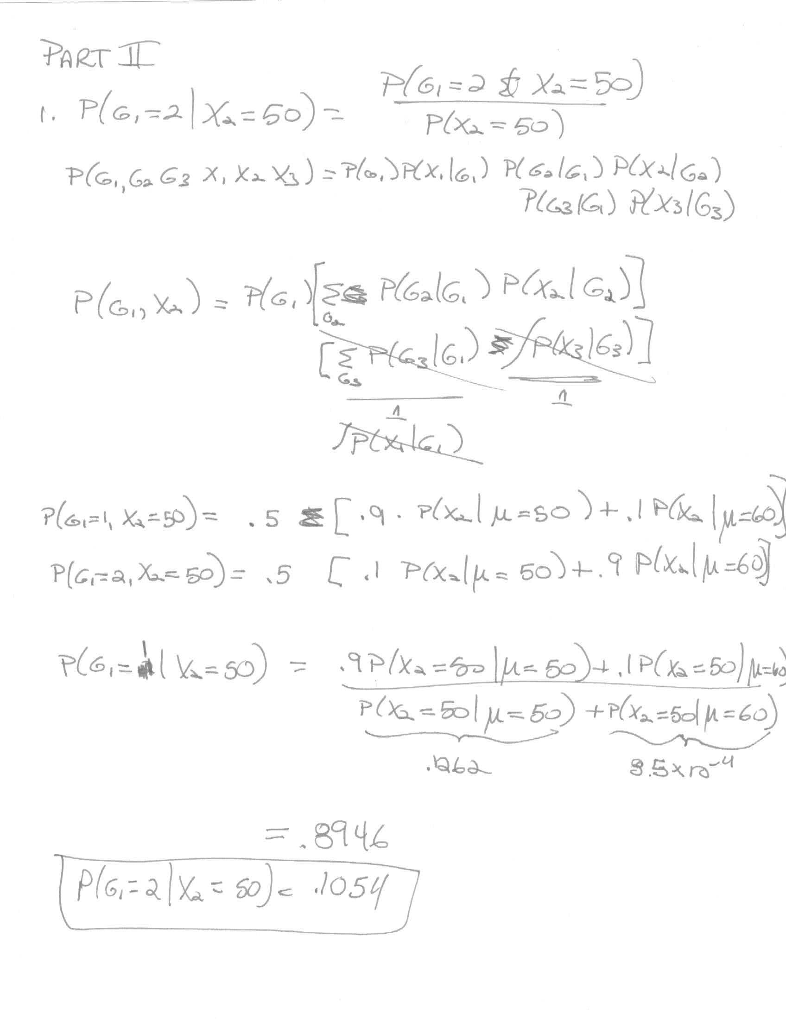
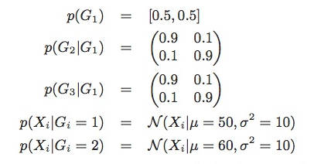
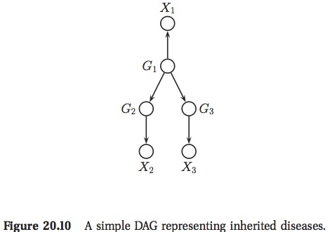
HW 4

Slide 2
Nonparametric Bayesian Models

Slide 3
Parametric Model
Fixed number of parameters that is independent of the data we’re fitting

Slide 4
Nonparametric Model
Number of free parameters grows with amount of data
Potentially infinite dimensional parameter space
Only a finite subset of parameters are used in a nonparametric model to explain a finite amount of data
    ➔Model complexity grows with amount of data

Slide 5
Example: k Nearest Neighbor (kNN) Classifier
x
o
?
x
o
x
x
o
?
o
x
o
?

Slide 6
Bayesian Nonparametric Models
Model is based on an infinite dimensional parameter space
But utilizes only a finite subset of available parameters on any given (finite) data set
i.e., model complexity is finite but unbounded
Typically
      Parameter space consists of functions or measures
      Complexity is limited by marginalizing out over surplus dimensions
nonnegative function over sets

Slide 7
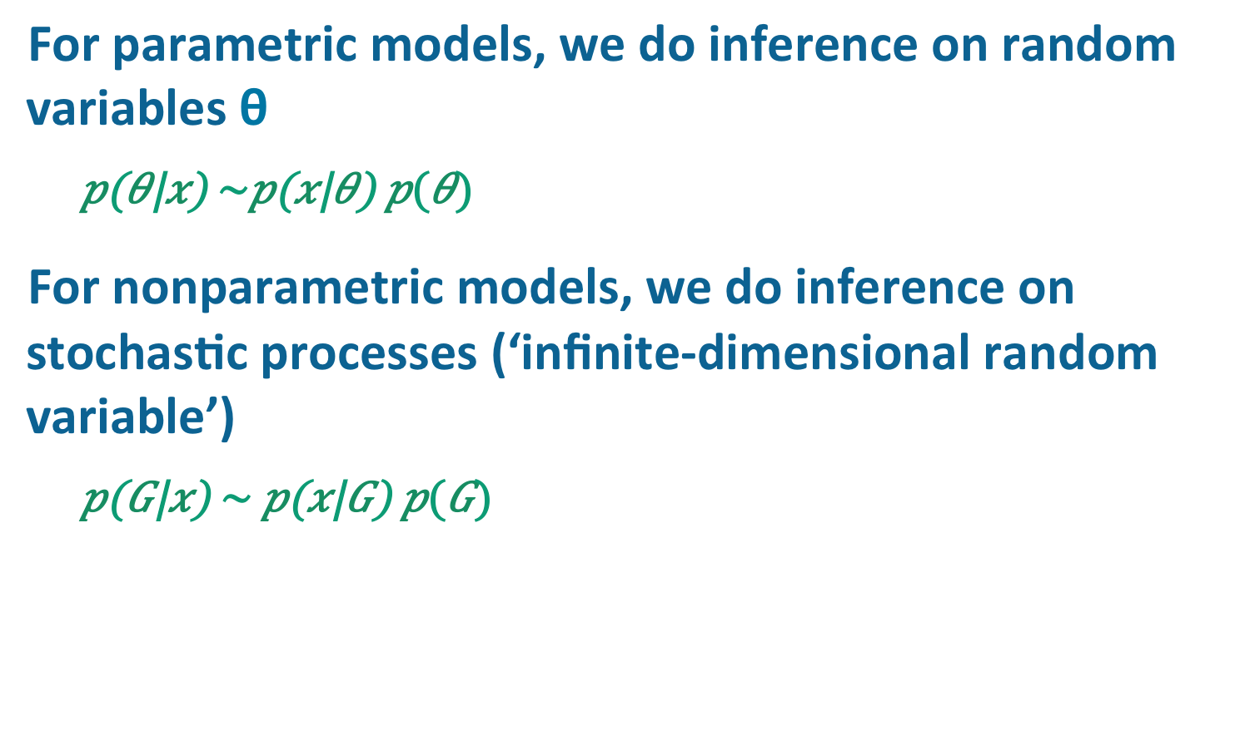
For parametric models, we do inference on random variables θ
For nonparametric models, we do inference on stochastic processes (‘infinite-dimensional random variable’)
Content of most slides borrowed from
Zhoubin Ghahramani and Michael Jordan

Slide 8
What Will This Buy Us?
Distributions over
  Partitions
    E.g., for inferring topics when number of topics not known in advance
    E.g., for inferring clusters when number of clusters not known in advance
  Directed trees of unbounded depth and breadth
    E.g., for inferring category structure
  Sparse binary infinite dimensional matrices
    E.g., for inferring implicit features
  Other stuff I don’t understand yet

Slide 9
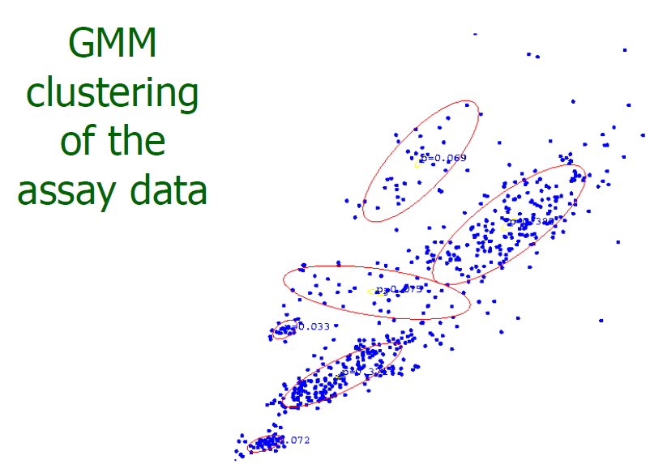
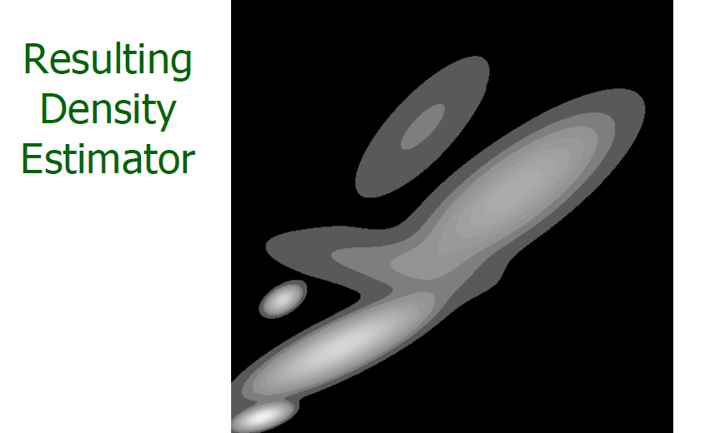
Intuition: Mixture Of Gaussians
Standard GMM has a fixed number of components.
    θ: means and variances
Quiz: What sort
of prior would
you put on π?
On θ?

Slide 10
Intuition: Mixture Of Gaussians
Standard GMM has a fixed number of components.
Equivalent form:
But suppose instead we had
G: mixing
distribution
= 1 unit of
probability
mass iff θ_{k}=θ
Notes:
Dirac delta

Slide 11
Being Bayesian
Can we define a prior over π?
    Yes: stick-breaking process
Can we define a prior over the mixing distribution G?
    Yes: Dirichlet process

Slide 12
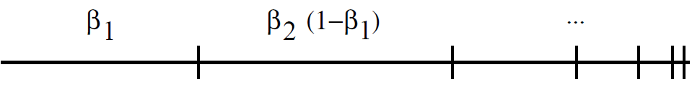
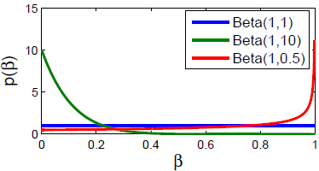
Stick Breaking
Imagine breaking a stick by recursively breaking off bits of the remaining stick
Formally, define infinite sequence of beta RVs:
And an infinite sequence based on the {β_{i}}
Produces distribution on countably infinite space
Notes:
What effect does alpha have?

Slide 13
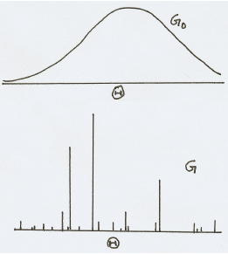

Dirichlet Process
infinite dimensional
Dirichlet distribution
Stick breaking gave us
For each k we draw θ_{k} ~ G₀
And define a new function
The distribution of G is known
as a Dirichlet process
    G ~ DP(α, G₀)
Borrowed from Gharamani tutorial

Slide 14
Dirichlet Process
Stick breaking gave us
For each k we draw θ_{k} ~ G₀
And define a new function
The distribution of G is known
as a Dirichlet process
    G ~ DP(α, G₀)
QUIZ
For GMM, what is θ_{k}?
For GMM, what is θ?
For GMM, what is a draw from G?
For GMM, how do we get draws that have fewer mixture components?
For GMM, how do we set G₀?
What happens to G as
α->∞?
Notes:
As alpha goes to infinity, G-> G0

Slide 15
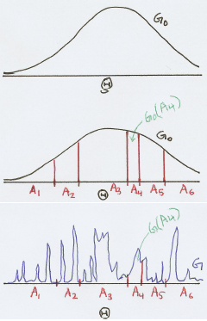


Dirichlet Process II
For all finite partitions (A₁, A₂, A₃, …, A_{K}) of Θ,
if G ~ DP(α, G₀)
What is G(A_{i})?
Note: partitions do not have to be
exhaustive
function
Adapted from Gharamani tutorial
Notes:
Can turn INFINITE DIMENSIONAL DIRICHLET DISTRIBUTION (dirichlet process) into a FINITE DIM DIRICHLET BY SELECTING PARTITIONS OF THETA

Slide 16
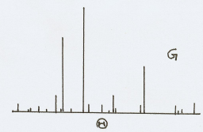
Drawing From A Dirichlet Process
DP is a distribution over discrete distributions
    G ~ DP(α, G₀)
Therefore, as you draw more points
from G, you are more likely to get
repetitions.
    φ_{i} ~ G
So you can think about a DP as inducing a partitioning of the points by equality
    φ_{i} = φ₃ = φ₄ ≠ φ₂ = φ₅
Chinese restaurant process (CRP) induces the corresponding distribution over these partitions
    CRP: generative model for (1) sampling from DP, then (2) sampling from G
    How does this relate to GMM?
Notes:
CRP: first sample from DP then sample a set of points from G

Slide 17
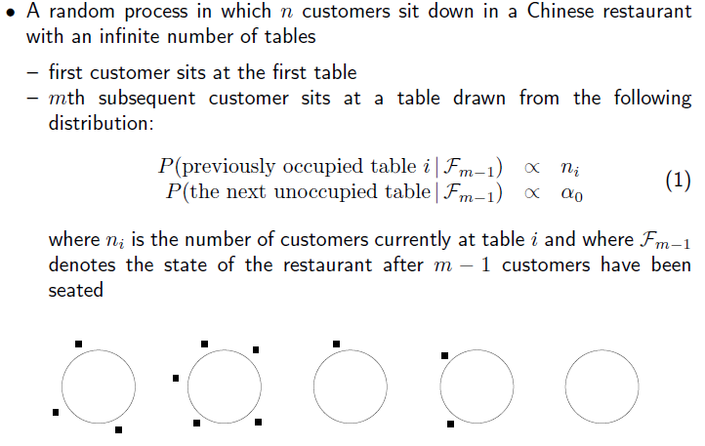
Chinese Restaurant Process:
Informal Description
Borrowed from Jordan lecture

Slide 18
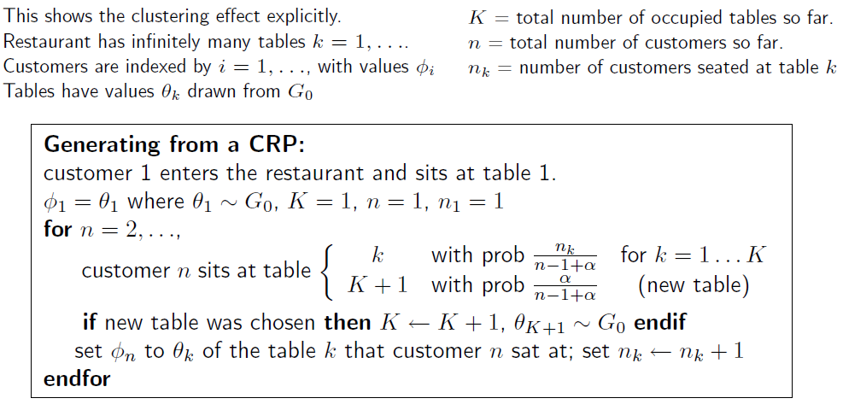
Chinese Restaurant Process:
Formal Description
meal (instance)
meal (type)
φ₁
φ₂
φ₄
φ₅
θ₁
θ₂
θ₃
θ₄
φ₃
φ₆
Borrowed from Gharamani tutorial
Notes:
Suppose different meal for each table: THETA is MEAL TYPE; PHI is MEAL INSTANCE

Slide 19
Comments On CRP
Rich get richer phenomenon
    The popular tables are more likely to attract new patrons
CRP produces a sample drawn from G, which in turn is drawn from the DP, without explicitly specifying G
    Analogous to how we could sample the outcome of a biased coin flip (H, T) without explicitly specifying coin bias ρ
    ρ ~ Beta(α,β)
    X ~ Bernoulli(ρ)

Slide 20
Infinite Exchangeability of CRP
Sequence of variables X₁, X₂, X₃, …, X_{n} is exchangeable if the joint distribution is invariant to permutation.
    With σ any permutation of {1, …, n},
An infinite sequence is infinitely exchangeable if any subsequence is exchangeable.
Quiz
  Relationship to iid (indep., identically distributed)?
Notes:
if iid -> exchangeable; if exchangeable, not necessarily iid

Slide 21

Inifinite Exchangeability of CRP
Probability of a configuration is independent of the particular order that individuals arrived
Convince yourself with a simple example:
φ₁
φ₂
φ₄
φ₁
φ₃
φ₅
φ₅
θ₁
θ₂
θ₃
φ₄
θ₁
θ₂
θ₃
φ₃
φ₆
φ₂
φ₆
Notes:
ru

Slide 22

De Finetti (1935)
If {X_{i}} is exchangeable, there is a random θ such that:
If {X_{i}} is infinitely exchangeable, then θ may be a stochastic process (infinite dimensional).
Thus, there exists a hierarchical Bayesian model for the observations {X_{i}}.

Slide 23
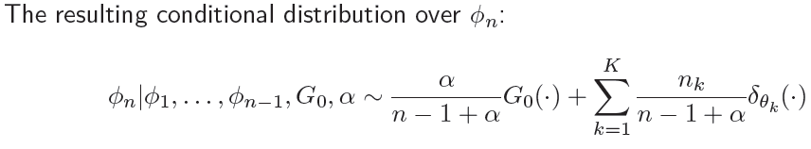
Consequence Of Exchangeability
Easy to do Gibbs sampling
This is collapsed Gibbs sampling
  feasible because DP is a conjugate prior on a multinomial draw

Slide 24
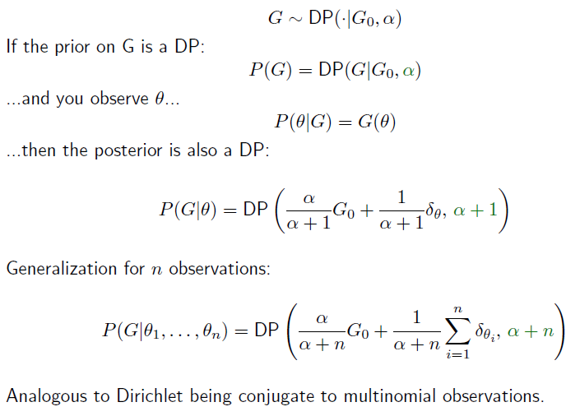
Dirichlet Process: Conjugacy
Borrowed from Gharamani tutorial

Slide 25
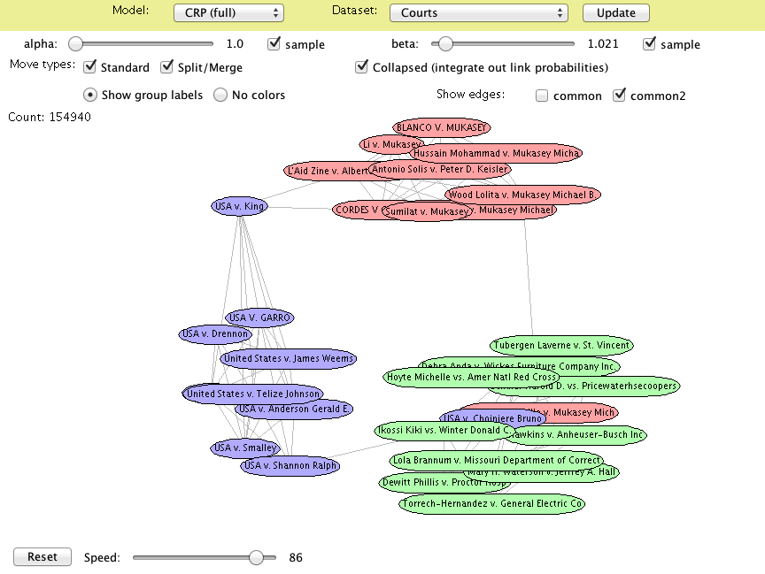
CRP-Based Gibbs Sampling Demo
http://chris.robocourt.com/gibbs/index.html

Slide 26
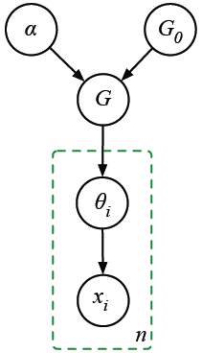
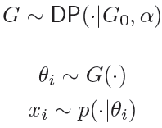
Dirichlet Process Mixture of Gaussians
Instead of prespecifying number of components, draw parameters of mixture model from a DP
→ infinite mixture model

Slide 27
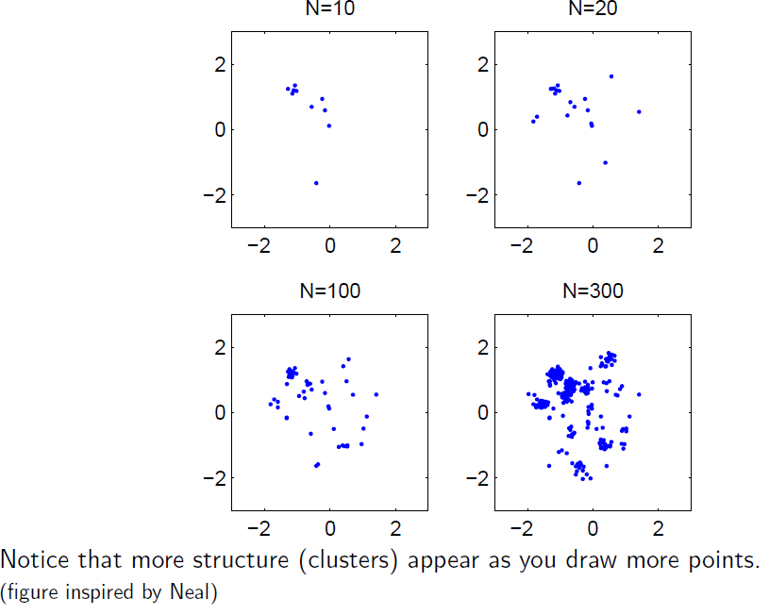
Sampling From A DP Mixture of Gaussians
Borrowed from Gharamani tutorial

Slide 28
Parameters Vs. Partitions
Rather than a generative model that
spits out mixture component
parameters, it could equivalently
spit out partitions of the data.
    Use s_{i} to denote the partition or indicator of x_{i}
Casting problem in terms of indicators
will allow us to use the CRP
Let’s first analyze the finite mixture case
s_{i}

Slide 29
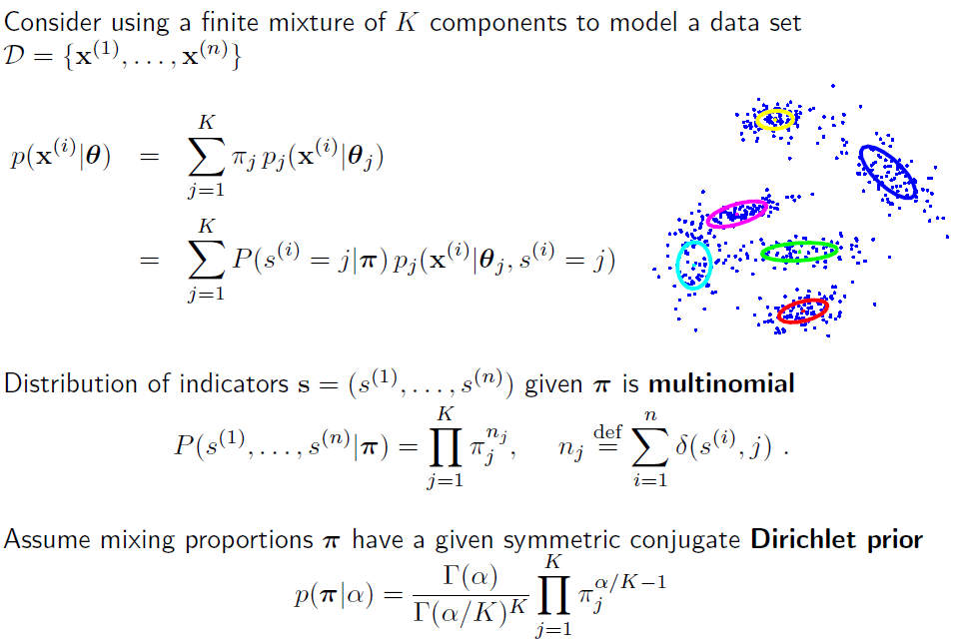
Bayesian Mixture Model (Finite Case)
Borrowed from Gharamani tutorial
Notes:
explain: symmetric ? why alpha/k?

Slide 30


Bayesian Mixture Model (Finite Case)
Integrating out the mixing proportions, π, we obtain
Allows for Gibbs sampling over posterior of indicators
Rich get richer effect
    more populous classes are likely to be joined

Slide 31
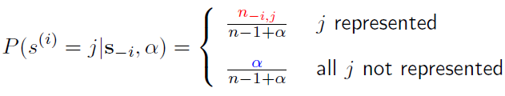
From Finite To Infinite Mixtures
Finite case
Infinite case

Slide 32
Don’t The Observations Matter?
Yes! Previous slides took a short cut and ignored the data (x) and parameters (θ)
Gibbs sampling should reassign indicators, {s_{i}}, conditioned on all other variables
s_{i}

Slide 33
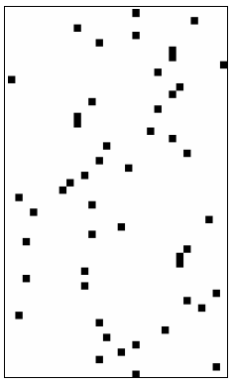
Partitioning Performed By CRP
You can think about CRP as creating a binary matrix
    Rows are diners
    Columns are tables
    Cells indicate assignment of diners to tables
Columns are mutually exclusive ‘classes’
    E.g., in DP Mixture Model
Infinite number of columns in matrix

Slide 34
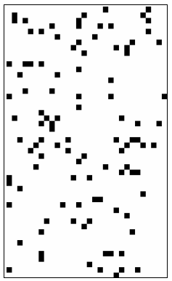
More General Prior On Binary Matrices
Allow each individual to be a member of multiple classes
    … or to be represented by multiple features
    ‘distributed representation’
    E.g., an individual is male, married, Democrat,
    fan of CU Buffs, etc.
As with CRP matrix, fixed number of
rows, infinite number of columns
But no constraint on number of columns
that can be nonzero in a given row

Slide 35
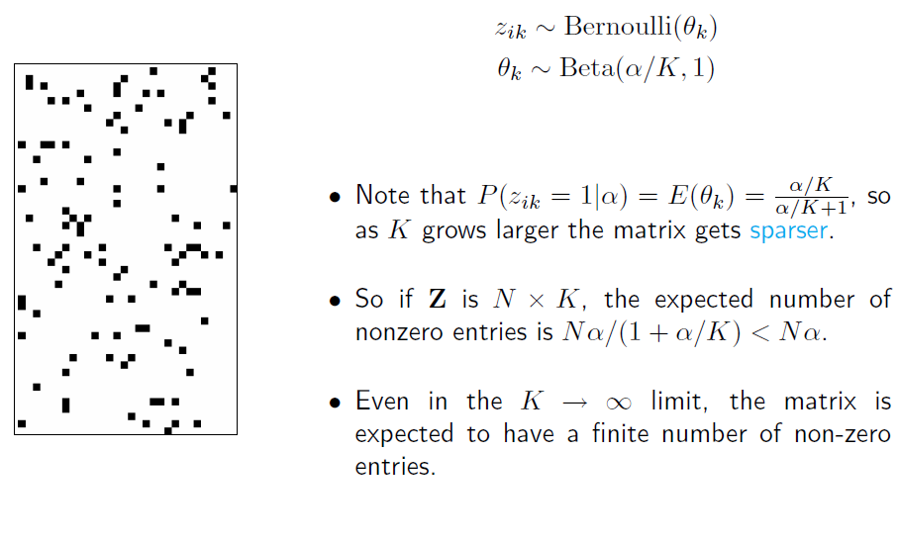
Finite Binary Feature Matrix
K
N
Borrowed from Gharamani tutorial

Slide 36
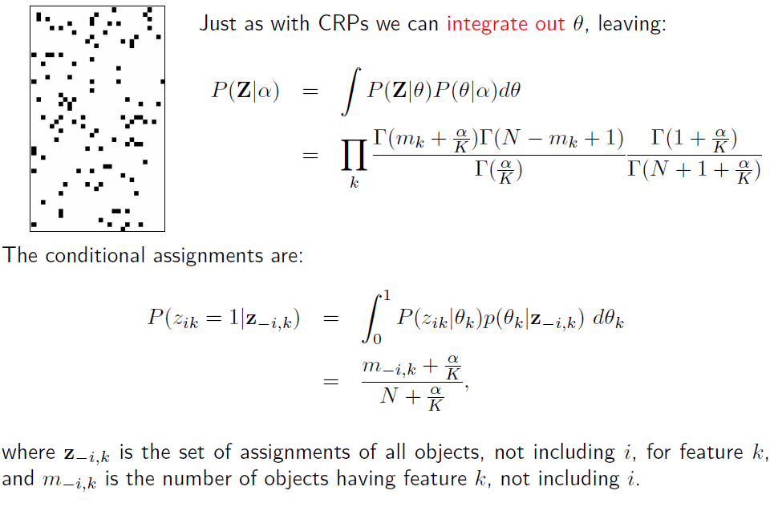
Borrowed from Gharamani tutorial

Slide 37
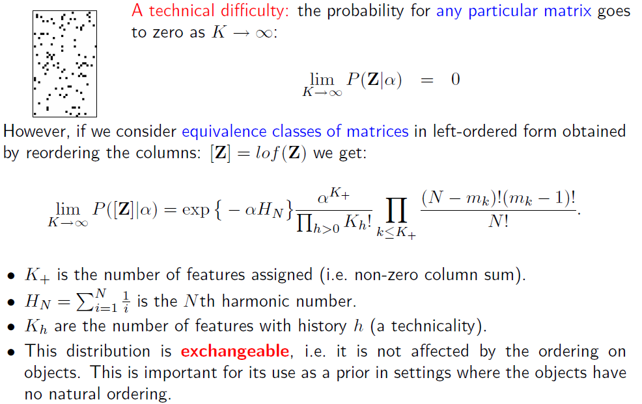
Borrowed from Gharamani tutorial

Slide 38
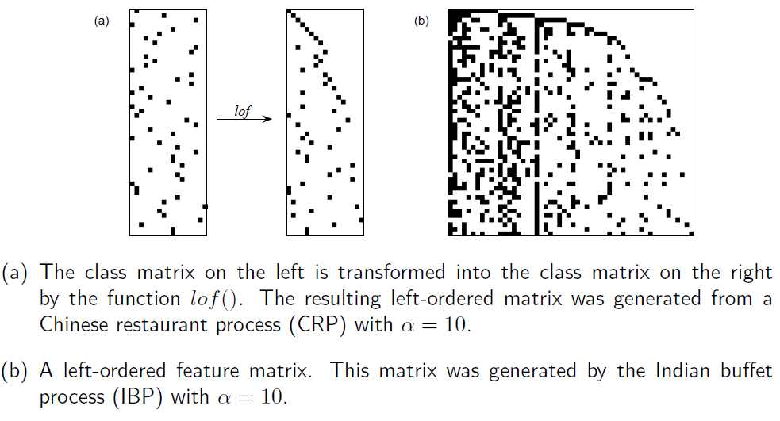
Binary Matrices In Left-Ordered Form
Borrowed from Gharamani tutorial
Notes:
Left ordered form: rearrange columns leaving rows alone. For the first row above, the second column has a nonzero value -> move it to first column of LOF
is a CRP: only one value filled in per row
is a IBP

Slide 39
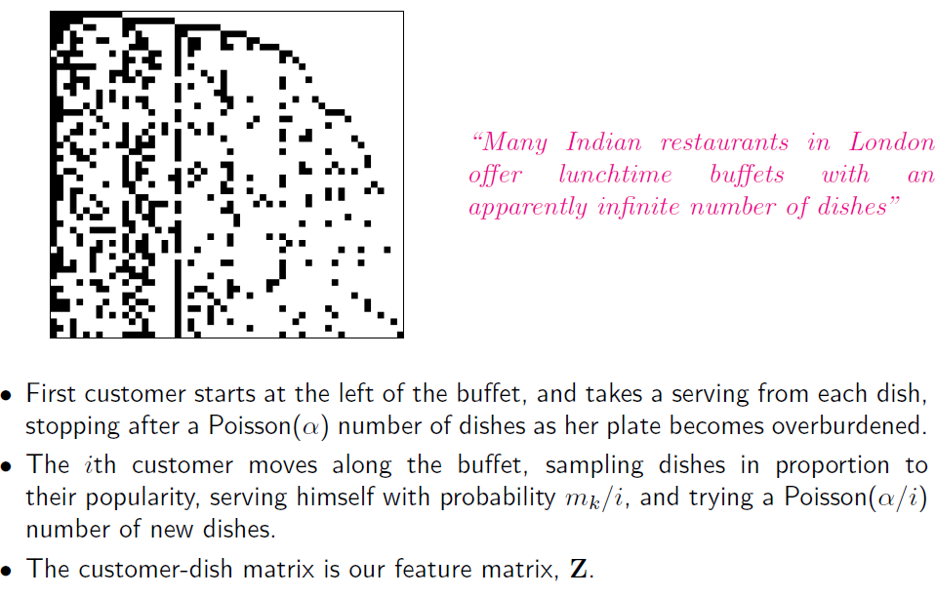
Indian Buffet Process
Number of diners who
chose dish k already

Slide 40
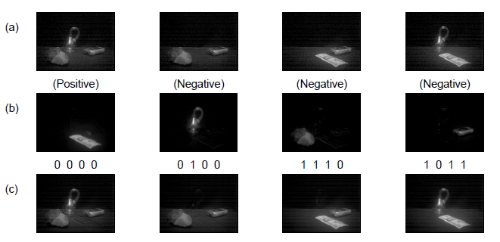
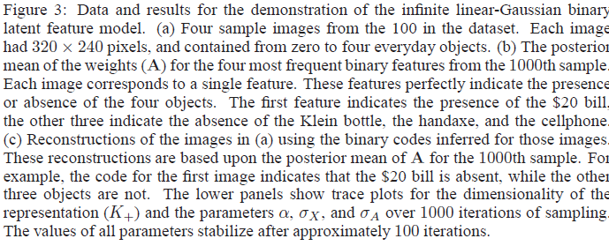
IBP Example (Griffiths & Ghahramani, 2006)
Notes:
Negative and positive refer to whether the presence of features in (b) is denoted by a 0 or by a 1 in the feature vector. (Symmetry)

Slide 41
Ghahramani’s Model Space

Slide 43
Hierarchical Dirichlet Process (HDP)
Suppose you want to model where people hang out in a town.
    Not known in advance how many locations need to be modeled
Some spots in town are generally popular, others not so much.
But individuals also have preferences that deviate from the population preference.
      E.g., bars are popular, but not for individuals who don’t drink
Need to model distribution over locations at level of both population and individual.

Slide 44
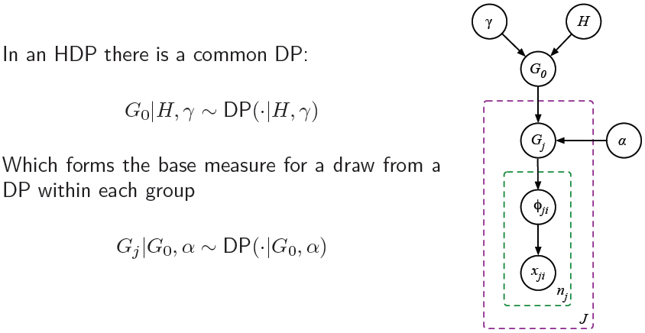
Hierarchical Dirichlet Process
Population
distribution
Individual
distribution

Slide 45
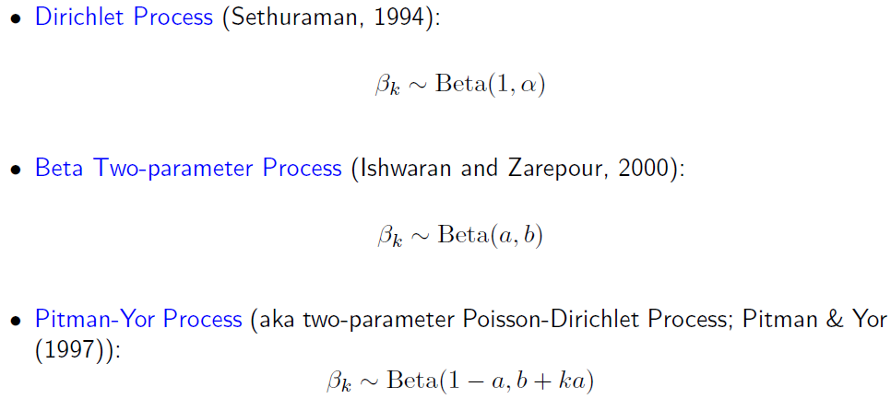
Other Stick Breaking Processes
Borrowed from Gharamani tutorial

