Slide 1
Motion Illusions As Optimal Percepts

Slide 2
What’s Special About Perception?
Arguably, visual perception is better optimized by evolution than other cognitive abilities.
Human visual perception outperforms all modern computer vision systems.
➔Understanding human vision will be helpful for building AI systems

Slide 3
Ambiguity of Perception
One-to-many mapping of retinal image to objects in the world
Same issue with 2D retina and 3D images
Notes:
perception is an inference problem. this class is about inference

Slide 4
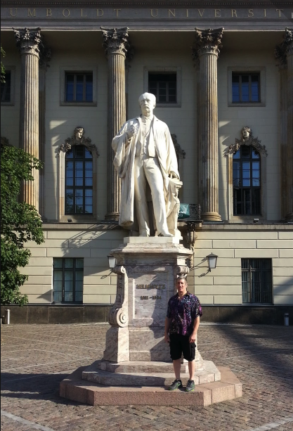
Hermann von Helmholtz
(1821-1894)
German physician/physicist who made
significant contributions to theories of
vision
Perception as unconscious inference
  Recover the most likely objects in the world based on the ambiguous visual evidence
Percept is a hypothesis about what the brain thinks is out there in the world.

Slide 5
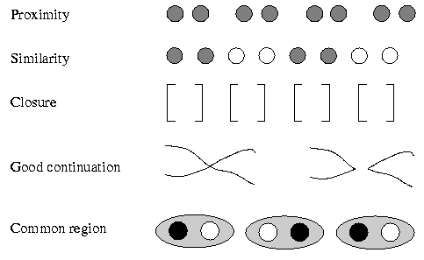
Additional Knowledge
Is Required To Perceive
Innate knowledge
  E.g., any point in the image has only one interpretation
  E.g., surfaces of an object tend to
  be a homogeneous color
  Gestalt grouping principles
Specific experience
  E.g., SQT is an unlikely letter
  combination in English
  E.g., bananas are yellow or
  green, not purple

Slide 6
Illusions
Most of the time, knowledge helps constrain perception to produce the correct interpretation of perceptual data.
Illusions are the rare cases where knowledge misleads
  E.g., hollow face illusion
  http://www.michaelbach.de/ot/fcs_hollow-face/
  Constraints: light source, shading cues, knowledge of faces

Slide 7
The Aperture Problem
Some slides adapted from Alex Pouget, Rochester
Notes:
The aperture in itself introduces uncertainty

Slide 8
The Aperture Problem

Slide 9
The Aperture Problem

Slide 10
The Aperture Problem
Vertical velocity (deg/s)
vertical velocity
horizontal velocity
Horizontal velocity (deg/s)

Slide 11
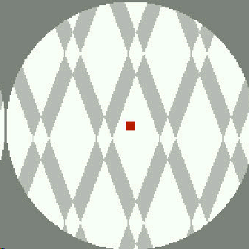
The Aperture Problem: Plaid
Notes:
PLAID STIMULUS
Note that gratings remain grouped even when diamond turns to gray (because there’s still information about the junciton point which is consistent only with upward motion). Gratings become ungrouped when pattern can be interpreted as superimposed translucent bars.

Slide 12
The Aperture Problem: Plaid
Vertical velocity (deg/s)
Horizontal velocity (deg/s)

Slide 13
The Aperture Problem: Rhombus
Vertical velocity (deg/s)
Horizontal velocity (deg/s)

Slide 14
The Aperture Problem
Vertical velocity (deg/s)
Horizontal velocity (deg/s)
Actual motion in blue

Slide 15
Standard Models of Motion Perception
IOC: intercept of constraints
VA: vector average
Feature tracking: focus on some distinguishing feature of display (e.g., max luminance)
Which model best fits data depends on speed, contrast, presentation time, retinal location, etc.
Maybe perception is an ad hoc combination of models, but that’s neither elegant nor parsimonious.

Slide 16
Standard Models of Motion Perception
IOC
VA
Vertical velocity (deg/s)
Horizontal velocity (deg/s)

Slide 17
Standard Models of Motion Perception
IOC
VA
Vertical velocity (deg/s)
Horizontal velocity (deg/s)

Slide 18
Standard Models of Motion Perception
Problem: perceived motion is close to either IOC or VA depending on stimulus duration, eccentricity, contrast and other factors.

Slide 19
Standard Models of Motion Perception
Example: Rhombus With Corners Occluded
Actual motion
Percept: IOC
Percept: VA
VA
IOC
VA
IOC
Vertical velocity (deg/s)
Vertical velocity (deg/s)
Horizontal velocity (deg/s)
Horizontal velocity (deg/s)

Slide 20
Rhombus Thickness Influences Perception

Slide 21
Bayesian Model of Motion Perception
Perceived motion correspond to the Maximum a Posteriori (MAP) estimate
Independence of observations
Notes:
MAP vs. ML

Slide 22
Prior
Weiss and Adelson:
Human observers favor slow motions
50
Vertical Velocity
0
-50
-50
0
50
Horizontal Velocity
Notes:
Rotating wheel
Switching dot patterns

Slide 23
Likelihood
Weiss and Adelson
50
Vertical Velocity
0
-50
-50
0
50
Horizontal Velocity
Notes:
Noise in perception of motion perpendicular to edge, uncertainty in motion along axis of edge

Slide 24
Likelihood
First-order
Taylor series
expansion
Notes:
1: likelihood model for the noise
2: taylor series expansion for prior image intensity
3: Ix, Iy, It = partial derivatives with respect to x,y,t

Slide 25
Likelihood
Notes:
Multiple image locations

Slide 26
Posterior

Slide 27
Bayesian Model of Motion Perception
Perceived motion corresponds to the MAP estimate
Posterior is Gaussian → MAP is mean
Only one free parameter
Notes:
Solution on second line….derivation on the next slide

Slide 28
Likelihood

Slide 29
Motion Through An Aperture
Likelihood
50
Vertical Velocity
0
-50
-50
0
50
ML
Horizontal Velocity
50
50
Vertical Velocity
Vertical Velocity
MAP
0
0
-50
-50
Prior
-50
0
50
-50
0
50
Posterior
Horizontal Velocity
Horizontal Velocity

Slide 30
Motion And Contrast
Driving in the fog
  Drivers tend to speed up
In low contrast situations, the prior dominates
  In fog, poor quality visual information about speed
  Priors biased toward slow speeds

Slide 31
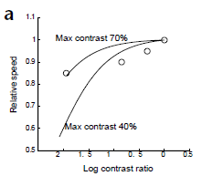
Motion And Constrast
Individuals tend to underestimate velocity in low contrast situations
  perceived speed of lower-contrast grating relative to higher-contrast grating
Notes:
as a function of contrast ratio (x axis) and contrast of higher-contrast grating

Slide 32
Perceived Velocity And Contrast
Likelihood
50
Vertical Velocity
0
High
Contrast
-50
-50
0
50
ML
Horizontal Velocity
50
50
Vertical Velocity
Vertical Velocity
MAP
0
0
-50
-50
Prior
-50
0
50
-50
0
50
Posterior
Horizontal Velocity
Horizontal Velocity

Slide 33
Perceived Velocity And Contrast
Likelihood
50
Vertical Velocity
0
Low
Contrast
-50
-50
0
50
ML
Horizontal Velocity
50
50
MAP
Vertical Velocity
Vertical Velocity
0
0
-50
-50
Prior
-50
0
50
-50
0
50
Posterior
Horizontal Velocity
Horizontal Velocity

Slide 34
Perceived Direction And Contrast
Likelihood
50
50
Vertical Velocity
Vertical Velocity
0
0
High
Contrast
-50
-50
-50
0
50
-50
0
50
IOC
Horizontal Velocity
Horizontal Velocity
50
50
MAP
Vertical Velocity
Vertical Velocity
0
0
-50
-50
Prior
-50
0
50
-50
0
50
Posterior
Horizontal Velocity
Horizontal Velocity

Slide 35
Influence Of Contrast On Perceived Direction
Likelihood
50
50
Vertical Velocity
Vertical Velocity
0
0
Low
Contrast
-50
-50
-50
0
50
-50
0
50
IOC
Horizontal Velocity
Horizontal Velocity
50
50
MAP
Vertical Velocity
Vertical Velocity
0
0
-50
-50
Prior
-50
0
50
-50
0
50
Posterior
Horizontal Velocity
Horizontal Velocity
Notes:
affects speed as we said previously but also direction

Slide 36
Perceived Direction And Contrast
Low contrast -> greater uncertainty in motion direction
Blurred information from two edges can combine if edges have similar angles
Notes:
The example from the paper with an acute angle

Slide 37
Influence Of Edge Angles
On Perceived Direction Of Motion
Example: Rhombus
Actual motion
Percept: IOC
Percept: VA
VA
IOC
VA
IOC
Vertical velocity (deg/s)
Vertical velocity (deg/s)
Horizontal velocity (deg/s)
Horizontal velocity (deg/s)
Notes:
Coming back to original demo…

Slide 38
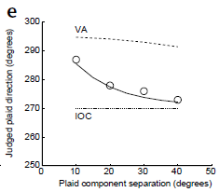
Influence Of Edge Angles
On Perceived Direction Of Motion
Type II plaids
    True velocity is not between the two surface normals
Vary angle between plaid components
    Analogous to varying shape of rhombus
Notes:
Instead of rhombus, use plaid: same information as rhombus – two distinct orientations

Slide 39
Greater alignment of edges -> less benefit of combining information from the two edges

Slide 40
Interaction of Edge Angle With Contrast
More uncertainty with low contrast
More alignment with acute angle
-> Union vs. intersection of edge information at low contrast with acute angle
Actual motion
VA
IOC
VA
IOC
Vertical velocity (deg/s)
Vertical velocity (deg/s)
Horizontal velocity (deg/s)
Horizontal velocity (deg/s)

Slide 41
Barberpole Illusion (Weiss thesis)
Actual motion
Perceived motion
Notes:
PHENOMENON
Grating viewed through circular aperture: move in diagonal (slowest motion consistent with data)
grating viewed through rectangular aperture: moving in direction of the long axis
edge provides evidence of motion along edge
if one edge is longer than the other, then it provides more evidence
Circular aperture: cancels out edge effects

Slide 42
Plaid Motion: Type I and II
Type I: true velocity
lies between two
normals
Type II: true
velocity lies outside
two normals

Slide 43
Plaids and Relative Contrast
Lower contrast
Notes:
Vary relative contrast of the two edges. Bayesian account takes in the relative quality of information from the two edges, IOC, VA do not

Slide 44
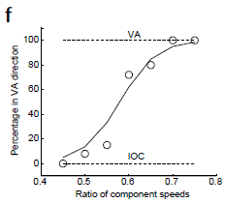
Plaids and Speed
Perceived direction of type II plaids depends on relative speed of components
Notes:
Subjects indicate if motion of plaid is left of veridical (consistent with VA) or right (consistent with IOC).

Slide 45
Plaids and Time
Viewing time reduces uncertainty

Slide 46
Motion Illusions As Optimal Percepts
Mistakes of perception are the result of a rational system designed to operate in the presence of uncertainty.
A proper rational model incorporates actual statistics of the environment
  Here, authors assume without direct evidence:
  (1) preference for slow speeds
  (2) noisy local image measurements
  (3) velocity estimate is the mean/mode of posterior distribution
“Optimal Bayesian estimator” or “ideal observer” is relative to these assumptions

