Slide 1
Spring 2014 Course
PSYC 5835 - Thinking Proseminar – Matt Jones
Provides beginning Ph.D. students with a basic introduction to research on complex human cognition, including reasoning, problem solving, decision making, analogy, concept learning, and knowledge representation. Will include consideration of theoretical, behavioral, and cognitive neuroscience perspectives. Graduate students in all programs and advanced undergraduates welcome with instructor consent.
Wednesdays 1100AM-1240PM
mcj@colorado.edu

Slide 2
Learning In Bayesian Networks:
Missing Data And Hidden Variables

Slide 3
Missing Vs. Hidden Variables
Missing
  often known but absent for certain data points
  missing at random or missing based on value
    e.g., netflix ratings
Hidden
  never observed but essential for predicting visible variables
    e.g., human memory state
  a.k.a. latent variables

Slide 4
Quiz
“Semisupervised learning” concerns learning where additional input examples are available, but labels are not. According to the model below, will partial data (either X or Y) inform the model parameters?
X known?
Y known?
θ_{x}
θ_{y|x}
θ_{y|~x}
X
X
X
Y
Y
Notes:
X known kind of trivial: will affect Qx, but because Y is not known, Y d-separates X from Qy|x Qy|~x
Y known: Qy|x update needs to marginalize out over X, so new Qy|x will be a mixture of betas!

Slide 6
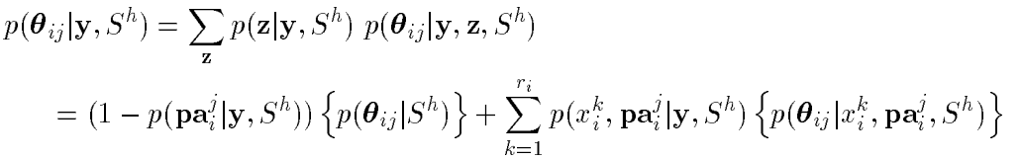
Missing Data: Exact Inference In Bayes Net
Y: observed variables
Z: unobserved variables
How do we do parameter updates for θ_{i} in this case?
  If X_{i} and Pa_{i} are observed, then situation is straightforward (e.g., like coin toss case).
  If X_{i} or any Pa_{i} are missing, need to marginalize over Z
  E.g., X_{i} ~ Multinomial(θ_{ij})
Note: posterior is a Dirichlet mixture
X = {Y,Z}
# values of X_{i}
Dirichlet
Dirichlet
Specific value of X_{i}
Notes:
Spiegelhalter & Lauritzen (1990) has derivation -> not intuitive
If Parents are all observed, then first term has weight 0; if parents aren’t likely -> can’t say much about theta_ij for the given j

Slide 7


Missing Data: Gibbs Sampling
Given a set of observed incomplete data, D = {y₁, ..., y_{N}}
1. Fill in arbitrary values for unobserved variables for each case
2. For each unobserved variable x_{i} in case l, sample:
3. evaluate posterior density on complete data D_{c}'
4. repeat steps 2 and 3, and compute mean of posterior density
Notes:
D_c = complete data

Slide 8





Missing Data: Gaussian Approximation
Approximate
as a multivariate Gaussian.
    Appropriate if sample size |D| is large, which is also the case when Monte Carlo is inefficient
1. find the MAP configuration by maximizing g(.)
2. approximate using 2nd degree Taylor polynomial
3. leads to approximate result that is Gaussian
~
~
negative Hessian of g(.) eval at

Slide 9

Missing Data: Further Approximations
As the data sample size increases,
      Gaussian peak becomes sharper, so can make predictions based on the MAP configuration
      can ignore priors (diminishing importance) -> max likelihood
How to do ML estimation
      Expectation Maximization
      Gradient methods
Notes:
Large data case: maximum likelihood solution – the thing we would have done before taking this course

Slide 10
Expectation Maximization
Scheme for picking values of missing data and hidden variables that maximizes data likelihood
E.g., population of Laughing Goat
  baby stroller, diapers, lycra pants
  backpack, saggy pants
  baby stroller, diapers
  backpack, computer, saggy pants
  diapers, lycra
  computer, saggy pants
  backpack, saggy pants

Slide 11
Expectation Maximization
Formally
  V: visible variables
  H: hidden variables
  θ: model parameters
Model
  P(V,H|θ)
Goal
  Learn model parameters θ in the absence of H
Approach
  Find θ that maximizes P(V|θ)

Slide 12
EM Algorithm (Barber, Chapter 11)
Bound on marginal likelihood
  equality only when q(h|v)=p(h|v,θ)
  E-step: for fixed θ, find q(h|v) that maximizes RHS
  M-step: for fixed q, find θ that maximizes RHS
  if each step maximizes RHS, it’s also improving LHS

Slide 13
EM Algorithm
Guaranteed to find local optimum of θ
Sketch of proof
  Bound on marginal likelihood
    equality only when q(h|v)=p(h|v,θ)
  E-step: for fixed θ, find q(h|v) that maximizes RHS
  M-step: for fixed q, find θ that maximizes RHS
  if each step maximizes RHS, it’s also improving LHS
    technically, it’s not lowering LHS
Notes:
Prove equality when q(h|v)=p(h|v,Theta)

Slide 14
Barber Example
Contours are of the lower bound
Note alternating steps along θ and q axes
  note that steps are not gradient steps and can be large
Choice of initial θ determines local likelihood optimum

Slide 15
Clustering: K-Means Vs. EM
K means
  choose some initial values of μ_{k}
  assign each data point to the closest cluster
  recalculate the μ_{k} to be the means of the set of points assigned to cluster k
  iterate to step 2

Slide 16
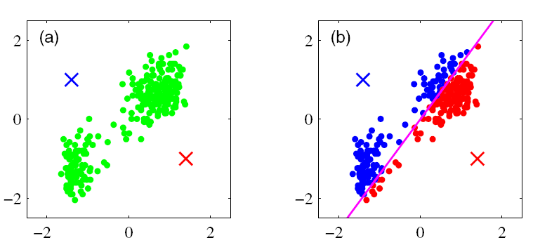
K-means Clustering
From C. Bishop, Pattern Recognition and Machine Learning

Slide 17
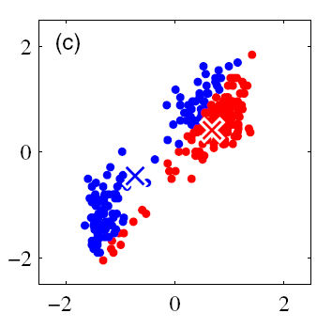
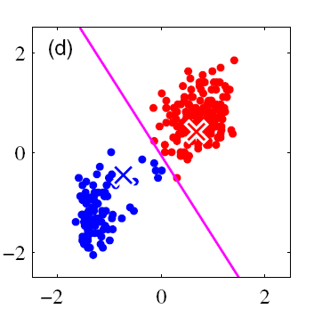
K-means Clustering

Slide 18
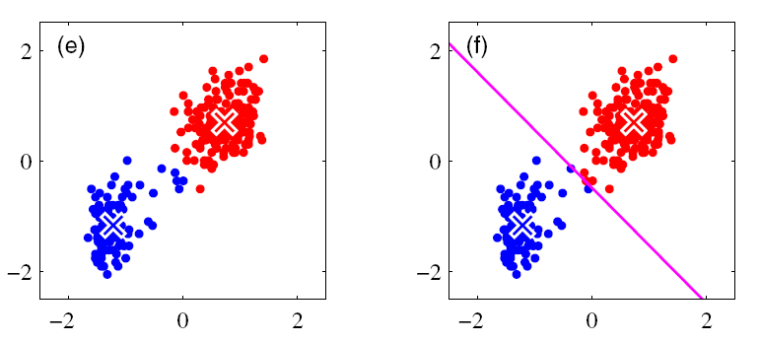
K-means Clustering

Slide 19
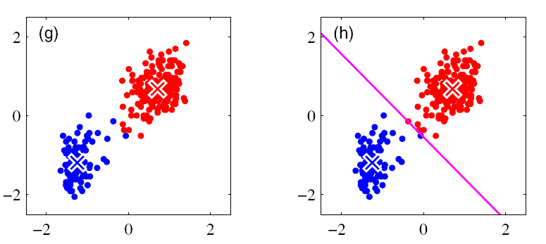
K-means Clustering

Slide 20
Clustering: K-Means Vs. EM
K means
  choose some initial values of μ_{k}
  assign each data point to the closest cluster
  recalculate the μ_{k} to be the means of the set of points assigned to cluster k
  iterate to step 2

Slide 21
Clustering: K-Means Vs. EM
EM
  choose some initial values of μ_{k}
  probabilistically assign each data point to clusters
    P(Z=k|μ)
  recalculate the μ_{k} to be the weighted mean of the set of points
    weight by P(Z=k|μ)
  iterate to step 2

Slide 22
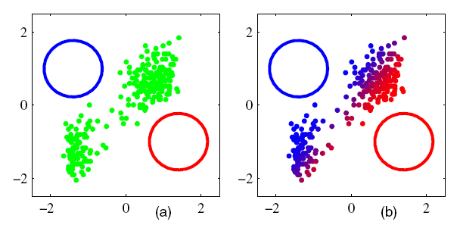
EM for Gaussian Mixtures

Slide 23
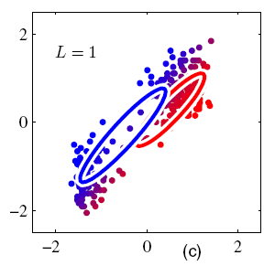
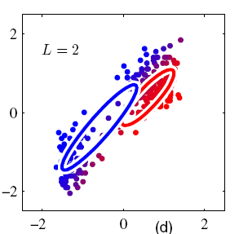
EM for Gaussian Mixtures

Slide 24
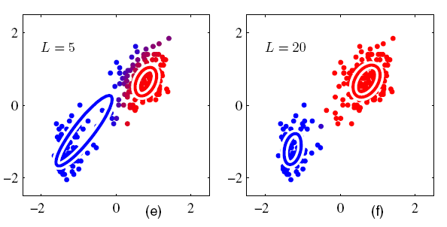
EM for Gaussian Mixtures

Slide 25
Variational Bayes
Generalization of EM
  also deals with missing data and hidden variables
Produces posterior on parameters
  not just ML solution
Basic (0th order) idea
  do EM to obtain estimates of p(θ) rather than θ directly

Slide 26
Variational Bayes
Assume factorized approximation of joint hidden and parameter posterior:
Find marginals that make this approximation as close as possible.
Advantage?
  Bayesian Occam’s razor: vaguely specified parameter is a simpler model -> reduces overfitting

Slide 27
Gradient Methods
Useful for continuous parameters θ
Make small incremental steps to maximize the likelihood
Gradient update:
swap
Notes:
e.g., suppose theta is the mean of a gaussian.
can compute partial log(v,h|theta) analytically
can use sampling to obtain p(h|v,theta)

Slide 28

All Learning Methods Apply To
Arbitrary Local Distribution Functions
LOCAL DISTRIBUTION FUNCTION
Local distribution function performs either
  Probabilistic classification (discrete RVs)
  Probabilistic regression (continuous RVs)
Complete flexibility in specifying local distribution fn
  Analytical function (e.g., homework 5)
  Look up table
  Logistic regression
  Neural net
  Etc.

Slide 29
Summary Of Learning Section
  Given model structure and probabilities,
  inferring latent variables
  Given model structure,
  learning model probabilities
      Complete data
      Missing data
  Learning model structure

Slide 30
Learning Model Structure

Slide 31

Learning Structure and Parameters
The principle
    Treat network structure, S^{h}, as a discrete RV
    Calculate structure posterior
    Integrate over uncertainty in structure to predict
The practice
    Computing marginal likelihood, p(D|S^{h}), can be difficult.
    Learning structure can be impractical due to the large number of hypotheses (more than exponential in # of nodes)

Slide 32
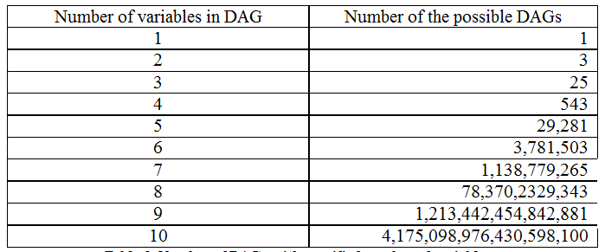
source: www.bayesnets.com

Slide 33
Approach to Structure Learning
  model selection
    find a good model, and treat it as the correct model
  selective model averaging
    select a manageable number of candidate models and pretend that these models are exhaustive
Experimentally, both of these approaches produce good results.
    i.e., good generalization

Slide 34
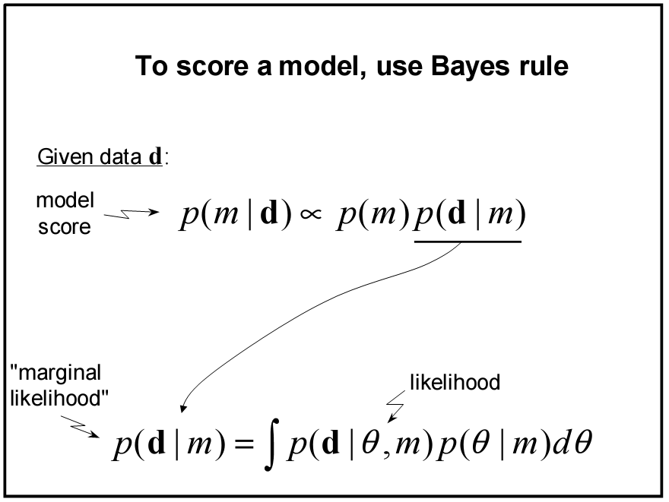

Slide 35
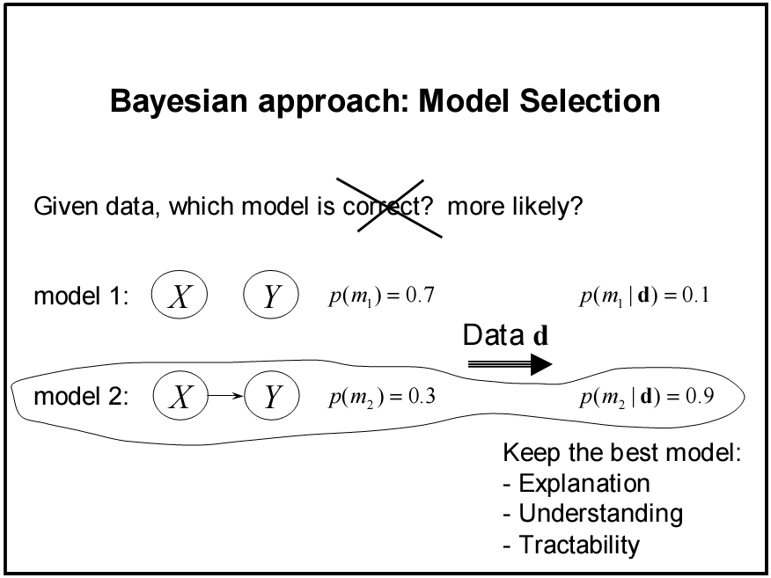
SLIDES STOLEN FROM DAVID HECKERMAN

Slide 36
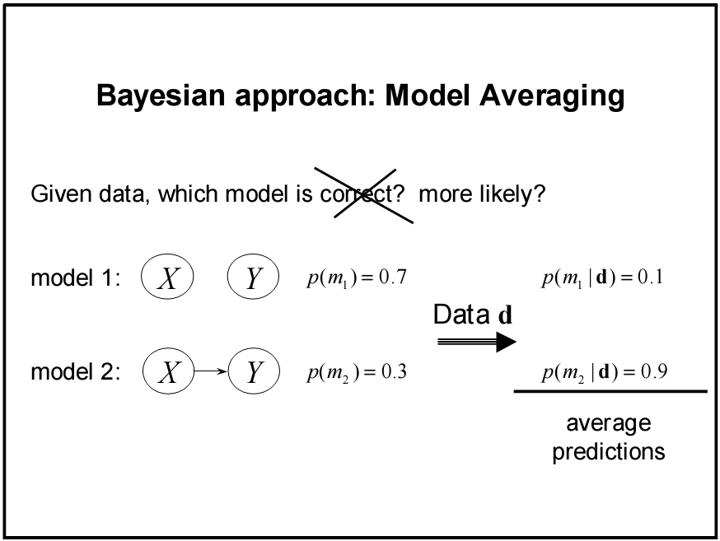

Slide 37


Interpretation of Marginal Likelihood
Using chain rule for probabilities
Maximizing marginal likelihood also maximizes sequential prediction ability!
Relation to leave-one-out cross validation
Problems with cross validation
      can overfit the data, possibly because of interchanges (each item is used for training and for testing each other item)
      has a hard time dealing with temporal sequence data

Slide 38
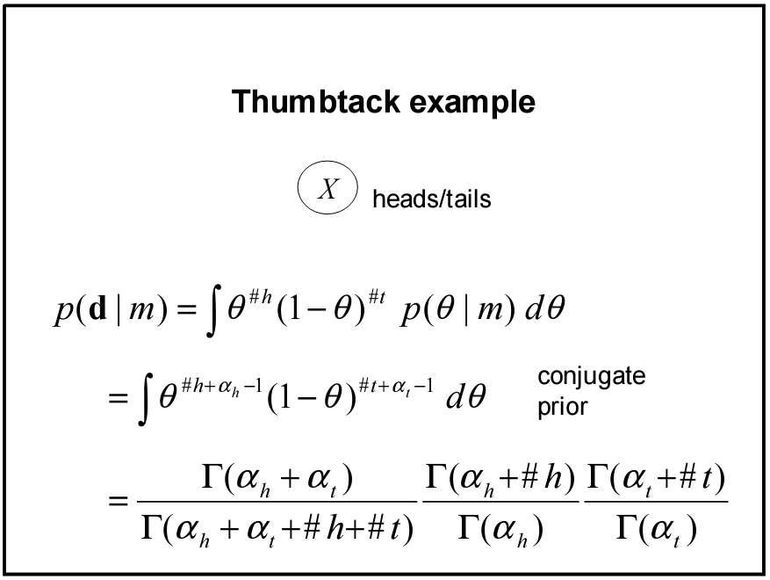
Coin Example

Slide 39
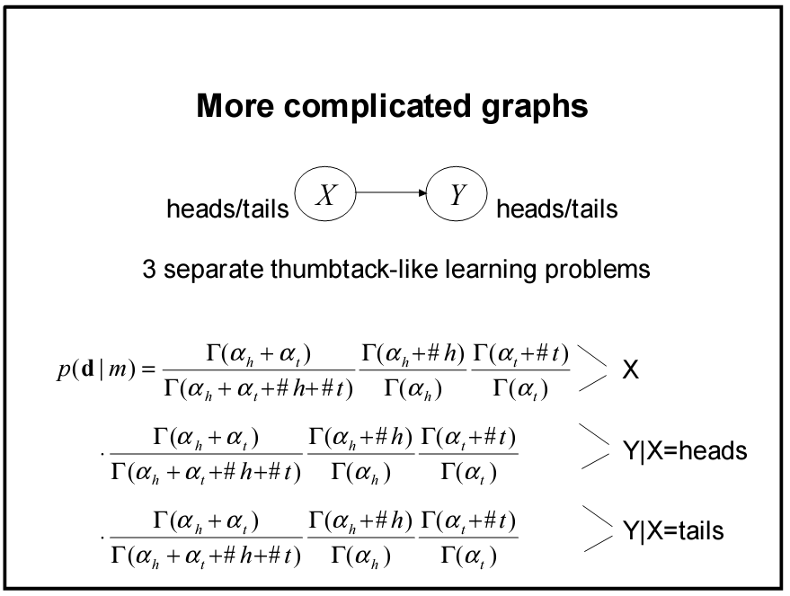
α_{h}, α_{t}, #h, and #t all indexed by these conditions

Slide 40
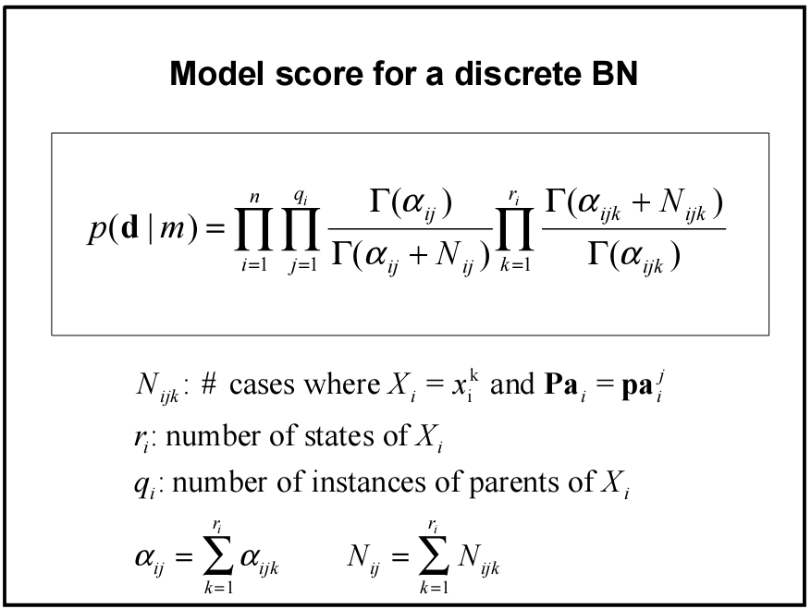
# parent config
# node states
# nodes

Slide 41
Computation of Marginal Likelihood
Efficient closed form solution if
  no missing data (including no hidden variables)
  mutual independence of parameters θ
  local distribution functions from the exponential family (binomial, Poisson, gamma, Gaussian, etc.)
  conjugate priors

Slide 42

Computation of Marginal Likelihood
Approximation techniques must be used otherwise.
E.g., for missing data can use Gibbs sampling or Gaussian approximation described earlier.
    Bayes theorem
    1. Evaluate numerator directly, estimate denominator using Gibbs sampling
    2. For large amounts of data, numerator can be approximated by a multivariate Gaussian

Slide 43
Structure Priors
Hypothesis equivalence
    identify equivalence class of a given network structure
All possible structures equally likely
Partial specification: required and prohibited arcs
(based on causal knowledge)
Ordering of variables + independence assumptions
    ordering based on e.g., temporal precedence
    presence or absence of arcs are mutually independent ->
    n(n-1)/2 priors
p(m) ~ similarity(m, prior Belief Net)

Slide 44
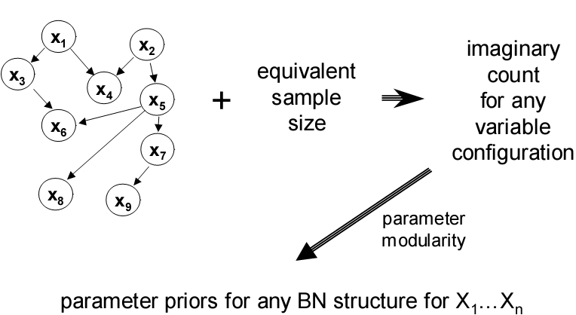
Parameter Priors
all uniform: Beta(1,1)
use a prior Belief Net
parameters depend
only on local structure

Slide 45
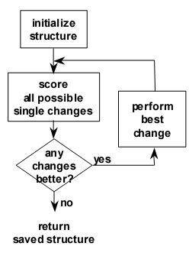
Model Search
Finding the belief net structure with highest score among those structures with at most k parents is NP-hard for k > 1 (Chickering, 1995)
Sequential search
      add, remove, reverse arcs
      ensure no directed cycles
      efficient in that changes to arcs affect only
      some components of p(D|M)
Heuristic methods
      greedy
      greedy with restarts
      MCMC / simulated annealing

Slide 46
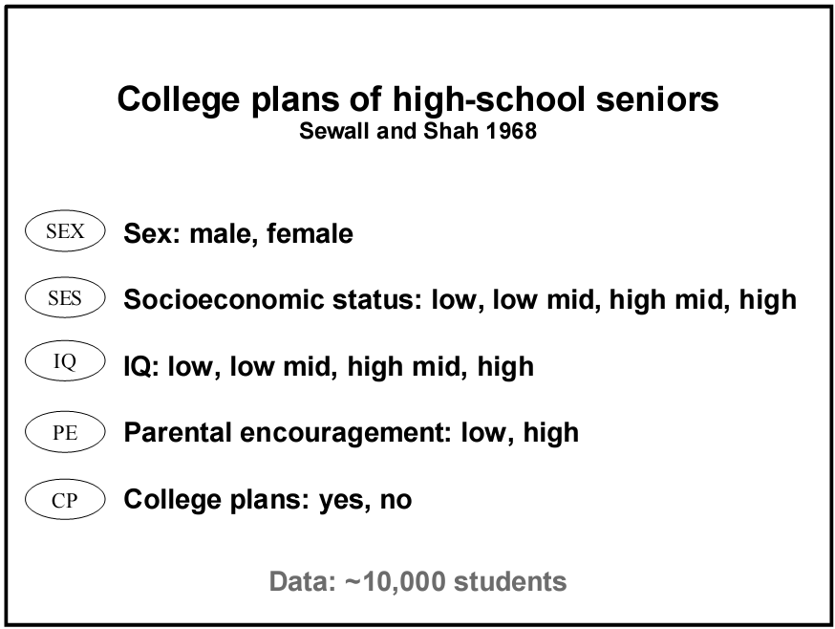

Slide 47
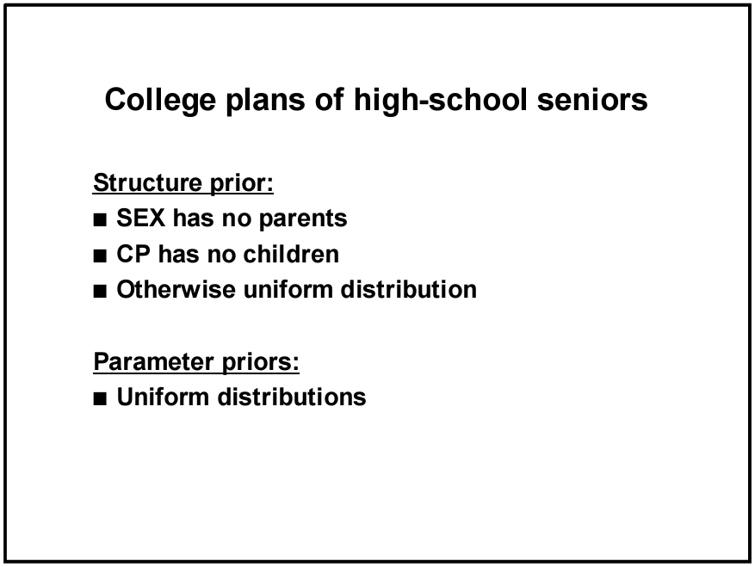

Slide 48
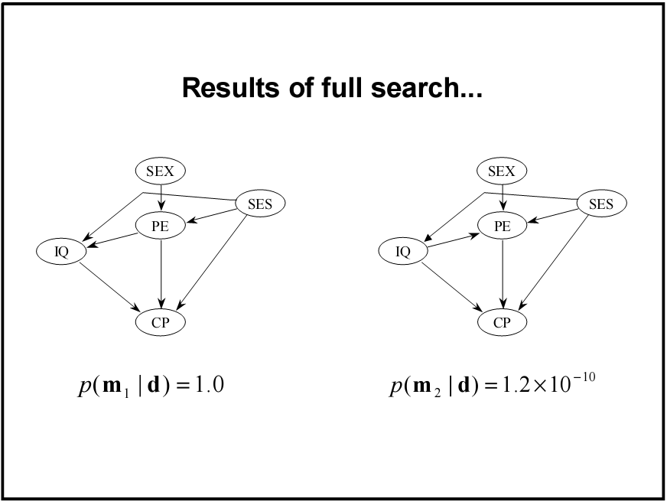
two most likely structures

Slide 49
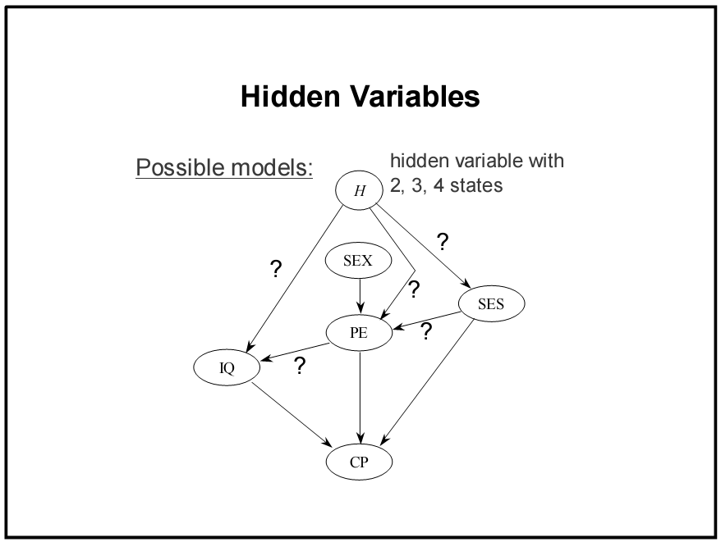

Slide 50
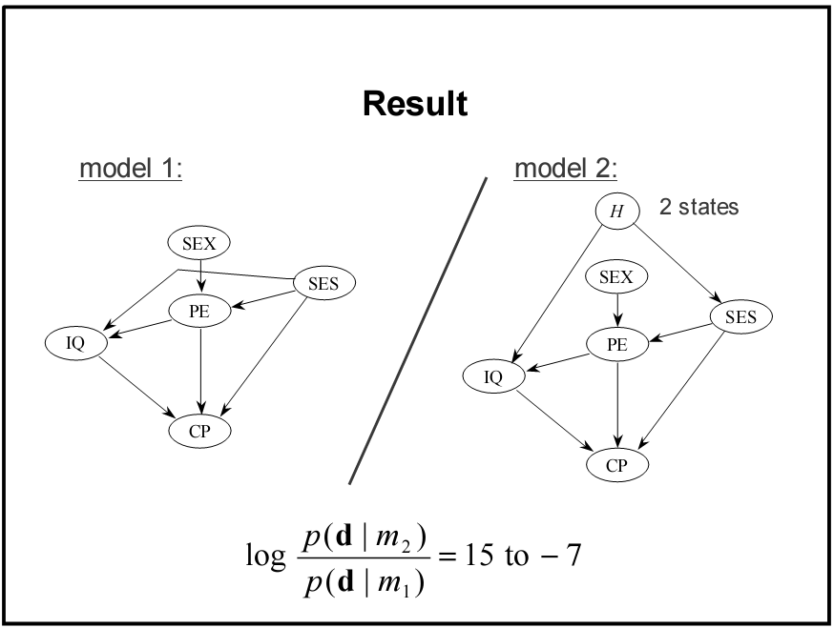
2x10¹⁰

Slide 51
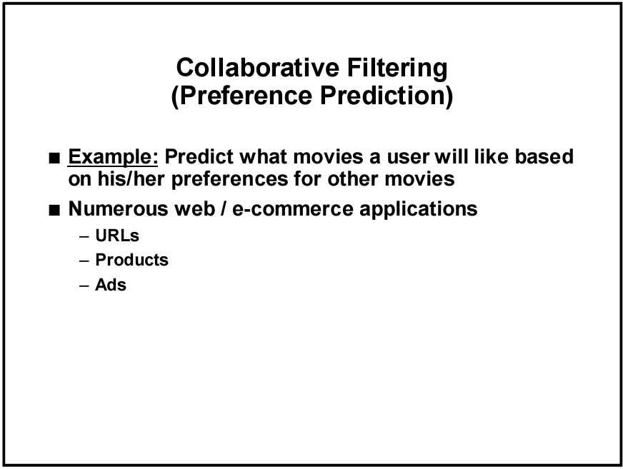

Slide 52
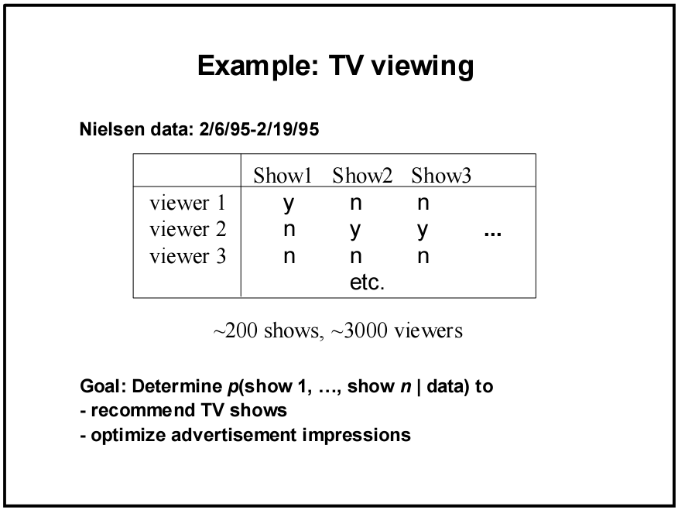

Slide 53
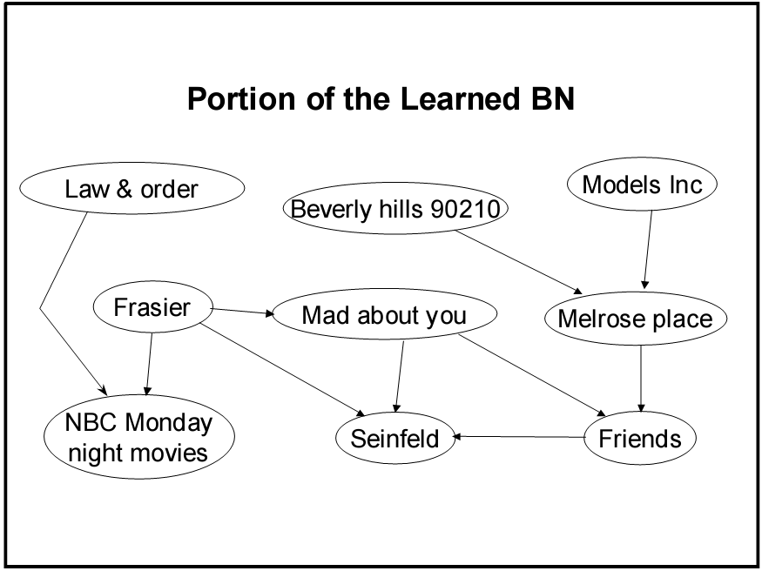

Slide 54
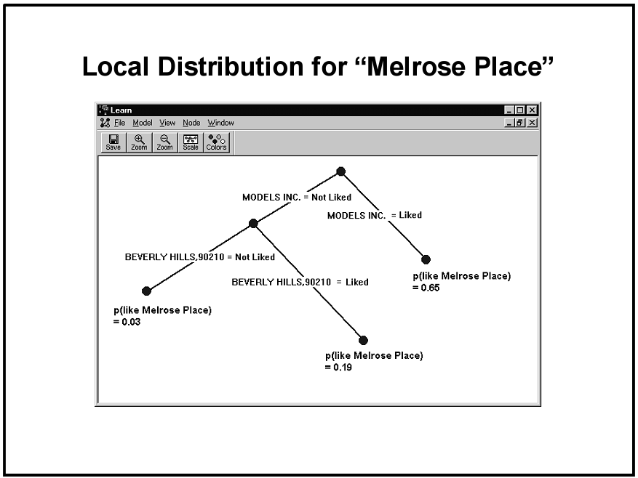

Slide 55
