Slide 1
Changepoint Detection

Slide 2
Changepoints
Observed time series
stock market prices
factory accidents
medical monitoring
Dynamics over an interval are produced by some stationary generative process
stationary = parameters constant
Changepoint = Time at which generative dynamics of generative process switch
Latent variable

Slide 3
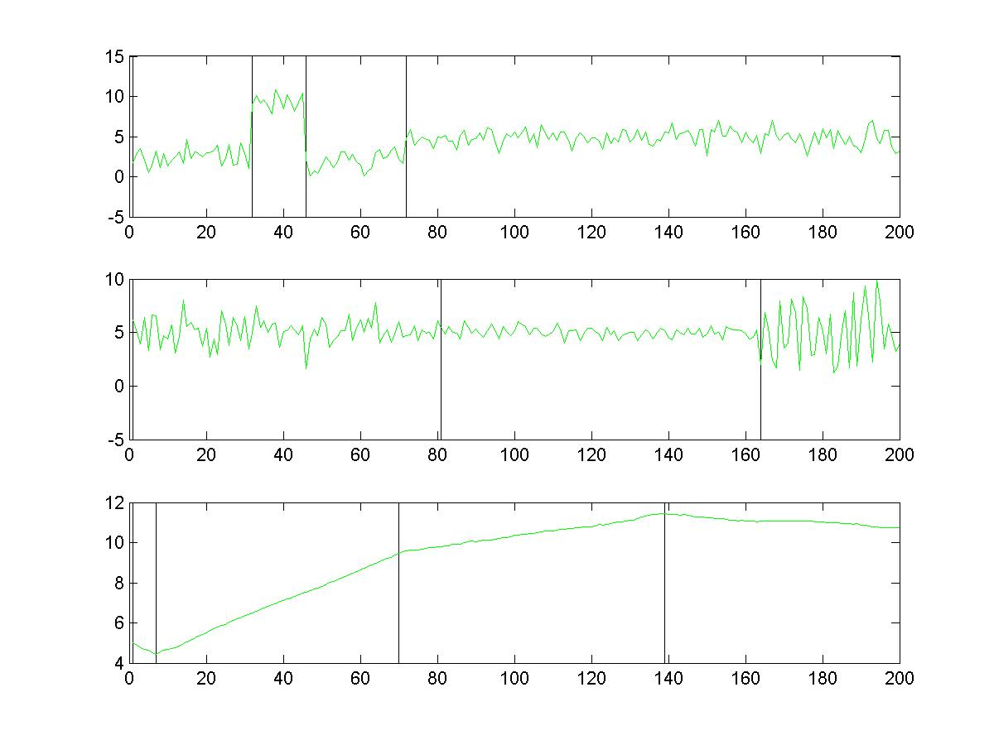

Slide 4
Generative Model
C₂
C₃
C_{T}
…
Y₁
Y₂
Y₃
Y_{T}
X₁
X₂
X₃
X_{T}

Slide 5
Two Tasks
C₂
C₃
C_{T}
…
Y₁
Y₂
Y₃
Y_{T}
Online detection
P(C_{t}|X₁,…X_{t})
Offline detection
P(C_{t}|X₁,…X_{T})
Both assume parametric model of P(Y_{t}|Y_{t-1})
Both require inference on {Y_{t}}
X₁
X₂
X₃
X_{T}

Slide 6
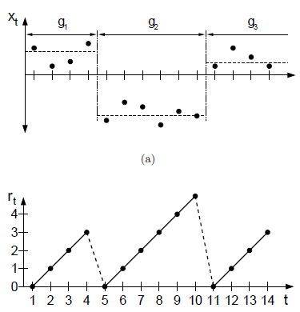
Alternative Representation of Changepoints
Run
Number of time steps during which generative process is stationary
E.g.,
Q Q Q Q R R R R R R R R R S S S
4 9 3
R_{t}: how long is the run up-to-but-not-including time t

Slide 7
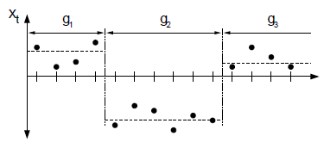
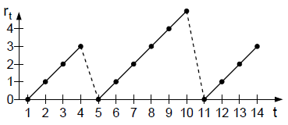
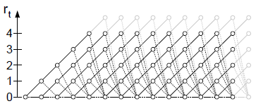
Bayesian Online Changepoint Detection
R_{t} is a random variable
R_{t} {1, 2, 3, …, t}
Compute posterior
P(R_{t} | X₁, …, X_{t})
Transitions
R_{t} = R_{t-1} + 1
R_{t} = 0
Otherwise, P(R_{t} | R_{t-1}) = 0

Slide 8
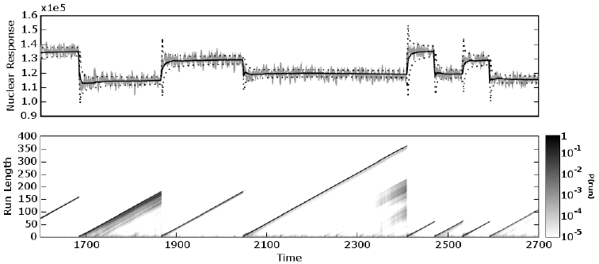
Bayesian Online Changepoint Detection
Notes:
UPPER FIGURE - mean switches, variance constant (light grey line)
- solid line is prediction, E(X_t+1)

Slide 9
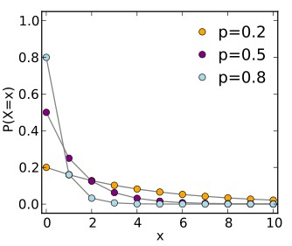
Run Length: Memoryless Transition
P(R_{t} | R_{t-1}) doesn’t depend on how long the run is
P(R_{t} > r+s | R_{t} ≥ s) = P(R_{t} > r)
Geometric distribution
P(R_{t} = 0 | R_{t-1} = r) = 1/λ
P(R_{t} = r+1 | R_{t-1} = r) = 1 – 1/λ
$$\frac{1}{λ}$$
C₂
C₃
C_{T}
Y₁
Y₂
Y₃
…
Y_{T}
X₁
X₂
X₃
X_{T}

Slide 10
Run Length: Memoried Transition
P(R_{t} | R_{t-1}) depends on run length
H(τ): hazard function
probability that run length = τ given that run length >= τ
Memoryless case
H(τ) = 1/λ

Slide 11
Representation Shift
Cool thing about run-length representation is that even when transition is memoried, exact inference can be performed in the model.
Whenever R_{t}=0, link form Y_{t-1} to Y_{t} is severed
Whenever R_{t}>0, link from R_{t} to Y_{t} is severed
→ messy dependence among changepoints disappears
C₂
C₃
C_{T}
R₂
R₃
R_{T}
Y₁
Y₂
Y₃
…
Y_{T}
…
Y₁
Y₂
Y₃
Y_{T}
X₁
X₂
X₃
X_{T}
X₁
X₂
X₃
X_{T}

Slide 12
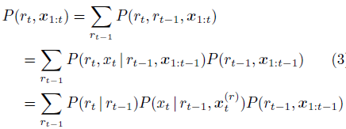
Inference
Marginal predictive distribution
Posterior on run length
same recursion
step used for
HMM updates
Notes:
P(x_t+1 | r_t, x_t(r) ) is on next slide

Slide 13
Posteriors On Generative Parameters Given Run Length
requires generative parameters of run
E.g., If r₈=3, then x₅, x₆, x₇ are relevant for predicting x₈
Suppose x is Gaussian with nonstationary mean
Start with prior,
Compute likelihood
Because x’s are assumed conditionally independent, computation can be done incrementally
With conjugate priors, it’s all simple bookkeeping of sufficiency statistics

Slide 14
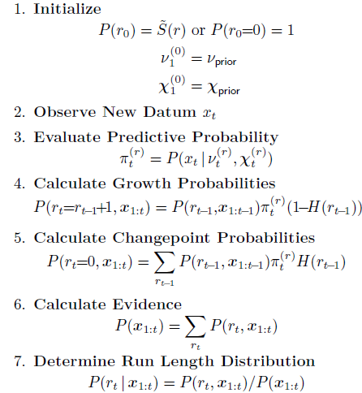
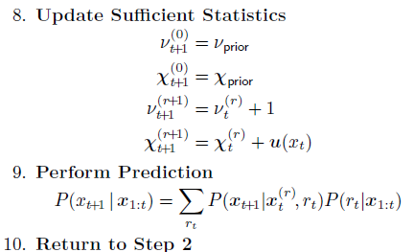
Algorithm
sufficient
statistics
Space complexity is... Time complexity is …
linear in number of data points
Notes:
answer: both are linear in number of data points

Slide 15
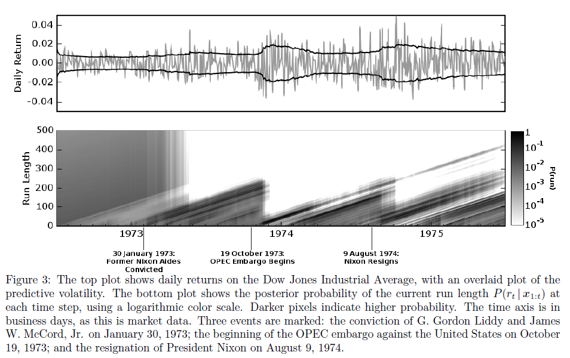
Dow Jones

Slide 16
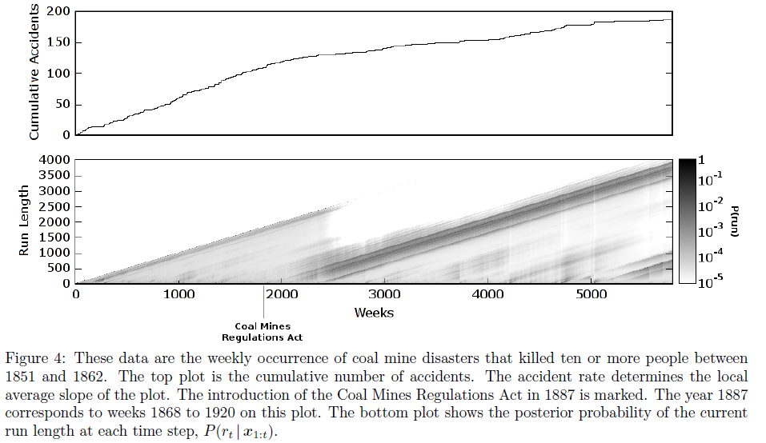
Coal Mine Disasters

Slide 17
Extensions (Fun Final Projects!)
1. Inference on changepoint prior λ for memoryless case
2. Inference on hazard function for memoried case
3. Can run-length representation trick be used for efficient offline inference?
This algorithm is like the forward (α) computation of forward-backward
My hunch is you can combine this with a backward calculation and do offline inference.

