Slide 1
Probabilistic Models in Human and Machine Intelligence
CSCI 5822
Spring 2018

Slide 2
Current Class Status
67 enrolled
12 waitlisted

Slide 3
Machine Learning @ CU
Intro courses
CSCI 5622: Machine Learning
CSCI 5352: Network Analysis and Modeling
CSCI 5822: Probabilistic Models
CSCI 5922: Neural Networks and Deep Learning
Other courses this semester
CSCI 7000-010: Mind Reading Machines (Sidney D’Mello)
CSCI 7000-008: Human Centered ML (Chenhao Tan)

Slide 4
A Very Brief History of Cog Sci and AI
1950’s-1980’s Symbolic computation
The mind is like a modern digital computer
Symbols are basic elements of representation, e.g., John, father
Symbol manipulation is basic operation,
e.g., (father Y X) & (father Z X) -> (sibling Y Z)
1980’s-1990’s Subsymbolic computation
The mind is a massively parallel network of simple neuron-like processors
Numerical vectors are basic elements of representation
Numerical computing is basic operation: y = f ( Σ_{i} w_{i} x_{i})
2000’s – 2010’s Probabilistic computation
The mind operates according to laws of probabilistic reasoning and statistical inference
Invades cog sci, AI (planning, natural language processing), ML
Formalizes the statistical intuitions underlying neural nets
2010’s and beyond Subsymbolic computation
The mind is a massively parallel neuron-like network of simple processors…
Well grounded in probability and statistics (e.g., Variational autoencoders, Boltzmann machines)
Notes:
ML conference in 1986 – all symbolic
Explanation based learning was the rage

Slide 5
Relation of Probabilistic Models to Symbolic and Subsymbolic Models
Subsymbolic
models
Probabilistic
models
Symbolic
models
statistical learning
(large # examples)
rule learning (small # examples)
feature-vector
representations
structured
representations
Notes:
structured rep: father of your brother is your father

Slide 6
What Is Probability?
Frequentist notion
Relative frequency obtained if event were observed many times (e.g., coin flip)
Subjective notion
Degree of belief in some hypothesis
Analogous to neural net activation
Long philosophical battle between these two views
Subjective notion makes sense for cog sci and AI given that probabilities represent mental states

Slide 7
Do People Reason According To The Laws Of Probability?
The probability of breast cancer is 1% for a woman at 40 who participates in routine screening. If a woman has breast cancer, the probability is 80% that she will have a positive mammography. If a woman does not have breast cancer, the probability is 9.6% that she will also have a positive mammography.
A woman in this age group had a positive mammography in a routine screening? What is the probability that she actually has breast cancer?
A. greater than 90% B. between 70% and 90% C. between 50% and 70% D. between 30% and 50% E. between 10% and 30% F. less than 10%
Is this typical or the exception?
Perhaps high-level reasoning isn’t Bayesian but underlying mechanisms of learning, inference, memory, language, and perception are.
95 / 100 doctors
correct answer
Notes:
WORK THROUGH BAYES RULE

Slide 8
Griffiths and Tenenbaum (2006) Optimal Predictions in Everyday Cognition
If you were assessing an insurance case for an 18-year-old man, what would you predict for his lifespan?
If you phoned a box office to book tickets and had been on hold for 3 minutes, what would you predict for the total time you would be on hold?
If your friend read you her favorite line of poetry, and told you it was line 5 of a poem, what would you predict for the total length of the poem?
If you opened a book about the history of ancient Egypt to a page listing the reigns of the pharaohs, and noticed that in 4000 BC a particular pharaoh had been ruling for 11 years, what would you predict for the total duration of his reign?

Slide 9
Griffiths and Tenenbaum Conclusion
Average responses reveal a “close correspondence between peoples’ implicit probabilistic models and the statistics of the world.”
People show a statistical sophistication and optimality of reasoning generally assumed to be absent in the domain of higher-order cognition.

Slide 10
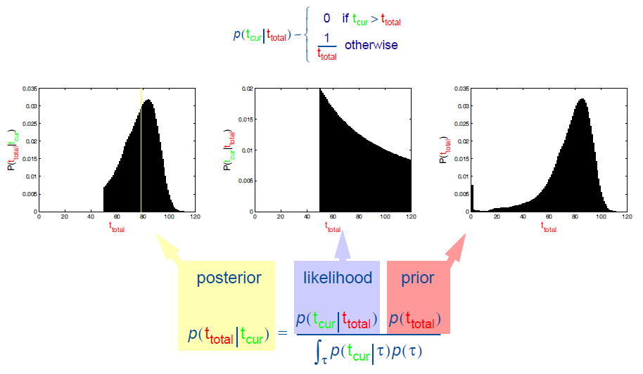
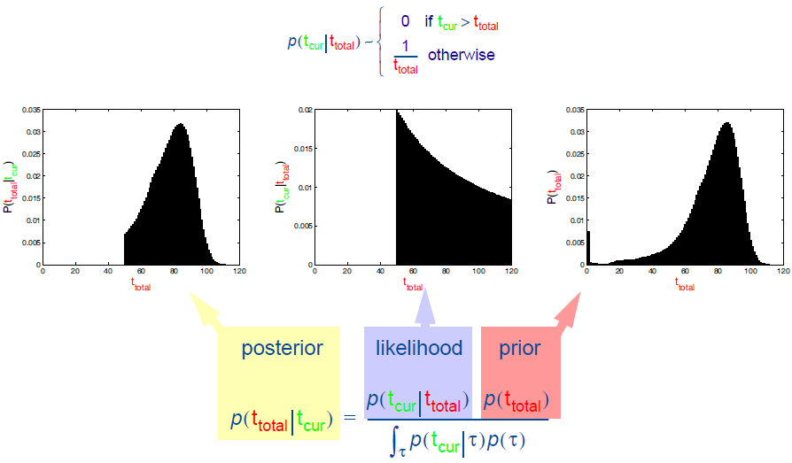
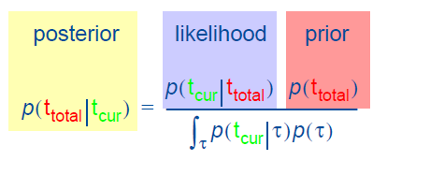
Griffiths and Tenenbaum Bayesian Model
If an individual has lived for t_{cur}=50 years, how many years t_{total} do you expect them to live?

Slide 11
What Does Optimality Entail?
Individuals have complete, accurate knowledge about the domain priors.
Fairly sophisticated computation involving Bayesian integral

Slide 12
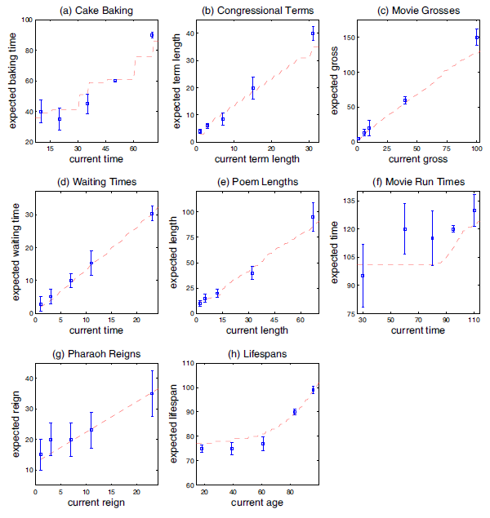

Slide 13
From The Economist (1/5/2006)
“[Griffiths and Tenenbuam]…put the idea of a Bayesian brain to a quotidian test. They found that it passed with flying colors.”
“The key to successful Bayesian reasoning is … in having an appropriate prior… With the correct prior, even a single piece of data can be used to make meaningful Bayesian predictions.”

Slide 14
My Caution
Bayesian formalism is sufficiently broad that nearly any theory can be cast in Bayesian terms
E.g., adding two numbers as Bayesian inference
Emphasis on how cognition conforms to Bayesian principles often directs attention away from important memory and processing limitations.

Slide 15
Latent Dirichlet Allocation (a.k.a. Topic Model)
Problem
Given a set of text documents, can we infer the topics that are covered by the set, and can we assign topics to individual documents
Unsupervised learning problem
Technique
Exploit statistical regularities in data
E.g., documents that are on the topic of education will likely contain a set of words such as ‘teacher’, ‘student’, ‘lesson’, etc.

Slide 16
Generative Model of Text
Each document is a collection of topics (e.g., education, finance, the arts)
Each topic is characterized by a set of words that are likely to appear
The string of words in a document is generated by:
Draw a topic from the probability distribution associated with a document
Draw a word from the probability distribution associated with a topic
Bag of words approach

Slide 17
Inferring (Learning) Topics
Input: set of unlabeled documents
Learning task
Infer distribution over topics for each document
Infer distribution over words for each topic
Distribution over topics can be helpful for classifying or clustering documents

Slide 18
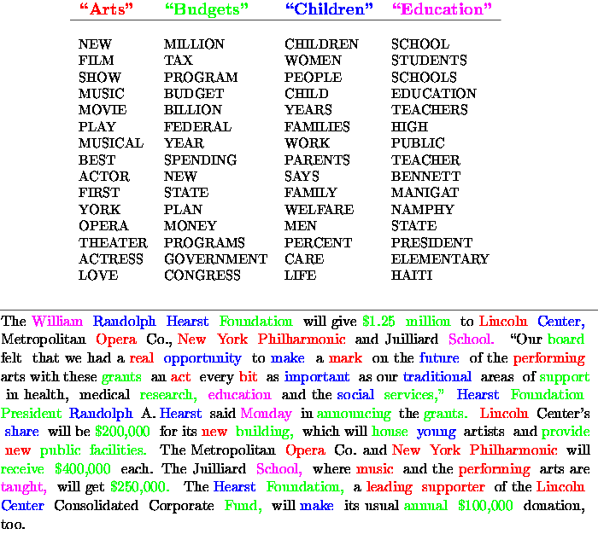

Slide 19
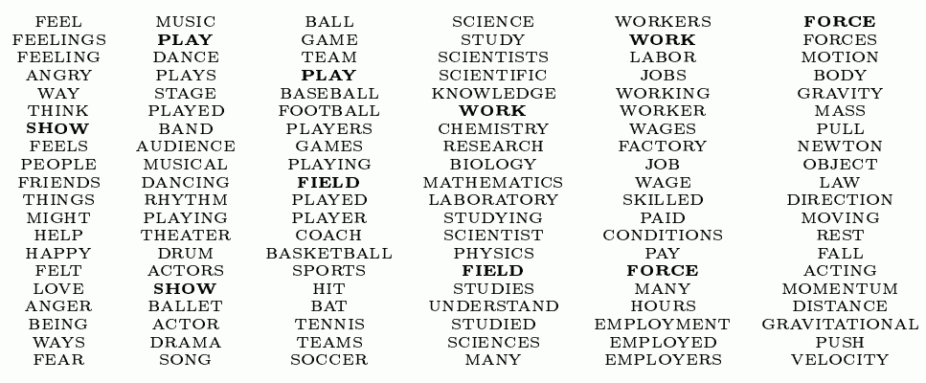

Slide 20
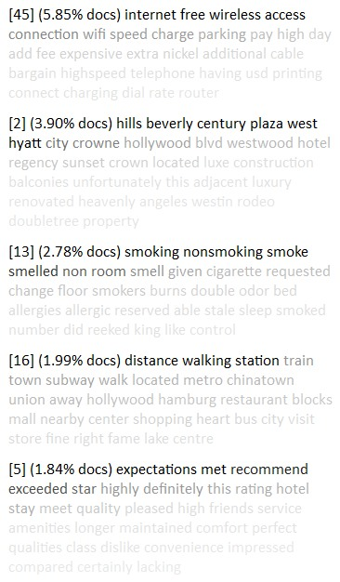
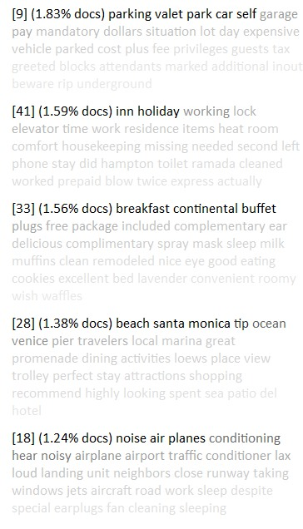
Topic Modeling Of Hotel Reviews
Dan Knights, Rob Lindsey @ JD Powers

Slide 21
Phrase Discovery
Rob Lindsey @ JD Powers

Slide 22
Value Of Probabilistic Models In AI And Cognitive Science
AI and humans fundamentally have to deal with an uncertain (unknown) world
Uncertainty is well described in the language of random events.

Slide 23
Value Of Probabilistic Models In AI And Cognitive Science
Mathematically principled theories
Currency of probability provides strong constraints on inference
compare to neural net activations
Probability is the optimal thing to compute, in the sense that any other strategy will lead to lower expected returns
e.g., “I bet you $1 that roll of die will produce number < 3. How much are you willing to wager?”

Slide 24
Value Of Probabilistic Models In AI And Cognitive Science
Elegant theories
Key claims of theories are explicit
Can minimize assumptions via Bayesian model averaging
Often provides a direct means of incorporating prior knowledge

Slide 25
Value Of Probabilistic Models In AI And Cognitive Science
Provides unified framework for describing pretty much any algorithm
Allows you to see interrelationship among algorithms
Allows you to develop new algorithms
Notes:
deterministic models are a subset of probabilistic models. neural nets are a subset of deterministic models

Slide 27
Important Technical Issues
Representing structured data
grammars
relational schemas (e.g., paper authors, topics)
Hierarchical models
different levels of abstraction
Nonparametric models
flexible models that grow in complexity as the data justifies
Inference: Exact vs. approximate
Markov chain Monte Carlo, particle filters, variational approximations

Slide 28
Rationality in Cognitive Science
Some theories in cognitive science are based on premise that human performance is optimal
Rational theories, ideal observer theories
Ignores biological constraints
Probably true in some areas of cognition (e.g., vision)
More interesting: bounded rationality
Optimality is assumed to be subject to limitations on processing hardware and capacity, representation, experience with the world.

