Slide 1
Topic and Role Discovery
In Social Networks

Slide 2
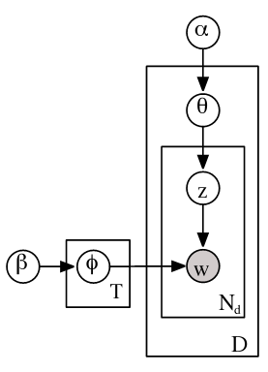
Review of Topic Model
Notes:
[*] Drop D and fold theta into document plate
same model

Slide 3
Review of Joint/Conditional Distributions
What do the following tell us:
P(Z_{i})
P(Z_{i} | {W,D})
P(θ | {W,D})

Slide 4
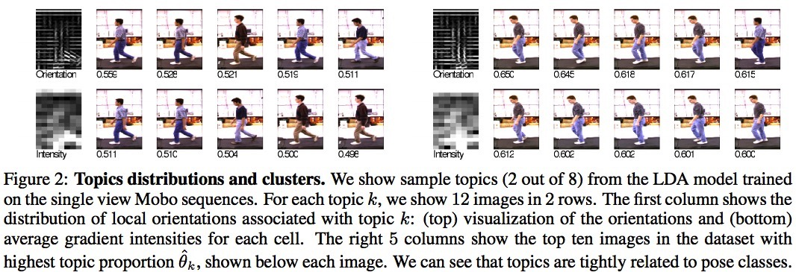
Extending The Topic Model
Topic Model spawned gobs of research
E.g., visual topic models
Bissacco, Yang, Soatto, NIPS 2006
Notes:
words are oriented gradients of intensity (compact image)
documents are image sequences

Slide 5
Extending Topic Modeling
To Social Network Analysis
Show how research in a field progresses
Show how Bayesian nets can be creatively tailored to tackle specific domains
Convince you that you have the background to read probabilistic modeling papers in machine learning

Slide 6
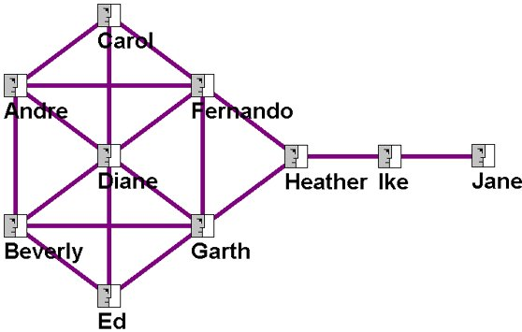
Social Network Analysis
Nodes of graph are individuals or organizations
Links represent relationships (interaction, communication)
Examples
    interactions among blogs on a topic
    communities of interest among faculty
    spread of infections within hospital
Graph properties
    connectedness
    distance to other nodes
    natural clusters

Slide 7
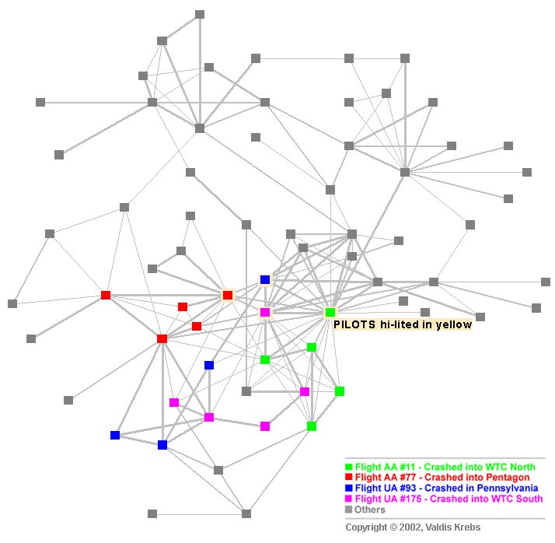
9/11 Hijacker Analysis
Notes:
Aaron has done some work with this data set

Slide 8
Indadequacy of Current Techniques
Social network analysis
    Typically captures a single type of relationship
    No attempt to capture the linguistic content of the interactions
Topic modelling (and other statistical language models)
    Doesn't capture directed interactions and relationships between individuals
Notes:
Social network analysis Is lacking because…

Slide 9
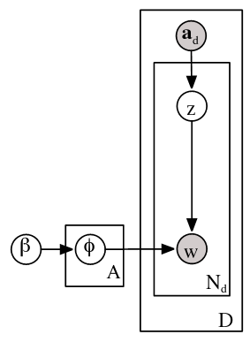
Author Model (McCallum, 1999)
Documents: research articles
a_{d}: set of authors associated with document
z: a single author sampled from set
(each author discusses a single topic)
Notes:
Z is what kind of variable? Why is Phi in a plate with the label “A”?

Slide 10
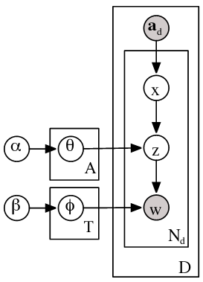
Author-Topic Model (Rosen-Zvi,
Griffiths, Steyvers, & Smyth, 2004)
Documents: research articles
Each author's interests are modeled by a mixture of topics
  x: one author
  z: one topic

Slide 11
Can Author-Topic Model Be Applied To Email?
Email: sender, recipient, message body
Could handle email if
  Ignored recipients
    But discards important information about
    connections between people
  Each sender and recipient were
  considered an author
    But what about asymmetry of
    relationship?

Slide 12
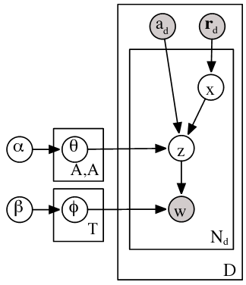

Author-Recipient-Topic (ART) Model
(McCallum, Corrado-Emmanuel, & Wang, 2005)
Email
  $r_{d}$: set of recipients of email $d$
  $a_{d}$: author of email $d$
  $N_{d}\text{: }\text{number} \text{of} \text{words} \text{in} \text{email} d$
Generative model for a word
  pick a particular recipient from r_{d}
  chose a topic from multinomial
  specific to author-recipient pair
  sample word from topic-specific
  multinomial

Slide 13
Review/Quiz
  What is a document?
  How many values of θ are there?
  Can data set be partitioned into subsets
  of {author, recipient} pairs and each
  subset is analyzed separately?
  What is α?
  What is β?
  What is form of P(w|z,φ₁, φ₂, φ₃,… φ_{T})?
Notes:
document = email
values of theta: one per pair of individuals (one sender, one recipient)
can’t partiion because (a) given topic, distribution over words is shared

Slide 14


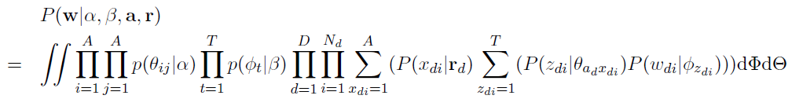
Author-Recipient-Topic (ART) Model
Joint distribution
Goals
  Infer topics
  Infer to which recipient a word was intended

Slide 15

Methodology
Exact inference is not possible
    Gibbs Sampling (Griffiths & Steyvers, Rosen-Zvi et al.)
    variational methods (Blei et al.)
    expectation propagation (Griffiths & Steyvers,
    Minka & Lafferty)
McCallum uses Gibbs sampling of latent variables
    latent variables: topics (z), recipients (x)
    basic result:

Slide 16

Derivation
Want to obtain posterior over z and x given corpus

Slide 17
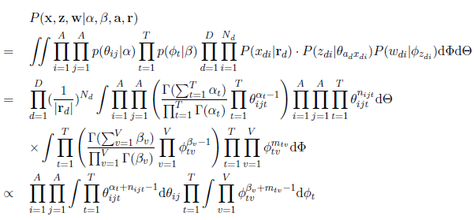

n_{ijt}: # assignments of topic t to author i with recipient j
m_{tv} : # occurrences of (vocabulary) word v to topic t
is conjugate prior of
is conjugate prior of
Notes:
Purple: regrouping all the words where m_tv is # times a given vocabulary item occurs in topic t
V: vocabulary items
Yellow: regrouping all the topic assignments. where n_ijt is the number of times topic t is assigned for author i and recipient j=
Orange: dirichlet
Green: dirichlet
conjugate priors
Blue: uniform priors over recipients
Bottom equation 1: simplification from combining conjugate prior with likelihood
Bottom equation 2: simplification from computing expectation of dirichlet distribution

Slide 18
Data Sets
Enron
    23,488 emails
    147 users
    50 topics
McCallum email
    23,488 emails
    825 authors, sent or received by McCallum
    50 topics
Hyperpriors
    α = 50/T
    β = .1

Slide 19
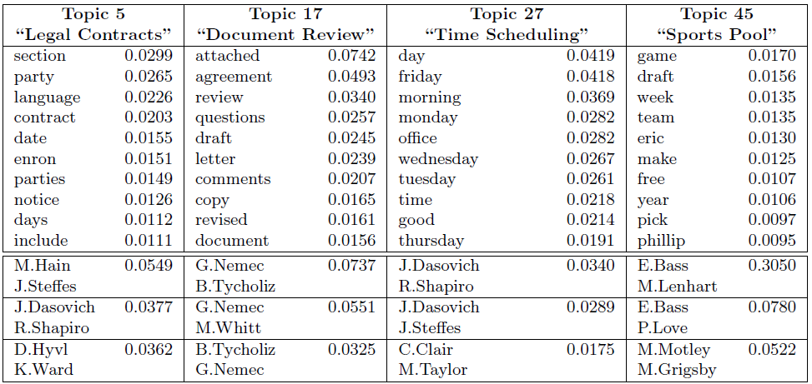
Enron Data
Human-generated label
three author/recipient pairs
with highest probability
for discussing topic
Hain: in house lawyer

Slide 20
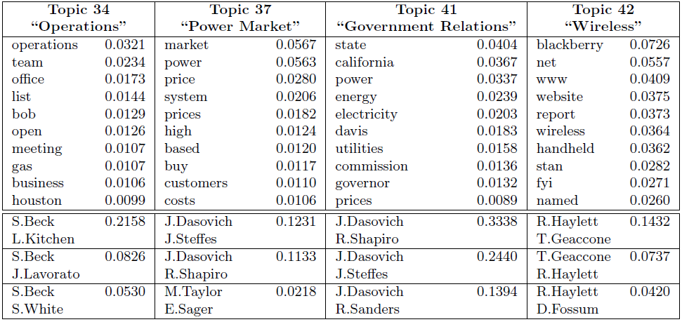
Enron Data
Beck: COO
Dasovich: Govt Relations
Steffes: VP Govt. Affairs

Slide 21
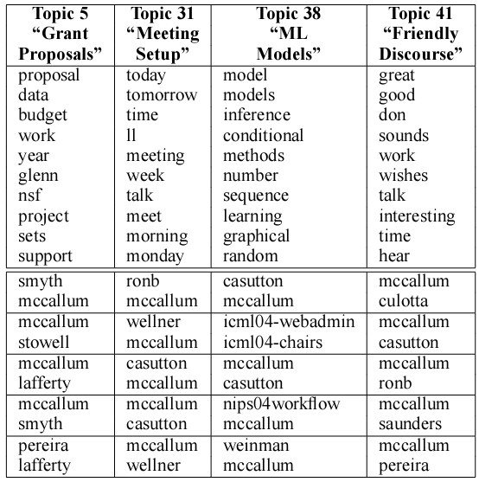
McCallum's Email

Slide 22


Social Network Analysis
Stochastic Equivalence Hypothesis
    Nodes that have similar connectivity must have similar roles
    e.g., in email network, probability that one node communicates with other nodes
How similar are two probability distributions?
    Jensen-Shannon divergence = measure of dissimilarity
    1/JSDivergence = measure of similarity
For ART, use recipient-marginalized topic distribution
D_{KL}

Slide 23
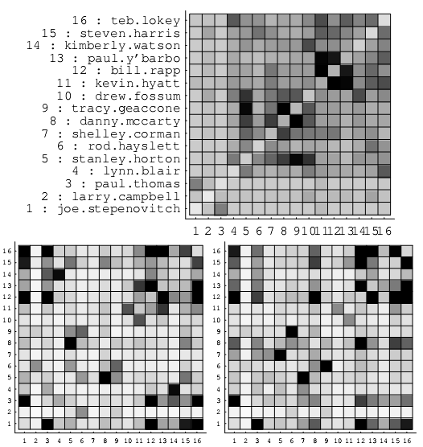
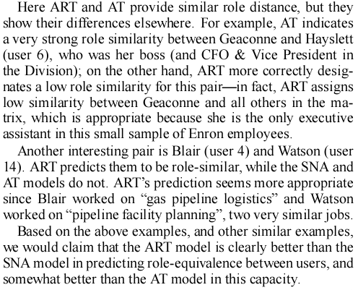
Predicting Role Equivalence
Block structuring JS divergence matrix
SNA
ART
AT
#9: Geaccone: executive assistant
#8: McCarty: VP

Slide 24
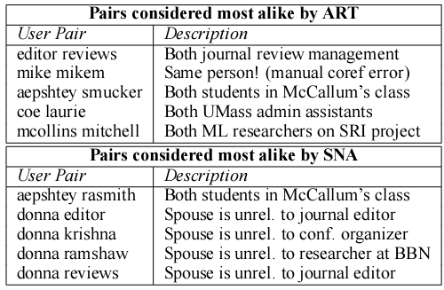
Similarity Analysis With McCallum Email

Slide 25
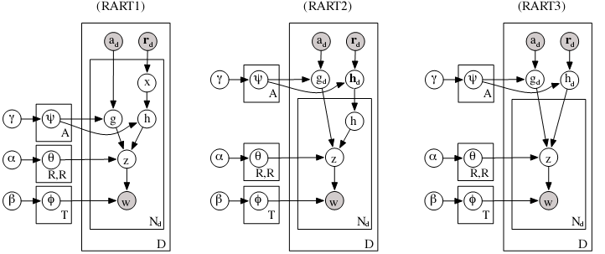
Role-Author-Recipient Topic (RART) Model
Person can have multiple roles
    e.g., student, employee, spouse
Topic depends jointly on roles of author and recipient
Notes:
What’s the difference among these:
RART1: role for each word is redrawn from among recipients and recipient roles
RART 2: role for each word is redrawn from recipients, but each recipient has one role for the document
RART 3: role for each word is fixed, drawn from recipients and recipient roles for the document

Slide 26
New Topic!
If you have 50k words, you need 50k free parameters to specify topic-conditioned word distribution.
For small documents, and small data bases, the data don’t constrain the parameters.
  Priors end up dominating
Can we exploit the fact that words aren’t just strings of letters but have semantic relations to one another?
Bamman, Underwood, & Smith (2015)

Slide 27
Distributed Representations Of Words
Word2Vec scheme for discovering word embeddings
  Count # times other words occur in the context of some word W
  Vector with 50k elements
  Do dimensionality reduction on these vectors to get compact, continuous vector representation of W
  Captures semantics

Slide 28
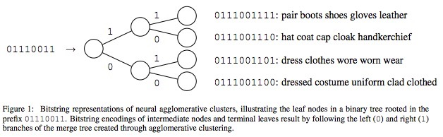
Distributed Representations Of Words
Perform hierarchical clustering on word embeddings
Limit depth of hierarchical clustering tree
(Not exactly what authors did, but this seems prettier.)

Slide 29
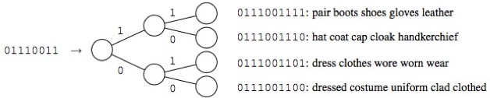
Distributed Representation Of Words
Each word is described by a string of 10 bits
Bits are ordered such that most-significant bit represents root of hierarchical clustering tree

Slide 30
Generative Model For Word
P(W) = P(B₁)P(B₂|B₁)P(B₃|B_{1:2}) … P(B₁₀|B_{1:9})
where the distributed representation of W is
(B₁, …, B₁₀)
How many free parameters are required to represent word distribution?
  1023 vs. 50k for complete distribution
Notes:
1023

Slide 31
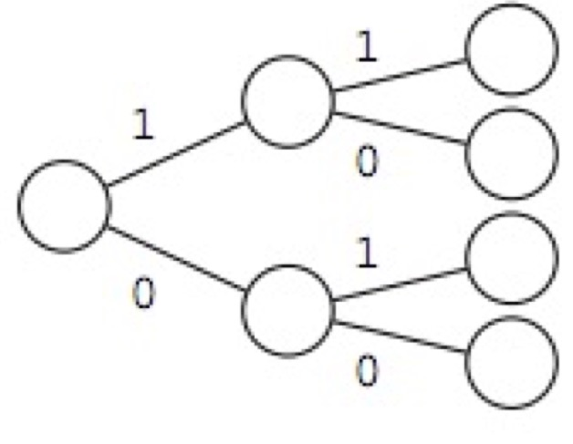
Generative Model For Word
P(W|T) = P(B₁|T)P(B₂|B₁,T)P(B₃|B_{1:2},T) … P(B₁₀|B_{1:9},T)
Each topic will have 1023 parameters associated with the word distribution.
What’s the advantage of using the bit
string representation instead of simply
specifying a distribution over the 1024
leaf nodes directly?
  Leveraging priors

