Slide 1
Kalman Filters and Linear Dynamical Systems and Optimal Adaptation To A Changing Body (Koerding, Tenenbaum, Shadmehr)

Slide 2
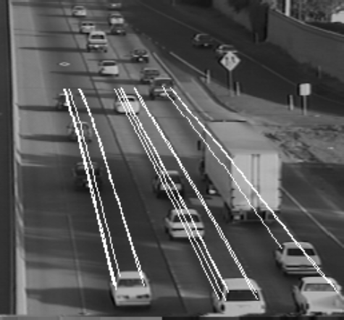
Tracking
{Cars, people} in {video images, GPS}
Observations via sensors are noisy
Recover true position
Temporal task
Position at t is determined in part by position at t-1
face tracking demo
object tracking demo
multiple person tracking demo (offline demo)
Coifman et al.

Slide 3
Bayesian Formulation
Prior
Predicted position of object based on previous position and velocity
Likelihood
Noisy observation
Posterior
Bayesian update

Slide 4
Graphical Model Formulation With Time
X₁
X₂
X₃
Z₁
Z₂
Z₃
X_{t}: state (position, velocity) at time t Z_{t}: observation (image, GPS data) at time t
P(X_{t}|X_{t-1}): state dynamics (how vehicle/person moves)
P(Z_{t}|X_{t}): observation dynamics (how observations are generated)

Slide 5
HMM Versus State Space Model
HMM
X is discrete; Z is often discrete
Transition distribution is look up table
State-space model
X and Z are continuous vectors
Dynamics (X_{t}→X_{t+1}, X_{t}→Z_{t}) are arbitrary
Linear state-space model
State-space model with linear dynamics
Kalman filter
Linear state-space model with additive Gaussian noise
X₁
X₂
X₃
Z₁
Z₂
Z₃
Notes:
KF magic thing from engineering, but something we can grok now that we understand probabilistic models

Slide 6
Kalman Filter Generative Model
Dynamics: linear stochastic difference equation
Observation model
Noise distributions
What distributions do x and z have?
U₁
U₂
U₃
X₁
X₂
X₃
Z₁
Z₂
Z₃

Slide 7
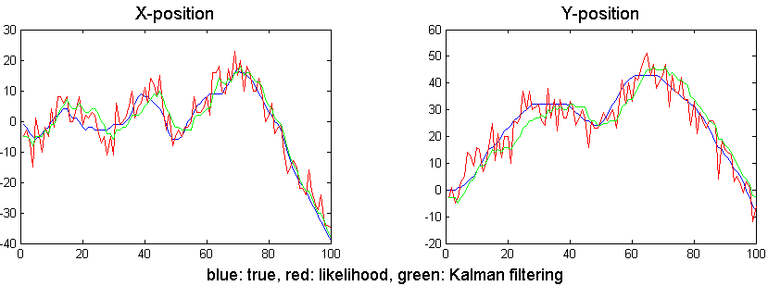
Kalman Filter
Assumes known dynamics and observation model, but that can be learned as well
Offline: EM algorithm
On-line: Gradient ascent in log likelihood
Uses
Prediction
Smoothing (noise reduction)
Uncertainty estimation
Optimal: minimizes estimation error
Credit: Hal Daumé III

Slide 8
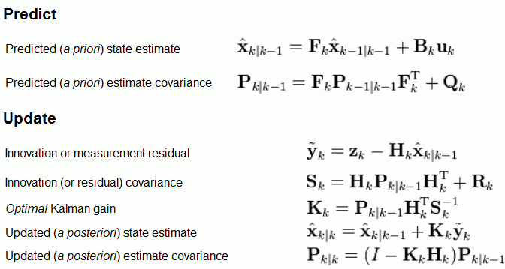
Kalman Filter Inference
U₁
U₁
U₂
U₂
U₃
U₃
X₁
X₁
X₂
X₂
X₃
X₃
Z₁
Z₁
Z₂
Z₂
Z₃
Mean of predicted X_{k}
given all observations to k-1
Mean of predicted X_{k-1}
given all observations to k-1
Reliability of observation vs. internal prediction
Notes:
(1) P(xk | z1...zk-1): Posterior predictive distribution
Distribution is Gaussian with a mean (xhat) and variance (P)
* explain subscripts: k|k-1, k-1|k-1
* dynamics of update
linear transform of Gaussian is Gaussian
scale up the mean by a factor, scale up the variance by factor squared
(2) P(xk|z1...zk): Posterior distribution
where we want to get to
Steps:
-- compute prediction error y~ -- observed z_k minus prediction Hx
-- but Hx is a distribution not a point prediction
-- so error is a distribution with mean y-tilde and covariance S
K_k: Kalman gain
-- I'll give you intuition here, not the derivation
-- reliability of observation vs. internal prediction
-- determines how much we move our state in direction of observation
-- intuition -- consider scalar case
S^-1 = 1/(HPH+R)
K = PH/(H^2P+R)
if R=0 = K = 1/H (just mapping observation to state space)
as R gets larger, adjustment to X gets smaller
-- note that it doesn't depend on data in any way

Slide 9
Extensions
Nonlinear dynamics
Extended Kalman filter
Particle filter
Switched linear dynamics
E.g., running vs. walking vs. climbing
S₁
S₂
S₃
X₁
X₂
X₃
Z₁
Z₂
Z₃

Slide 10
Motor Adaptation
Thought experiment
Walking on the moon
Many reasons for changing response of muscles
Fatigue
Disease
Exercise
Development
Notes:
Thought experiments: imagine experience and how you would react to it.
Or bionic woman

Slide 11
Simple Example
Saccadic eye movement to target
Adaptation task
Motor error -> gain adjustment
error

Slide 12
Time Scale
When muscles are perturbed, what is the time scale of the perturbation?
Fatigue: a few minutes
Disease/injury: months
Exercise: months to years
Development: lifetime
Any adaptation to perturbation should last only as long as the time scale of the perturbation.
Key idea
Need to represent perturbations at multiple time scales
Terminology
Perturbation = Disturbance = Deviation of gain from default (1.0)

Slide 13
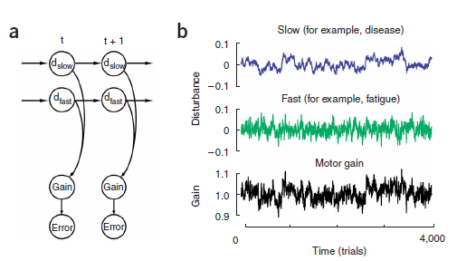
Generative Model of Disturbances: Random Walk At Two Time Scales

Slide 14
Kalman Filter Model Of Adaptation
X₁
X₂
X₃
X: vector of internal gain disturbances, one per time scale
Z: net gain disturbance
τ : something like number of time steps for state to decay
τ=1 (fast time scale) vs. τ=100 (slow time scale)
Large τ -> less memory of past, more noise -> rapid increase in uncertainty over time
Z₁
Z₂
Z₃
$$ε_{i} \sim 𝓝(0,cτ_{i}^{−1/2})$$

Slide 15
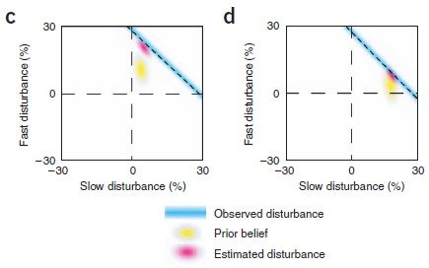
Credit Assignment
Net observed disturbance is sum of slow and fast
Why is there a tendency to move ↑ instead of →?
After
prolonged
exposure to
disturbance:
shift from fast
to slow scale
Notes:
30% adjustment to gain: could be due to fast, to slow, or some linear combination (dashed line)
[dashed line is like Weiss model: in weiss model, uncertainty about whether motion was due to x displacement, y displacement, or some combination of the two]
Hazy blue is uncertainty in dashed line due to observation noise
Yellow: prior belief (gaussian blur)
Red: posterior (gaussian)
Tendency to move up = interpretation as fast disturbance
Fast disturbance can change quickly -> more likely to be responsible
If weather outside is freaky today it could be due to (a) storm passing through, or (b) global warming

Slide 16
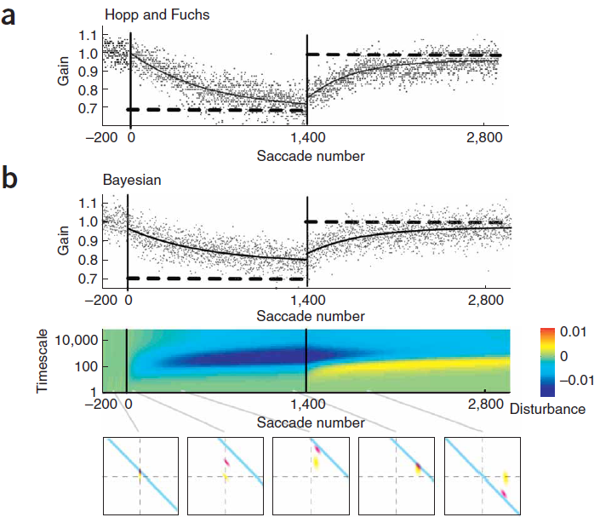
Saccadic Gain Adaptation
Two phases of gain
Adaptation (30% shift)
Maintained perturbation
leads to slow shift from fast
time scale to slow time scale
Note that final state is not the same as initial state, even though behavior is identical.
Notes:
MONKEY DATA; Thick lines are exponential fits
30 different time scales, ranging from tau=1 to tau > 10k
graphs at bottom compare one slow and one fast time scale. notice posterior sliding down line between #3 and #4.
note in graph #5 that posterior is along diagonal but not at origin where it started: corresponds to fast has neg perturbation, but slow has pos perturbation

Slide 17
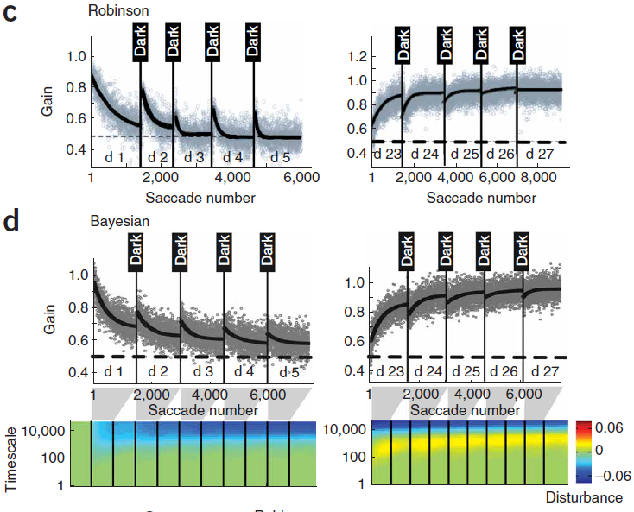
Phase 1
Phase 2
Multiday study: 1500 trials per day, followed by dark goggles.
Features:
(1) Day-to-day forgetting;
(2) faster relearning
Model claim: Forgetting occurs because monkey makes eye movements without feedback → greater uncertainty over time
Notes:
[*] Multiday monkey study
1500 trials per day followed by dark goggles
Thick lines are exponential fits to the noisy trial-by-trial data
At end of session, monkey was blindfolded and held in darkness for rest of the day
points to note:
forgetting (recovery) from d1 to d2,
faster relearning (steepness of curve)
[*] Simulation
Note that at end of phase 2, short term is compensating for long term

Slide 18
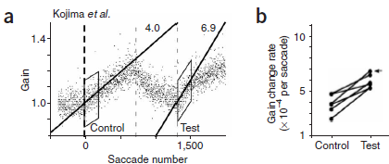
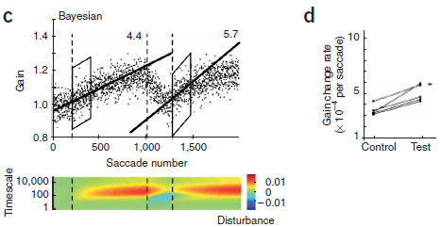
Double Reversal Experiment
Tgt jump: +35% -35% +35%
Slow states positive; fast states negative
Notes:
Phase 1: target jump of +35% [control period]
Adaptation continues until gain reaches ~1.25
Phase 2: target jump of -35%
Adaptation continues until gain returns to 1.0
Phase 3: target jump of +35% again [test period]
Lines fit to data at beginning of phases 1 and 3
Despite apparent washout from phase 2, faster relearning

Slide 19
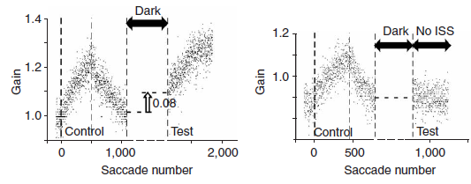
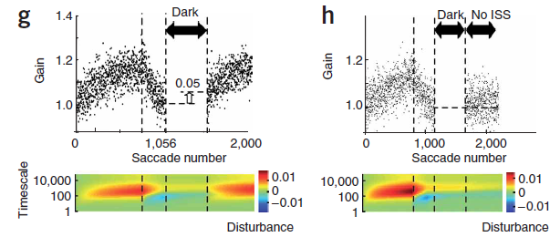
Double Reversal Experiment II
No intrasaccadic
target steps
During dark period, decay of to zero at all at all time scales. Faster decay for faster time scales.
Because slow time scales are positive, net increase in gain
Increased uncertainty -> rapid learning
Notes:
Same sequence of three stages as previous experiment, but period of darkness between 2 and 3.
Monkey shows spontaneous recovery in 3d stage
New condition in which 3d stage had a target jump of +0degrees
Monkey shows no spontaneous recovery
MODEL: at end of darkness period, pos gain for slow states; fast states had decayed.
Due to lack of feedback, all states are highly uncertain
Uncertainty makes learning quicker -> rapid bump up due to locking in pos gain for slow states
This bump up isn’t manifested if there’s no intrasaccadic step (ISS): system quickly locks in on
Gain=1.

Slide 20
Relation To Human Memory
Effect of relearning
Faster to relearn material than initial acquisition
Effect of spacing
Material is better remembered if the time between study sessions is increased

Slide 21
Relevance To AI / Machine Learning
Robotics
Any agent dealing with complex, nonstationary environment needs to adapt continuously
But also needs to remember what had been learned earlier
HCI
If you’re going to design a system that adapts to users, it must have memory of user at multiple time scales

