Slide 1
CSCI 5822
Probabilistic Models of
Human and Machine Learning
Mike Mozer
Department of Computer Science and
Institute of Cognitive Science
University of Colorado at Boulder

Slide 2
Flipping A Biased Coin
Suppose you have a coin with an unknown bias,
θ ≡ P(head).
You flip the coin multiple times and observe the outcome.
From observations, you can infer the bias of the coin

Slide 3
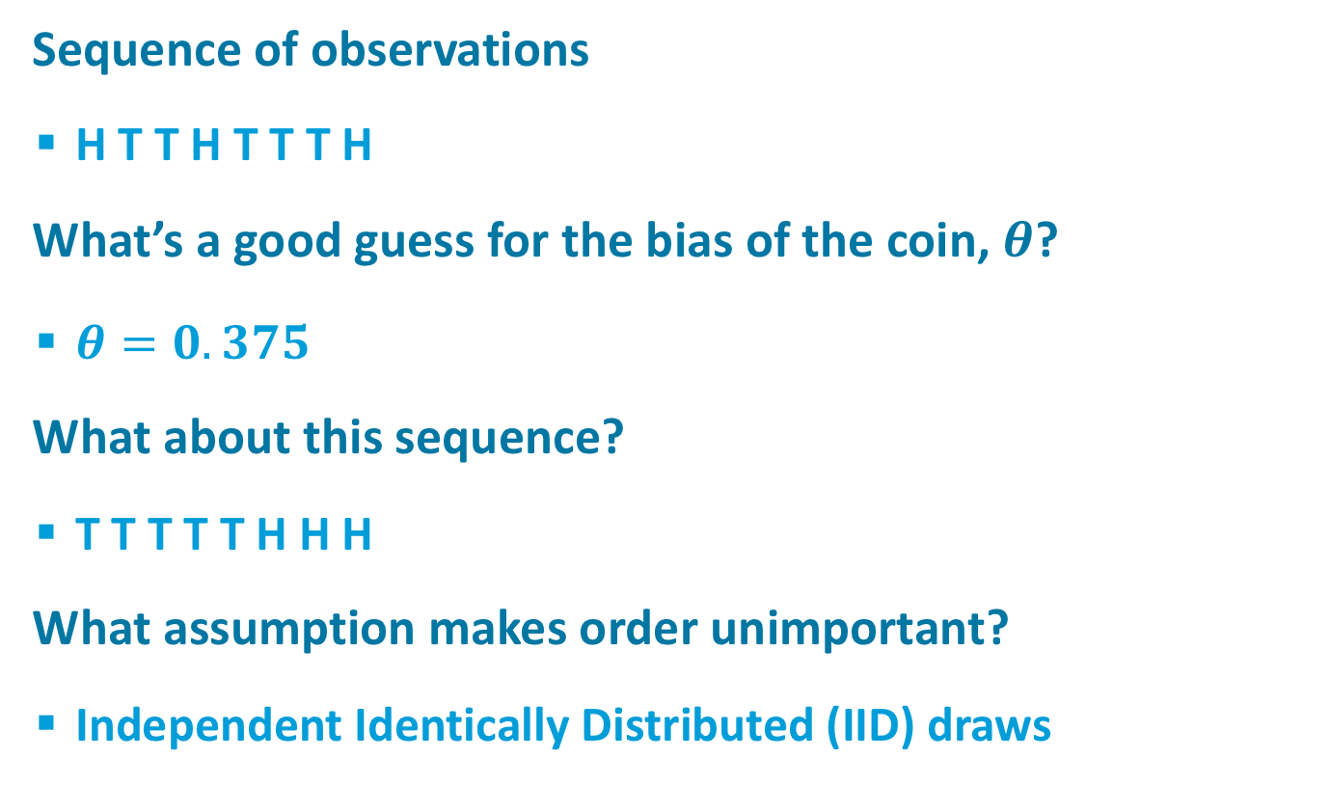
Parameter Estimation
Sequence of observations
  H T T H T T T H
What’s a good guess for the bias of the coin, $θ$?
  $θ=0.375$
What about this sequence?
  T T T T T H H H
What assumption makes order unimportant?
  Independent Identically Distributed (IID) draws
Notes:
Explain Max Likelihood estimate: max_THETA P(OBSERVATION | THETA)

Slide 4
Computing Event Likelihood
Independent events ->
Related to binomial distribution
N_{H} and N_{T} are sufficient statistics
Notes:
Binomial: Prob of getting Nh heads out of Nh+Nt flips – combines over orderings; here it’s a specific sequence
Max likelihood solution: use log likelihood and take derivative

Slide 5
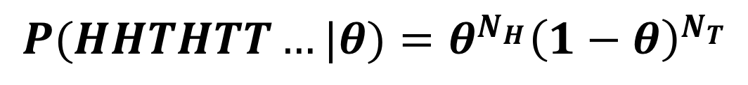
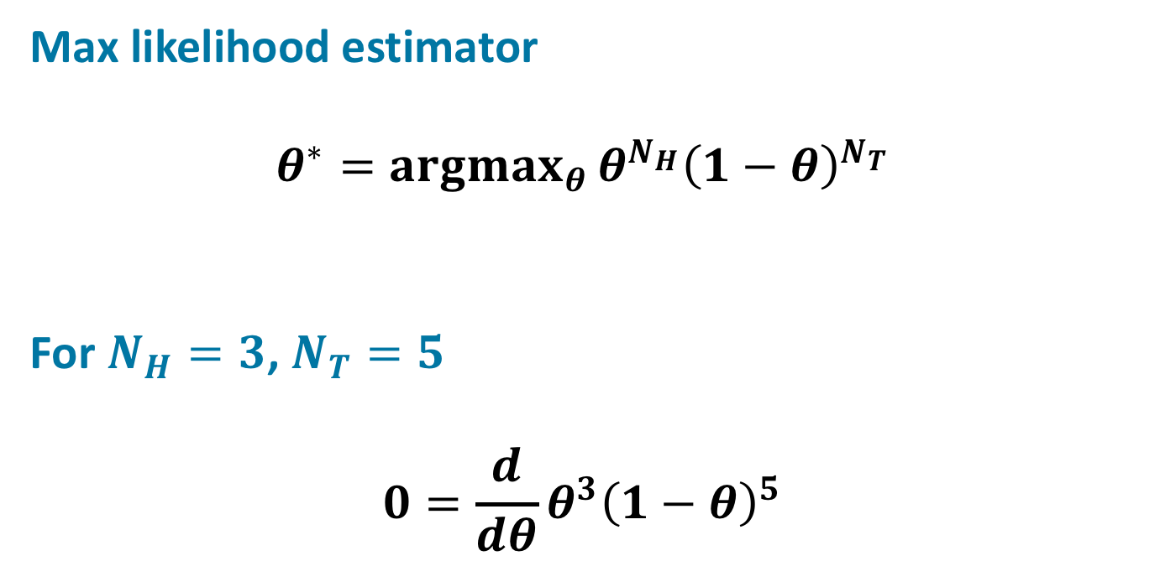
Maximum Likelihood Estimation
$$P(HHTHTT…|θ)=θ^{N_{H}}{\left(1−θ\right)}^{N_{T}}$$
Max likelihood estimator
$$θ^{∗}={argmax}_{θ }θ^{N_{H}}{\left(1−θ\right)}^{N_{T}}$$
For $N_{H}=3$, $N_{T}=5$
$$0=\frac{d}{dθ}θ^{3}{\left(1−θ\right)}^{5}$$
Notes:
Binomial: Prob of getting Nh heads out of Nh+Nt flips – combines over orderings; here it’s a specific sequence
Max likelihood solution: use log likelihood and take derivative 3THETA^2

Slide 6



Bayesian Hypothesis Evaluation:
Two Alternatives
  Two hypotheses
    h₀: θ=.5
    h₁: θ=.9
  Role of priors diminishes as number of flips increases
  Note weirdness that each hypothesis has an associated probability, and each hypothesis specifies a probability
    probabilities of probabilities! or degree of belief in coin bias
  Setting prior to zero -> narrowing hypothesis space
hypothesis, not head!
Notes:
Whether we observe a particular sequence or just a count of #H and #T, same posterior because the combinatorial factor drops out

Slide 7
Bayesian Hypothesis Evaluation:
Many Alternatives
  11 hypotheses
    h₀: θ=0.0
    h₁: θ=0.1
    …
    h₁₀: θ=1.0
  Uniform priors
    P(h_{i}) = 1/11

Slide 9
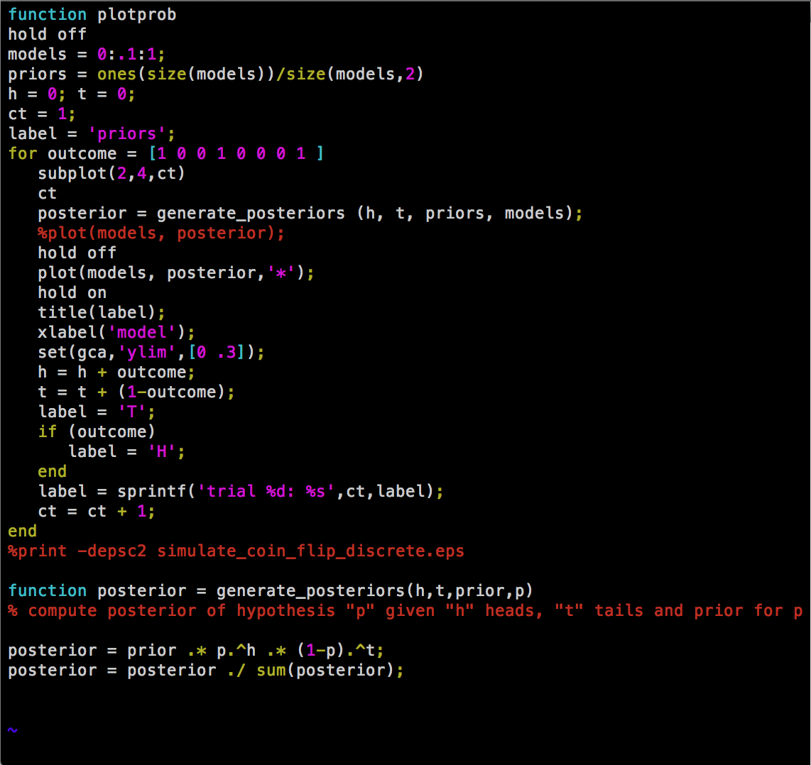
MATLAB Code

Slide 10




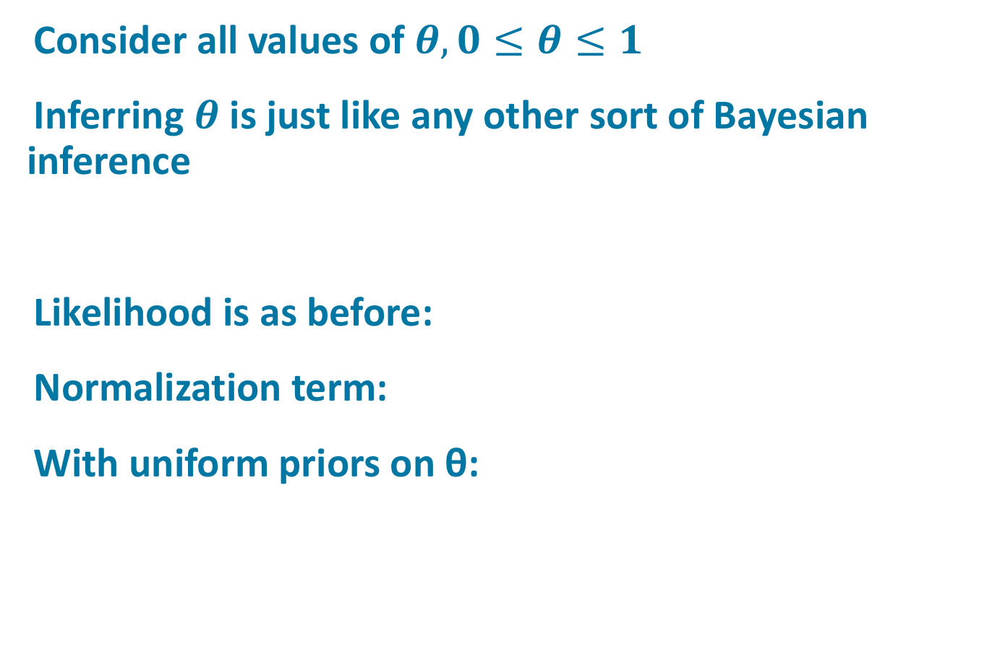
Infinite Hypothesis Spaces
Consider all values of $θ, 0≤θ≤1$
Inferring $θ$ is just like any other sort of Bayesian inference
Likelihood is as before:
Normalization term:
With uniform priors on θ:

Slide 12

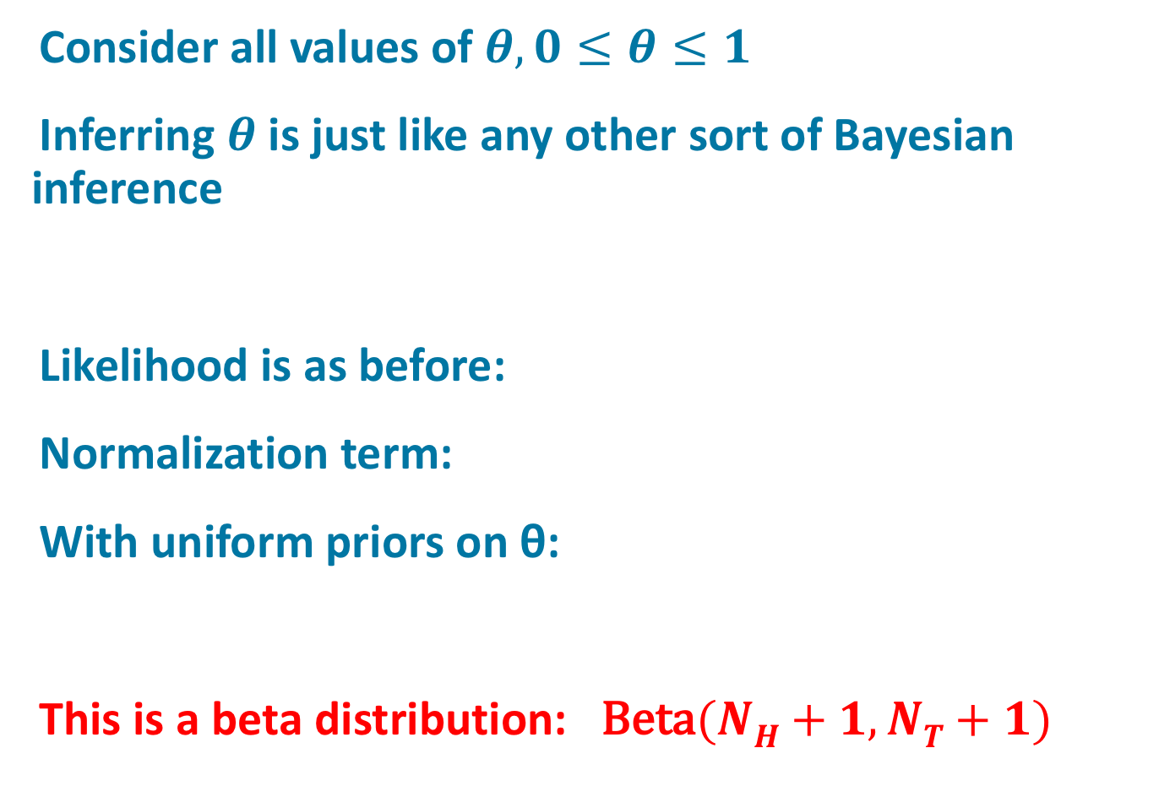
Infinite Hypothesis Spaces
Consider all values of $θ, 0≤θ≤1$
Inferring $θ$ is just like any other sort of Bayesian inference
Likelihood is as before:
Normalization term:
With uniform priors on θ:
This is a beta distribution: $\text{Beta}(NH+1, NT+1)$
Notes:
SAME AS EARLIER SLIDE. NEW: RED TEXT AT BOTTOM OF SLIDE

Slide 13
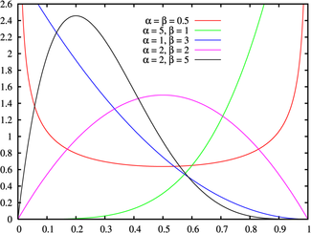
Beta Distribution
x
Notes:
Gamma function: generalization of factorial

Slide 15
Incorporating Priors
Suppose we have a Beta prior
Can compute posterior analytically
Posterior is also
Beta distributed

Slide 18
Imaginary Counts
V_{H} and V_{T} can be thought of as the outcome of coin flipping experiments either in one’s imagination or in past experience
Equivalent sample size = V_{H} + V_{T}
The larger the equivalent sample size, the more confident we are about our prior beliefs…
And the more evidence we need to overcome priors.

Slide 19
Regularization
Suppose we flip coin once and get a tail, i.e.,
N_{T} = 1, N_{H} = 0
What is maximum likelihood estimate of θ?
What if we toss in imaginary counts, V_{H} = V_{T} = 1?
    i.e., effective N_{T} = 2, N_{H} = 1
What if we toss in imaginary counts, V_{H} = V_{T} = 2?
    i.e., effective N_{T} = 3, N_{H} = 2
Imaginary counts smooth estimates to
avoid bias by small data sets
Issue in text processing
  Some words don’t appear in train
  corpus
Notes:
Note that for V>=1, ML estimate here is the same as the MAP estimate with V as prior counts

Slide 20
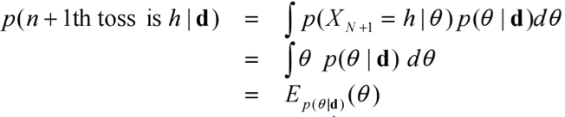
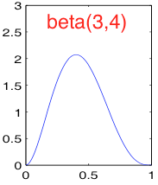
Prediction Using Posterior
Given some sequence of n coin flips (e.g., HTTHH), what’s the probability of heads on the next flip?
expectation of a beta
distribution

Slide 21
Summary So Far
Beta prior on θ
Bernoulli likelihood for
observations
Beta posterior on θ
Conjugate priors
    The Beta distribution is the conjugate prior of a binomial or Bernoulli distribution

Slide 22
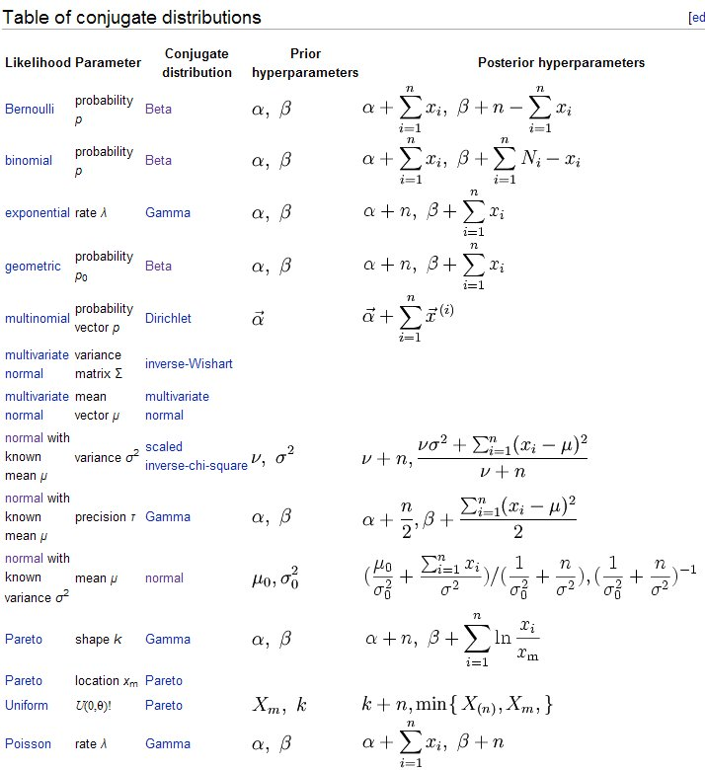
Notes:
Notable: Gaussian prior, Gaussian likelihood, Gaussian posterior – appeared in Weiss model

Slide 23
Conjugate Mixtures
If a distribution Q is a conjugate prior for likelihood R, then so is a distribution that is a mixture of Q’s.
E.g., mixture of Betas
After observing 20 heads and 10 tails:
Example from Murphy (Fig 5.10)
Notes:
Note change in mixture weights

Slide 24
Dirichlet-Multinomial Model
We’ve been talking about the Beta-Binomial model
  Observations are binary, 1-of-2 possibilities
What if observations are 1-of-K possibilities?
  K sided dice
  K English words
  K nationalities

Slide 25
Multinomial RV
Variable X with values x₁, x₂, … x_{K}
Likelihood, given N_{k} observations of x_{k}:
Analogous to binomial draw
θ specifies a probability mass function (pmf)

Slide 26
Dirichlet Distribution
The conjugate prior of a multinomial likelihood
… for θ in K-dimensional probability simplex,
0 otherwise
Dirichlet is a distribution over probability mass functions (pmfs)
Compare {α_{k}} to
V_{H} and V_{T}
From Frigyik, Kapila, & Gupta (2010)

Slide 27
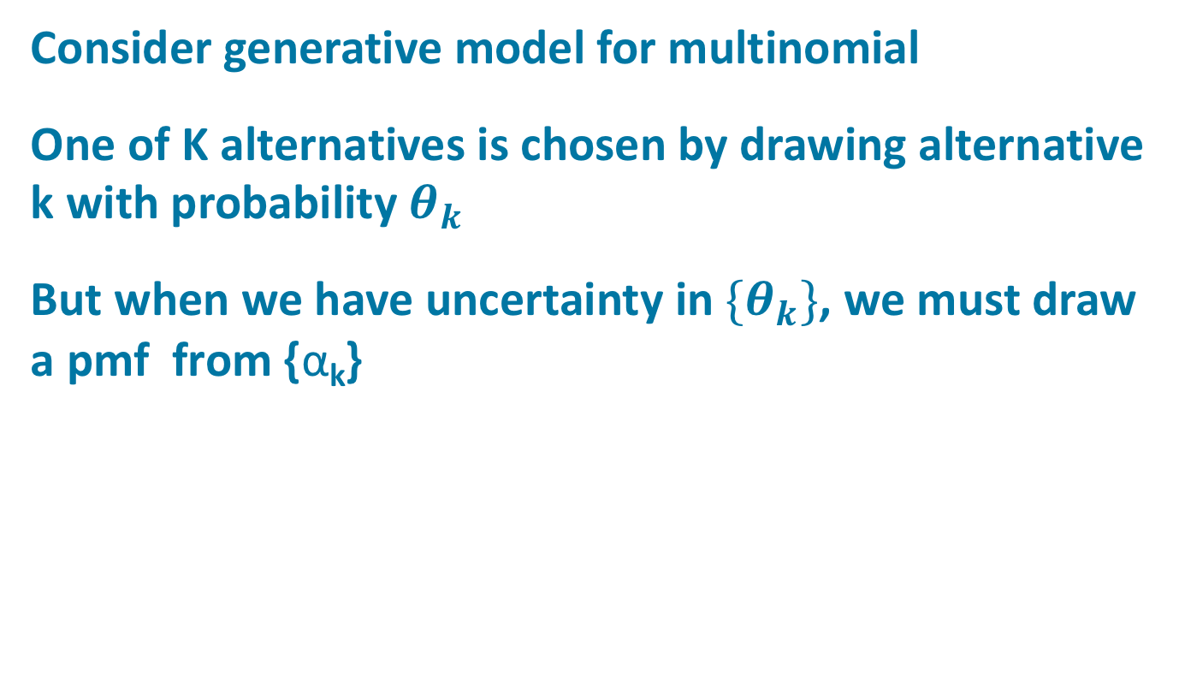
Hierarchical Bayes
Consider generative model for multinomial
One of K alternatives is chosen by drawing alternative k with probability${ θ}_{k}$
But when we have uncertainty in${ \{θ}_{k}\}$, we must draw a pmf from {α_{k}}
Hyperparameters
Parameters of
multinomial

Slide 28
Hierarchical Bayes
Whenever you have a parameter you don’t know, instead of arbitrarily picking a value for that parameter, pick a distribution.
Weaker assumption than selecting parameter value.
Requires hyperparameters (hyper^{n}parameters), but results are typically less sensitive to hyper^{n}parameters than hyper^{n-1}parameters

Slide 29
Example Of Hierarchical Bayes:
Modeling Student Performance
Collect data from S students on performance on N test items.
There is variability from student-to-student and from item-to-item
item distribution
student distribution

Slide 30
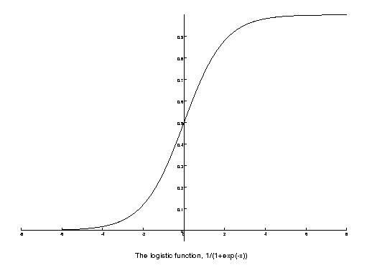
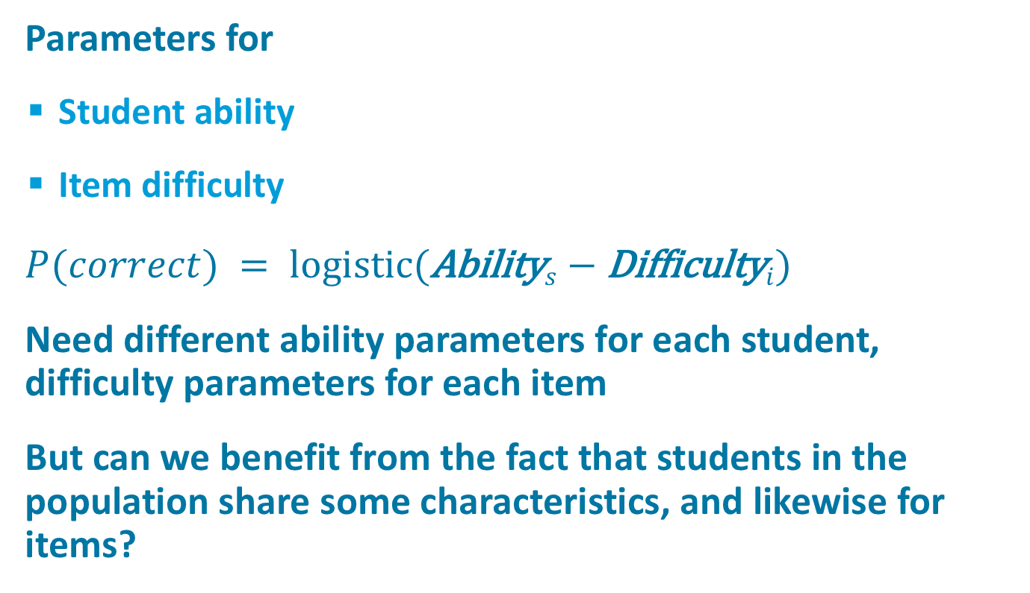
Item-Response Theory
Parameters for
  Student ability
  Item difficulty
$P(correct) = logistic(\text{Ability}s−\text{Difficulty}i)$
Need different ability parameters for each student, difficulty parameters for each item
But can we benefit from the fact that students in the population share some characteristics, and likewise for items?

