Slide 1
CSCI 5922
Neural Networks and Deep Learning:
Practical Advice I
Mike Mozer
Department of Computer Science and
Institute of Cognitive Science
University of Colorado at Boulder

Slide 2
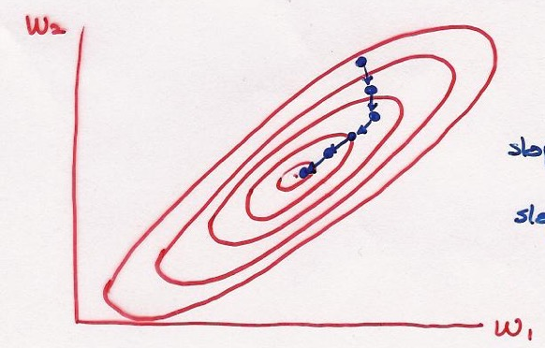
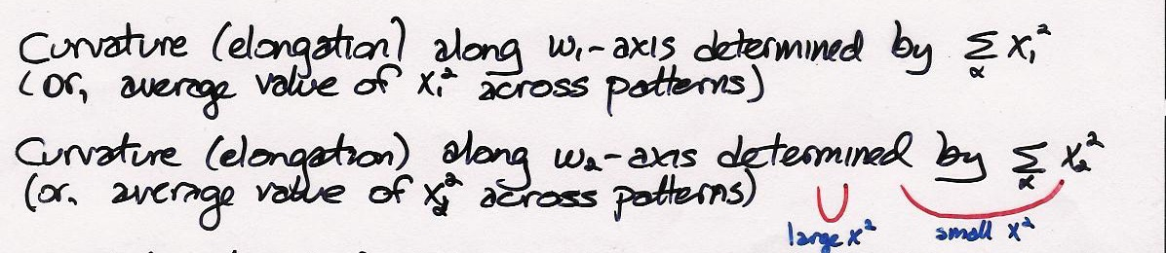
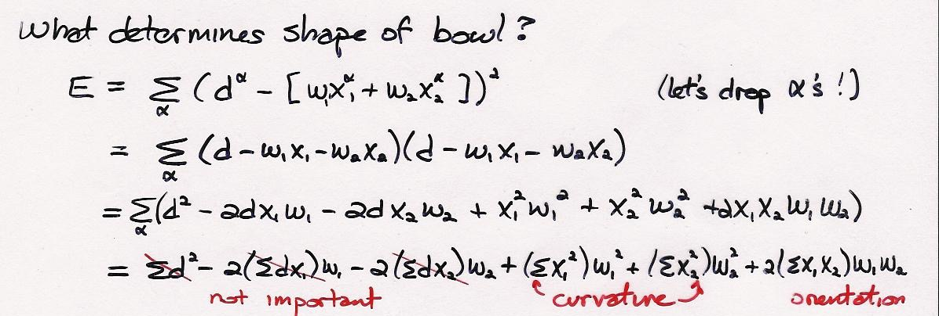

Input Normalization
Reminder from past lecture
True whether $w_{1}$ and $w_{2}$are in same or different layers
  We want activations of two units in the input layer to have the same range
  We want activations of units in different layers to have the same range

Slide 3
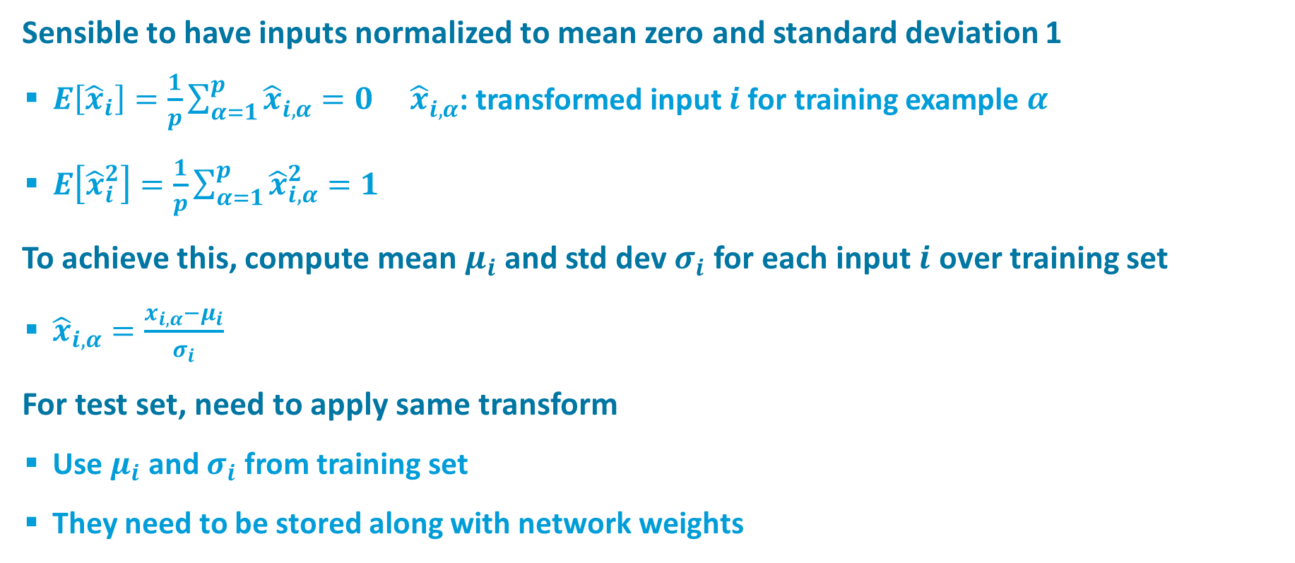
Input Normalization
Sensible to have inputs normalized to mean zero and standard deviation 1
  $E\left[{\hat{x}}_{i}\right]=\frac{1}{p}\sum_{α=1}^{p}{{\hat{x}}_{i,α}^{}=0}$ ${\hat{x}}_{i,α}^{}$: transformed input $i$ for training example $α$
  $E\left[{\hat{x}}_{i}^{2}\right]=\frac{1}{p}\sum_{α=1}^{p}{{\hat{x}}_{i,α}^{2}=1}$
To achieve this, compute mean $μ_{i}$and std dev $σ_{i}$ for each input $i$ over training set
  ${\hat{x}}_{i,α}=\frac{x_{i,α}−μ_{i}}{σ_{i}}$
For test set, need to apply same transform
  Use $μ_{i}$ and $σ_{i}$ from training set
  They need to be stored along with network weights

Slide 4
Weight Initialization
(For great detail, see section 8.4 of text)
If initial weights are too large
  network has committed to a solution
If initial weights are too small
  network has difficulty breaking symmetry
Initial weights should be positive and negative to avoid saturation of activity
Notes:
PERMUTING AND INDEXING

Slide 5
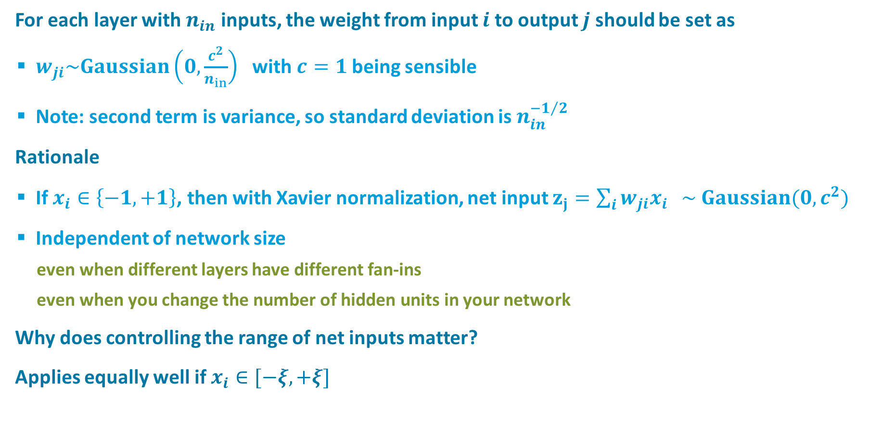
Xavier Normalization
For each layer with $n_{in}$ inputs, the weight from input $i$ to output $j$ should be set as
  $w_{ji}\sim Gaussian\left(0,\frac{c^{2}}{n_{in}}\right)$ with $c=1$being sensible
  Note: second term is variance, so standard deviation is $n_{in}^{−1/2}$
Rationale
  If $x_{i}∈\left\{−1,+1\right\}$, then with Xavier normalization, net input $z_{j}=\sum_{i}{w_{ji}x_{i} } \sim Gaussian(0,c^{2})$
  Independent of network size
    even when different layers have different fan-ins
    even when you change the number of hidden units in your network
Why does controlling the range of net inputs matter?
Applies equally well if $x_{i}∈[−ξ,+ξ]$

Slide 6
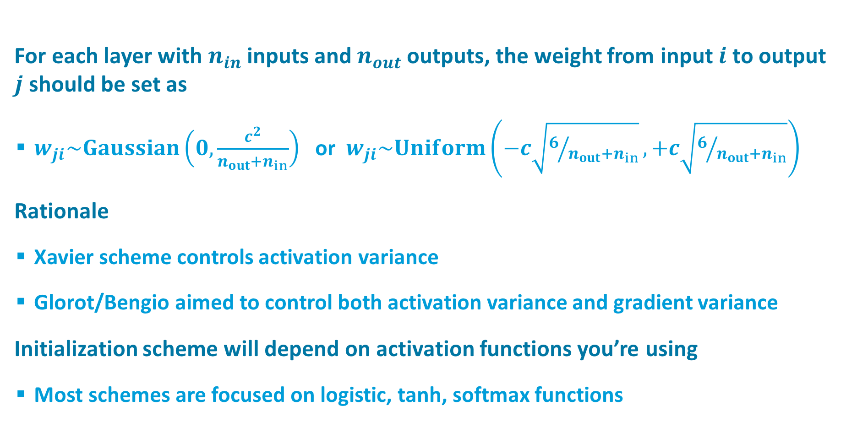
Glorot/Bengio Normalization
For each layer with $n_{in}$ inputs and $n_{out}$outputs, the weight from input $i$ to output $j$ should be set as
  $w_{ji}\sim Gaussian\left(0,\frac{c^{2}}{{n_{out}+n}_{in}}\right)$ or $w_{ji}\sim Uniform\left(−c\sqrt{6/{{n_{out}+n}_{in}}},+c\sqrt{6/{{n_{out}+n}_{in}}}\right)$
Rationale
  Xavier scheme controls activation variance
  Glorot/Bengio aimed to control both activation variance and gradient variance
Initialization scheme will depend on activation functions you’re using
  Most schemes are focused on logistic, tanh, softmax functions

Slide 7
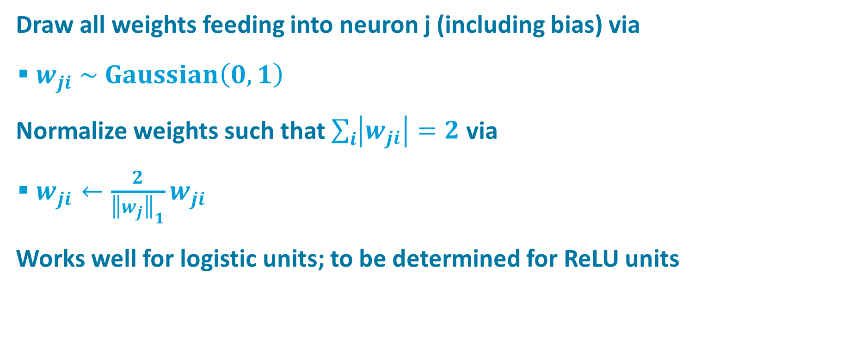
My Weight Initialization
Draw all weights feeding into neuron j (including bias) via
  $w_{ji} \sim Gaussian\left(0,1\right)$
Normalize weights such that $\sum_{i}{\left|w_{ji}\right|}=2$ via
  $w_{ji}←\frac{2}{{\left\|w_{j}\right\|}_{1}}w_{ji}$
Works well for logistic units; to be determined for ReLU units

Slide 8
When To Stop Training
1. Train n epochs; lower learning rate; train m epochs
  bad idea: can’t assume one-size-fits-all approach
2. Error-change criterion
  stop when error isn’t dropping ‘significantly’
  bad idea: often plateaus in error even when weights are changing a lot
  compromise: criterion based on % drop over a window of, say, 10 epochs
    1 epoch is too noisy
    absolute error criterion is too problem dependent
Notes:
NOTE: these belong in practical_advice.pptx. Move after 2015.

Slide 9
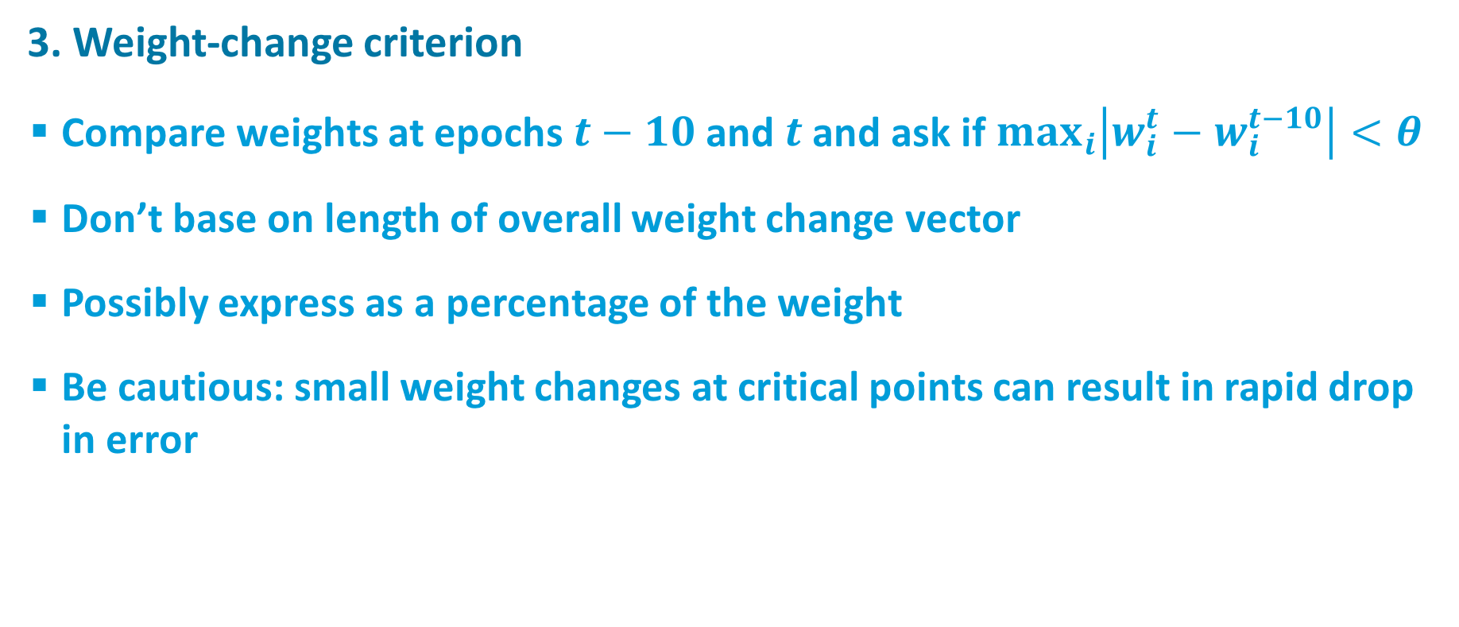
When To Stop Training
3. Weight-change criterion
  Compare weights at epochs $t−10$and $t$and ask if $max_{i}\left|w_{i}^{t}−w_{i}^{t−10}\right|<θ$
  Don’t base on length of overall weight change vector
  Possibly express as a percentage of the weight
  Be cautious: small weight changes at critical points can result in rapid drop in error

Slide 10
When To Stop Training
4. Early stopping with a validation set
  Intuition
    Hidden units all try to grab the biggest sources of error
    As training proceeds, they start to differentiate from one another
    Effective number of free parameters (model complexity) increases with training
Validation Set
Training Set
Training Epoch

Slide 11
Setting Learning Rates I
Initial guess for learning rate
  If error doesn’t drop consistently, lower initial learning rate and try again
  If error falls reliably but slowly, increase learning rate.
Toward end of training
  Error will often jitter, at which point you can lower the learning rate down to 0 gradually to clean up weights
Remember, plateaus in error often look like minima
  be patient
  have some idea a priori how well you expect your network to be doing, and print statistics during training that tell you how well it’s doing
  plot epochwise error as a function of epoch, even if you’re doing minibatches

Slide 12
Setting Learning Rates II
Momentum
Adaptive and neuron-specific learning rates
  Observe error on epoch t-1 and epoch t
  If decreasing, then increase global learning rate, ε_{global}, by an additive constant
  If increasing, decrease global learning rate by a multiplicative constant
  If fan-in of neuron j is f_{j}, then
Notes:
do quick simulation to show logic of 1/sqrt(f)
multiplicative constant = .5 if batch, .9 if online (to allow for jitter)
additive constant = 10% of initial step size when learning rate is set (but keep it as this constant)

Slide 13
Setting Learning Rates III
Mike’s hack
Initialization
    epsilon = .01
    inc = epsilon / 10
    if (batch_mode_training)
    scale = .5
    else
    scale = .9
Update
    if (current_epoch_error < previous_epoch_error)
    epsilon = epsilon + inc
    saved_weights = weights
    else
    epsilon = epsilon * scale
    inc = epsilon / 10
    if (batch_mode_training)
    weights = saved_weights

Slide 14
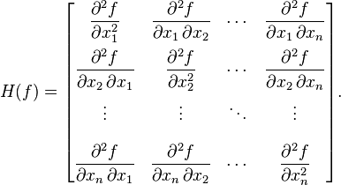
Setting Learning Rates IV
RMSprop
  see text
ADAM
  see text
Second-order methods
  Take a numerical optimization course
  Requires computation of Hessian

Slide 15
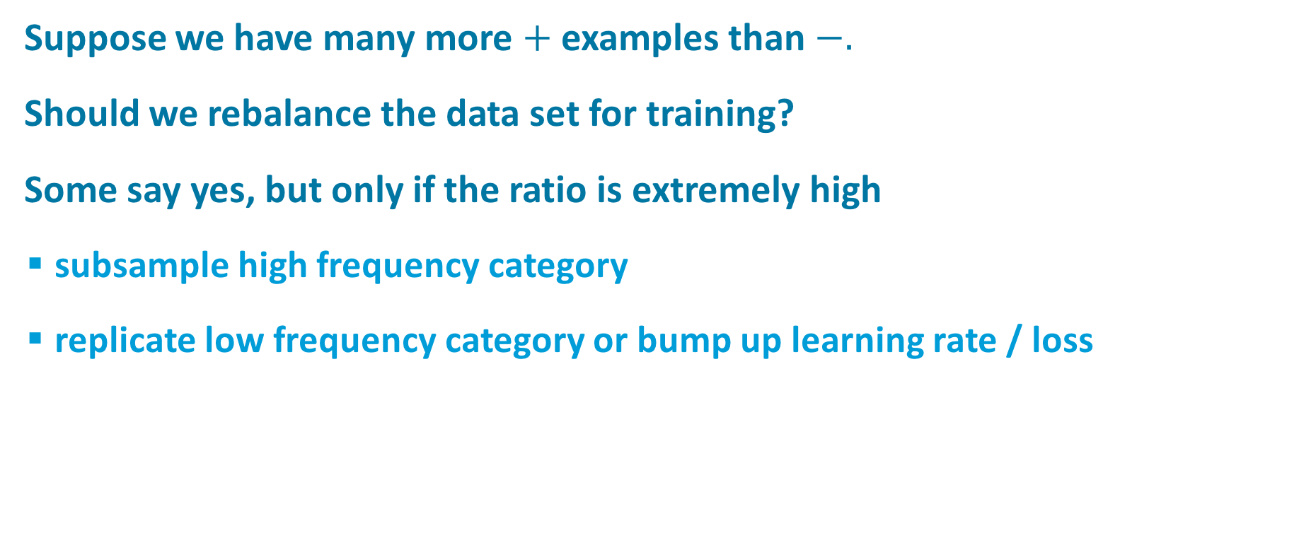
Unbalanced Data Sets
Suppose we have many more $+$ examples than $−.$
Should we rebalance the data set for training?
Some say yes, but only if the ratio is extremely high
  subsample high frequency category
  replicate low frequency category or bump up learning rate / loss
FIX THIS

