Slide 1
CSCI 5922 Neural Networks and Deep Learning: Learning 1
Mike Mozer
Department of Computer Science and Institute of Cognitive Science University of Colorado at Boulder
Notes:
position
audience

Slide 2
Notation
Standard Mike’s handprinted slides
vector: $x y$ X, Y
vector element: $x_{i} { y}_{j}$ x_{i}, y_{j}
matrix: $W$ W
matrix row: $W_{i}$ W_{i}
matrix element: $w_{ij}$ w_{ij}

Slide 3
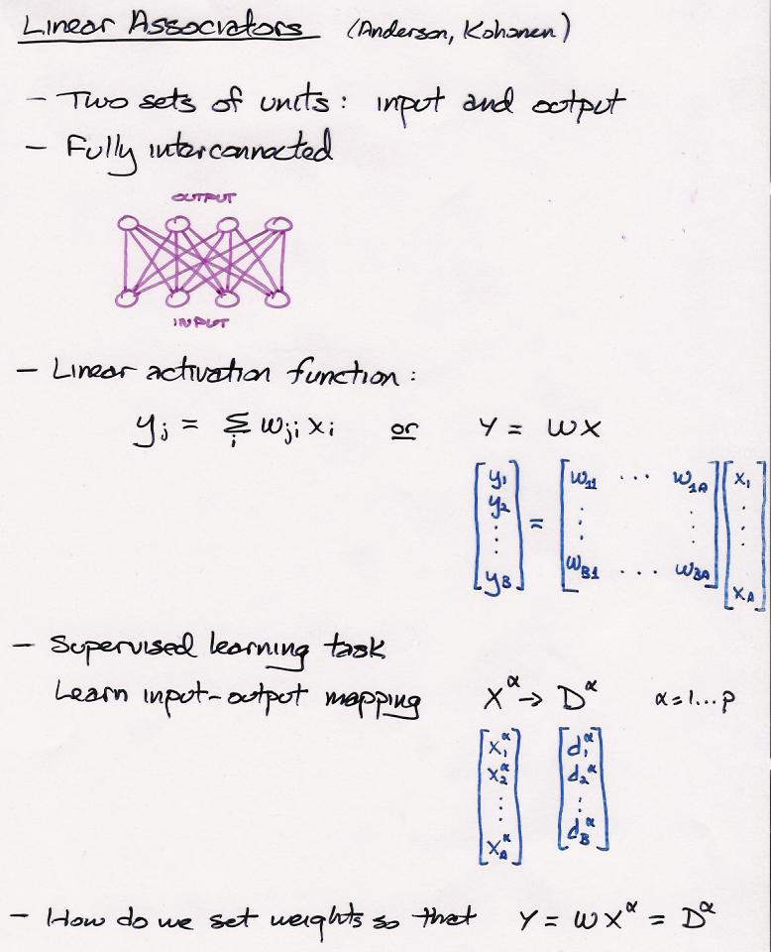

Slide 4
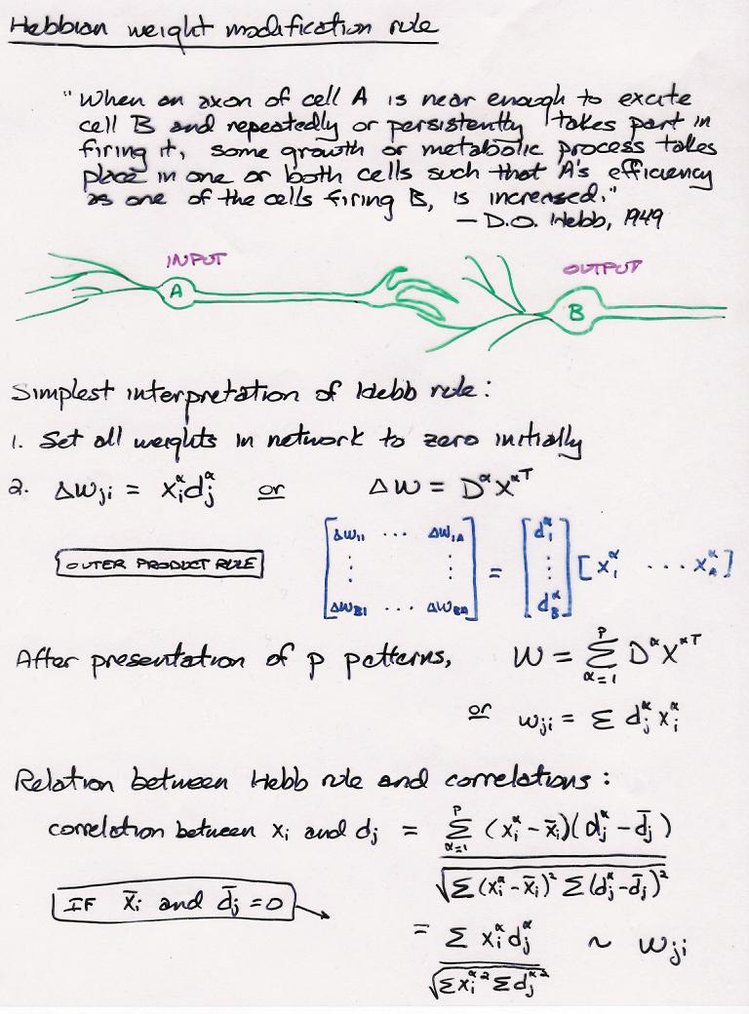
Notes:
Hebb, Organization of Behavior: A Neuropsychological Theory 1949

Slide 5
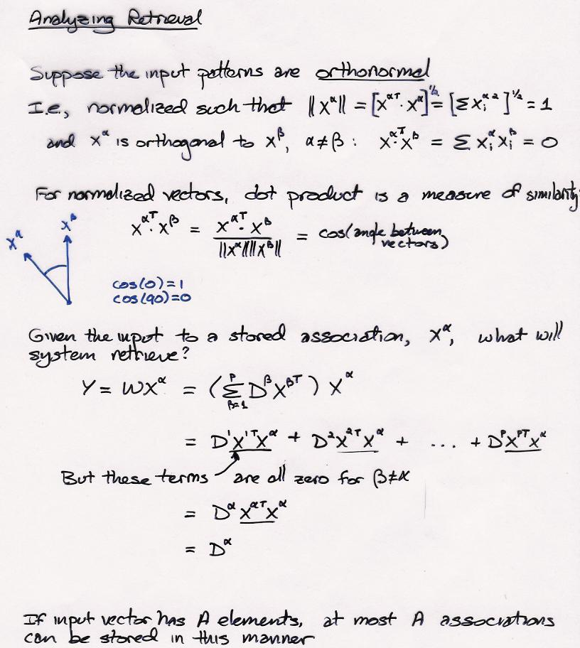
Notes:
Q: HOW MANY ASSOCIATIONS CAN BE STORED?

Slide 6
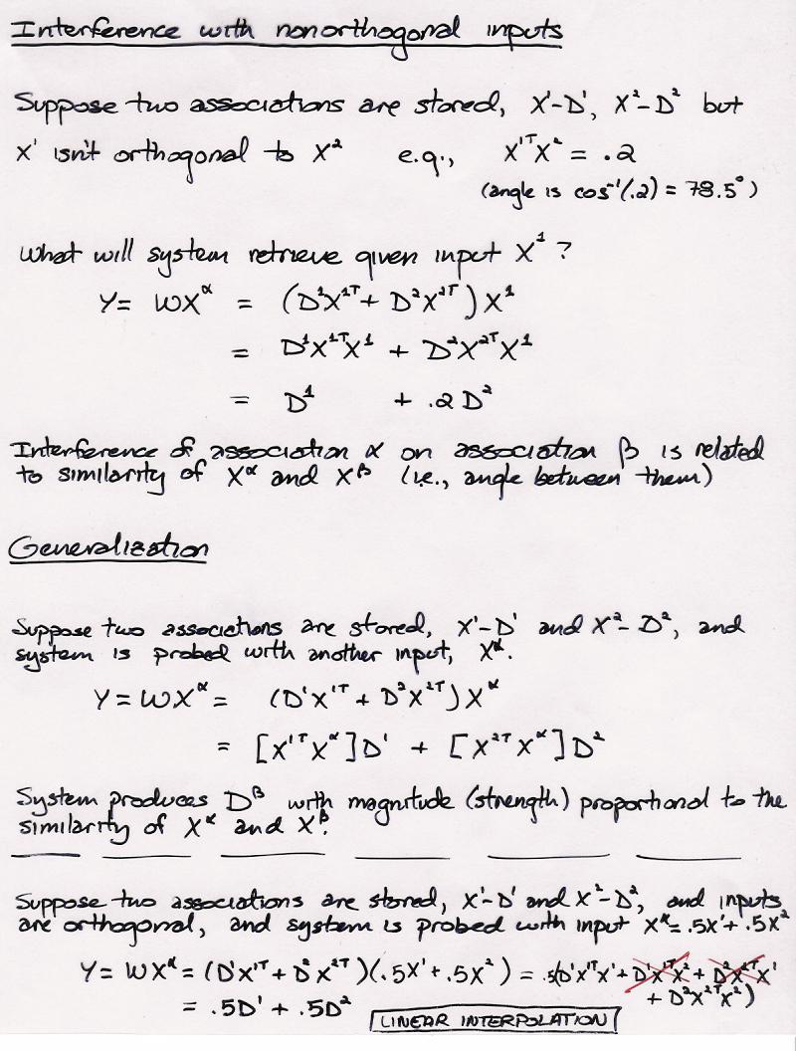

Slide 7
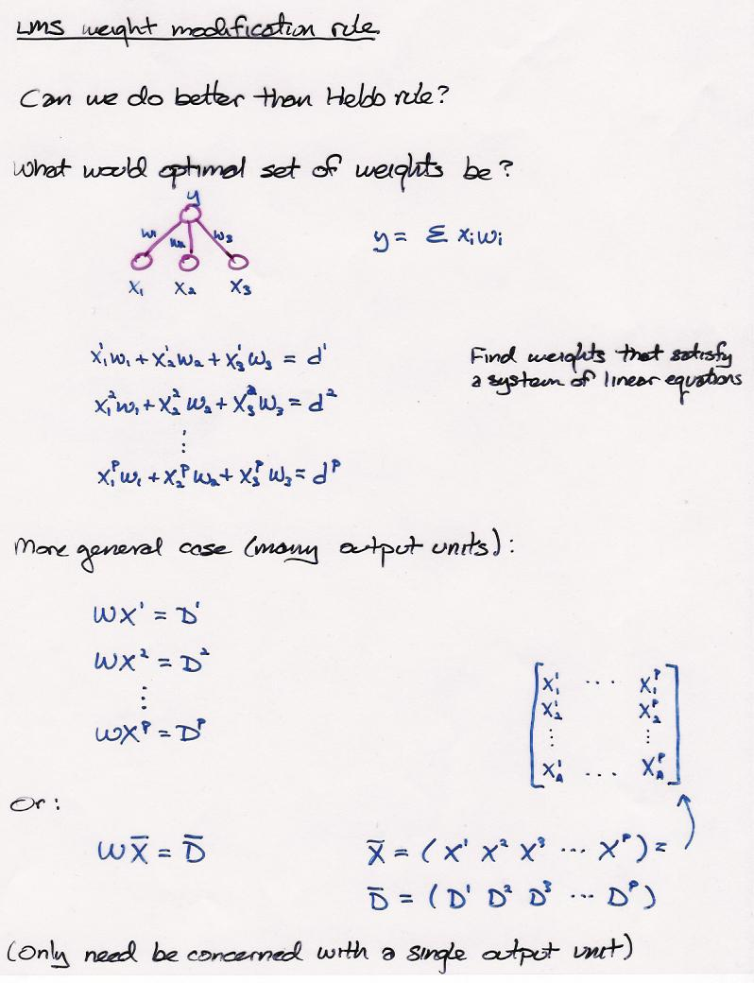

Slide 8
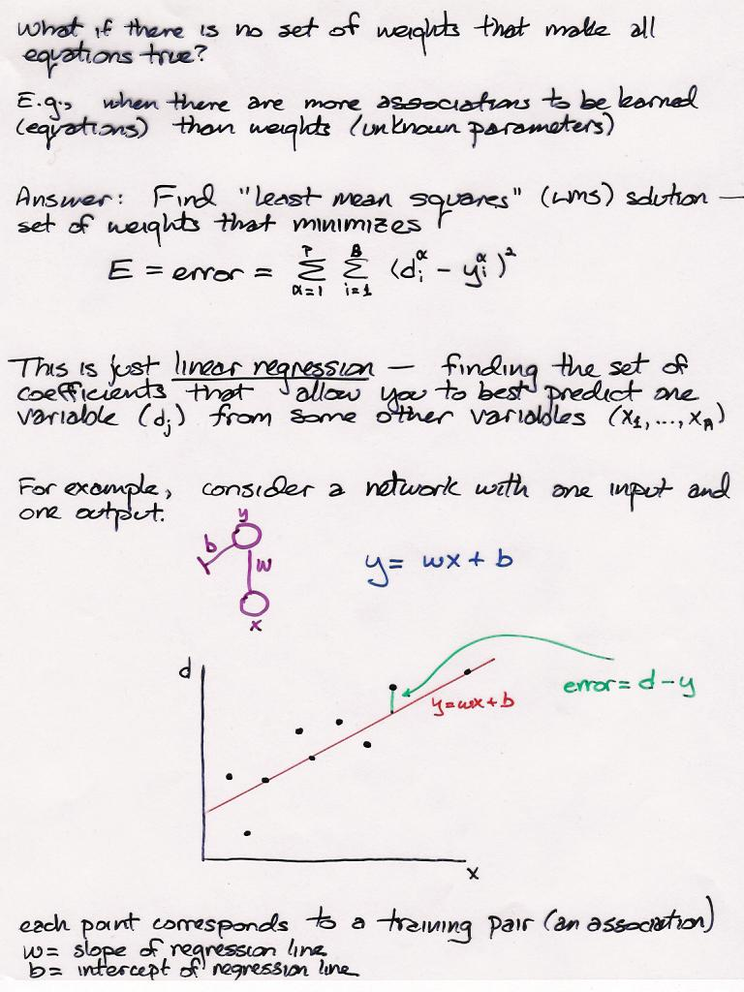

Slide 9
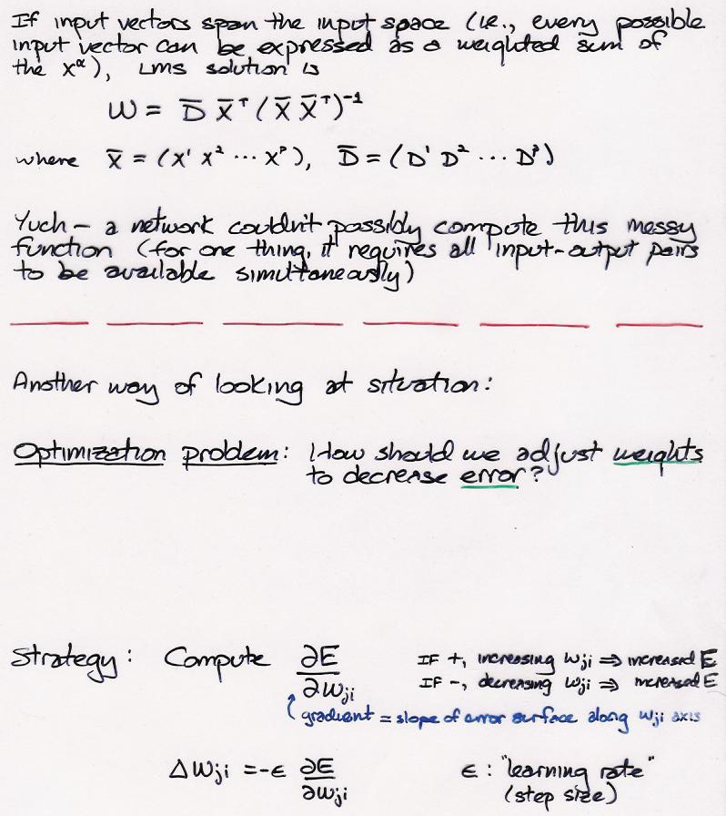
Notes:
moore-penrose pseudoinverse

Slide 11
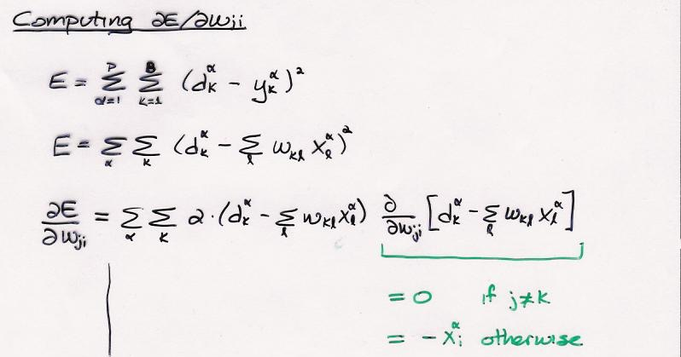

Slide 12
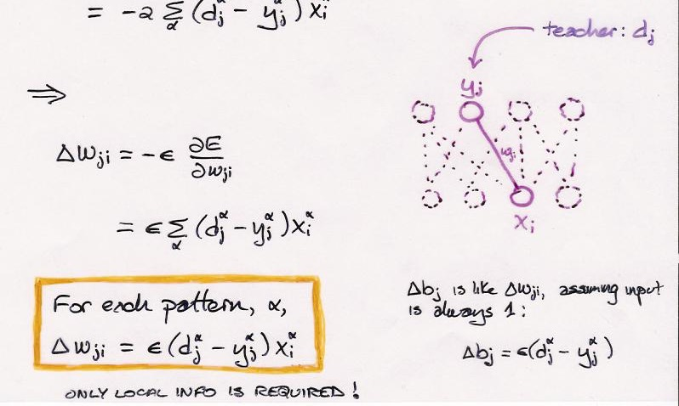

Slide 13
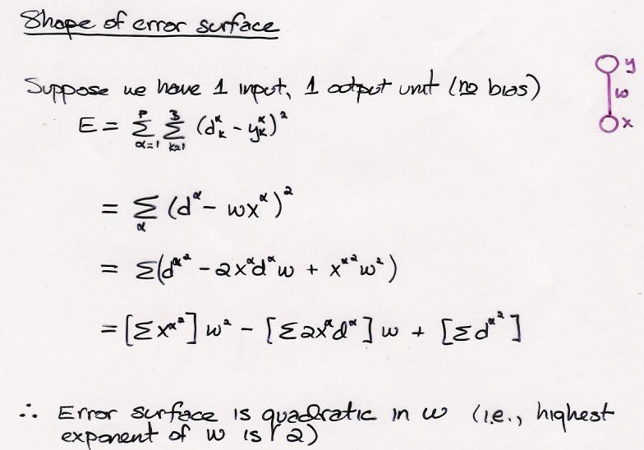

Slide 15
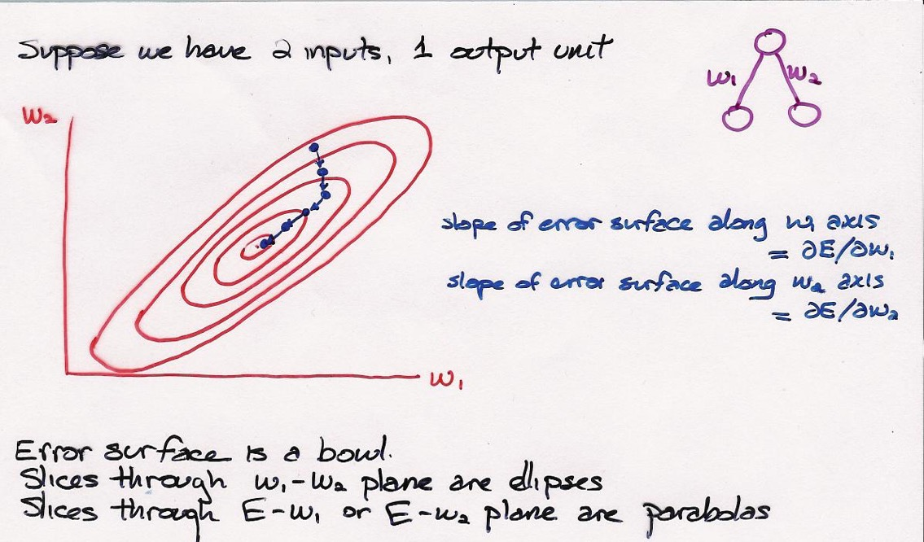
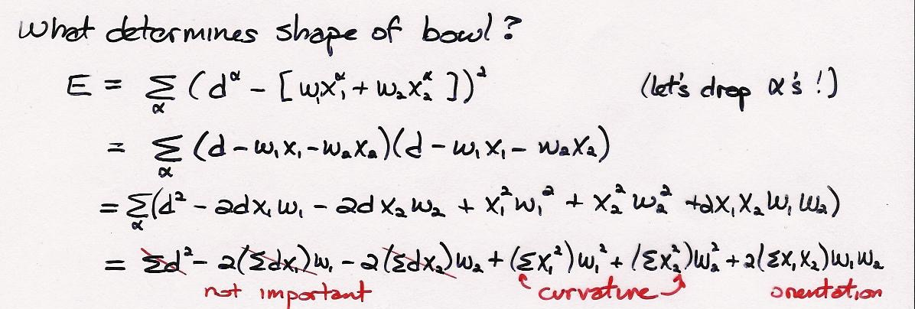

Slide 16
