Slide 1
CSCI 5922
Neural Networks and Deep Learning:
Deep Reinforcement Learning
Mike Mozer
Department of Computer Science and
Institute of Cognitive Science
University of Colorado at Boulder
Some slides adapted from L. Matthey (Gatsby Computational Neuroscience Unit)
and from Russell & Norvig (AI: A Modern Approach)

Slide 2
Areas Of Research In Machine Learning
Supervised learning
  Learning with a teacher
  Requires target (desired) response/output
  Most research in deep learning
Unsupervised learning
  Learning without a teacher by observing environment
  and discovering regularities
  E.g., autoencoders
Reinforcement learning
  Learning from punishment/reward
  Requires exploration of the environment

Slide 3

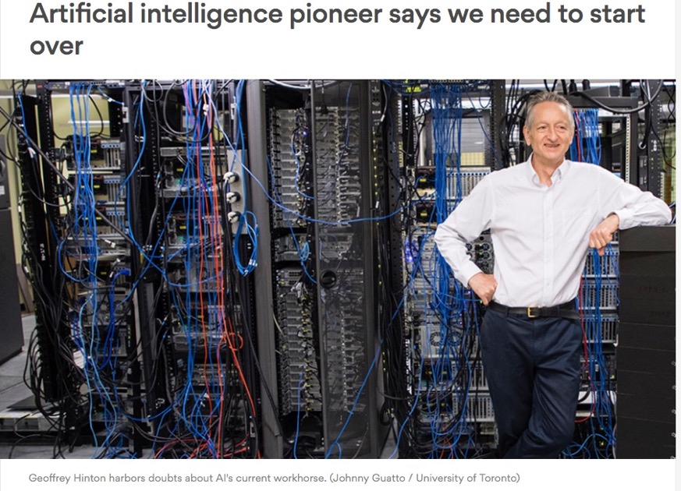
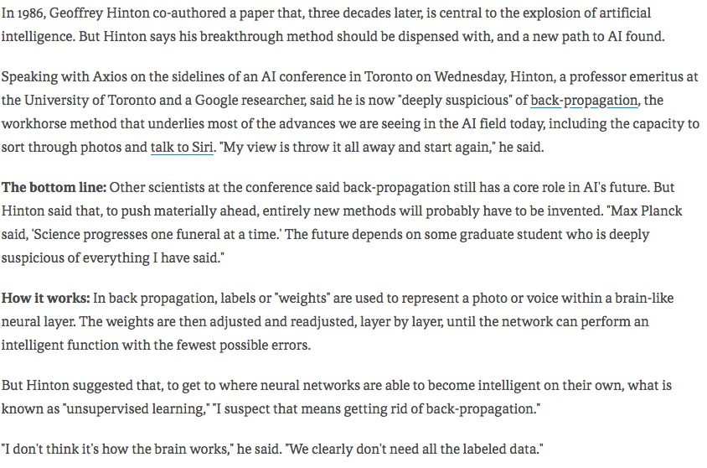
September 2017

Slide 4
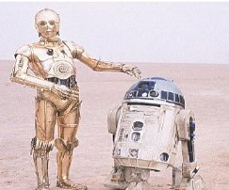
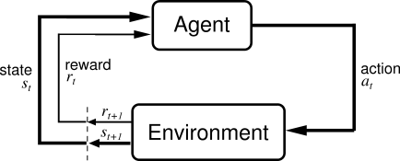
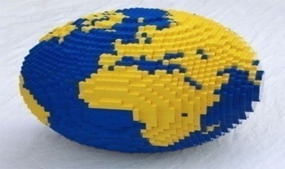
Reinforcement Learning Paradigm
Learner is active, interacting with environment
At each time step t, the agent is in some state state (s_{t}), takes action (a_{t}).
As a result, the world changes state (s_{t+1}) and a reward is delivered (r_{t+1})

Slide 5


Formally Known As A Markov Decision Process
Current state tells you everything you
need to know to act
    World: You are in state 7. You can choose actions A, B, C
    Agent: I choose action A
    World: You are now in state 47; you receive a reward of +7.
    You can choose actions A, B, D
    Agent: I choose action D
    World: You are now in state 19; you receive a reward of -4.
    You can choose actions A, C, D
    Agent: I choose action C
    World: You are now in state 7; you receive a reward of 0. …

Slide 6

The Environment
Characterizing environment requires
  Reward function
    r_{t} = ρ(s_{t}) or r_{t} = ρ(s_{t}, a_{t})
  Transition function
    s_{t+1} = δ(s_{t}, a_{t})
Environment can be nondeterministic
    Pr(r_{t} | s_{t}) or Pr(r_{t} | s_{t}, a_{t})
    Pr(s_{t+1} | s_{t}, a_{t})
Note Markov property

Slide 7
The Agent
Acts according to a policy
    a_{t} = π(s_{t})
    Or the nondeterministic version, Pr(a_{t} | s_{t})
For every Markov decision problem, there is (at least) one deterministic optimal policy.
  At every state, the action chosen by the optimal policy is at least as good as any other policy
on expectation
… if environment is nondeterministic

Slide 8
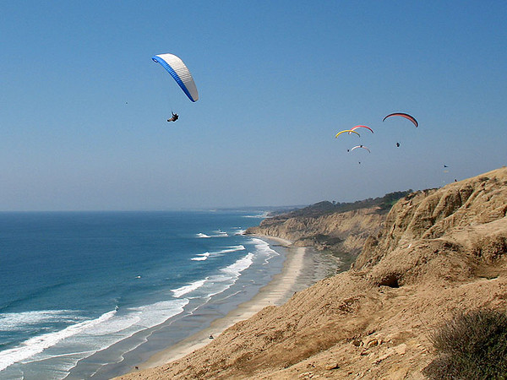
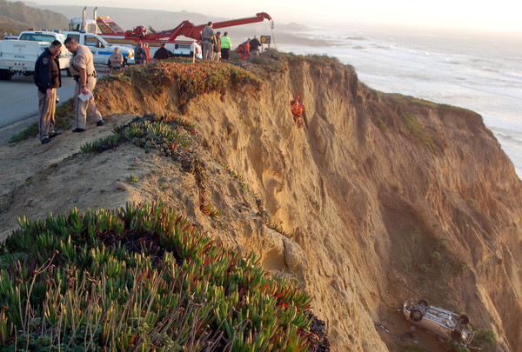
Assessing Reward
Actions may have immediate rewards but delayed costs
… and vice versa
Notes:
When you visit san diego, you can go to Torrey Pines Hang glider port.
The closer you drive to the cliff the better a view you get of the hang gliders
[ADVANCE]
Other examples of this?
You’re in class today vs. sleeping
You’re deciding whether to go to starbucks today vs. put $ in retirement

Slide 9
Assessing Reward
Immediate reward
Finite horizon reward
  Easy to compute
Average reward
  Lousy measure because it doesn’t
  distinguish between small reward
  now and large reward in the future
Hyperbolic discounted reward
  What people appear to do
Exponentially discounted reward
  Easier for theorem proving

Slide 10
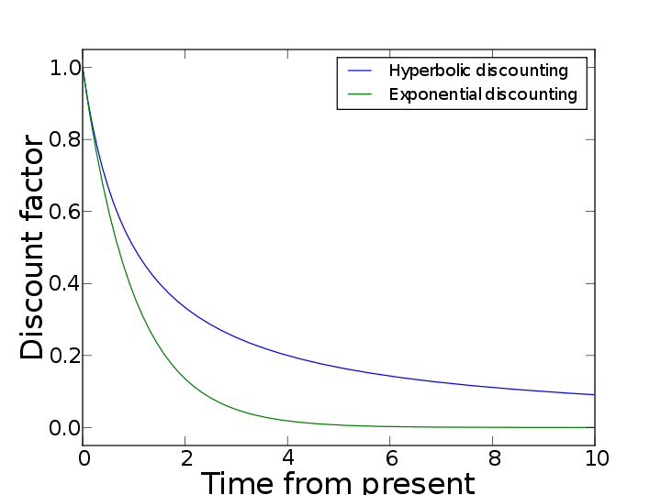
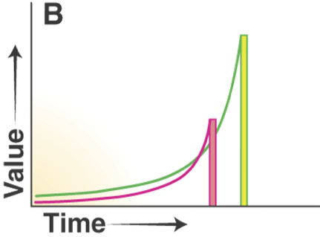
Comparing Two Forms Of Infinite Discounting
present value
of two future
rewards
Notes:
lower graph: present value of two future rewards

Slide 11
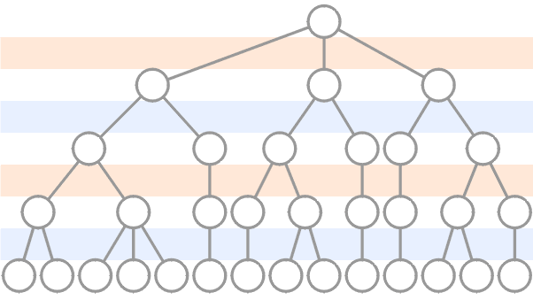

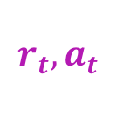

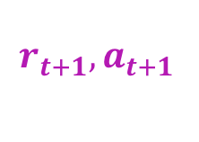

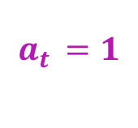


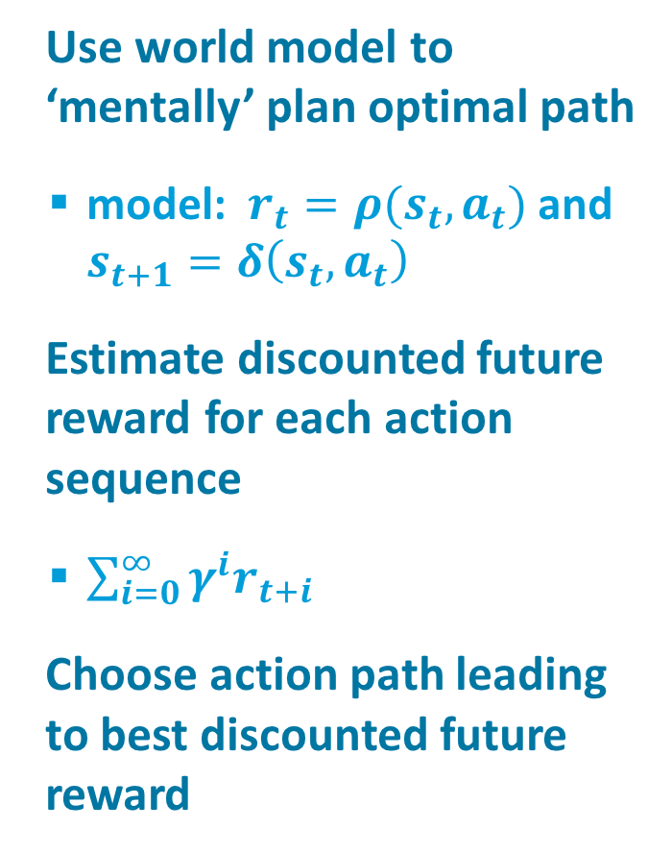
Traditional Approach to Planning
Use world model to ‘mentally’ plan optimal path
  model: $r_{t}=ρ(s_{t},a_{t})$ and $s_{t+1}=δ\left(s_{t},a_{t}\right)$
Estimate discounted future reward for each action sequence
  $\sum_{i=0}^{∞}{γ^{i}r_{t+i}}$
Choose action path leading to best discounted future reward
$$s_{t}$$
$$a_{t }=1$$
$$2$$
$$3$$
$${r_{t},a}_{t }$$
$$s_{t+1}$$
$${r_{t+1},a}_{t+1 }$$
$$…$$

Slide 12
Policy Vs. Value Function
Policy
mapping from
state to action
⬅➔
Value function
mapping from state to
expected discounted reward
associated with state
.048
.130
.240
1.00
-.023
-.330
-1.00
-.099
-.197
-.339
-.602
Notes:
SINGLE ACTION: PRESS BUTTON. Transitions are probabilistic
or TWO ACTIONS, and policy is to take actions with equal probability
Emphasize that value function is sum of discounted rewards

Slide 13
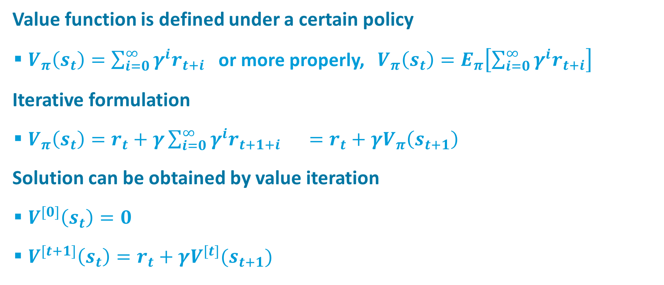
Value Function
Value function is defined under a certain policy
  $V_{π}\left(s_{t}\right)=\sum_{i=0}^{∞}{γ^{i}r_{t+i}}$ or more properly, $V_{π}\left(s_{t}\right)=E_{π}\left[\sum_{i=0}^{∞}{γ^{i}r_{t+i}}\right]$
Iterative formulation
  $V_{π}\left(s_{t}\right)=r_{t}+γ\sum_{i=0}^{∞}{γ^{i}r_{t+1+i}} =r_{t}+γV_{π}\left(s_{t+1}\right)$
Solution can be obtained by value iteration
  $V^{[0]}\left(s_{t}\right)=0$
  $V^{[t+1]}\left(s_{t}\right)=r_{t}+γV^{[t]}(s_{t+1})$

Slide 14
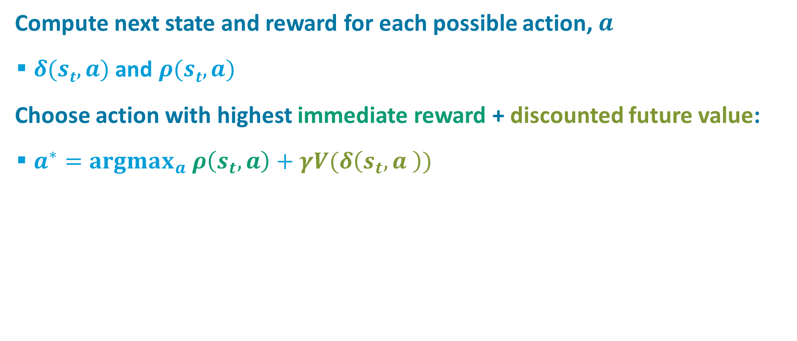
Using Value Function To Act
Compute next state and reward for each possible action, $a$
  $δ(st, a)$ and $ρ(st, a)$
Choose action with highest immediate reward + discounted future value:
  $a^{∗}=argmax_{a} ρ\left(s_{t}, a\right)+γV(δ\left(s_{t},a \right))$
.048
.130
.240
1.00
-.023
-.330
-1.00
-.099
-.197
-.339
-.602
Notes:
SINGLE ACTION: PRESS BUTTON. Transitions are probabilistic
note: a* -- * means optimal
PROBLEM WITH POLICY:
need a transition model; may not be available
value function was created under the assumption of random next state (i.e., no choice of actions)

Slide 15
Two Varieties Of Reinforcement Learning
Model-Based
  Agent has available (or has learned) a model of the environment
    Environment model = Transition function + Reward function
    Allows the agent to perform planning in the head
Model-Free
  Agent acts in the environment only knowing which actions are good or bad in a given state
    Instead of planning, agent must try actions and observe their consequences.

Slide 16
Value Iteration Code
v = zeros(1,12);
gamma = .9; % discount rate
for i = 1:1000
for s = 1:12
if (terminalState(s))
vNew(s) = reward(s);
else
vNew(s) = sum(transitionProb(s) .*
(reward(s) + gamma * v));
end
end
v = vNew;
end

Slide 17
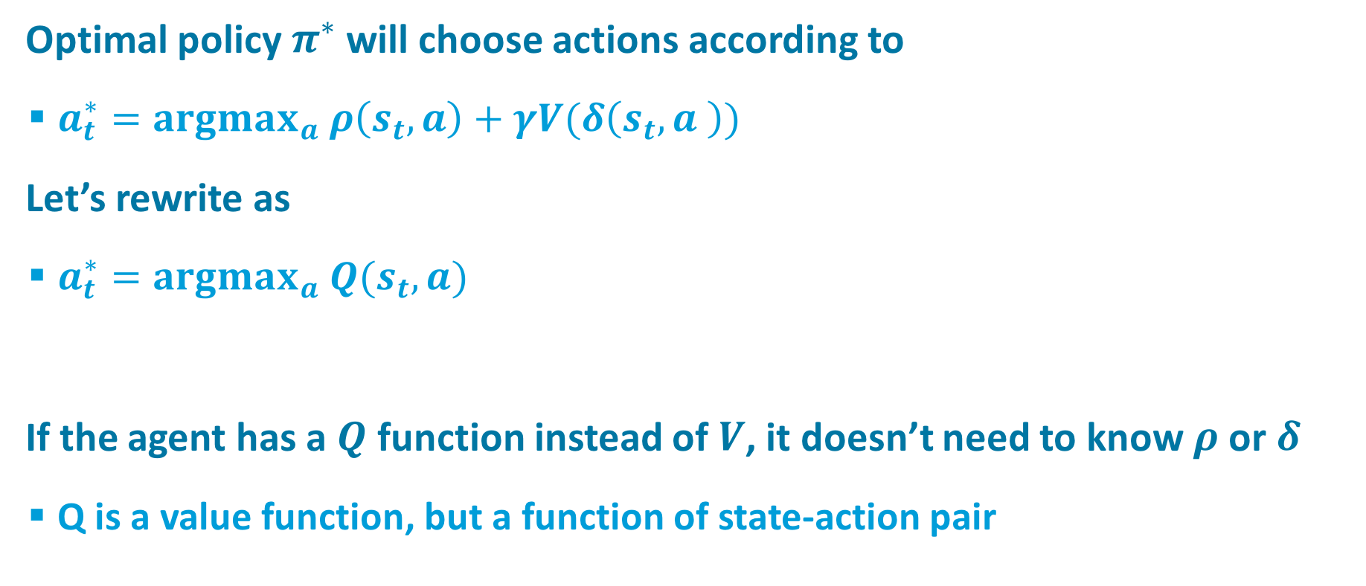
Eliminating The Need For A Model
Optimal policy $π^{∗}$ will choose actions according to
  $a_{t}^{∗}=argmax_{a} ρ\left(s_{t}, a\right)+γV(δ\left(s_{t},a \right))$
Let’s rewrite as
  $a_{t}^{∗}=argmax_{a} Q(s_{t},a)$
If the agent has a $Q$ function instead of $V$, it doesn’t need to know $ρ$ or $δ$
  Q is a value function, but a function of state-action pair

Slide 18
Q Learning
(Watkins & Dayan, 1992)
ρ
ρ
R
Notes:
Replace delta(s,a), rho(s,a) with action in the world

Slide 19
Example of Q Learning
From Mitchell (1997) Machine Learning
Maze environment
  actions: up, down, left, right
  Assume γ = 0.9

Slide 20

Example of Q Learning
From Mitchell (1997) Machine Learning
Notes:
End of slide:
you can REPLACE Q value with new value, but if you have stochastic (noisy) reward, then you want to average over many experiences.
Instead of replacing Q, average old and new Q values…[next slide]

Slide 21

Incremental Q Learning Rule
This equation is sometimes referred to as value iteration.
  Will eventually converge to the optimal policy for deterministic MDPs
Notes:
Looks more like Neural Net Learning Rule
alpha is the fraction of the way you go from old Q to new Q

Slide 22
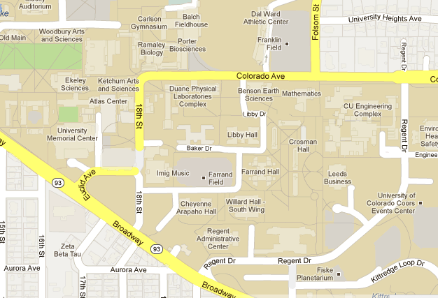
Exploration-Exploitation Dilemma
Getting around campus: Engineering to UMC
Exploitation
  Follow route you currently believe to be best
Exploration
  Randomly try some route other than the one you believe to be best
Exploration should dominate early in learning; exploitation should dominate later in learning

Slide 23
Temporal Difference (TD) Learning
Q learning is algorithm for learning to make decisions
But it’s also fundamentally a prediction algorithm
  What will my future reward be under the policy that is implicit in the value function?
TD learning is like Q learning, but which focuses on prediction not decision making
  learns a value function V(s) under a fixed policy
  e.g., weather prediction
Relationship to dynamic programming
  TD learning is a form of stochastic dynamic programming

Slide 24
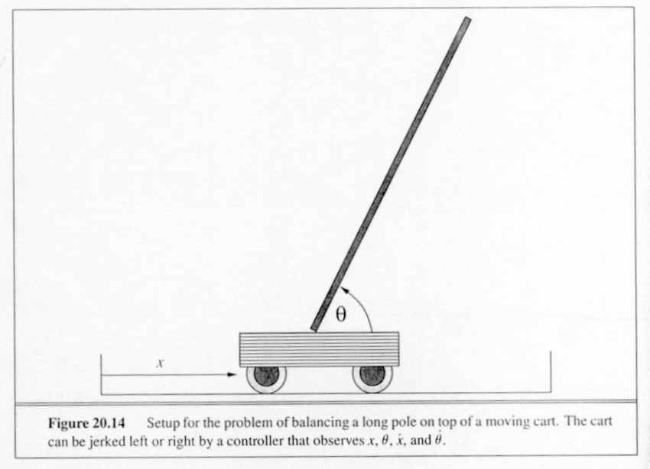
Pole Balancing
http://www.cs.utexas.edu/~bradknox/rlmuseum/Interactive_Museum_of_Reinforcement_Learning.html

Slide 25


V and Q functions
Original RL theory based on value look-up tables
  V(s) or Q(s,a)
  separate memory for each state; no interference
Algorithms have been extended to linear function approximation
  rather than needing one parameter per state (or state-action pair), can operate with far fewer parameters
  better generalization since learning transfers to similar states

Slide 26
V and Q functions
Nonlinear function approximation (e.g., deep net) is tricky
  change to Q or V -> change to policy -> change to observations ->
  change in loss function
  observations in a sequence are correlated, not independent

Slide 27
TD Gammon (Tesauro, 1992)
Reinforcement learning for backgammon
  Instead of using a look up table that had a value associated with each possible board state, used a neural net to map board configurations to values
  Net played 1.5M games against itself
  Plays at the level of the best human players
  Beats a neural net trained by supervised learning

Slide 28
TD Gammon (Tesauro, 1992)

Slide 29


Mnih et al. (2015)
Notes:
When I was asked to come here, thought about what to say.
react against current trend: end-to-end learning.
Don’t build anything in. Let learning do it all.
Was also the fantasy in late 1980s
DQN: what is built into it? [convolution]
[what about game actions?]
[what about player-relative coding? people code all stimulation with respect to their bodies]

Slide 30
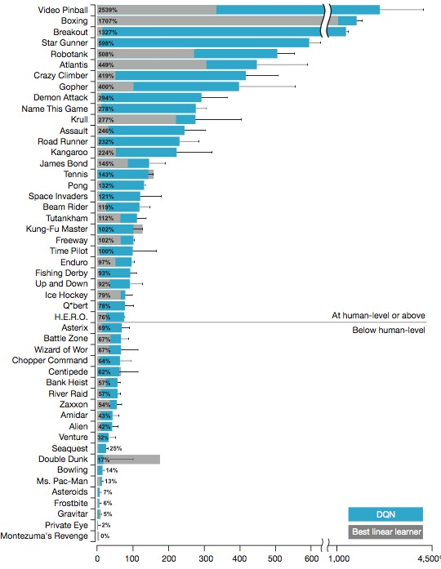
Single Model Learns 49 Games
Notes:
grey: linear learner
blue DQN

Slide 31
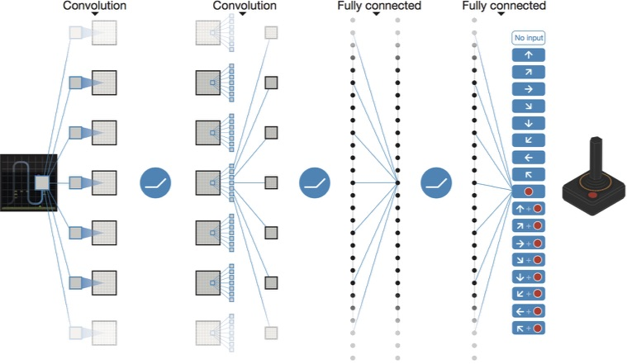
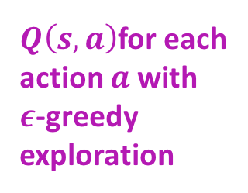
Generic End-to-End Convolutional Architecture
game
  210x160 RGB @ 60Hz
input
  stack last 4 frames, reduced to 84x84 luminance
  skip and train on only every 4 frames
$Q\left(s,a\right)$for each
action $a$with
$ε$-greedy
exploration

Slide 32
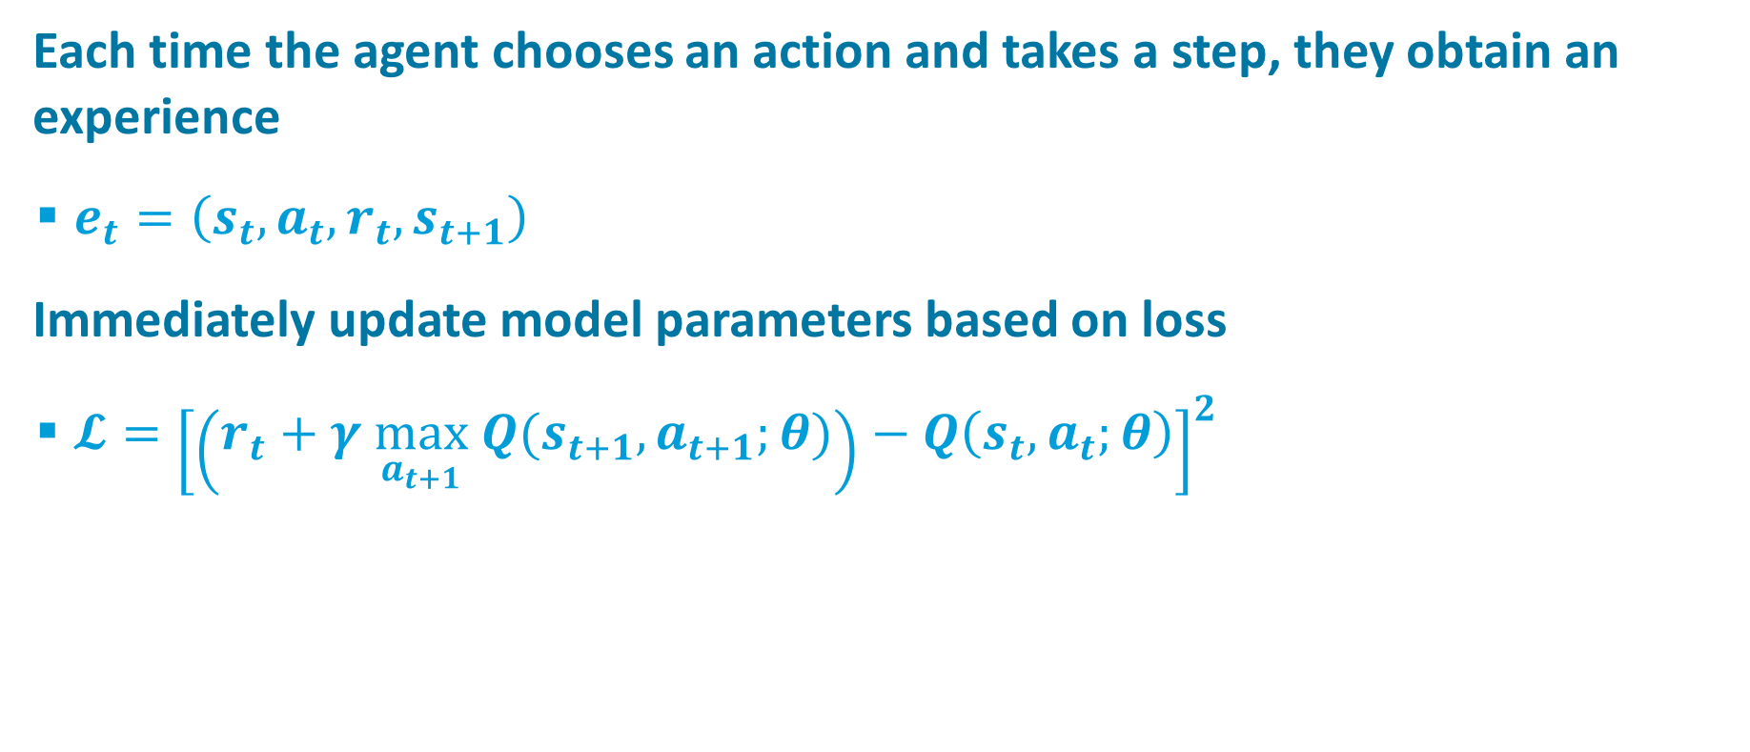
Traditional Approach To RL With Function Approximation
Each time the agent chooses an action and takes a step, they obtain an experience
  $e_{t}=\left(s_{t}, a_{t}, r_{t}, s_{t+1}\right)$
Immediately update model parameters based on loss
  $𝓛={\left[\left(r_{t}+γ \max_{a_{t+1}} Q(s_{t+1},a_{t+1};θ)\right)−Q\left(s_{t},a_{t};θ\right)\right]}^{2}$

Slide 33
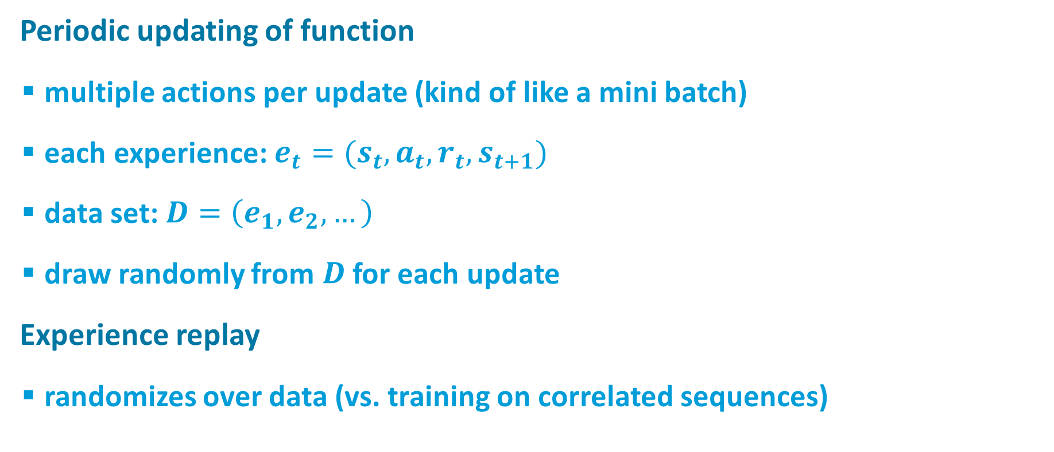
Key Ideas
Periodic updating of function
  multiple actions per update (kind of like a mini batch)
  each experience: $e_{t}=(s_{t}, a_{t}, r_{t}, s_{t+1})$
  data set: $D=\left(e_{1}, e_{2}, …\right)$
  draw randomly from $D$ for each update
Experience replay
  randomizes over data (vs. training on correlated sequences)

Slide 34
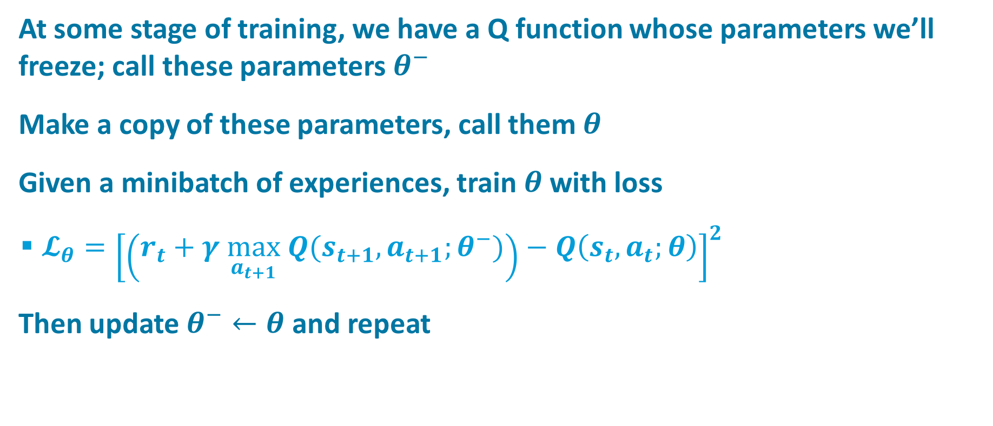
Updating Procedure
At some stage of training, we have a Q function whose parameters we’ll freeze; call these parameters $θ^{−}$
Make a copy of these parameters, call them $θ$
Given a minibatch of experiences, train $θ$with loss
  $𝓛_{θ}={\left[\left(r_{t}+γ \max_{a_{t+1}} Q(s_{t+1},a_{t+1};θ^{−})\right)−Q\left(s_{t},a_{t};θ\right)\right]}^{2}$
Then update $θ^{−}←θ$ and repeat

Slide 35

Demo: Space Invaders

Slide 36
Demo: Learning Breakout

Slide 37
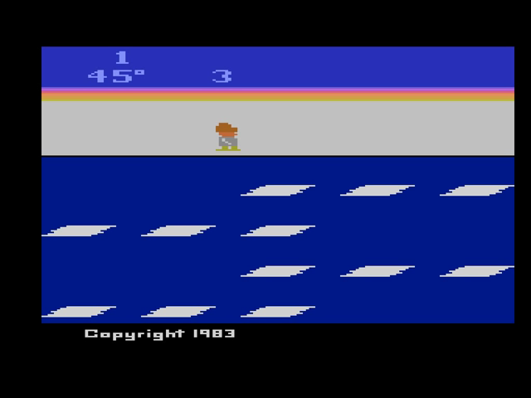
Frostbite
One of the games which DQN performed poorly (7% of human expert score)

Slide 38
The “Frostbite Challenge”
(Lake, Ullman, Tenenbaum, & Gershman, in press)
Can AI system reach human-level performance?
Does AI system learn as efficiently as people do?
Can AI perform new tasks or achieve novel goals with little or no retraining?
Notes:
stages…

Slide 39
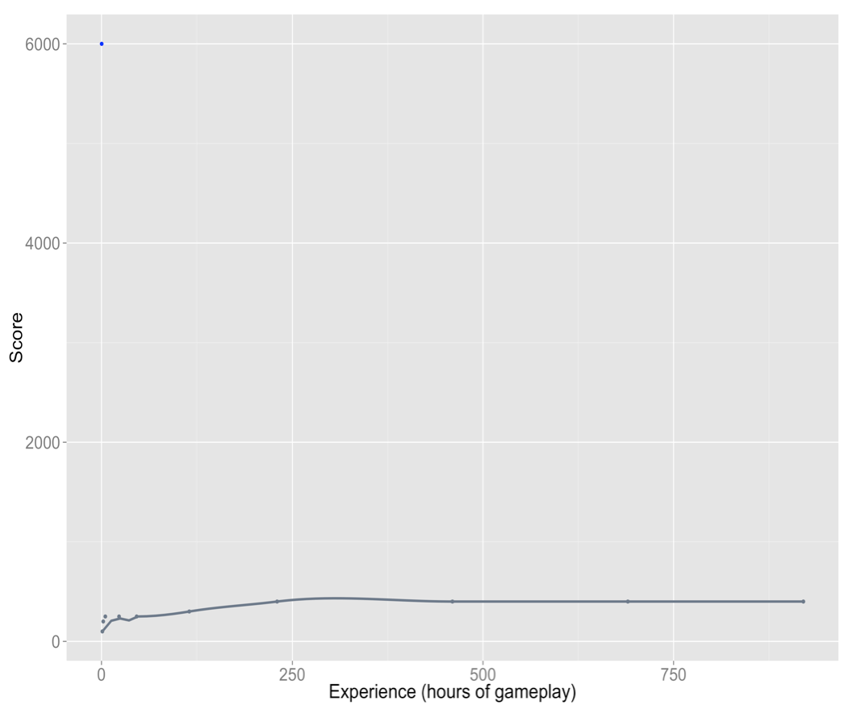

0 250 500 750
0 250 500 750
Experience (hours of gameplay)
slide credit: Sam Gershman
Notes:
Human asymptotic performance
WHAT DO YOU THINK LEARNING CURVE IS?
[*] 2 hours of play to reach asymptote
at that point in time, DQN is at 3.5% of human performance.
drops to 15-20 min of practice if you can watch experts play for 2 minutes.
newer versions of DQN that have smarter experience replay and more efficient parameter sharing
still, 900+ hr of play to get to human level of performance

Slide 40
Humans Make Much Better Use Of Experience Than AI
Why?
  Humans come to task with their entire evolutionary and developmental histories
  Deep neural nets are trained de novo
Notes:
Because of this fact, maybe we’ve compared unfairly.
We could instead look at rate of learning when you match humans and AI for skill level

Slide 41
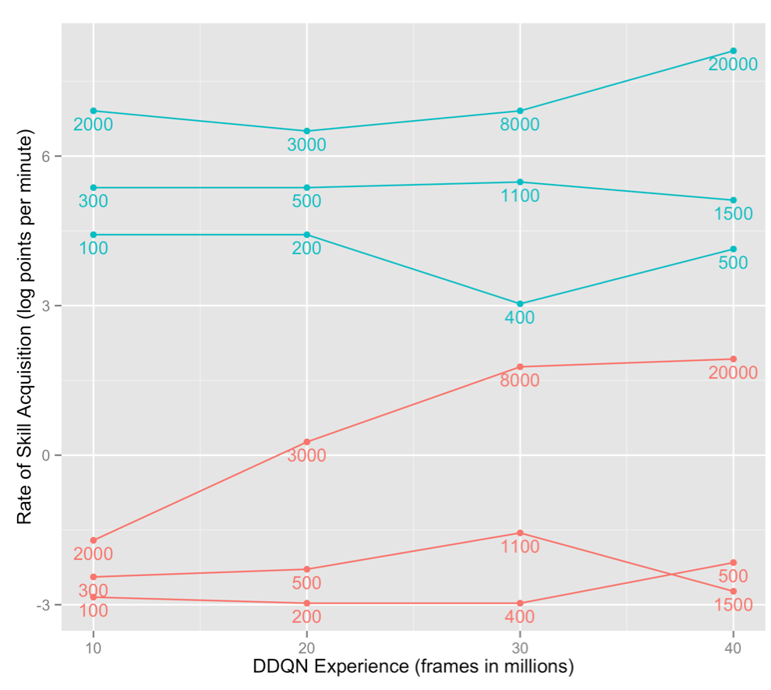
Learning Rates Conditioned On Game Performance
Stargunner
Humans
Frostbite
Amidar
Learning Rate
(log points per minute)
Stargunner
DDQN
Amidar
score achieved
Frostbite
50 100 150 200
Hours Of DDQN Play
slide credit: Sam Gershman
Notes:
Compare human and DQN learning rates given comparable performance (i.e., same skill level)
DDQN – one of the improved versions of DQN
x axis is hours of DDQN game play
the small numbers are the scores achieved after that amount of play
they then looked at humans who played a much shorter time but were obtaining the same performance
and asked: how quickly do people learn vs. how quickly does DDQN learn
to be clear: I could put you and a 12 yr old in a room and teach you some fancy math.
the 12 yr old may need 10 yr of tutoring before he gets to the same level that you get to in an hour
but once you get to the same level, wouldn’t you expect to learn at the same rate?
y axis – learning rate….log scale for y axis to give bigger range
not just that people have a head start: at every level of performance they’re learning faster.

Slide 42
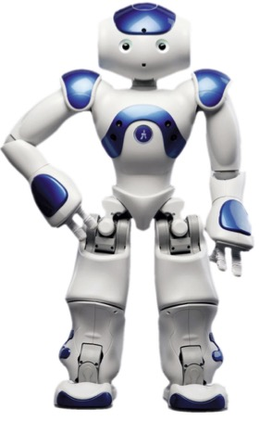
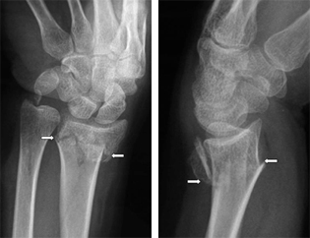
The Main Message Of My Lectures
Maybe we shouldn’t start AI from scratch!
Without some additional help,
  will may never get to human-level AI.
  will may never be able to tackle problems for which
  data are expensive, unobtainable, or unreliable.
  You are unlikely to get the best possible solution to
  the problem you’re working on.
Notes:
One tiny example: x-ray radiography -- image diagnosis
On the one hand, these concerns are completely obvious
They are also dumb since any part of the answer that we build in is avoiding learning.
But on the other hand, it’s not like the human learning to play frostbite came to the task with knowledge of how to play already…

Slide 43

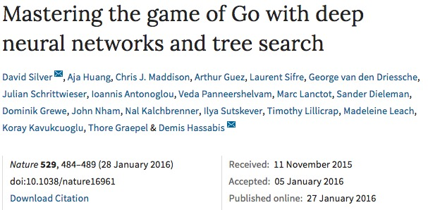
Supervised policy learning from humans
value function learning from self-play
Monte carlo tree search to plan

Slide 44
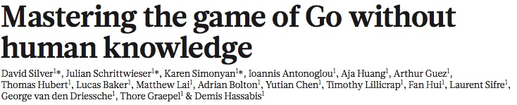
Alpha Go Zero – October 2017
Pure RL
“It’s more powerful than previous approaches because we’ve removed the constraints of human knowledge.” – David Silver
“Humankind has accumulated Go knowledge from millions of games played over thousands of years. In the space of a few days… AlphaGo Zero was able to rediscover much of this Go knowledge, as well as novel strategies that provide new insights into the oldest of games.”

Slide 45
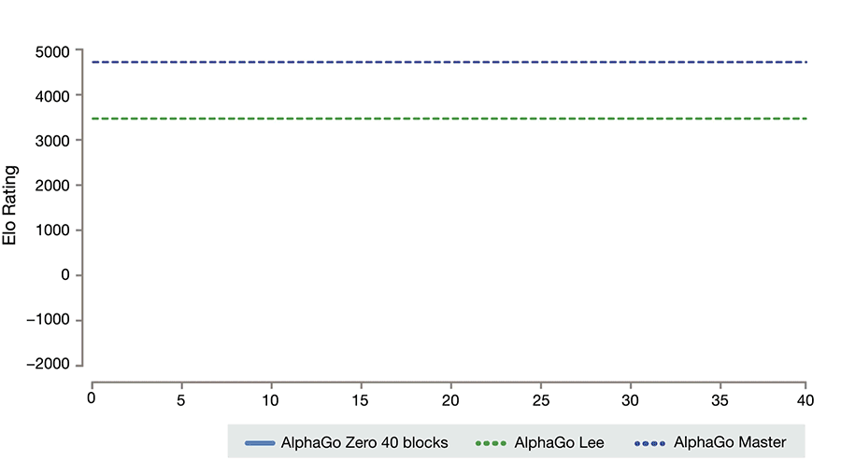

Slide 46
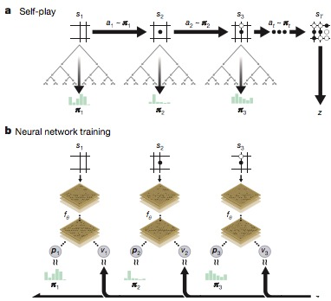
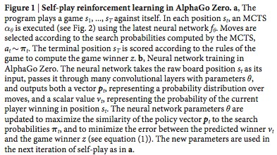

Slide 47
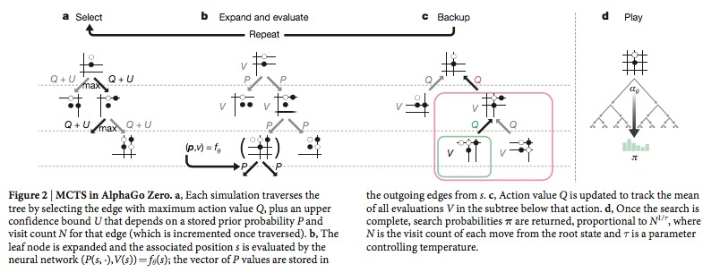

Slide 48
Kirkpatrick 2017 PNAS deep mind paper on generalization

