Slide 1
Unsupervised Learning
With Neural Nets
Deep Learning and Neural Nets
Spring 2015

Slide 2
Agenda
1. Gregory Petropoulos on renormalization groups
2. Your insights from Homework 4
3. Unsupervised learning
4. Discussion of Homework 5

Slide 3
Discovering Binary Codes
If hidden units of autoencoder discover
binary code, we can
  measure information content in hidden rep.
  interface with digital representations
I tried this without much success in the 1980s using an additional cost term on the hidden units that penalized nonbinary activations
Y
A’
B’
C
B
A
X

Slide 4
Discovering Binary Codes
Idea: Make network behavior robust to noisy hidden units
  Hinton video 1
  Hinton video 2

Slide 5
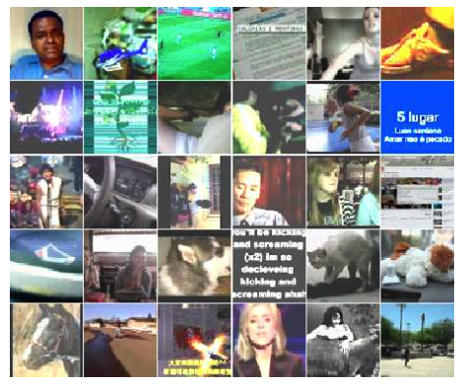
Discovering High-Level Features Via Unsupervised Learning (Le et al., 2012)
Training set
  10M YouTube videos
  single frame sampled
  from each
  200 x 200 pixels
  fewer than 3% of
  frames contain
  faces (using OpenCV
  face detector)

Slide 6
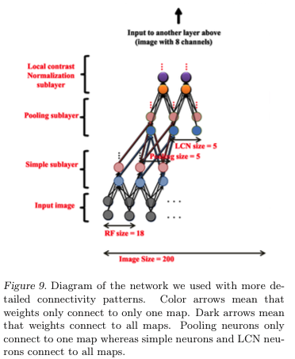
Sparse deep autoencoder architecture
  3 encoding layers
  each “layer” consists of three transforms
    spatially localized receptive fields to detect
    features
    spatial pooling to get translation
    invariance
    subtractive/divisive normalization to
    get sparse activation patterns
  not convolutional
  1 billion weights
  train with version of sparse PCA
C
B
A
X

Slide 7
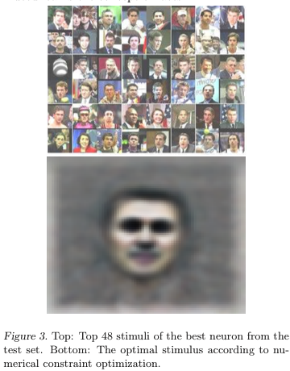
Some Neurons Become Face Detectors
Look at all neurons in final
layer and find the best face
detector

Slide 8
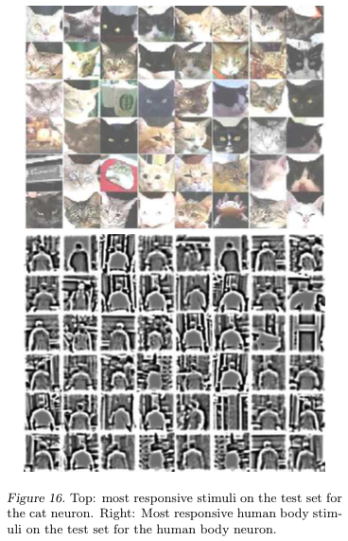
Some Neurons Become Cat and Body Detectors

Slide 9
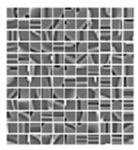
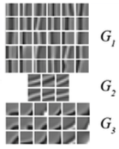
How Fancy Does Unsupervised Learning
Have To Be?
Coates, Karpathy, Ng (2012)
  K-means clustering – to detect
  prototypical features
  agglomerative clustering – to
  pool together features that
  are similar under transformation
  multiple stages
Face detectors emerge

Slide 10
Simple Autoencoder
Architecture
  y = tanh(w₂ h)
  h = tanh(w₁ x)
100 training examples with
  x ~ Uniform(-1,+1)
  y_{target} = x
What are the optimal weights?
How many solutions are there?
y
w₂
h
w₁
x

Slide 11
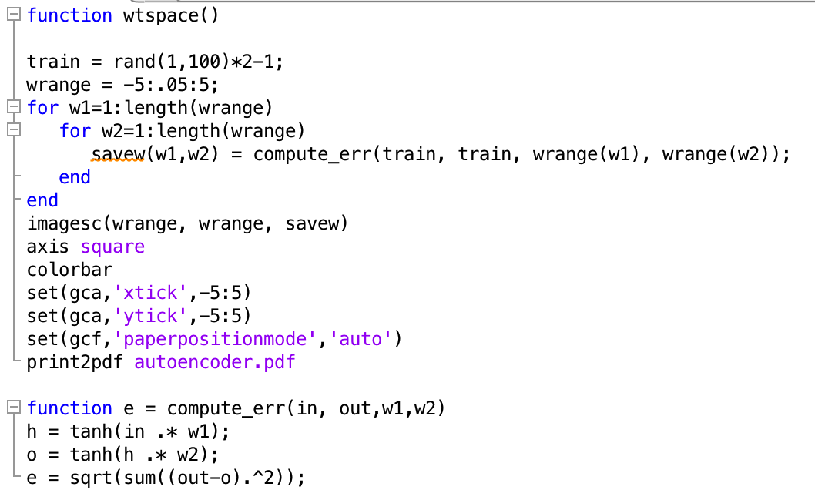
Simple Autoencoder: Weight Search

Slide 12
Simple Autoencoder: Error Surface
w₁
log sum squared error
w₂

Slide 13
Simple Supervised Problem
Architecture
  y = tanh(w₂ h + 1)
  h = tanh(w₁ x - 1)
100 training examples with
  x ~ Uniform(-1,+1)
  y_{target} = tanh( -2 tanh( 3 x + 1) -1)
What are the optimal weights?
How many solutions are there?
y
w₂
h
w₁
x

Slide 14
Simple Supervised Problem:
Error Surface
w₁
w₁
log sum squared error
w₂
w₂

Slide 15
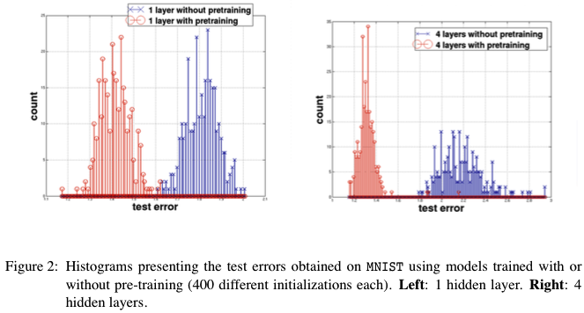
Why Does Unsupervised Pretraining Help Deep Learning?
“Unsupervised training guides the learning toward basins of attraction of minima that support better generalization from the training set” (Erhan et al. 2010)
  More hidden layers ->
  increase likelihood of
  poor local minima
  result is robust to random
  initialization seed

Slide 16
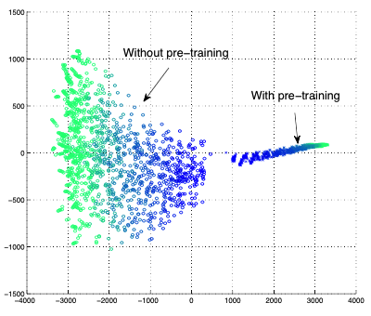
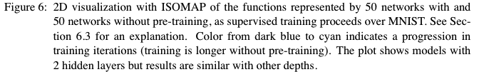
Visualizing Learning Trajectory
Train 50 nets with and without pretraining on MNIST
At each point in training, form giant vector of all output activations for all training examples
Perform dimensionality reduction using ISOMAP
  Pretrained and not-pretrained
  models start and stay in different
  regions of function space
  More variance (different local
  optima?) with not-pretrained
  models

Slide 17
Using Autoencoders To Initialize Weights For Supervised Learning
Effective pretraining of weights should act as a regularizer
  Limits the region of weight space that will be explored by supervised learning
Autoencoder must be learned well enough to move weights away from origin
  Hinton mentions that adding restriction on ||w||₂ is not effective for pretraining

Slide 18
Training Autoencoders To Provide Weights For Bootstrapping Supervised Learning
Denoising autoencoders
  randomly set inputs to zero (like dropout on inputs)
  target output has missing features filled in
  can think of in terms of attractor nets
  removing features better than
  features with additive Gaussian
  noise

Slide 19



Training Autoencoders To Provide Weights For Bootstrapping Supervised Learning
Contractive autoencoders
  a good hidden representation will be insensitive to most small changes in the input (while still preserving information to reconstruct the input)
  Objective function
    Frobenius norm of the Jacobian
    For logistic hidden:

