Slide 1
Tricks of the Trade II
Deep Learning and Neural Nets
Spring 2015

Slide 2
Agenda
Review
Discussion of homework
Odds and ends
The latest tricks that seem to make a difference

Slide 3
Cheat Sheet 1
Perceptron
  Activation function
  Weight update
Linear associator (a.k.a. linear regression)
  Activation function
  Weight update
assumes minimizing squared error loss function

Slide 4
Cheat Sheet 2
Two layer net (a.k.a. logistic regression)
  activation function
  weight update
Softmax net (a.k.a. multinomial logistic regression)
  activation function
  weight update
assumes minimizing squared error loss function

Slide 5
Cheat Sheet 3
Back propagation
  activation function
  weight update
assumes minimizing squared error loss function

Slide 6
Cheat Sheet 4
Loss functions
  squared error
  cross entropy

Slide 7
How Many Hidden Units Do We Need To Learn Handprinted Digits?
Two isn’t enough
Think of hidden as a bottleneck conveying all information from input to output
Sometimes networks can surprise you
  e.g., autoencoder

Slide 8
Autoencoder
Self-supervised training procedure
Given a set of input vectors (no target outputs)
Map input back to itself via a hidden layer bottleneck
How to achieve bottleneck?
  Fewer neurons
  Sparsity constraint
  Information transmission constraint (e.g., add noise to unit, or shut off randomly, a.k.a. dropout)

Slide 9
Autoencoder and 1-of-N Task
Input/output vectors
  1 0 0 0 0 0 0 0
  0 1 0 0 0 0 0 0
  0 0 1 0 0 0 0 0
  0 0 0 1 0 0 0 0
  0 0 0 0 1 0 0 0
  0 0 0 0 0 1 0 0
  0 0 0 0 0 0 1 0
  0 0 0 0 0 0 0 1
How many hidden units are require to perform this task?

Slide 10
When To Stop Training
1. Train n epochs; lower learning rate; train m epochs
  bad idea: can’t assume one-size-fits-all approach
2. Error-change criterion
  stop when error isn’t dropping
  My recommendation: criterion based on % drop over a window of, say, 10 epochs
    1 epoch is too noisy
    absolute error criterion is too problem dependent
  Karl’s idea: train for a fixed number of epochs after criterion is reached (possibly with lower learning rate)
Notes:
NOTE: these belong in practical_advice.pptx. Move after 2015.

Slide 11
When To Stop Training
3. Weight-change criterion
  Compare weights at epochs t-10 and t and test:
  Don’t base on length of overall weight change vector
  Possibly express as a percentage of the weight
  Be cautious: small weight changes at critical points can result in rapid drop in error

Slide 12
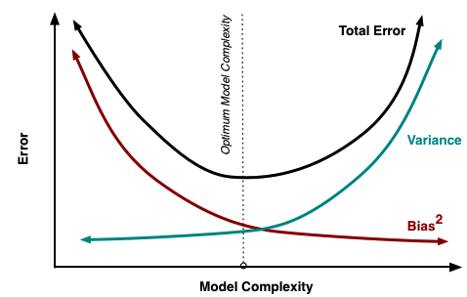
Setting Model Hyperparameters
How do you select the appropriate model size, i.e., # of hidden units, # layers, connectivity, etc.?
  validation method
    split training set into two parts, T and V
    train many different architectures on T
    choose the architecture that minimizes error on V
  fancy Bayesian optimization methods are starting to become popular

Slide 13
The Danger Of Minimizing Network Size
My sense is that local optima arise only if you use a highly constrained network
  minimum number of hidden units
  minimum number of layers
  minimum number of connections
  xor example?
Having spare capacity in the net means there are many equivalent solutions to training
  e.g., if you have 10 hidden and need only 2, there are 45 equivalent solutions

Slide 14
Regularization Techniques
Instead of starting with smallest net possible, use a larger network and apply various tricks to avoid using the full network capacity
7 ideas to follow…
Notes:
why is early stop

Slide 15
Regularization Techniques
  1. early stopping
    Rather than training network until error converges, stop training early
    Rumelhart
      hidden units all go after the same source of error initially -> redundancy
    Hinton
      weights start small and grow over training
      when weights are small, model is mostly operating in linear regime
    Dangerous: Very dependent on training algorithm
      e.g., what would happen with random weight search?
    While probably not the best technique for controlling model complexity, it does suggest that you shouldn’t obsess over finding a minimum error solution.
Notes:
why is early stop

Slide 16
Regularization Techniques
  2. Weight penalty terms
    L2 weight decay L1 weight decay
    weight elimination
    See Reed (1993) for survey of ‘pruning’ algorithms
Notes:
why is early stop

Slide 17
Regularization Techniques
  3. Hard constraint on weights
    Ensure that for every unit
    If constraint is violated, rescale all weights:
    [See Hinton video @ minute 4:00]
    I’m not clear why L₂ normalization and not L₁
  4. Injecting noise
    [See Hinton video]

Slide 18
Regularization Techniques
  6. Model averaging
    Ensemble methods
    Bayesian methods
  7. Drop out
    [watch Hinton video]
Notes:
why is early stop

Slide 19
More On Dropout
With H hidden units, each of which can be dropped, we have 2^{H} possible models
Each of the 2^{H-1} models that include hidden unit h must share the same weights for the units
  serves as a form of regularization
  makes the models cooperate
Including all hidden units at test with a scaling of 0.5 is equivalent to computing the geometric mean of all 2^{H} models
  exact equivalence with one hidden layer
  “pretty good approximation” according to Geoff with multiple hidden layers

Slide 20
Two Problems With Deep Networks
Credit assignment problem
Vanishing error gradients
  note y(1-y) ≤ 25

Slide 21
Unsupervised Pretraining
Suppose you have access to a lot of unlabeled data in addition to labeled data
  “Semisupervised learning”
Can we leverage unlabeled data to initialize network weights?
  alternative to small random weights
  requires an unsupervised procedure: autoencoder
With good initialization, we can minimize credit assignment problem.

Slide 22
Autoencoder
Self-supervised training procedure
Given a set of input vectors (no target outputs)
Map input back to itself via a hidden layer bottleneck
How to achieve bottleneck?
  Fewer neurons
  Sparsity constraint
  Information transmission constraint (e.g., add noise to unit, or shut off randomly, a.k.a. dropout)

Slide 23
Autoencoder Combines
An Encoder And A Decoder
Decoder
Encoder

Slide 24
Stacked Autoencoders
...
copy
deep network
Note that decoders can be stacked to produce a generative model of the domain

Slide 25
Rectified Linear Units
  Version 1
  Version 2
  Do we need to worry about z=0?
  Do we need to worry about lack of gradient for z<0?
  Note sparsity of activation pattern
  Note no squashing of error derivative
Notes:
why is early stop

Slide 26
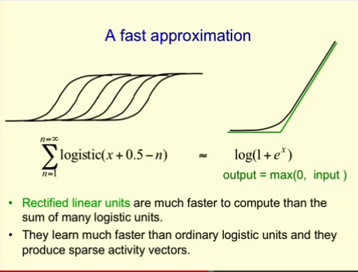
Rectified Linear Units
  Hinton argues that this is a form of model averaging
Notes:
why is early stop

Slide 27
Hinton Bag Of Tricks
Deep network
Unsupervised pretraining if you have lots of data
Weight initialization
  to prevent gradients from vanishing or exploding
Dropout training
Rectified linear units
Convolutional NNs if spatial/temporal patterns

