Slide 1
Tricks of the Trade
Deep Learning and Neural Nets
Spring 2015

Slide 2
Agenda
Homa Hosseinmardi on cyberbullying
Model fitting and overfitting
Generalizing architectures, activation functions, and error functions
The latest tricks that seem to make a difference

Slide 3
Learning And Generalization
What’s my rule?
  1 2 3 ⇒ satisfies rule
  4 5 6 ⇒ satisfies rule
  6 7 8 ⇒ satisfies rule
  9 2 31 ⇒ does not satisfy rule
Plausible rules
  3 consecutive single digits
  3 consecutive integers
  3 numbers in ascending order
  3 numbers whose sum is less than 25
  3 numbers < 10
  1, 4, or 6 in first column
  “yes” to first 3 sequences, “no” to all others

Slide 4
“What’s My Rule” For Machine Learning
x1 | x2 | x3 | y
0 | 0 | 0 | 1
0 | 1 | 1 | 0
1 | 0 | 0 | 0
1 | 1 | 1 | 1
0 | 0 | 1 | ?
0 | 1 | 0 | ?
1 | 0 | 1 | ?
1 | 1 | 0 | ?
16 possible rules (models)
With N binary inputs and P training examples, there are 2^{(2^N-P)} possible models.

Slide 5
Model Space
restricted
model
class
models
consistent
with data
correct
model
All possible
models
Challenge for learning
  Start with model class appropriately restricted for problem domain
Notes:
Size of model class = complexity

Slide 6
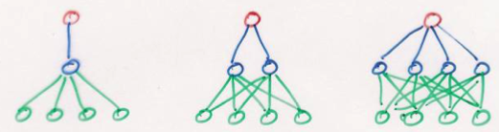
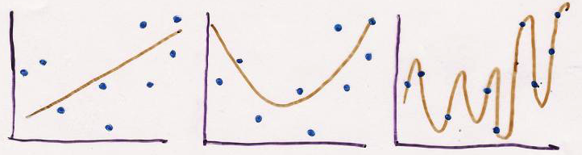
Model Complexity
Models range in their flexibility to fit arbitrary data
simple model
constrained
small capacity may
prevent it from
representing all
structure in data
high bias
low variance
complex model
unconstrained
large capacity may
allow it to memorize
data and fail to
capture regularities
low bias
high variance

Slide 7
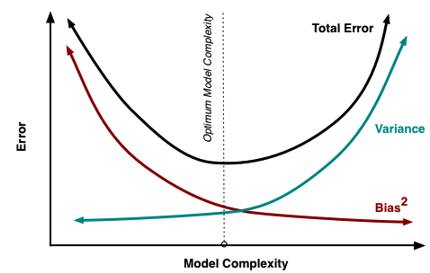
Training Vs. Test Set Error
Test Set
Training Set

Slide 8
Bias-Variance Trade Off
Error on Test Set
underfit
overfit
image credit: scott.fortmann-roe.com

Slide 9
Overfitting
Occurs when training procedure fits not only regularities in training data but also noise.
  Like memorizing the training examples instead of learning the statistical regularities that make a “2” a “2”
Leads to poor performance on test set
Most of the practical issues with neural nets involve avoiding overfitting

Slide 10
Avoiding Overfitting
Increase training set size
  Make sure effective size is growing;
  redundancy doesn’t help
Incorporate domain-appropriate bias into model
  Customize model to your problem
Set hyperparameters of model
  number of layers, number of hidden units per layer, connectivity, etc.
Regularization techniques
  “smoothing” to reduce model complexity

Slide 11
Incorporating Domain-Appropriate
Bias Into Model
Input representation
Output representation
  e.g., discrete probability distribution
Architecture
  # layers, connectivity
  e.g., family trees net; convolutional nets
Activation function
Error function

Slide 12
Customizing Networks
Hinton softmax video lecture gives one example of how neural nets can be customized based on understanding of problem domain
  choice of error function
  choice of activation function
Domain knowledge can be used to impose domain-appropriate bias on model
  bias is good if it reflects properties of the data set
  bias is harmful if it conflicts with properties of data

Slide 13
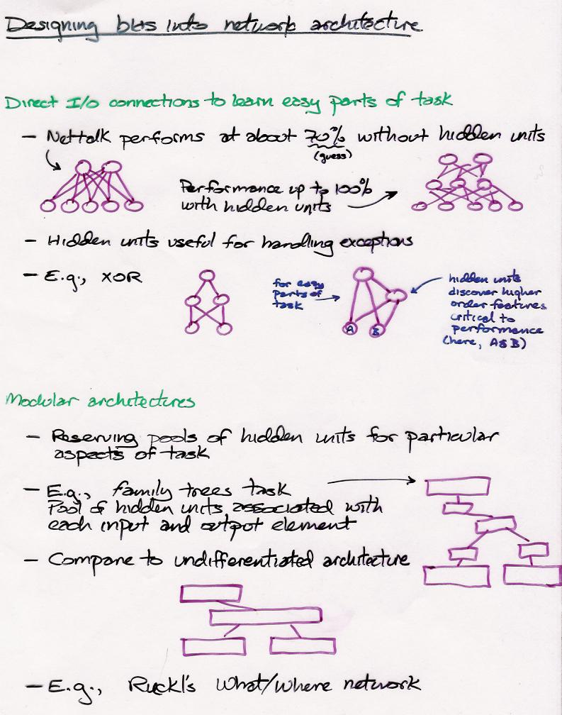

Slide 14
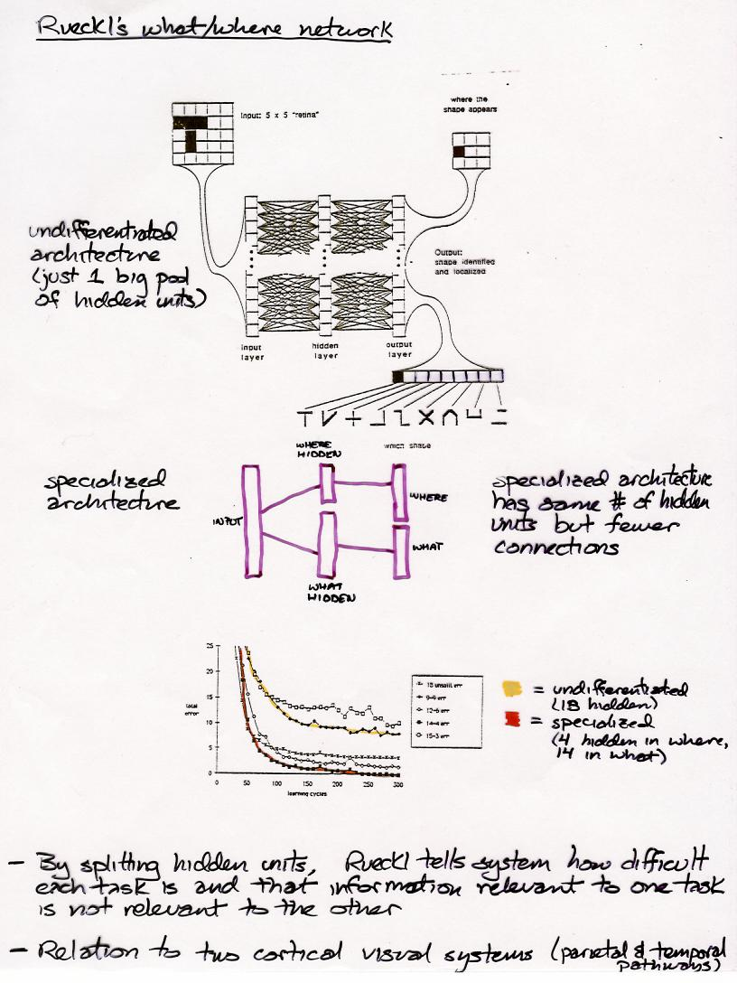

Slide 15
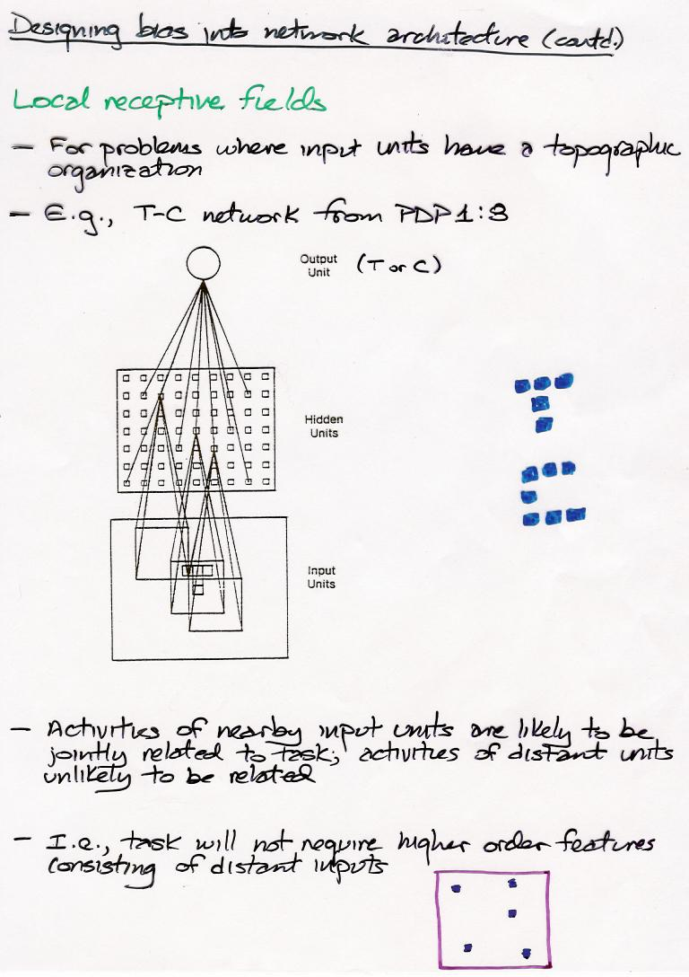

Slide 16
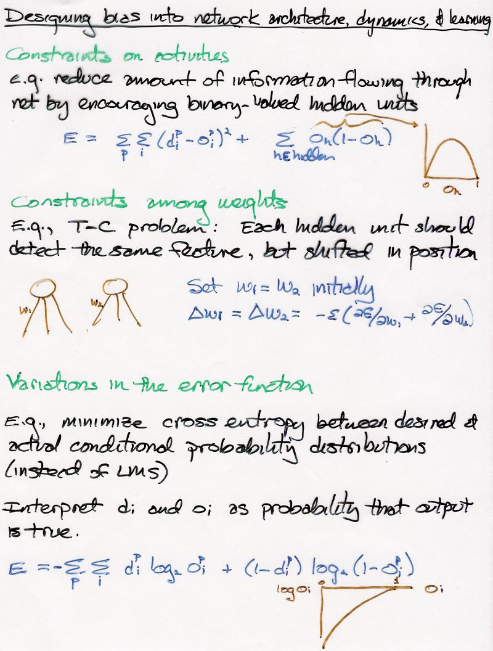

Slide 17
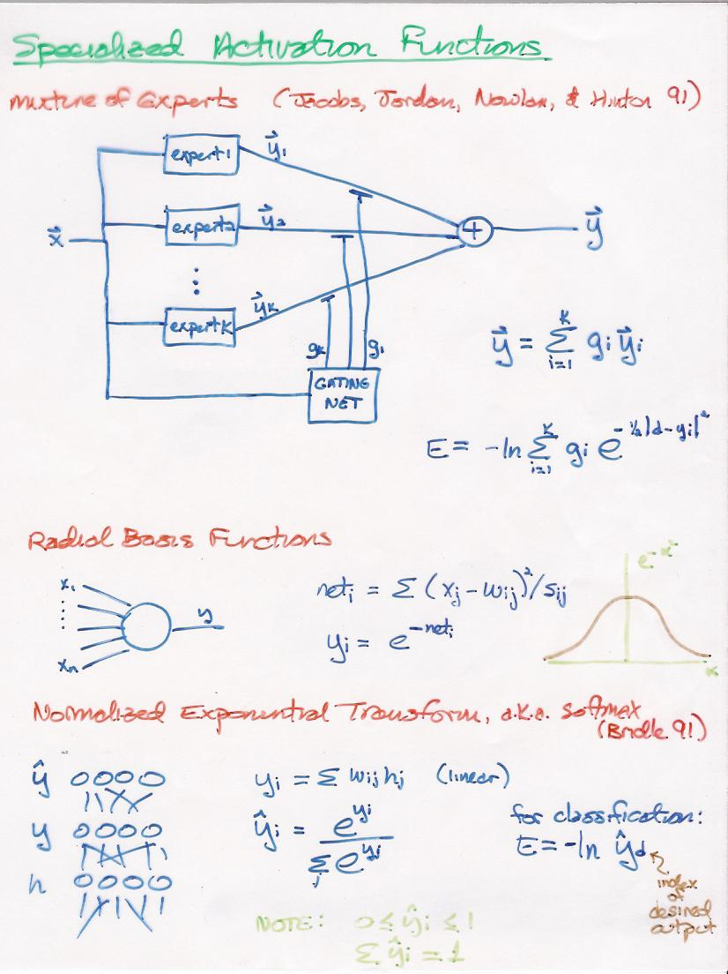

Slide 18
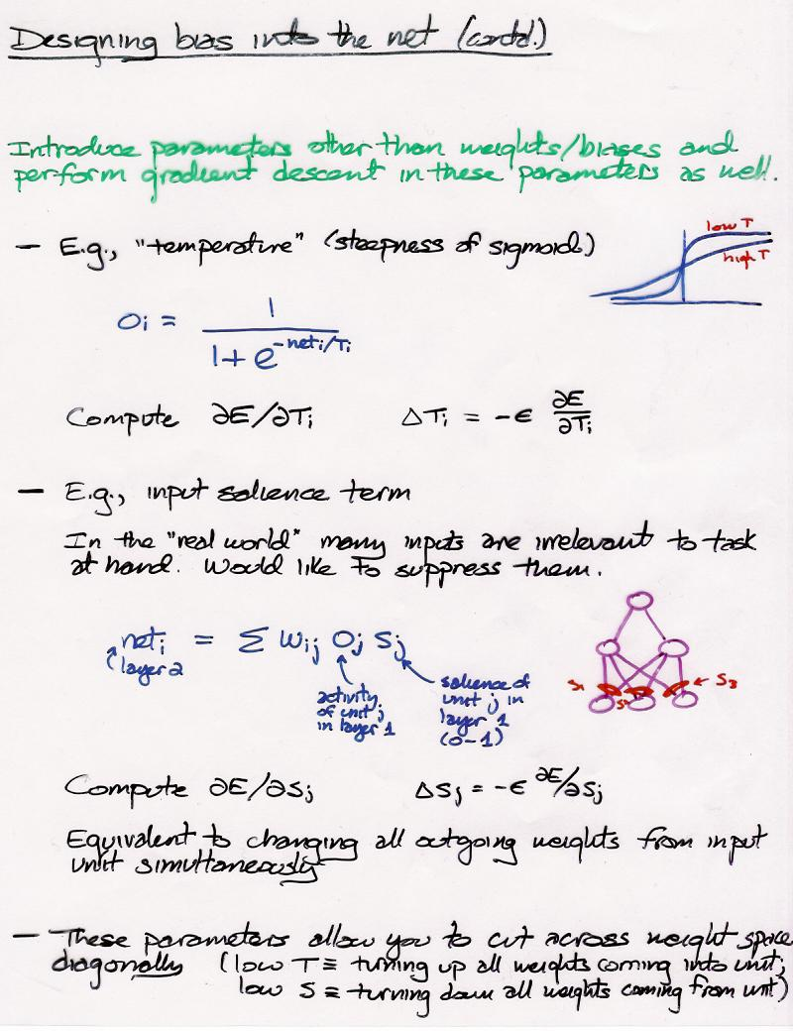

Slide 19
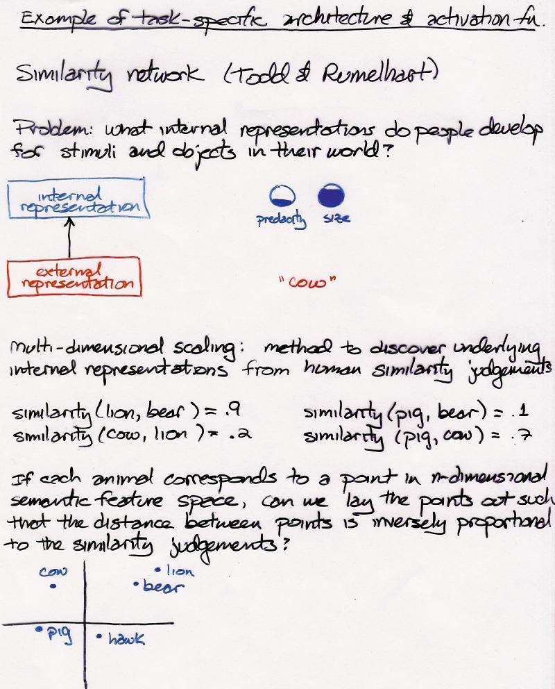

Slide 20
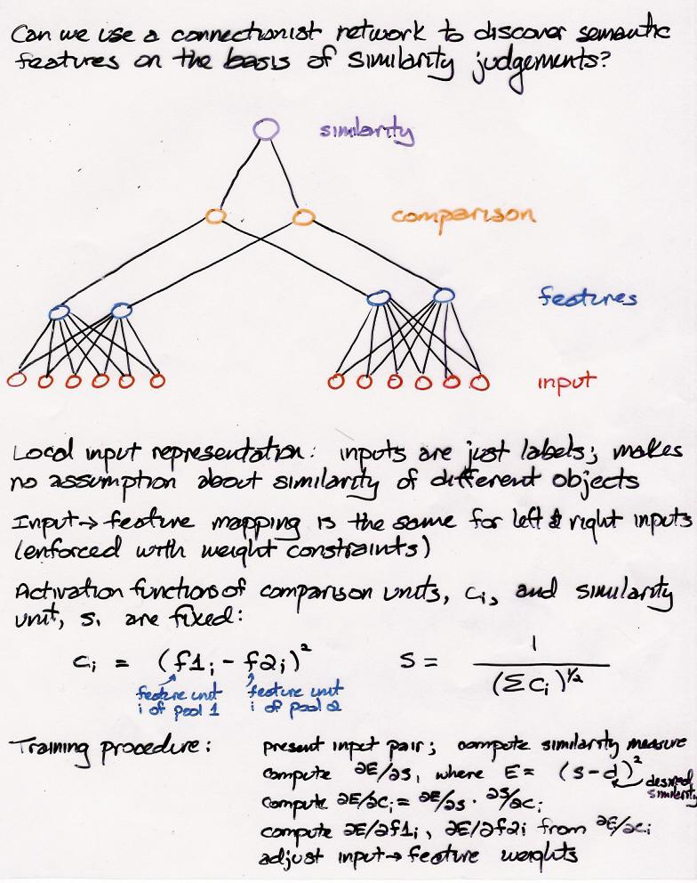

Slide 21
