Slide 1
Stochastic Neural Networks
Deep Learning and Neural Nets
Spring 2015

Slide 2
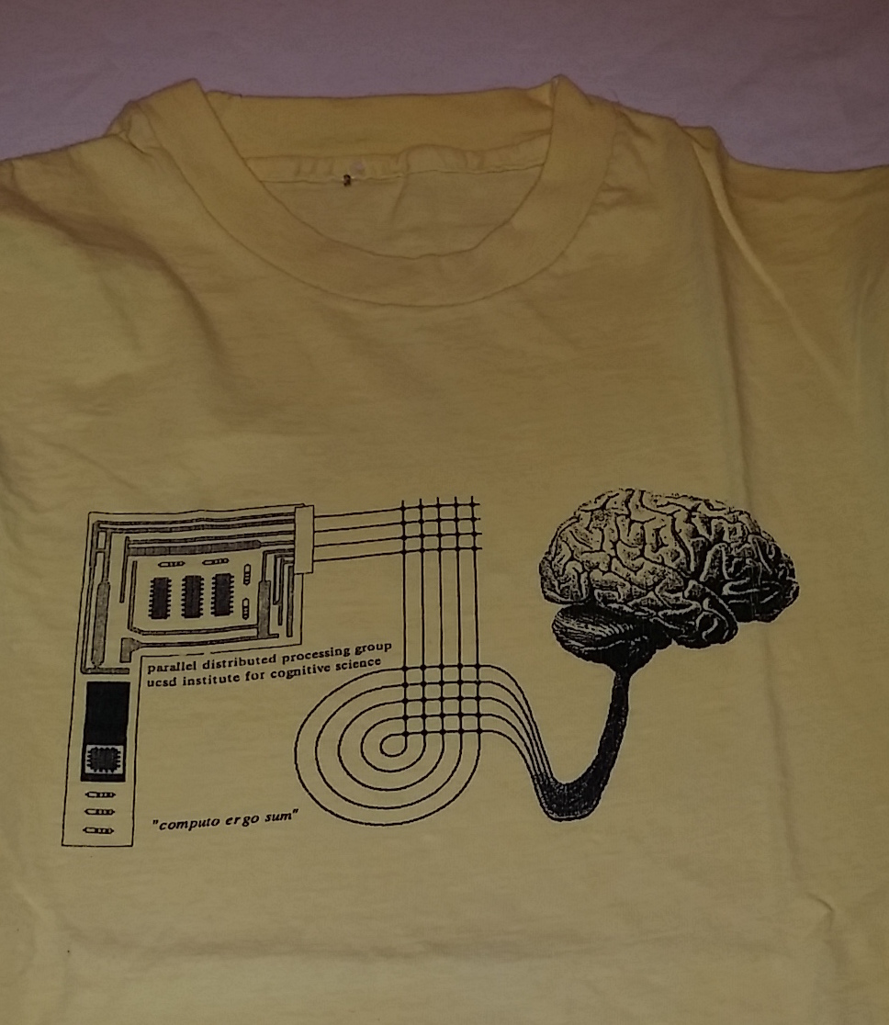
Neural Net T-Shirts

Slide 3
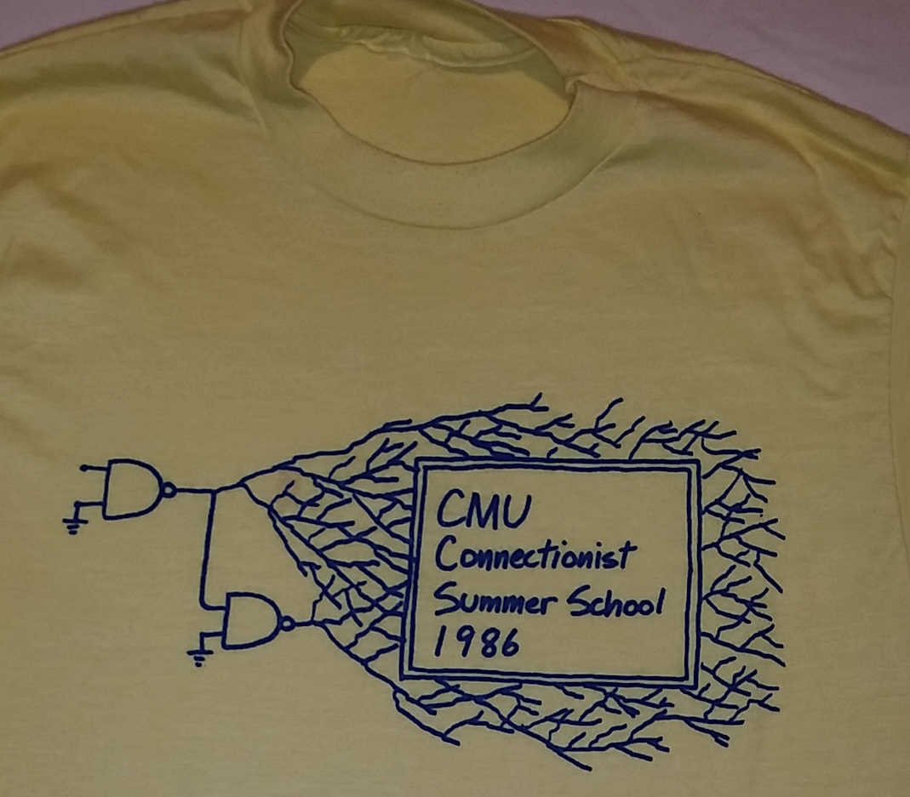
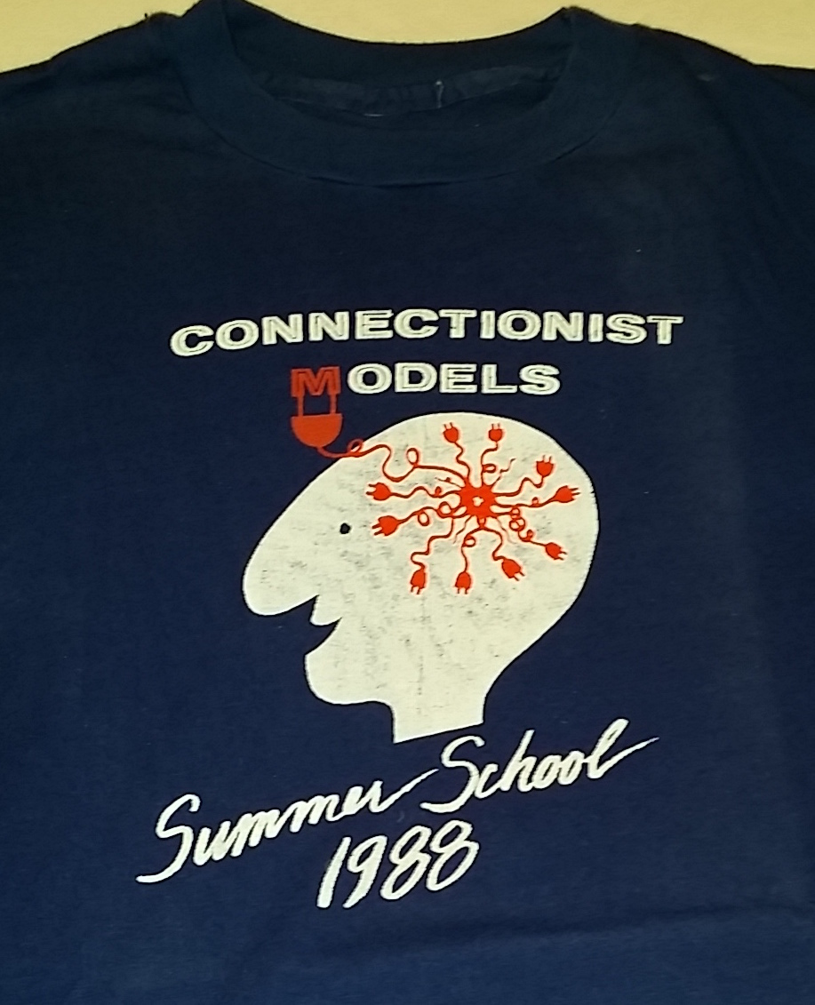
Neural Net T-Shirts

Slide 4
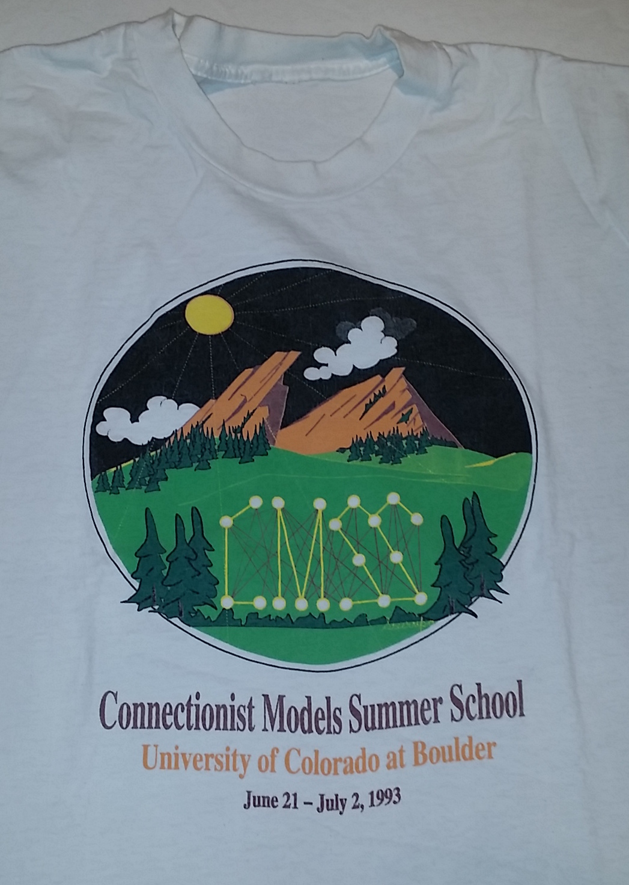
Neural Net T-Shirts

Slide 5
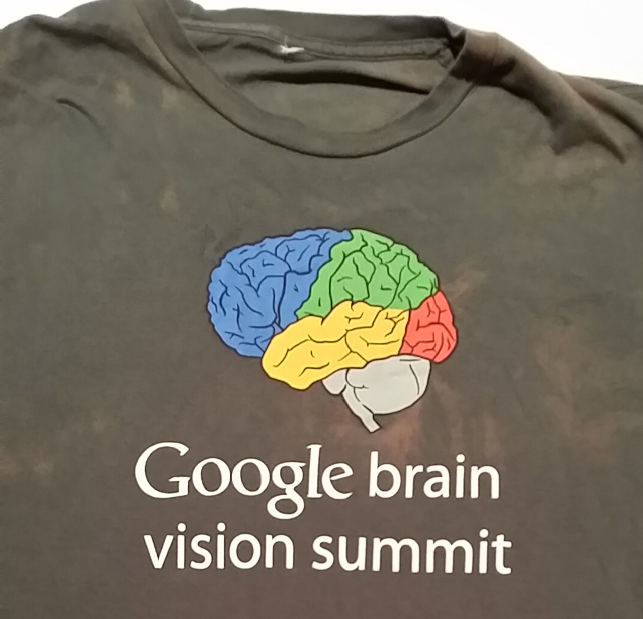
Neural Net T-Shirts

Slide 6
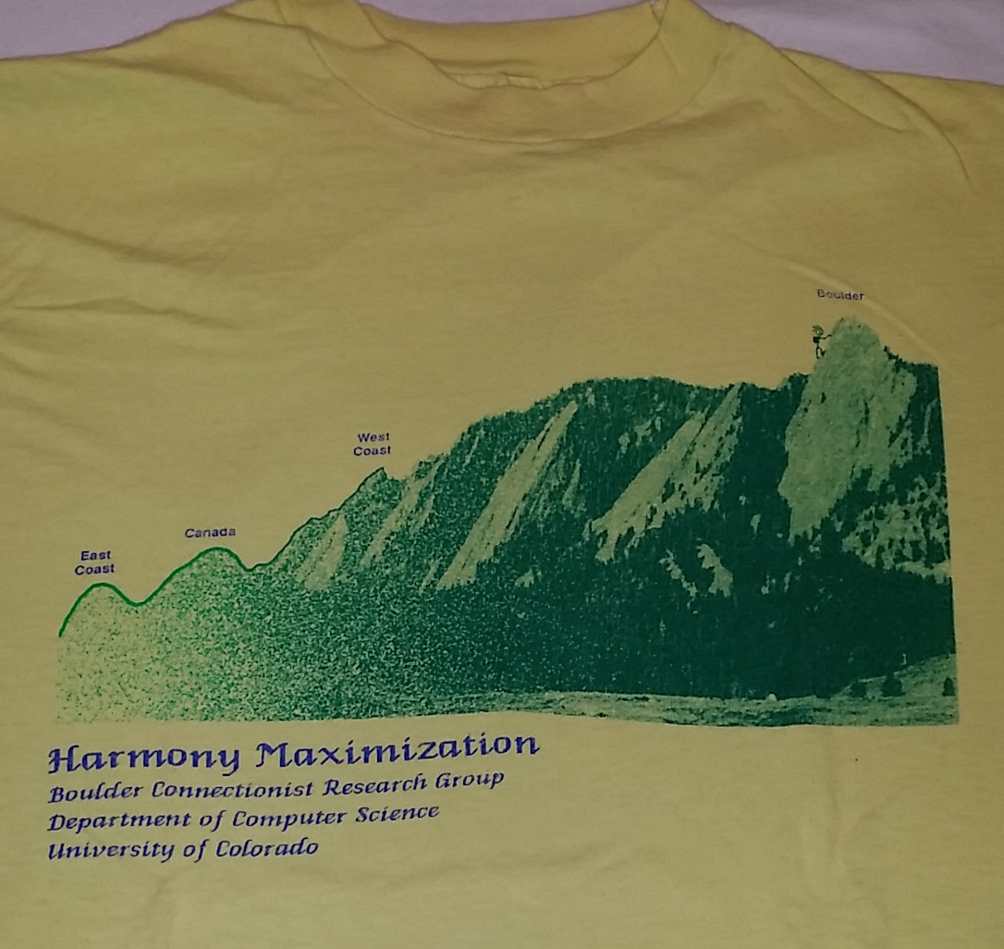
Neural Net T-Shirts

Slide 7
A Brief History Of Deterministic And Stochastic Networks
Boltzmann
Machines /
Harmony Nets
1985
1982
Hopfield
Nets
1986
Back
Propagation
1992 Sigmoid Belief
Networks
2005
Restricted
Boltzmann Machines
and
Deep
Belief
Nets
2009
Deep
Learning
With
Back
Propagation

Slide 9
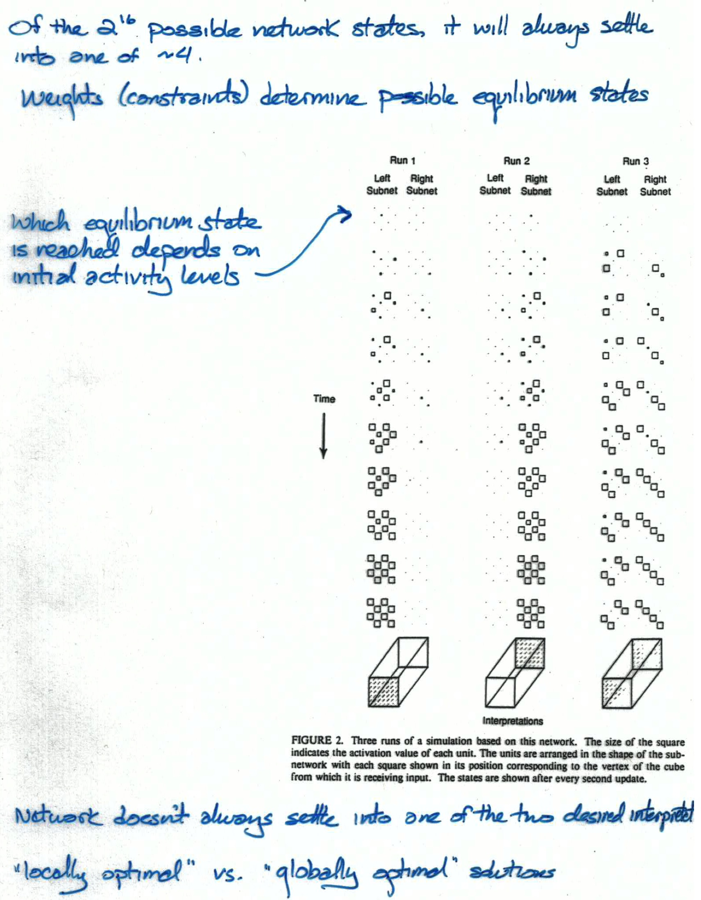

Slide 10
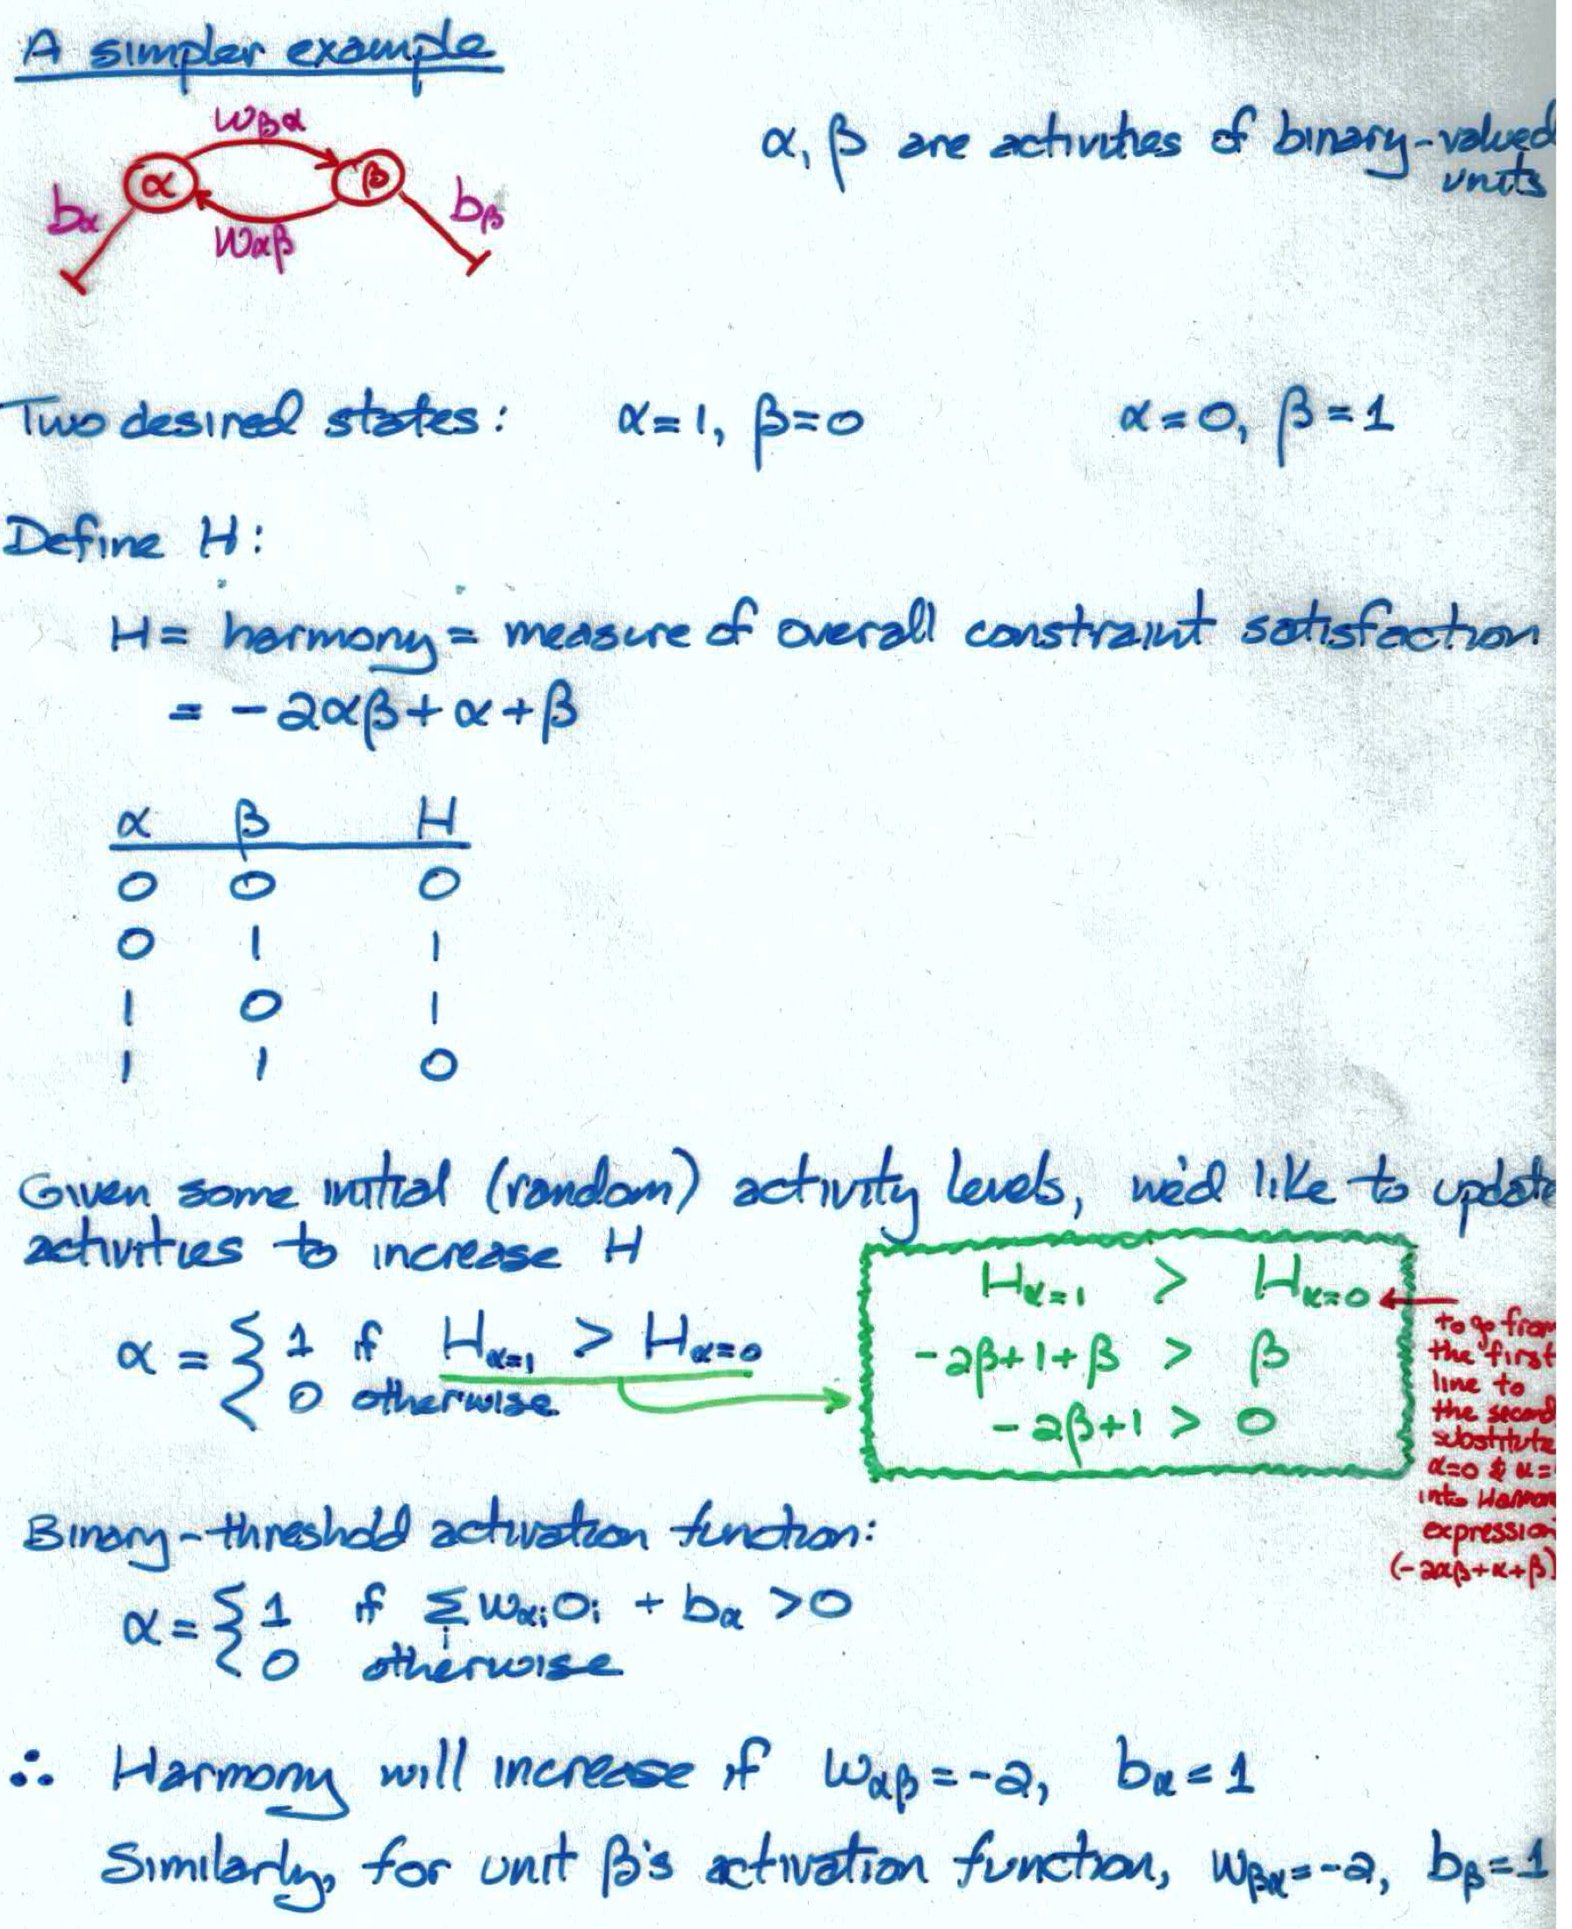

Slide 11
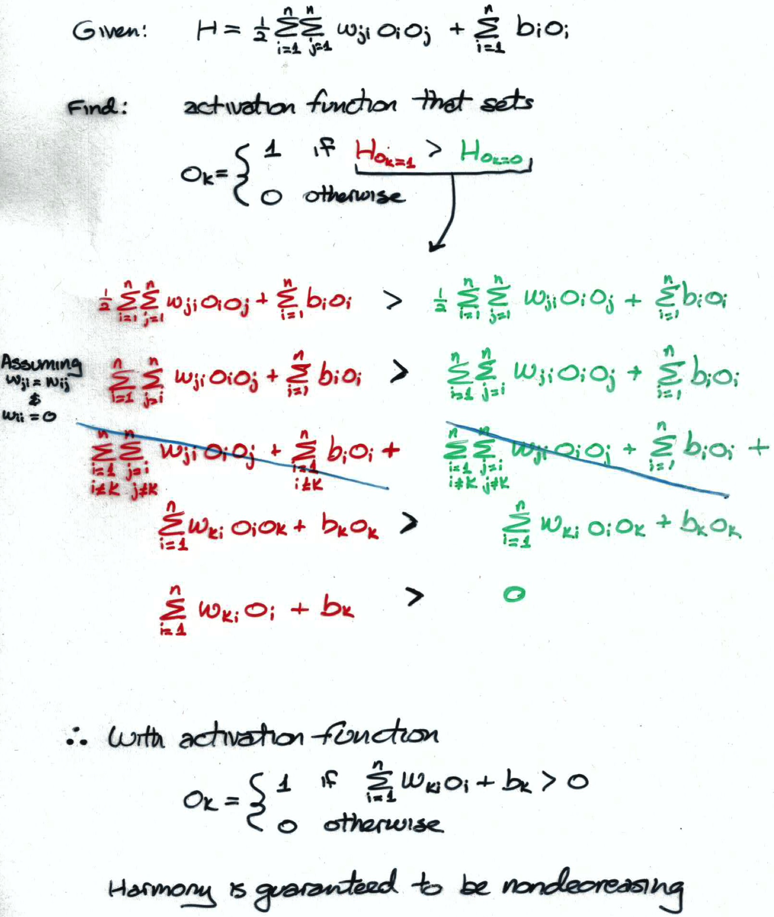

Slide 12
Hopfield Networks
Binary-threshold units
Asynchronous update
Symmetric weights
Solves an optimization problem
minimize energy (or cost or potential)
maximize harmony (or goodness-of-fit)
search for parameters (activities) that produce the best solution

Slide 13
y
h

Slide 14
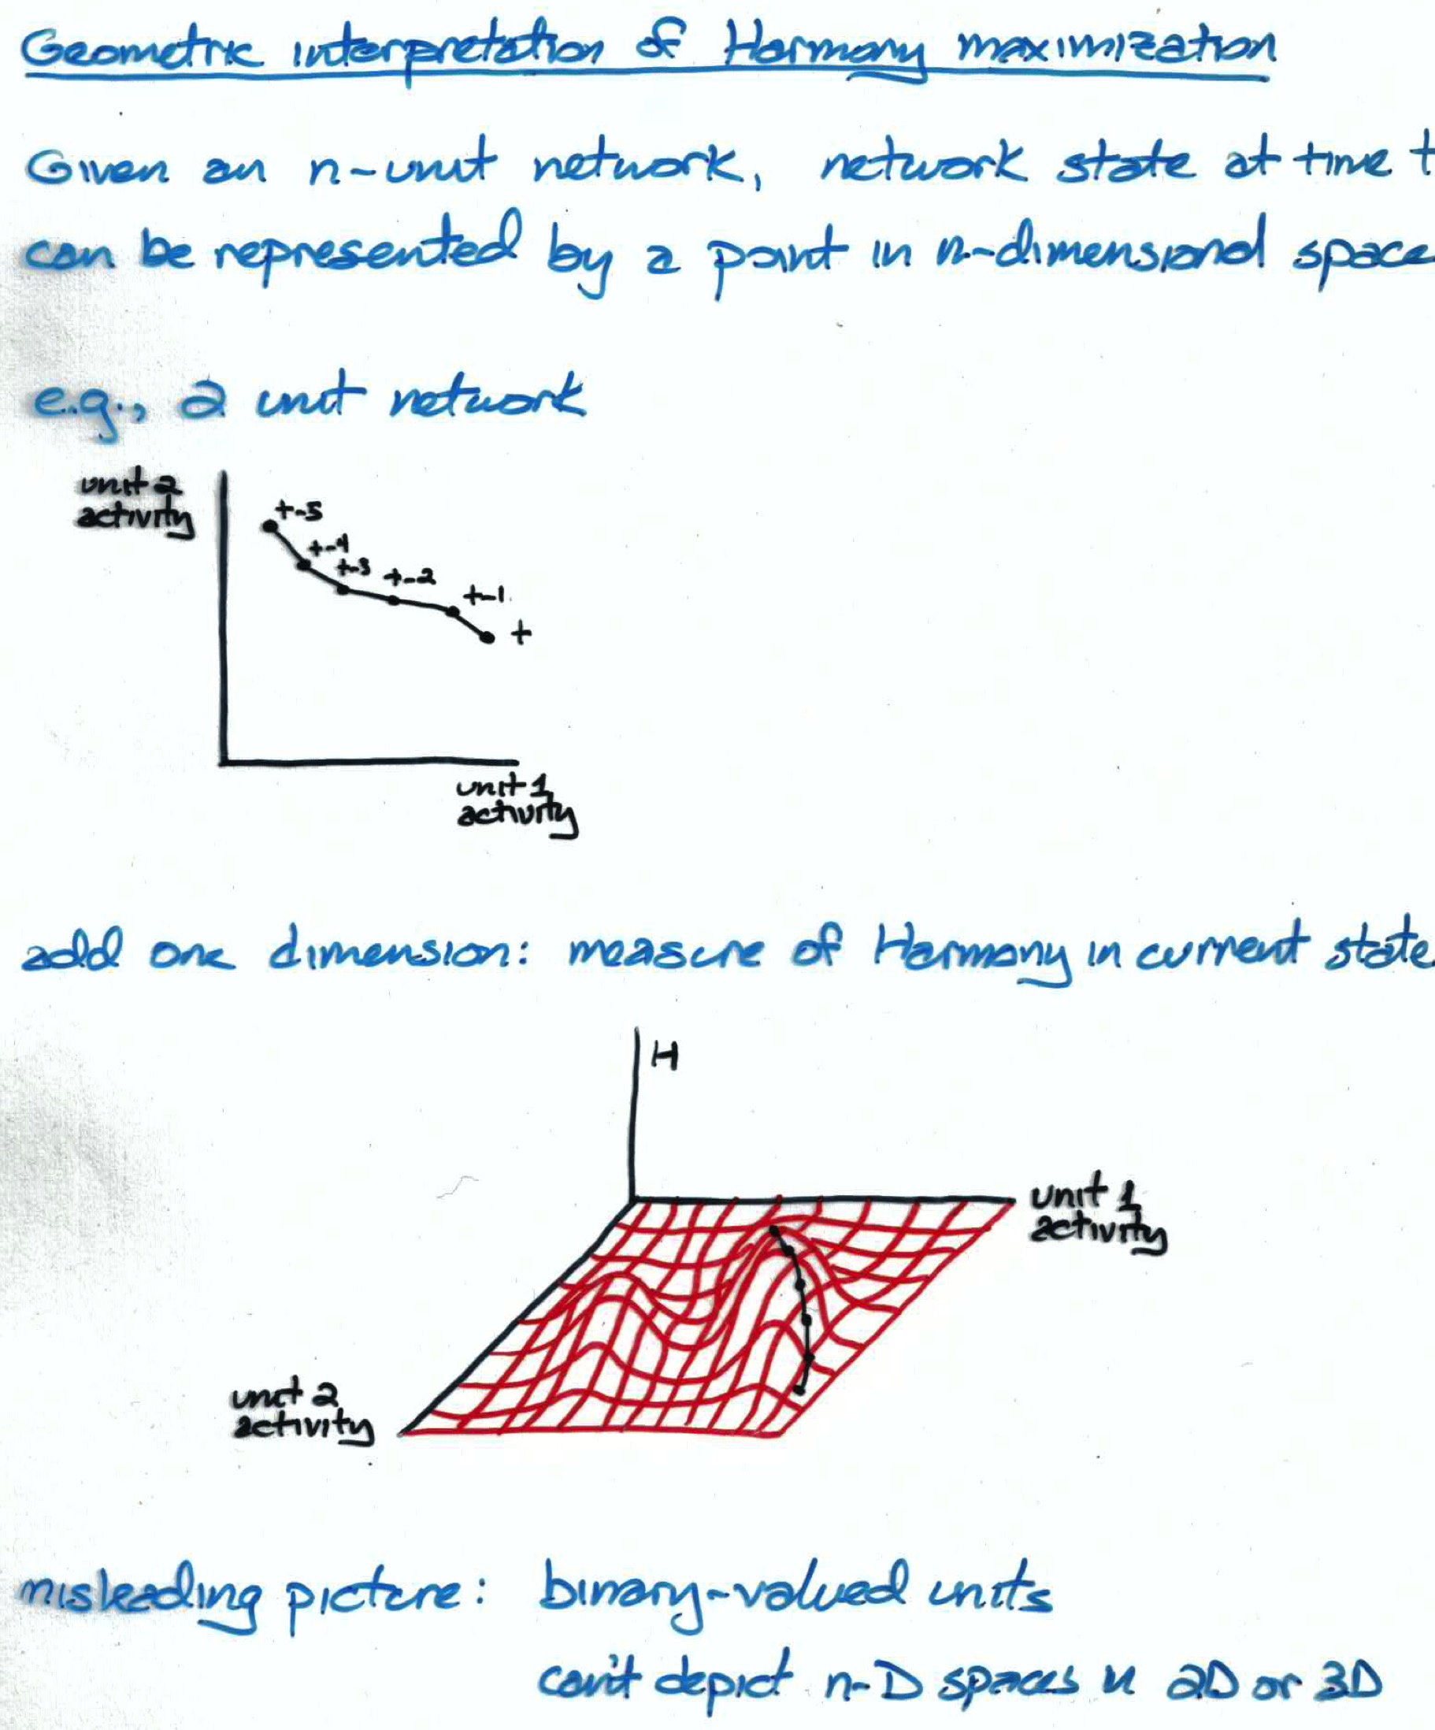

Slide 15
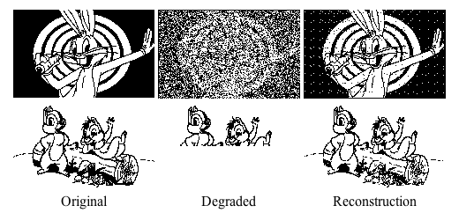
Hopfield Net As Content Addressible Memory
Won’t discuss training procedure because it’s dorky
Hebbian learning
Training on set of patterns causes them to become attractors
Degraded input is mapped to nearest attractor

Slide 16
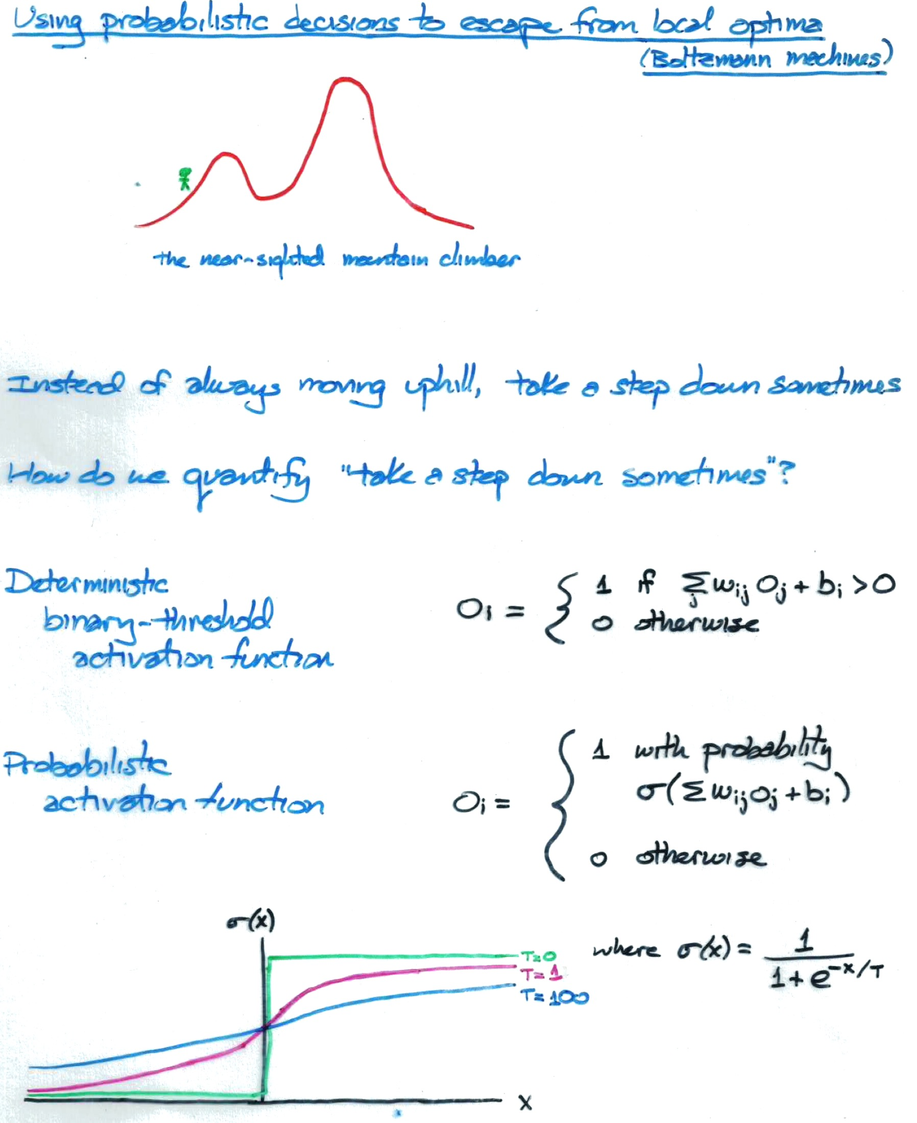

Slide 17
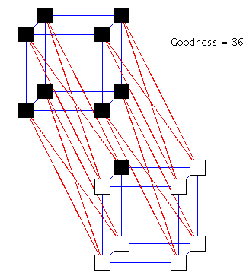
Boltzmann Machine Demo
Necker Cube Demo (Simon Dennis)

Slide 18
How a Boltzmann machine models data

Slide 19
Three Ways To Specify Inputs
Use input to set initial activations
bad idea: initial activations irrelevant once equilibrium is reached
Use input to clamp or freeze unit activations
clamped neurons effectively vanish from network and serve as bias on hidden neurons
Use input to impose strong bias
set b_{i} such that unit i will (almost) always be off or on

Slide 22
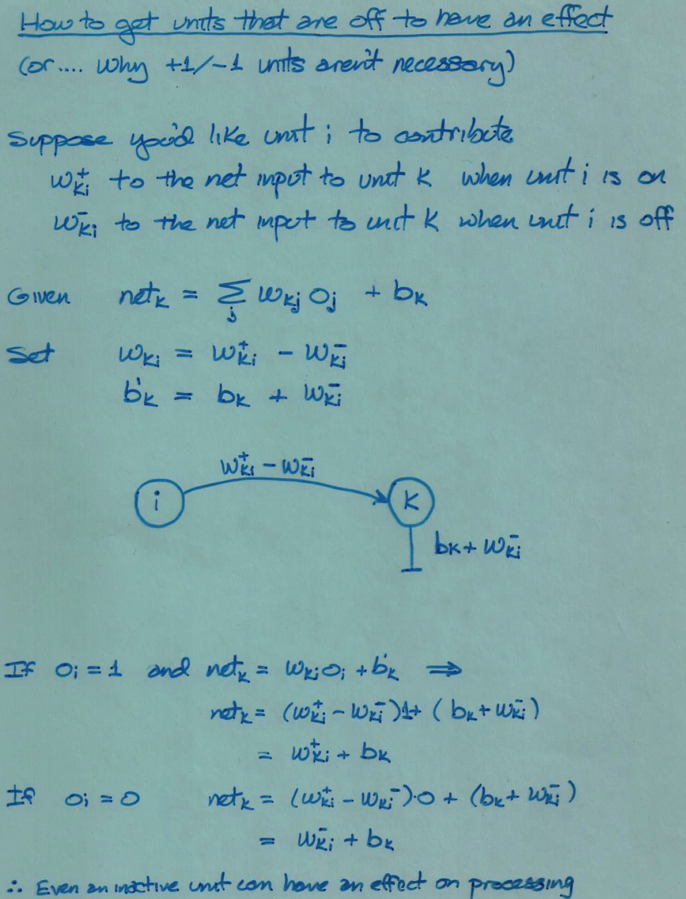

Slide 23
Back To Thermal Equilibrium

Slide 24
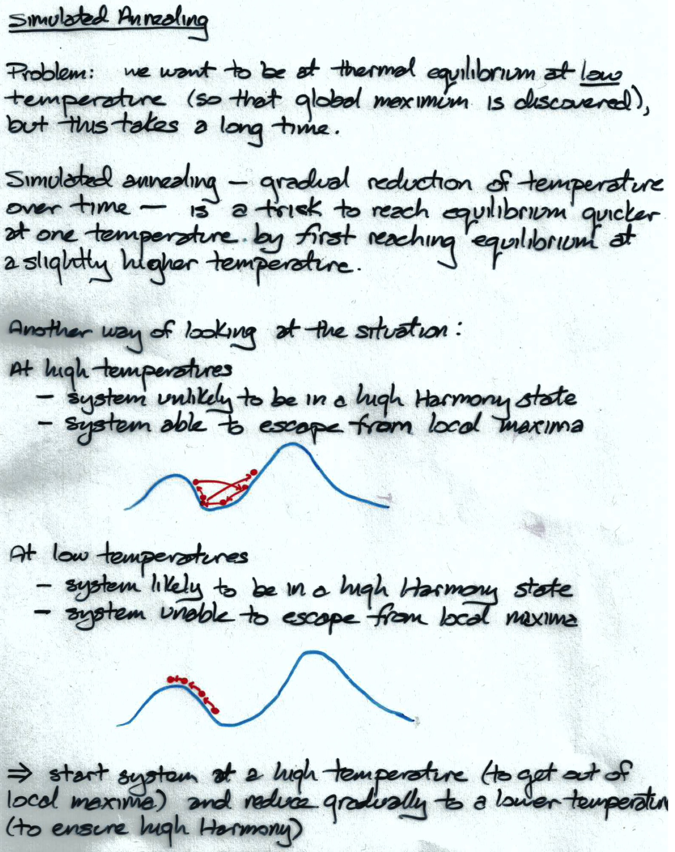
Notes:
statistical physics analogy

Slide 25
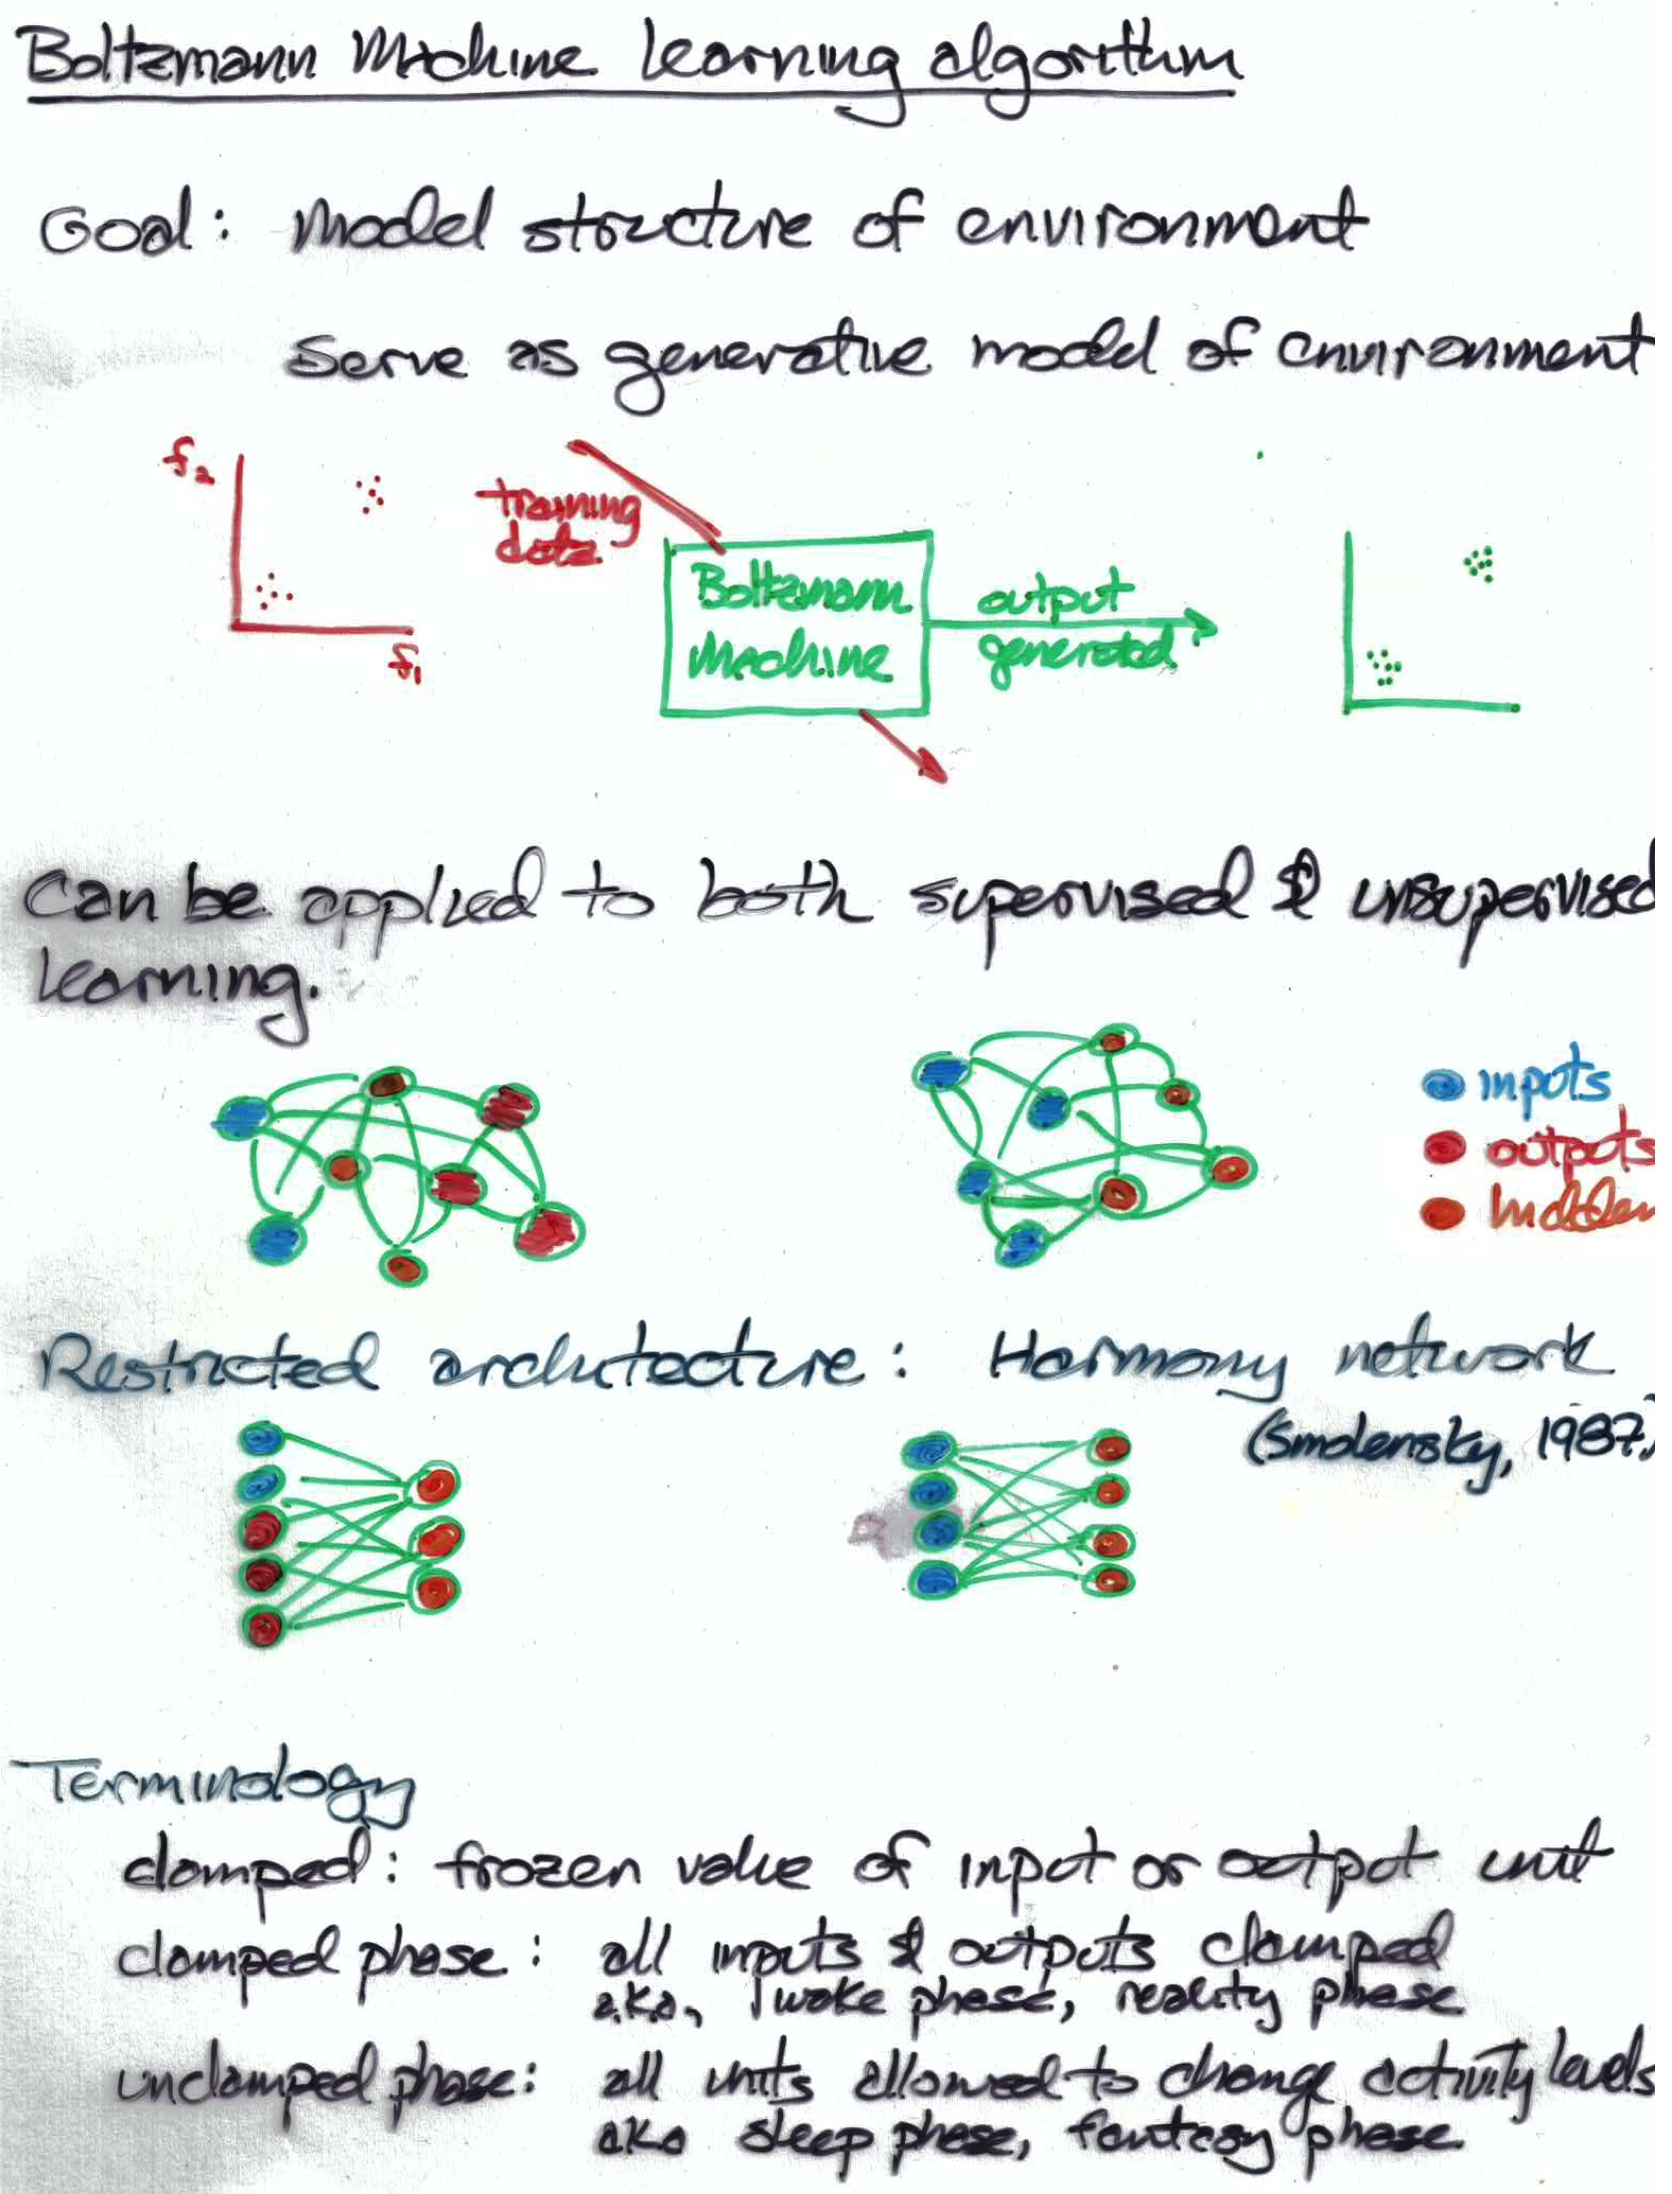

Slide 26
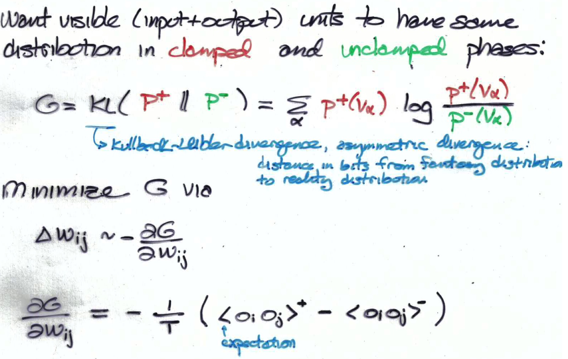
Positive and negative phases
positive phase
clamp visible units set hidden randomly run to equilibrium for given T compute expectations <o_{i}o_{j}>⁺
negative phase
set visible and hidden randomly run to equilibrium for T=1 compute expectations <o_{i}o_{j}>⁻
no need for
back propagation
Notes:
didn’t scale up, computers weren’t fast enough -> people thought boltzmann machines would never be practical

Slide 27
Why Boltzmann Machine Failed
Too slow
loop over training epochs loop over training examples loop over 2 phases (+ and -) loop over annealing schedule for T loop until thermal equilibrium reached loop to sample <o_{i}o_{j}>
Sensitivity to annealing schedule
Difficulty determining when equilibrium is reached
As learning progresses, weights get larger, energy barriers get hard to break -> becomes even slower
Back prop was invented shortly after
The need to perform pattern completion wasn’t necessary for most problems (feedforward nets sufficed)

Slide 28
Comments On Boltzmann Machine Learning Algorithm
No need for back propagation
reaching thermal equilibrium involves propagating information through network
Positive and negative phase
positive phase
clamp visible units set hidden randomly run to equilibrium for T=1 compute expectations <o_{i}o_{j}>⁺
negative phase
set visible and hidden randomly run to equilibrium for T=1 compute expectations <o_{i}o_{j}>⁻
Why Boltzmann machine failed (circa 1985)

Slide 29
Restricted Boltzmann Machine (also known as Harmony Network)
Architecture
Why positive phase is trivial
Contrastive divergence algorithm
Example of RBM learning
Notes:
gibbs sampling /
what if inputs are continuous: then make input units linear with gaussian noise

Slide 30
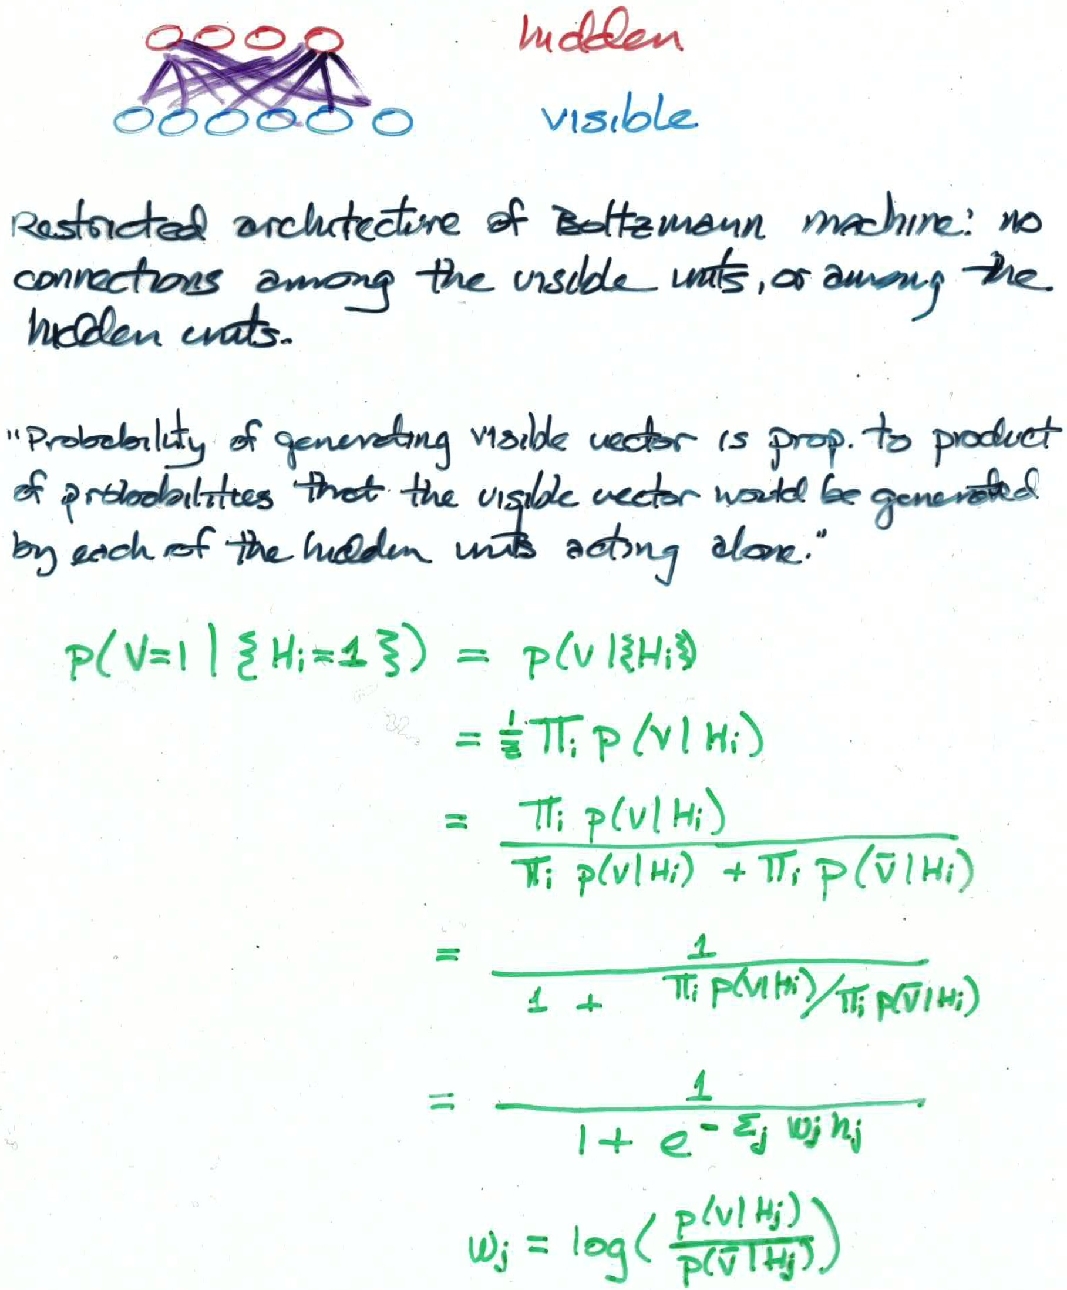
RBM Generative Model As A Product Of Experts

Slide 31
Deep RBM Autoencoder
Hinton & Salakhutdinov (2006)
Notes:
Guarantee that stacking improves

Slide 35
Deep Belief Nets (DBNs): Using Stacked RBMs As A Generative Model
H3
H2
H3
H2
H2
H1
H1
H1
V
V
Generative model is not a Boltzmann machine
Why do we need symmetric connections between H2 and H3?

Slide 36
Using A DBN For Supervised Learning
1. Train RBMs in unsupervised fashion
2. In final RBM, include additional units representing class labels
3a. Recognition model
Use feedforward weights and fine tune with back prop
3b. Generative model
Alternating Gibbs sampling between H3 and H4, and feedback weights elsewhere
H1
H2
H3
V
H1
H2
H4
L
H3
L
L
H4
H4
H3
H3
H2
H2
H1
H1
V
V

Slide 37
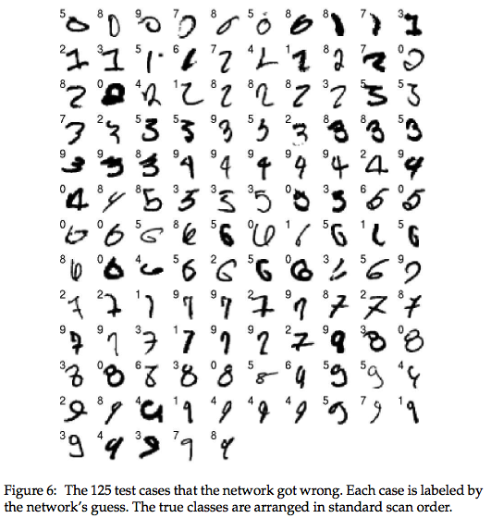
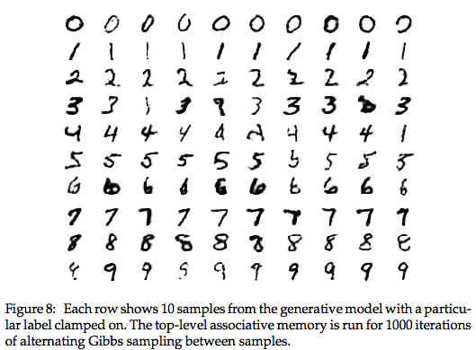
Performance on MNIST (Hinton, Osindero, & Teh, 2006)
recognition model
generative model

