Slide 1
Speech Recognition
Deep Learning and Neural Nets
Spring 2015

Slide 2
Radar, Circa 1995

Slide 3
Microsoft Demo, Circa 2012
youtube video, start @ 3:10
for entertainment, turn on closed captioning

Slide 4
Acoustic Models
Specify P(phoneme | audio signal)
Instead of phoneme, typically some smaller phonetic unit that describes sounds of language
allophone: one alternate way of pronouncing phoneme (e.g., p in pin vs. spin)
context-sensitive allophones: even more specific
~ 2000-
Instead of raw audio signal, typically some features extracted from signal
e.g., MFCC – mel frequency cepstral coefficients
e.g., pitch

Slide 5
Acoustic Models Used With HMMs
HMMs are generative models, and thus require
P(audio signal | phoneme)
Neural net trained discriminatively learns
P(phoneme | audio signal)
But Bayes rule lets you transform:
P(audio | phoneme) ~ P(phoneme | audio) / P(phoneme)
normalization constant doesn’t matter
Phoneme priors obtained from training data

Slide 6
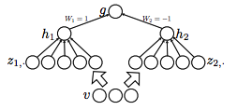
Maxout Networks (Goodfellow, Warde-Farley, Mirza, Courville, & Bengio, 2013)
Each hidden neuron i with input x computes
Each hidden neuron performs piecewise linear approximation to arbitrary convex function
includes ReLU as special case
Notes:
universal approximator: with h1 and h2 connected to linear g with weights +1 and -1, can approximate any function

Slide 7
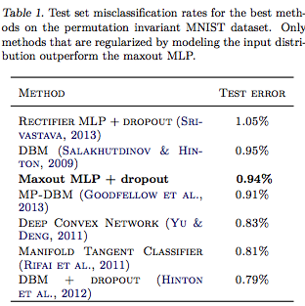
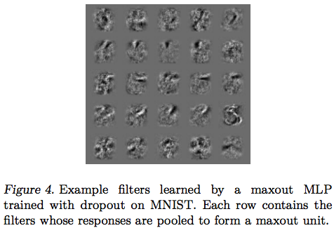
Maxout Results
MNIST
nonconvolutional model
2 fully connected maxout layers + softmax output

Slide 8
Digression To Explain Why Maxout Works
Bagging (Breiman, 1994)
Dropout (Hinton, 2012)

Slide 9
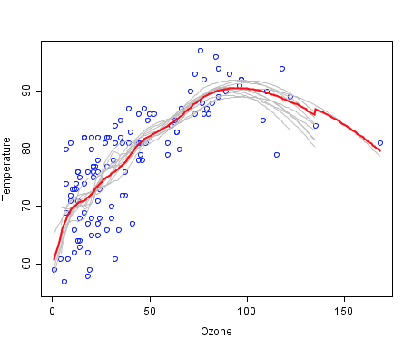
Bootstrap Aggregation or Bagging (Breiman, 1994)
Given training set of size N
Generate M new training sets of size N via bootstrap sampling
uniform sampling with replacement
for large N, ~63% unique samples, the rest are duplicates
Build M models
For regression, average outputs
For classification, voting
source: wikipedia

Slide 10
Dropout
What is dropout?
How is dropout like bagging?
dropout assigns different examples to different models
prediction by combining models
How does dropout differ from bagging?
dropout shares parameters among the models
models trained for only one step

Slide 11
Dropout And Model Averaging
Test time procedure
use all hidden units
divide weights by 2
With one hidden layer and softmax outputs, dropout computes exactly the geometric mean of all the 2^{H} models
What about multiple hidden layers?
approximate model averaging with nonlinear hidden layers
exact model averaging with linear hidden layer

Slide 12
Why Do Maxout Nets Work Well?
Multilayered maxout nets are locally linear -> dropout training yields something very close to model averaging
multilayered tanh nets have lots of local nonlinearity
same argument applies to ReLU
Optimization is easier because error signal is back propagated through every hidden unit
With ReLU, if the net input < 0, the unit does not learn
Gradient flow is diminished to lower layers of the network

Slide 13
Improving DNN Acoustic Models Using Generalized Maxout Networks (Zhang, Trmal, Povey, Khudanpur, 2014)
Replace
with soft maxout
or p-norm maxout
Notes:
ICASSP

Slide 14
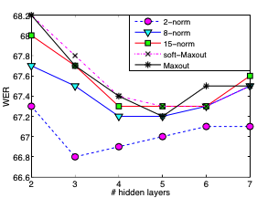
Testing
LimitedLP
10 hours of training data in a language
FullLP
60 or 80 hours of training
Performance measures
WER: word error rate
ATWV: actual term weighted value
Bengali LimitedLP
Notes:
Bengali Limited LP

Slide 15
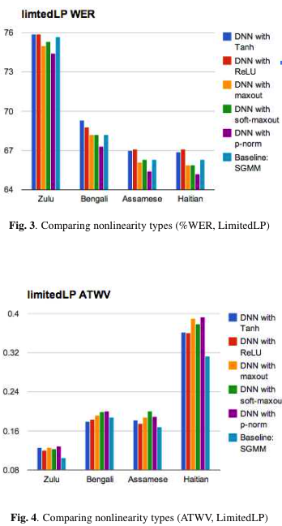

Slide 16
DeepSpeech: Scaling Up End-To-End Speech Recognition (Ng and Baidu Research group, 2014)
50+ yr of evolution of speech recognition systems
Many basic tenets of speech recognition used by everyone
specialized input features
specialized intermediate representations (phoneme like units)
acoustic modeling methods (e.g, GMMs)
HMMs
Hard to beat existing systems because they’re so well engineered
Suppose we toss all of it out and train a recurrent neural net…
Notes:
Andrew Ng (Stanford) was bought by Baidu last year, and they opened a lab in sillicon valley

Slide 17
End-To-End Recognition Task
Input
speech spectrogram
10 ms slices indicate power in various frequency bands
Output
english text transcription
output symbols are letters of english (plus space, period, etc.)

Slide 18
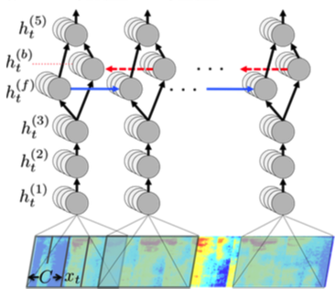
Architecture
softmax output
one output per character
1 layer feedforward
combining forward and backward recurrent outputs
1 recurrent layer
recurrence both forward and backward in time
striding (skipping time steps) for computational efficiency
3 layers feedforward
ReLU with clipping (max activation)
1st hidden layer looks over local window of time (9 frames of context in either direction)
2048 neurons per hidden layer

Slide 19
Tricks I
Dropout
feedforward layers, not recurrent layer
5-10%
Jitter of input
translate raw audio files by 5ms (half a filter bank step) to the left and right
average output probabilities across the 3 jitters
Language model
Find word sequences that are consistent both with net output and an 4-gram language model

Slide 20
Tricks II
Synthesis of noisy training data
additive noise
noise from public video sources
Lombard effect
speakers change pitch or inflections to overcome noise
doesn’t show up in recorded data since environments are quiet
induce Lombard effect by playing loud background noise during data collection
Speaker adaptation
normalize spectral features on a per speaker basis
Notes:
speaker adaptation: helps to listen to speaker for a long time; you adapt to their voice. critical in most ASR systems

Slide 21
Tricks III
Generating supervised training signal
acoustic input and word transcription needs to be aligned… or…
define a loss function for scoring transcriptions produced by network without explicit alignment
CTC – connectionist temporal classification (Graves et al., 2006) provided this loss function

Slide 22
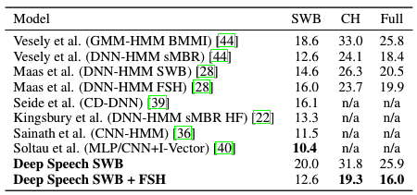
Switchboard corpus
SWB is easy bit
CH is hard bit
FULL is both
Data sets
Notes:
Their model wins when trained on a larger data set

Slide 23
Noisy Speech
Evaluation set
100 noisy and 100 noise-free utterances from 10 speakers
noise environments
background radio or TV, washing dishes, cafeteria, restaurant, inside car while driving in rain

