Slide 1
Where We’re At
Three learning rules
  Hebbian learning regression
  LMS (delta rule) regression
  Perceptron classification

Slide 2
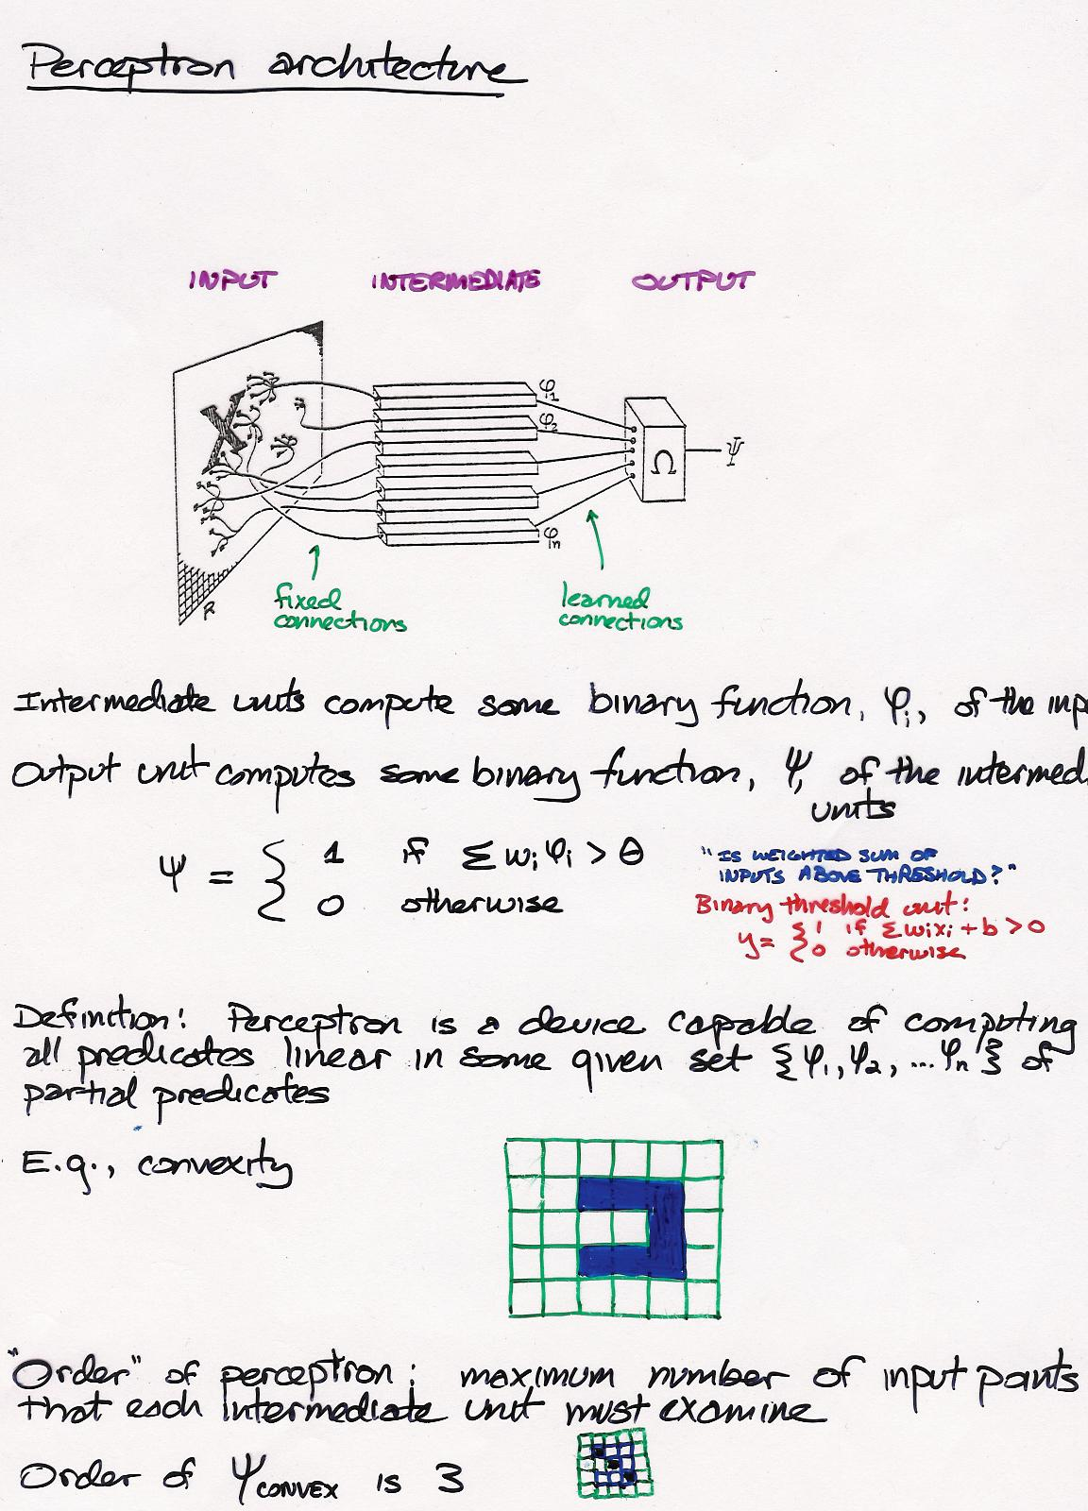
Notes:
note confusion about definition of a perceptron: often used to refer to binary-threshold unit, often to learning algorithm, occasionally to this architecture

Slide 3
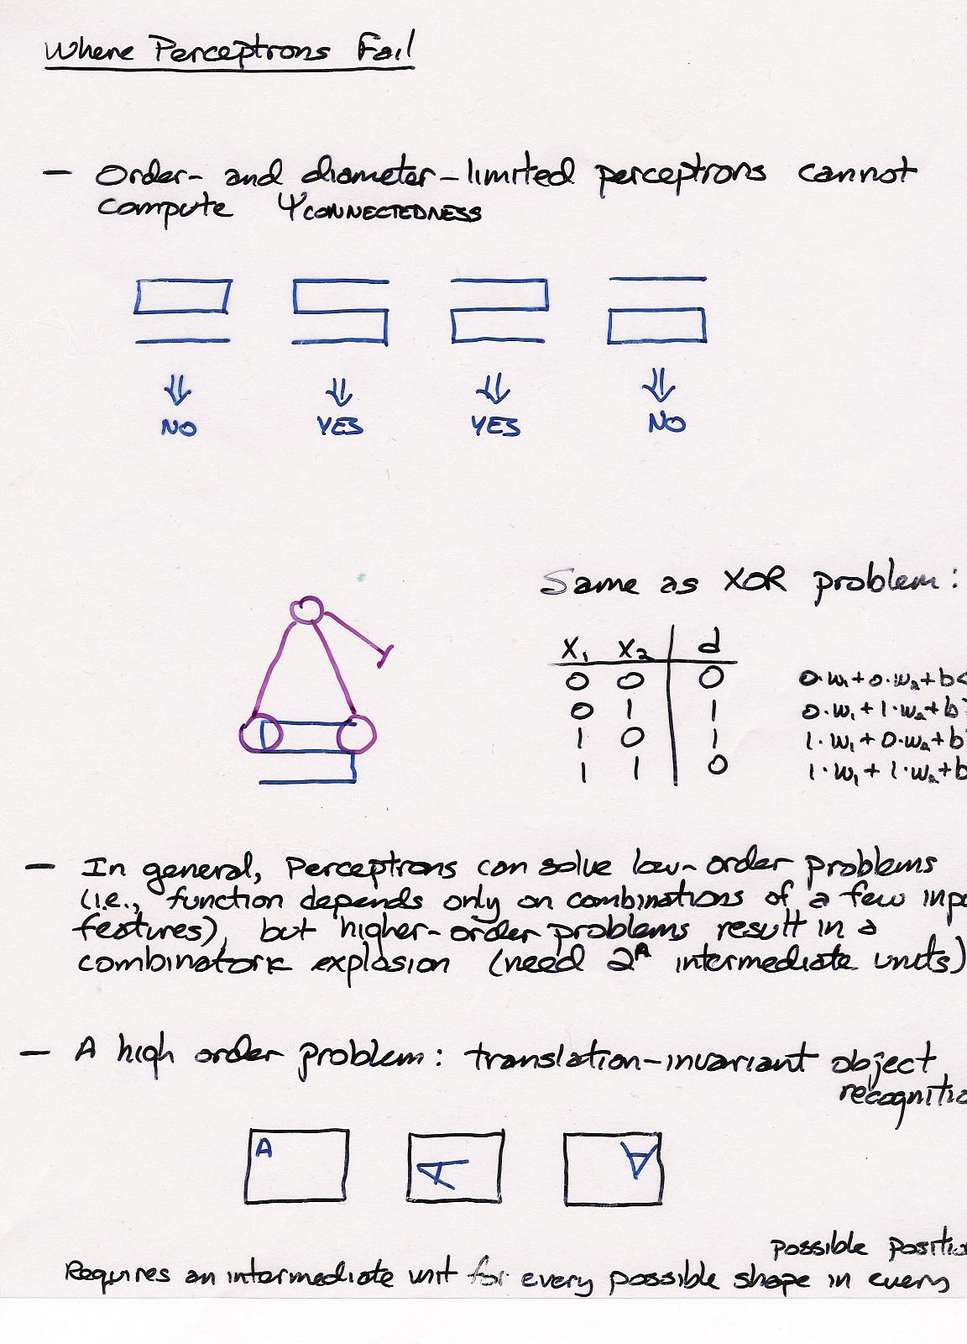
proof?

Slide 4
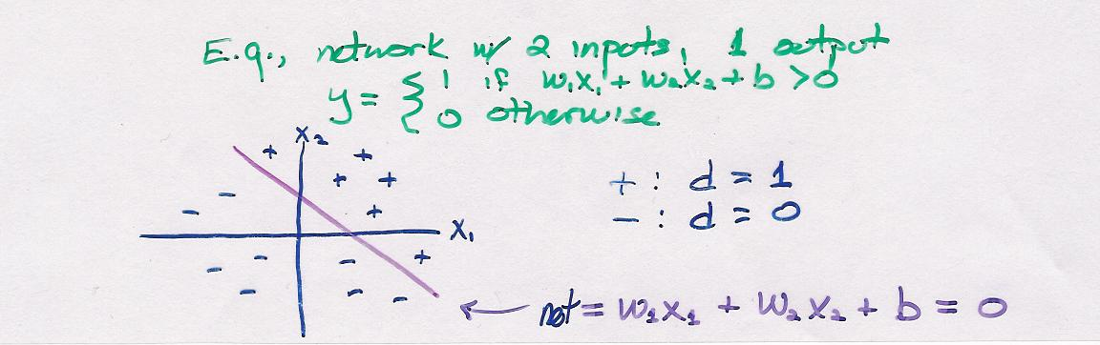
Where Perceptrons Fail
Perceptrons require linear separability
  a hyperplane must exist that can separate positive and negative examples
  perceptron weights define this hyperplane

Slide 5
Limitations of Hebbian Learning
With Hebb learning rule, input patterns must be orthogonal to one another.
If input vector has α elements, then at most α arbitrary associations can be learned.

Slide 6
Limitations of Delta Rule (LMS Algorithm)
To guarantee learnability, input patterns must be linearly independent of one another.
  Weaker constraint than orthogonality -> LMS is more powerful algorithm than Hebbian learning.
    What’s the downside of LMS relative to Hebbian learning
  If input vector has α elements, then at most α associations can be learned.

Slide 7
Exploiting Linear Dependence
For both Hebbian learning and LMS, more than α associations can be learned if one association is a linear combination of the others.
Note:
x⁽³⁾ = x⁽¹⁾ + 2 x⁽²⁾
d⁽³⁾ = d⁽¹⁾ + 2 d⁽²⁾
example # | x₁ | x₂ | desired output
1 | .4 | .6 | -1
2 | -.6 | -.4 | +1
3 | -.8 | -.2 | +1

Slide 8

The Perils Of Linear Interpolation

Slide 9
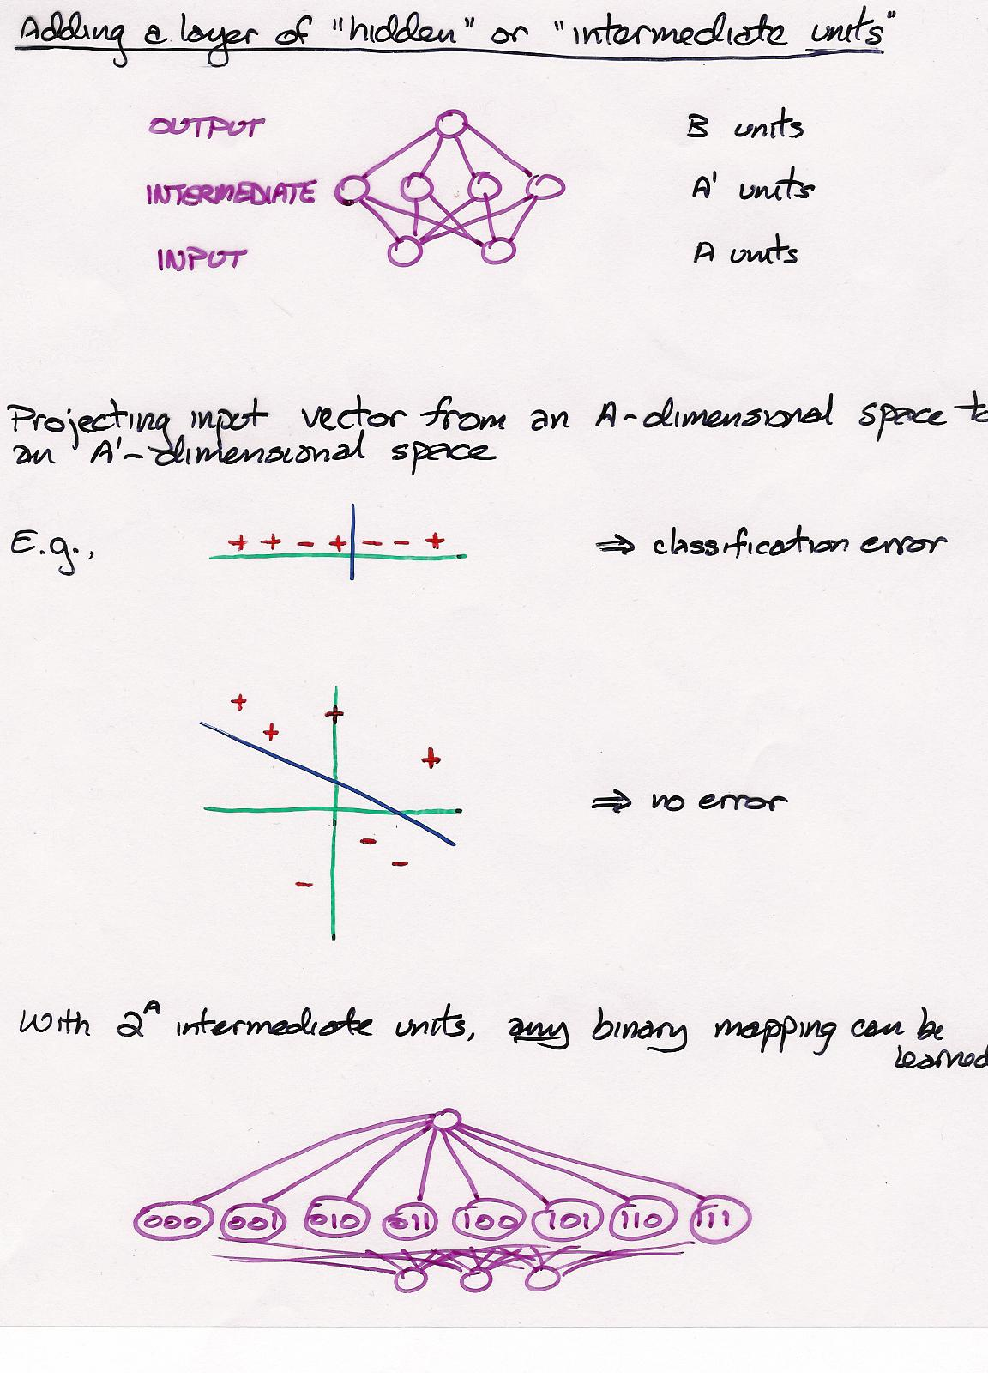

Slide 10
Hidden Representations
Exponential number of hidden units is bad
  Large network
  Poor generalization
With domain knowledge, we could pick an appropriate hidden representation.
  E.g., perceptron scheme
Alternative: learn hidden representation
Problem
  Where does training signal come from?
  Teacher specifies desired outputs, not desired hidden unit activities.

Slide 11
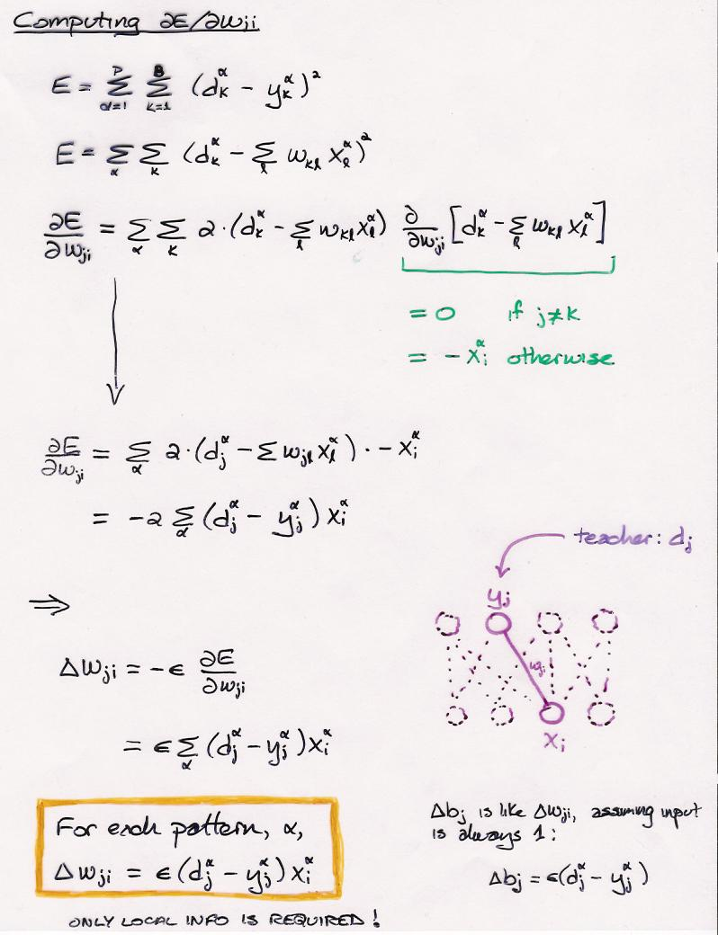
Challenge: adapt algorithm for the case where the actual output should be ≥ desired output
i.e.,

Slide 13
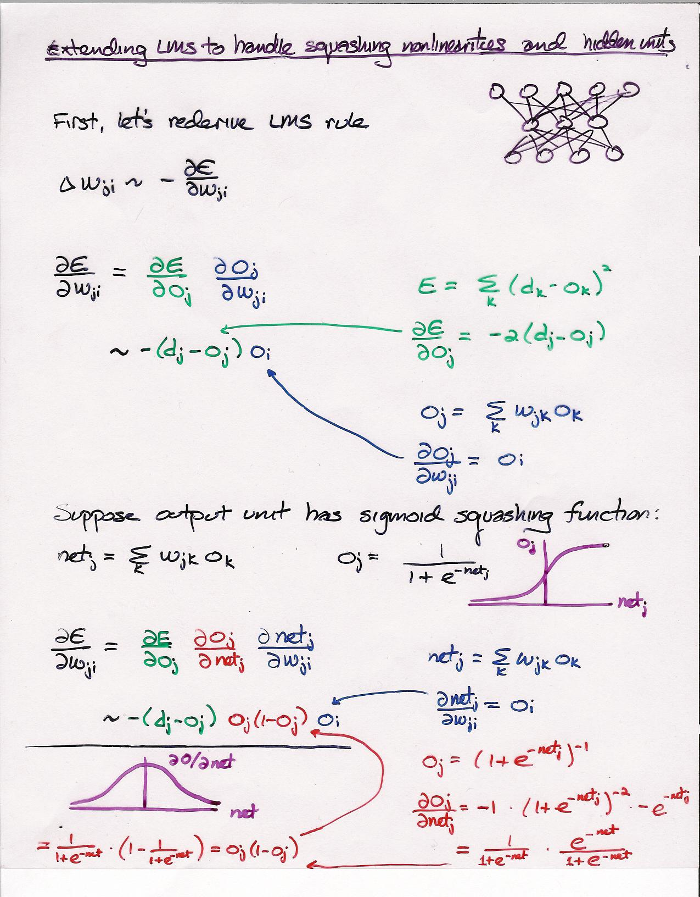

Slide 14
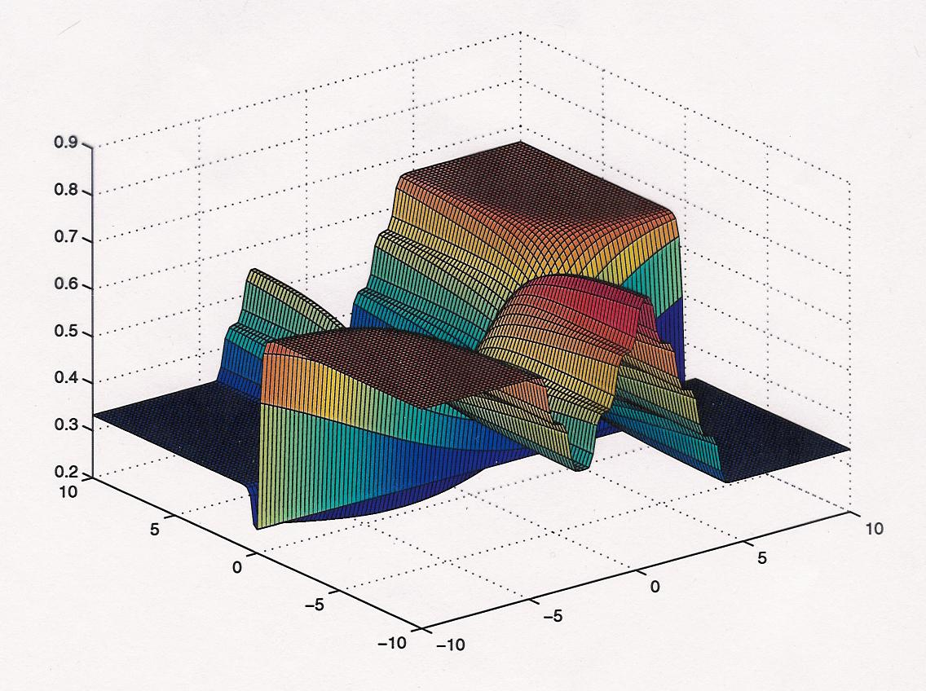

Slide 15
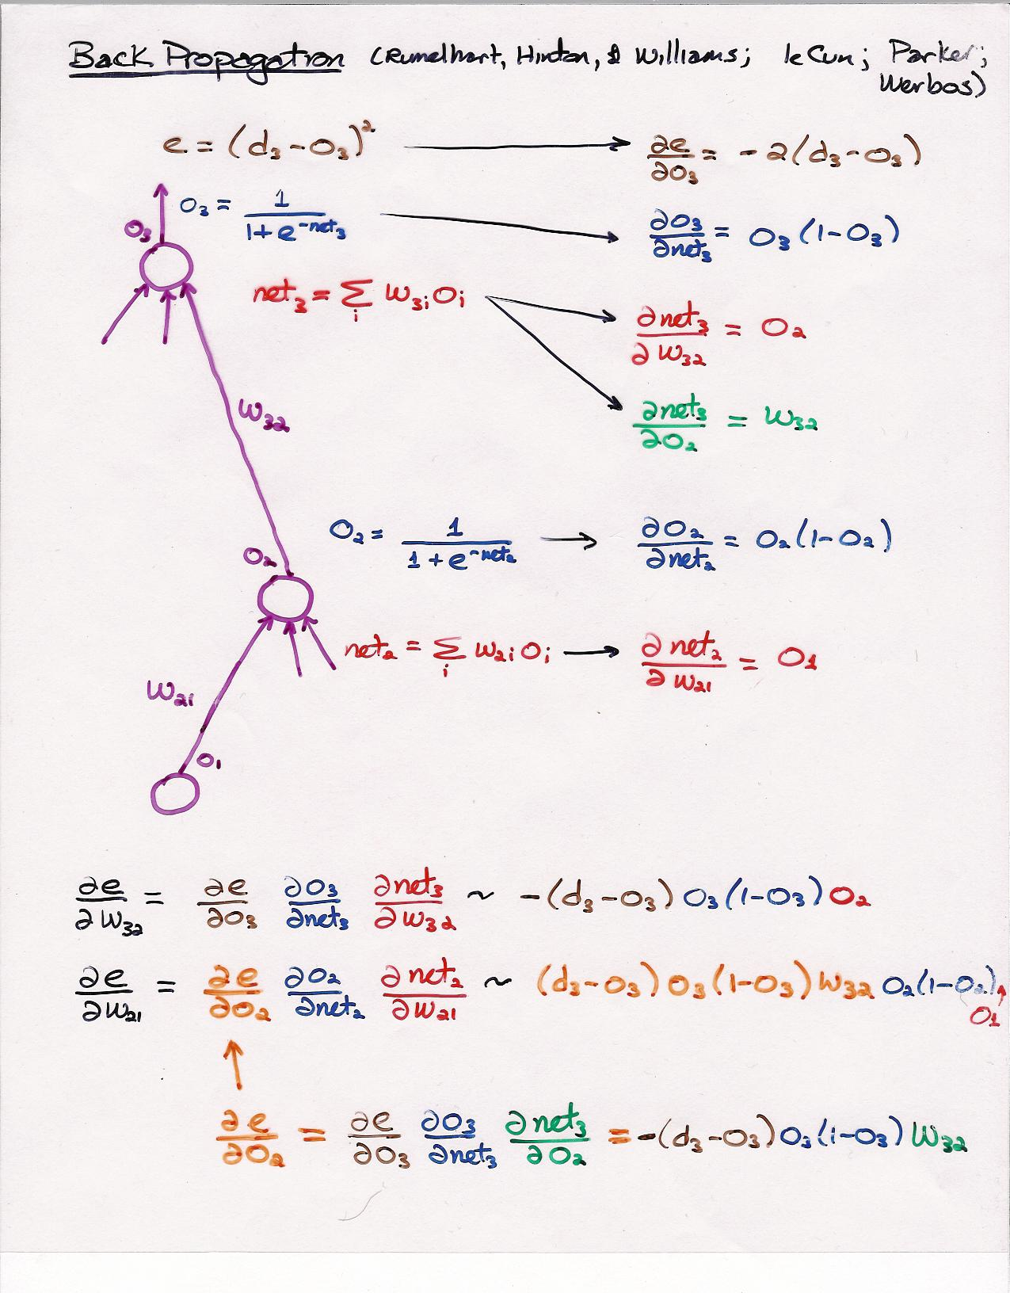

Slide 16
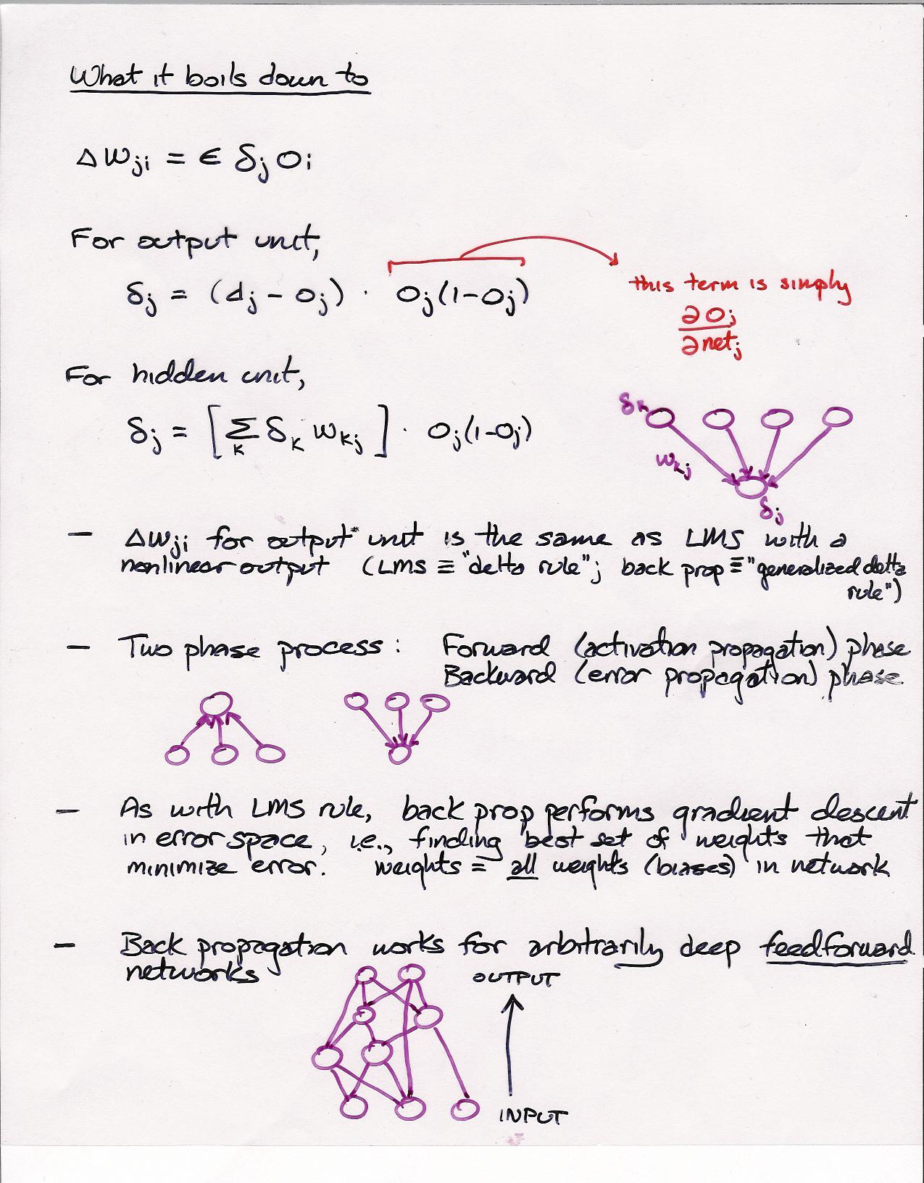

Slide 17
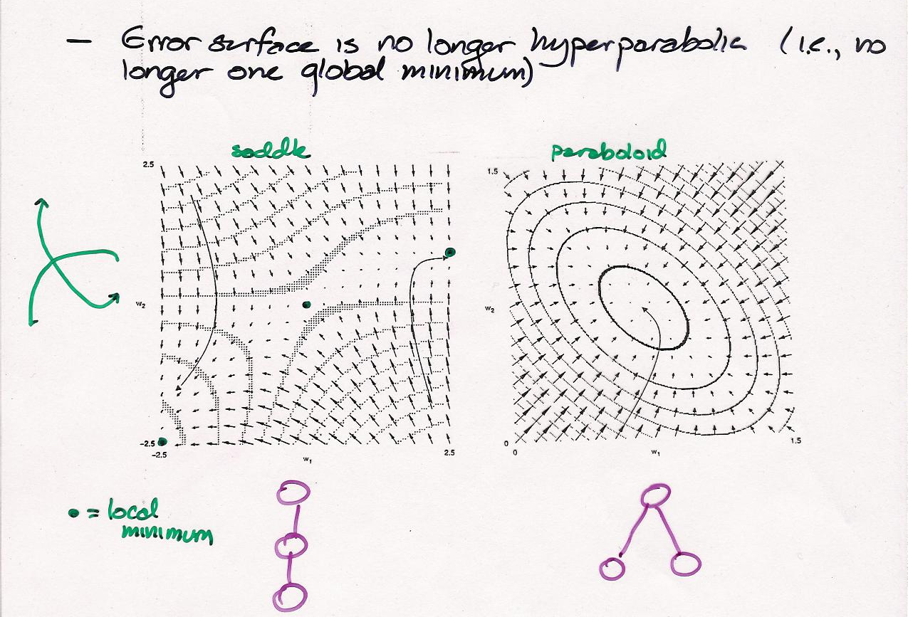

Slide 18
Why Are Nonlinearities Necessary?
Prove
  A network with a linear hidden layer has no more functionality than a network with no hidden layer (i.e., direct connections from input to output)
  For example, a network with a linear hidden layer cannot learn XOR
z
V
y
W
x

Slide 19
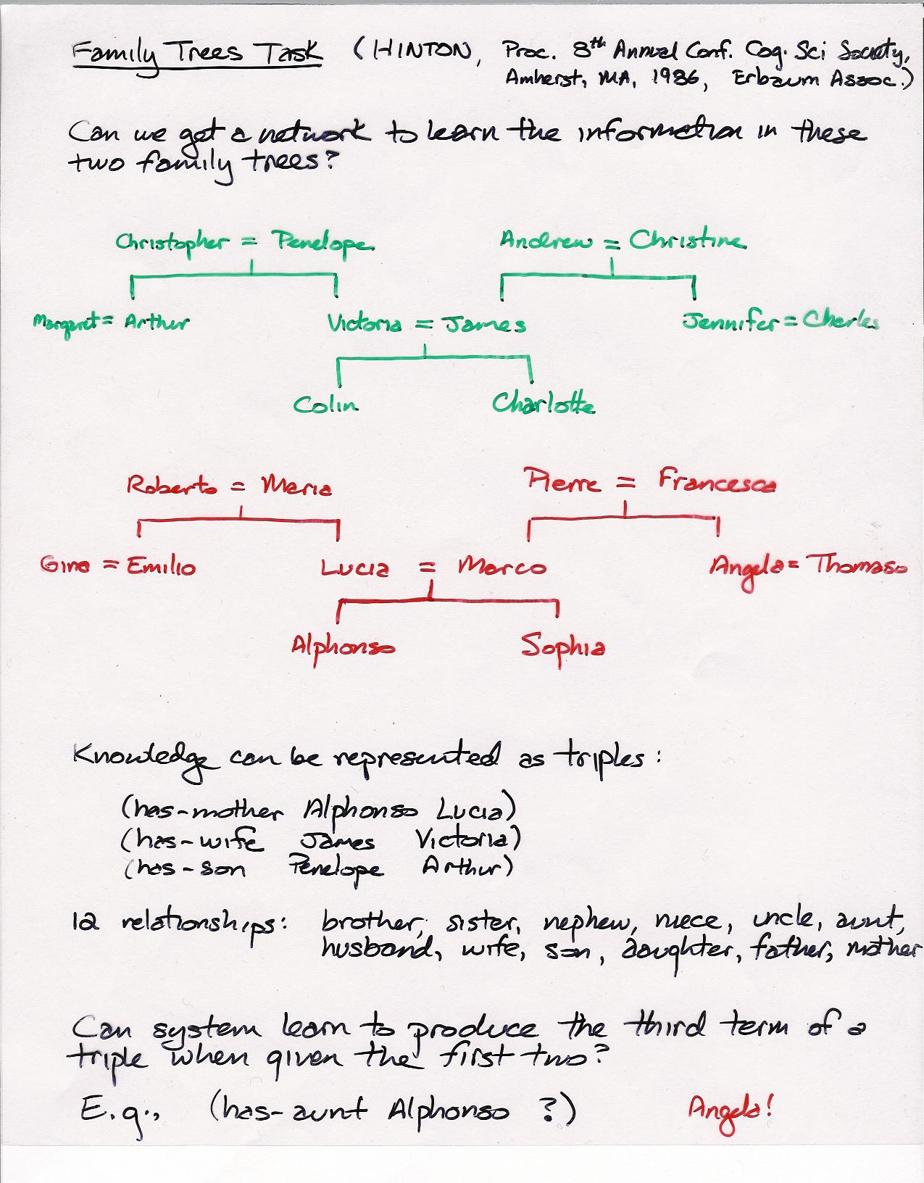

Slide 20
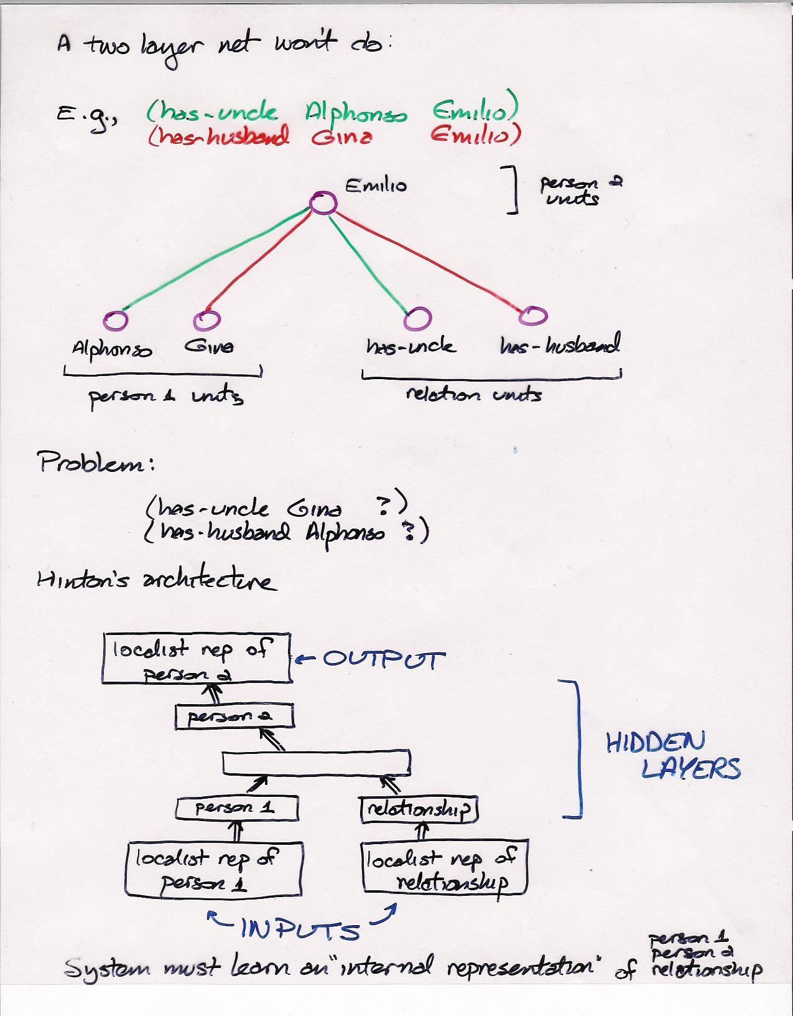

Slide 21
