Slide 1
Neural Net Language Models
Deep Learning and Neural Nets
Spring 2015

Slide 2
Statistical Language Models
Try predicting word t given previous words in string
  “I like to eat peanut butter and …”
  P(w_{t} | w₁, w₂, …, w_{t-1})
Why can’t you do this with a conditional probability table?
Solution
  n-th order Markov model
  P(w_{t} | w_{t-n}, w_{t-n+1}, …, w_{t-1})

Slide 3
N-grams
n-th order markov model needs data on sequences of n+1 words
Google n-gram viewer

Slide 4
What Order Model Is Practical?
~170k words in use in English
~20k word (families) in use by an educated speaker
1st order Markov model
  400M cells
  if common bigrams are 1000 more likely than uncommon bigrams, then you need 400B examples to train a decent bigram model
higher order Markov models
  data sparsity problem grows exponentially worse
Google gang is elusive, but based on conversations, maybe they’re up to 7th or 8th order models
  Tricks like smoothing, stemming, adaptive context, etc.

Slide 5
Neural Probabilistic Language Models
(Bengio et al., 2003)
Instead of treating words as tokens, exploit semantic similarity
  Learn a distributed representation of words that will allow sentences like these to be seen as similar
    The cat is walking in the bedroom.
    A dog was walking in the room.
    The cat is running in a room.
    The dog was running in the bedroom.
    etc.
  Use a neural net to represent the conditional probability function P(w_{t} | w_{t-n}, w_{t-n+1}, …, w_{t-1})
  Learn the word representation and the probability function simultaneously

Slide 6
Hinton Video
Neural probabilistic language models

Slide 7
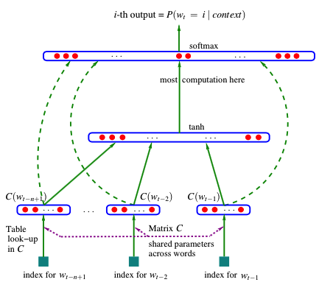
Scaling Properties Of Model
Adding a word to vocabulary
  cost: #H₁ connections
Increasing model order
  cost: #H₁ X #H₂ connections
Compare to exponential growth with probability table look up
H₂
H₁

Slide 8
Performance
Perplexity
  geometric average of 1/P(w_{t} | w₁, w₂, …, w_{t-1})
  smaller is better
Corpora
  Brown
    1.18M word tokens, 48k word types
    vocabulary size reduced to 16,383 by merging rare words
    800k used for training, 200k for validation, 181k for testing
  AP
    16M word tokens, 149k word types
    vocabulary size reduced to 17964 by merging rare word, ignoring case
    14M training, 1M validation, 1M testing

Slide 9
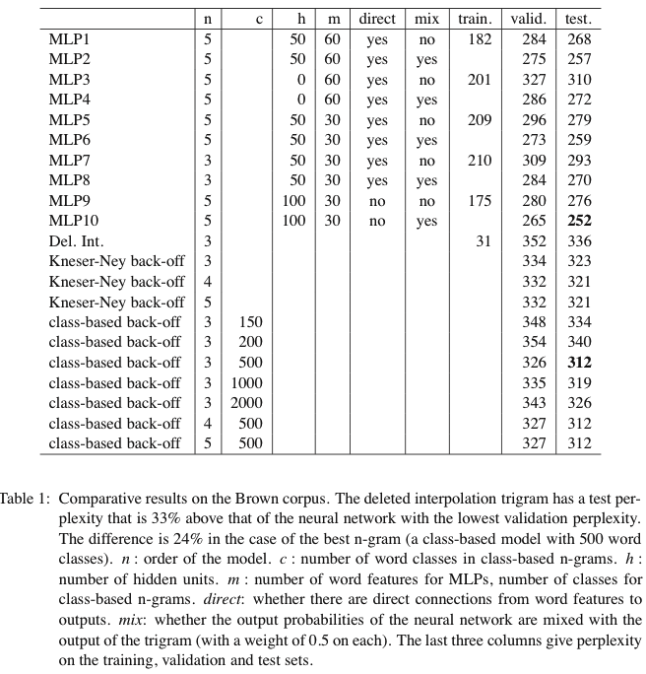
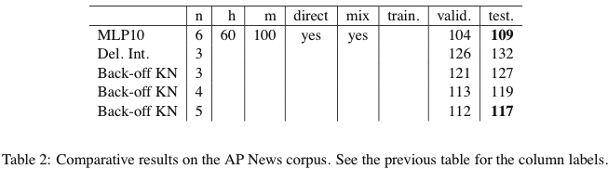
Performance
Pick best model in class based on validation performance and assess test performance
24% difference
in perplexity
8% difference
in perplexity
Notes:
remember, this was ~2000

Slide 10
Model Mixture
Combine predictions of a trigram model with neural net
  could ask neural net to learn only what trigram model fails to predict
    E = (target – trigram_model_out – neural_net_out)²
  weighting on prediction can be
  determined by cross validation
+
neural
net
trigram
model

Slide 11
Hinton Video
Dealing with large number of possible outputs

Slide 12
Domain Adaptation For Large-Scale Sentiment Classification (Glorot, Bordes, Bengio, 2011)
Sentiment Classification / Analysis
  determine polarity (pos vs. neg) and magnitude of writer’s opinion on some topic
    “the pipes rattled all night long and I couldn’t sleep”
    “the music wailed all night long and I didn’t want to go to sleep”
Common approach using classifiers
  reviews of various products
  bag-of-words input, sometimes includes bigrams
  each review human-labeled with positive or negative sentiment

Slide 13
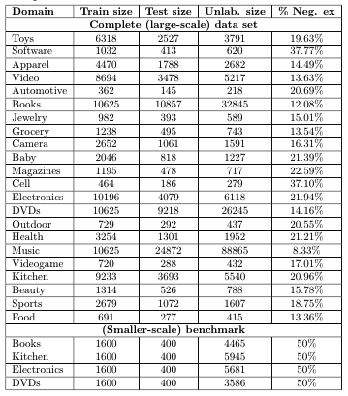
Domain Adaptation
Source domain S
(e.g., toy reviews)
  provides labeled training data
Target domain T
(e.g., food reviews)
  provides unlabeled data
  provides testing data

Slide 14
Approach
Stacked denoising autoencoders
  uses unlabeled data from all domains
  trained sequentially (remember, it was 2011)
  input vectors stochastically corrupted
    not altogether different in higher layers from dropout
    validation testing chose 80% removal (“unusually high”)
Final “deep” representation fed into a linear SVM classifier trained only on source domain
copy

Slide 15
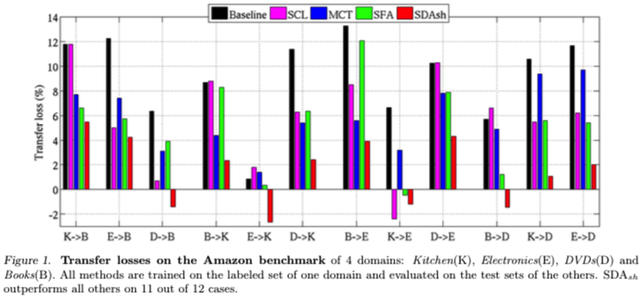
Comparison
Baseline – linear SVM operating on raw words
SCL – structural correspondence learning
MCT – multi-label consensus training (ensemble of SCL)
SFA – spectral feature alignment (between source and target domains)
SDA – stacked denoising autoencoder + linear SVM
Notes:
SDA wins on 11 of 12 transfer tests

Slide 16
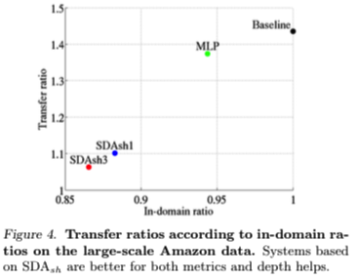
Comparison On Larger Data Set
Architectures
  SDAsh3: 3 hidden layers, each with 5k hidden
  SDAsh1: 1 hidden layer, each with 5k hidden
  MLP: 1 hidden layer, std supervised training
Evaluations
  transfer ratio
    how well do you do on
    S->T transfer vs. T->T training
  in-domain ratio
    how well do you do on T->T
    training relative to baseline

Slide 17
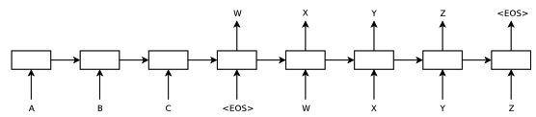
Sequence-To-Sequence Learning
(Sutskever, Vinyals, Le, 2014)
Map input sentence (e.g., A-B-C) to output sentence (e.g., W-X-Y-Z)

Slide 18
Approach
Use LSTM to learn a representation of the input sequence
Use input representation to condition a production model of the output sequence
Key ideas
  deep architecture
    LSTM_{in} and LSTM_{out} each have 4 layers with 1000 neurons
  reverse order of words in input sequence
    abc -> xyz vs. cba -> xyz
    better ties early words of source sentence with early words of target sentence
LSTM_{in}
LSTM_{out}
INPUT
OUTPUT

Slide 19
Details
input vocabulary 160k words
output vocabulary 80k words
  implemented as softmax
Use ensemble of 5 networks
Sentence generation requires stochastic selection
  instead of selecting one word at random and feeding it back, keep track of top candidates
  left-to-right beam search decoder

Slide 20
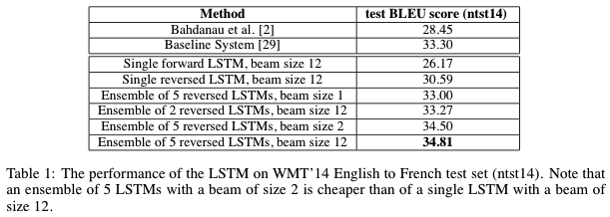
Evaluation
English-to-French WMT-14 translation task
(Workshop on Machine Translation, 2014)
Ensemble of deep LSTM
  BLEU score 34.8
  “best result achieved by direct translation with a large neural net”
Using ensemble to recore 1000-best lists of results produced by statistical machine translation systems
  BLEU score 36.5
Best published result
  BLEU score 37.0
Notes:
Workshop on machine translation 2014

Slide 21
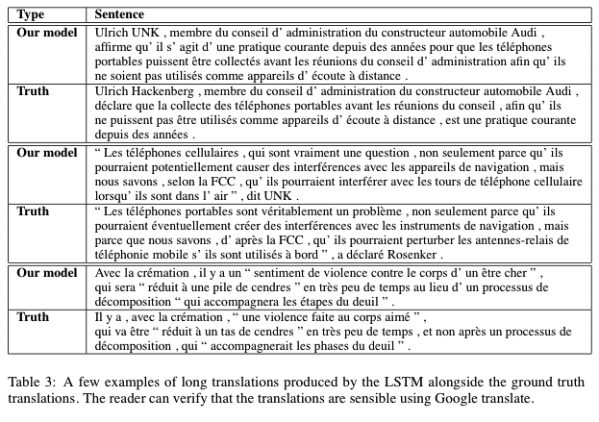
Translation

Slide 22
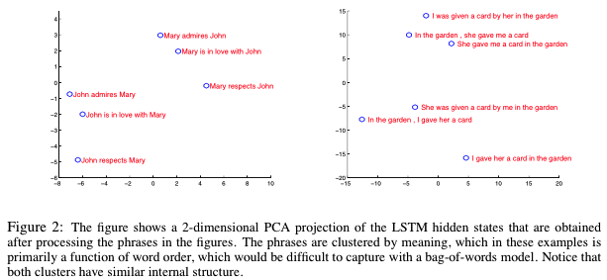
Interpreting LSTM_{in} Representations

