Slide 1
Neural Network Intro Slides
Michael Mozer
Spring 2015

Slide 2
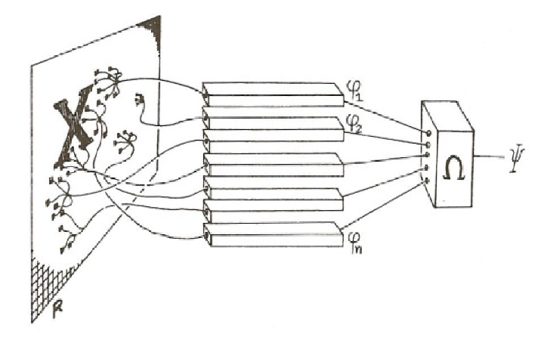
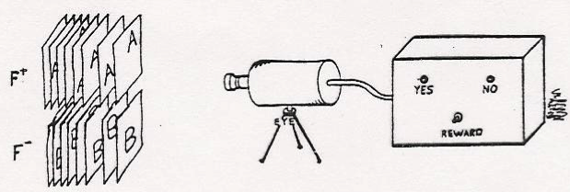
A Brief History Of Neural Networks
1962
    Frank Rosenblatt, Principles of Neurodynamics: Perceptrons and the Theory of Brain Mechanisms
    Perceptron can learn anything you can program it to do.

Slide 3
A Brief History Of Neural Networks
1969
    Minsky & Papert, Perceptrons: An introduction to computational geometry
    There are many things a perceptron can’t in principle learn to do
Notes:
Early computational complexity analysis:
how does learning time scale with size of problem?
how does network size scale with problem?
How much information does each weight need to represent?
Are there classes of functions that can or cannot be computed by perceptrons of a certain architecture?
e.g., translation invariant pattern recognition

Slide 4
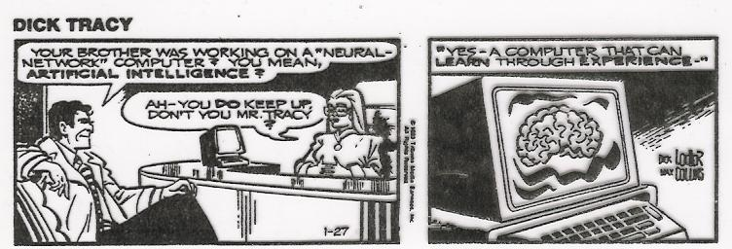
A Brief History Of Neural Networks
1970-1985
    Attempts to develop symbolic rule discovery algorithms
1986
    Rumelhart, Hinton, & Williams, Back propagation
    Overcame many of the Minsky & Papert objections
    Neural nets popular in cog sci and AI
circa
1990

Slide 5
A Brief History Of Neural Networks
1990-2005
    Bayesian approaches
      take the best ideas from neural networks – statistical computing, statistical learning
    Support-Vector Machines
      convergence proofs (unlike neural nets)
    A few old timers keep playing with neural nets
      Hinton, LeCun, Bengio, O’Reilly
    Neural nets banished from NIPS!

Slide 6
A Brief History Of Neural Networks
2005-2010
    Attempts to resurrect neural nets with
      unsupervised pretraining
      probabilistic neural nets
      alternative learning rules

Slide 7
A Brief History Of Neural Networks
2010-present
    Most of the alternative techniques discarded in favor of 1980’s style neural nets with
      lots more training data
      lots more computing cycles
      a few important tricks that improve training and generalization (mostly from Hinton)

Slide 8
2013

Slide 9
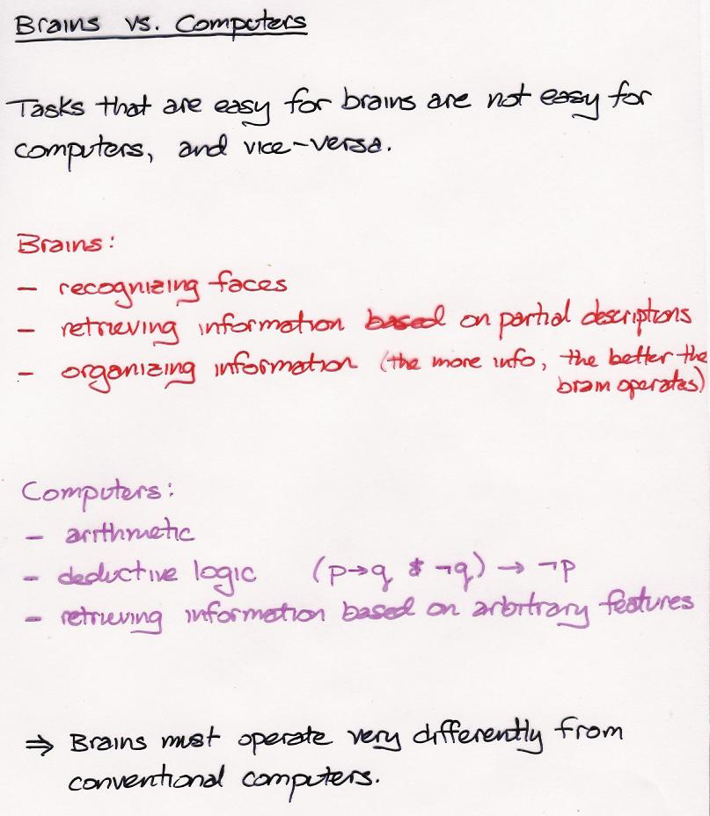

Slide 10
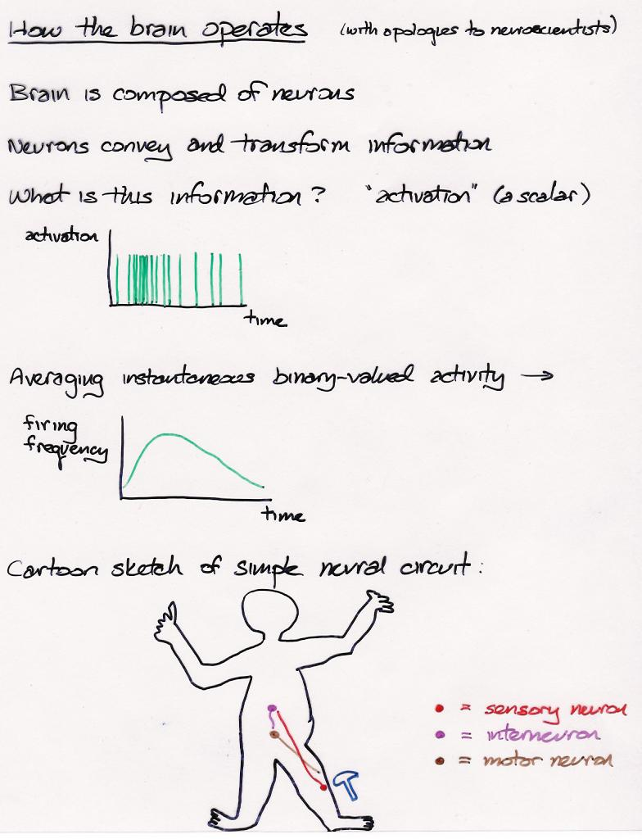

Slide 11
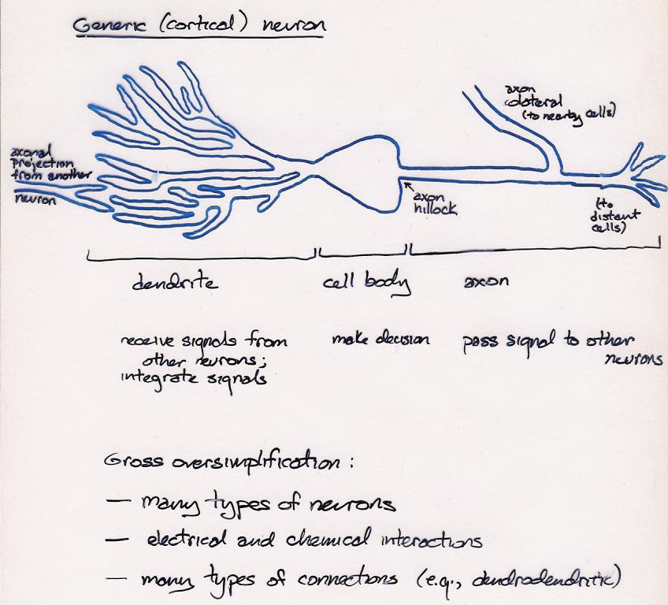

Slide 12
Key Features of Cortical Computation
Neurons are slow (10^{–3} – 10^{–2} propagation time)
Large number of neurons (10¹⁰ – 10¹¹)
No central controller (CPU)
Neurons receive input from a large number of other neurons (10⁴ fan-in and fan-out of cortical pyramidal cells)
Communication via excitation and inhibition
Statistical decision making (neurons that single-handedly turn on/off other neurons are rare)
Learning involves modifying coupling strengths (the tendency of one cell to excite/inhibit another)
Neural hardware is dedicated to particular tasks (vs. conventional computer memory)
Information is conveyed by mean firing rate of neuron, a.k.a. activation

Slide 13
Conventional computers
  One very smart CPU
  Lots of extremely dumb memory cells
Brains, connectionist computers
  No CPU
  Lots of slightly smart memory cells

Slide 14
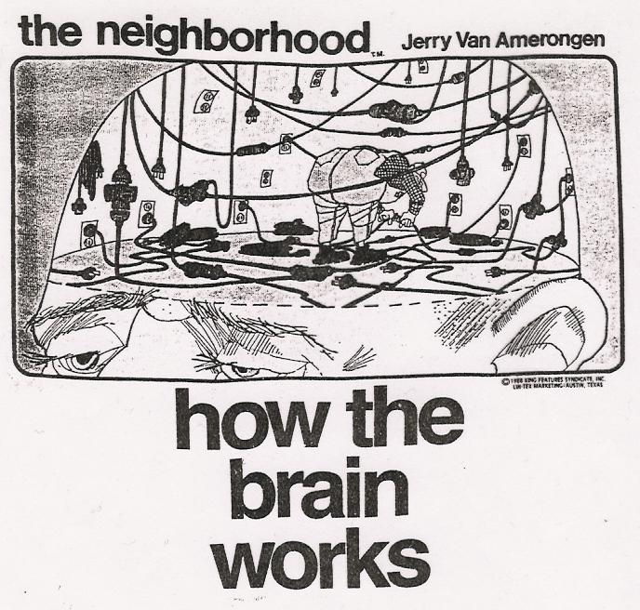

Slide 15
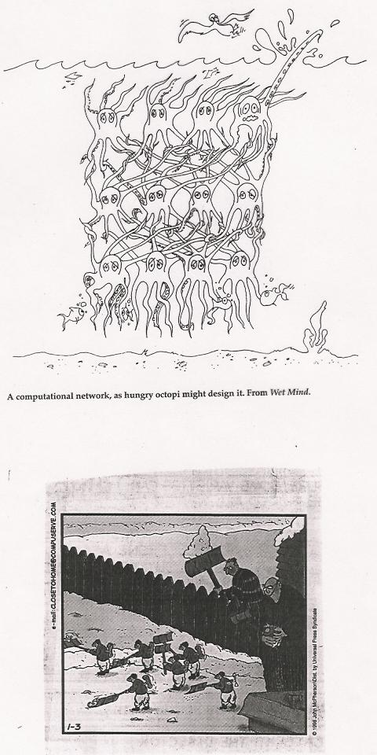

Slide 16
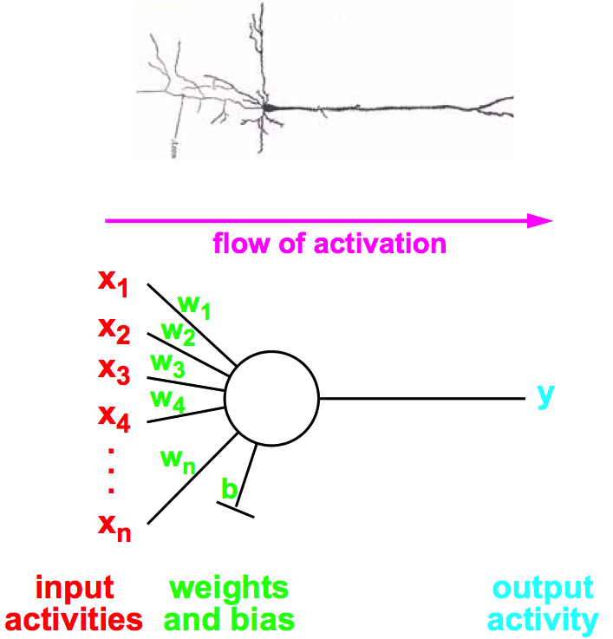
Modeling Individual Neurons

Slide 17
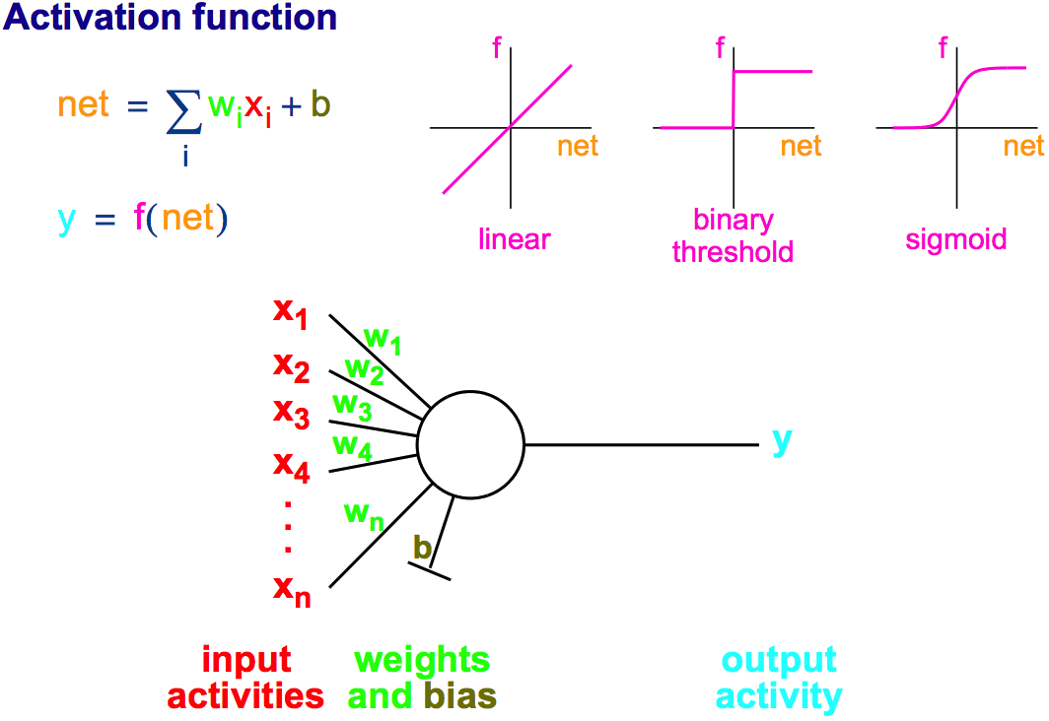
Modeling Individual Neurons
threshold

Slide 18
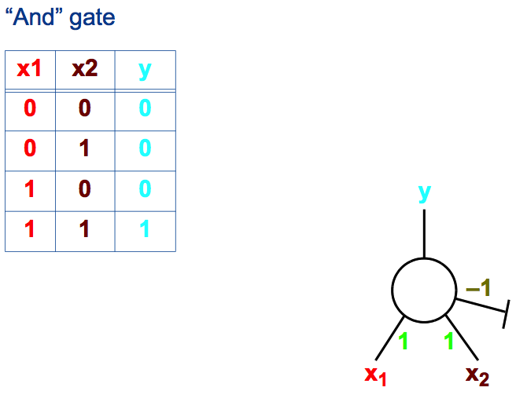
Computation With A Binary Threshold Unit
= 1 if net > 0

Slide 19
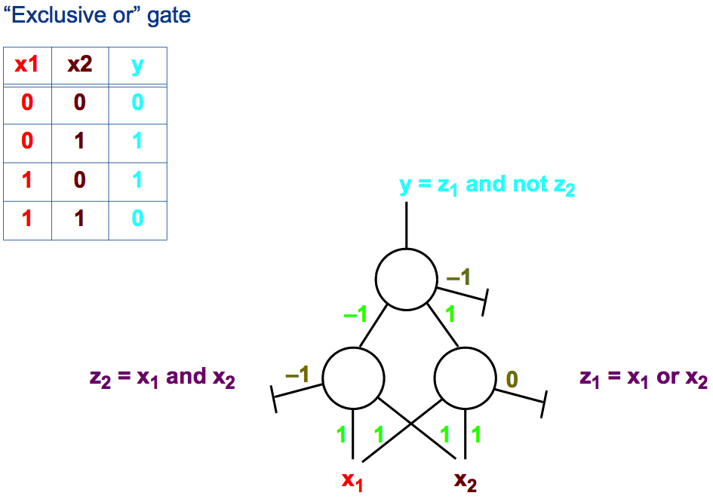
Computation With A Binary Threshold Unit
0

Slide 20
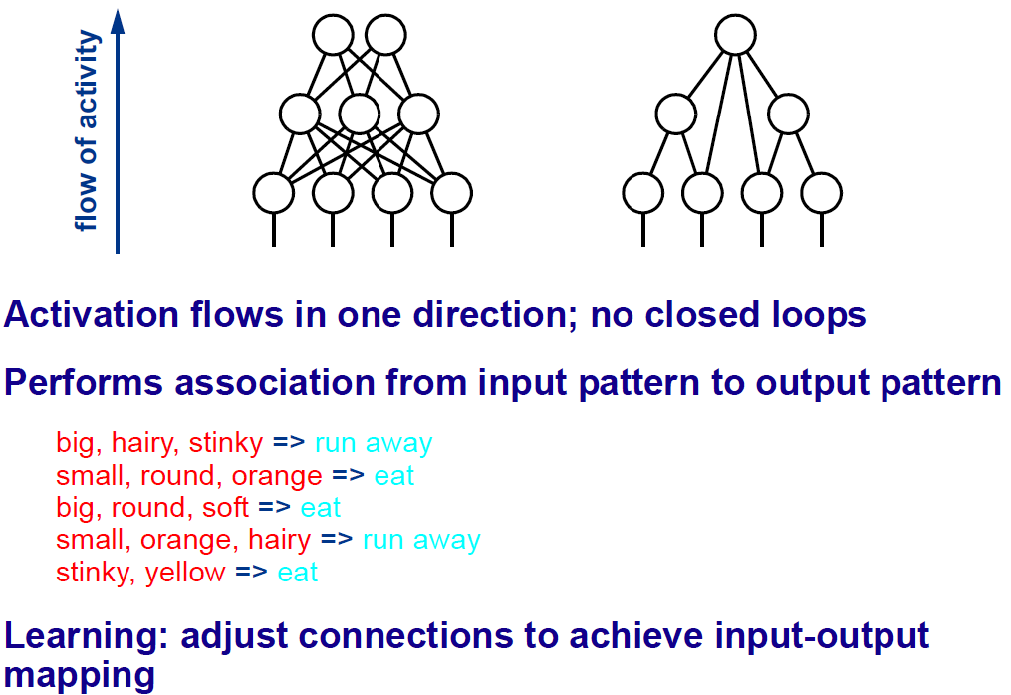
Feedforward Architectures

Slide 21
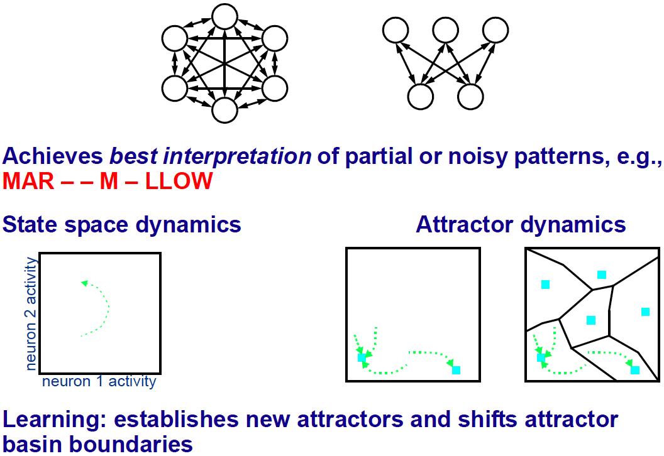
Recurrent Architectures

Slide 22
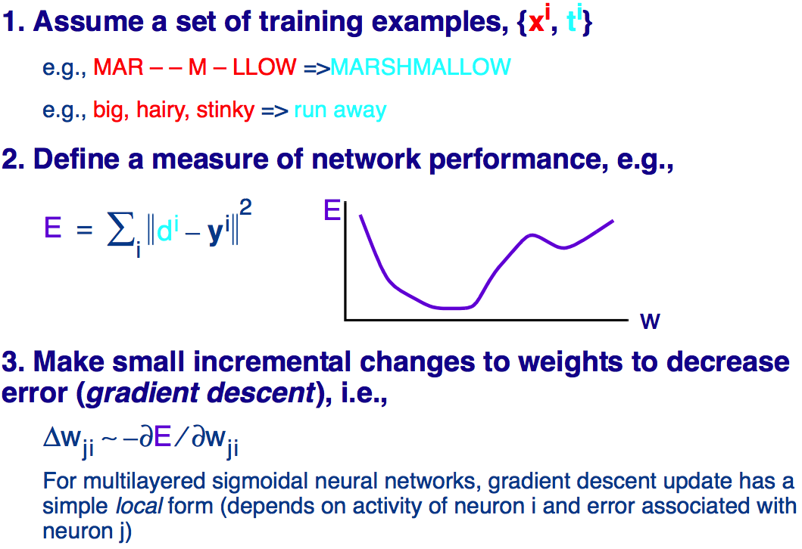
Supervised Learning In Neural Networks

