Slide 1
Characterization of User Behavior in Social Networks to Better Understand Cyberbullying
Homa Hosseinmardi
Department of Computer Science
University of Colorado at Boulder

Slide 2
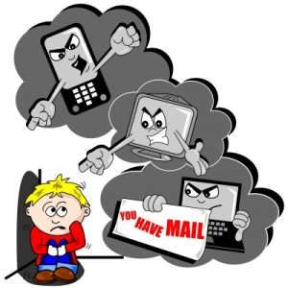
motivation
“Cyberbullying means posting mean, negative and hurtful comments, pictures or videos posted online or on cell phones, or spreading of rumors or threats via technology.”
Important and growing social problem
Devastating psychological
Can happen on a 24/7 basis
Notes:
As online social networks (OSNs) have grown in popularity, instances of cyberbullying in OSNs have become an increas- ing concern. In fact more than half of American teens have been the victims of cyberbullying (National Crime Preven- tion Council 2011)

Slide 3
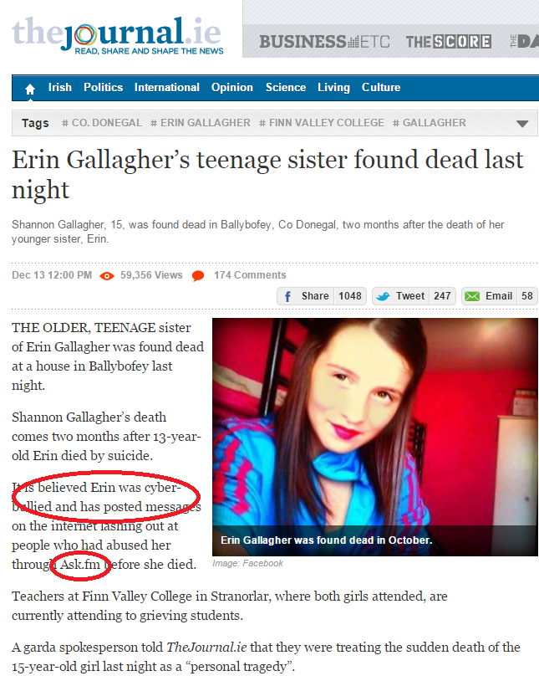
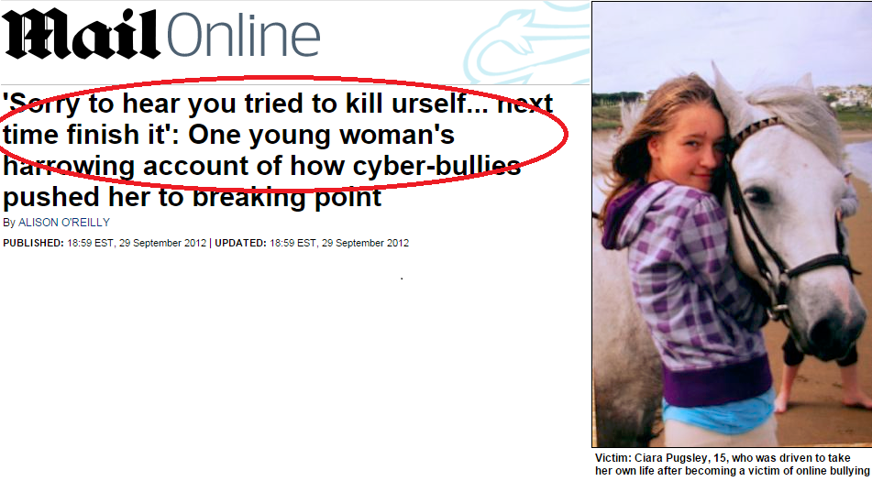
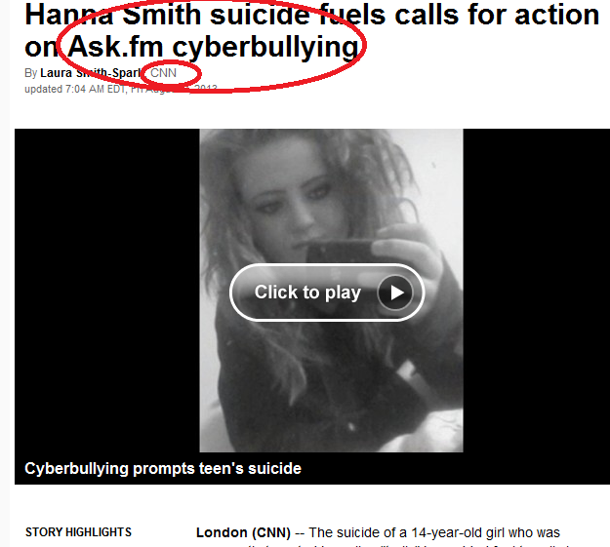
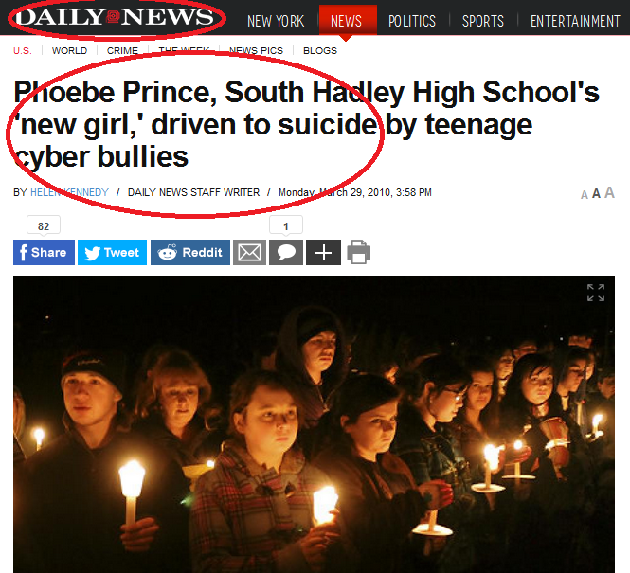
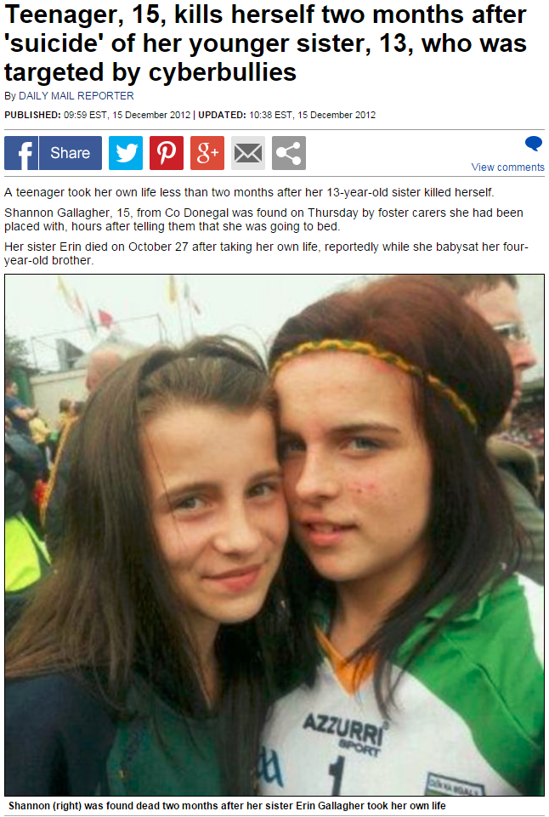
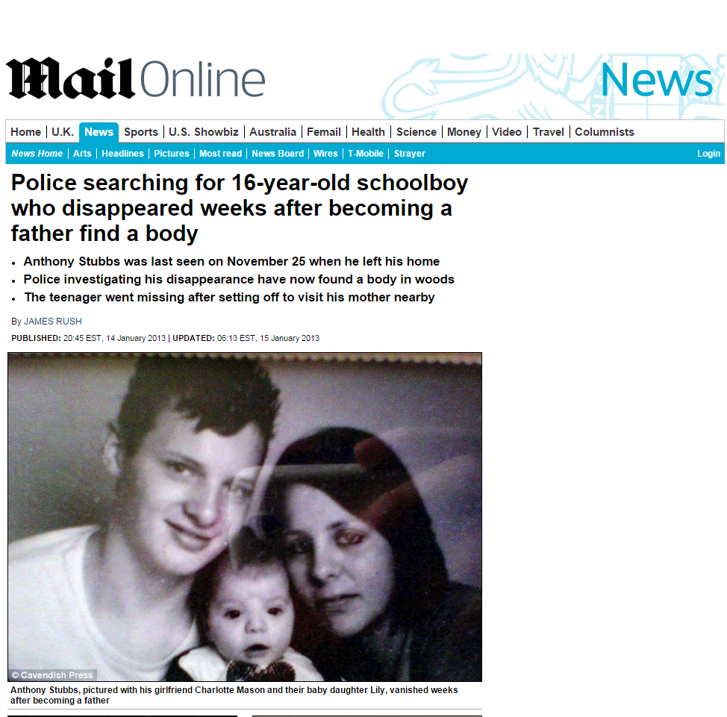
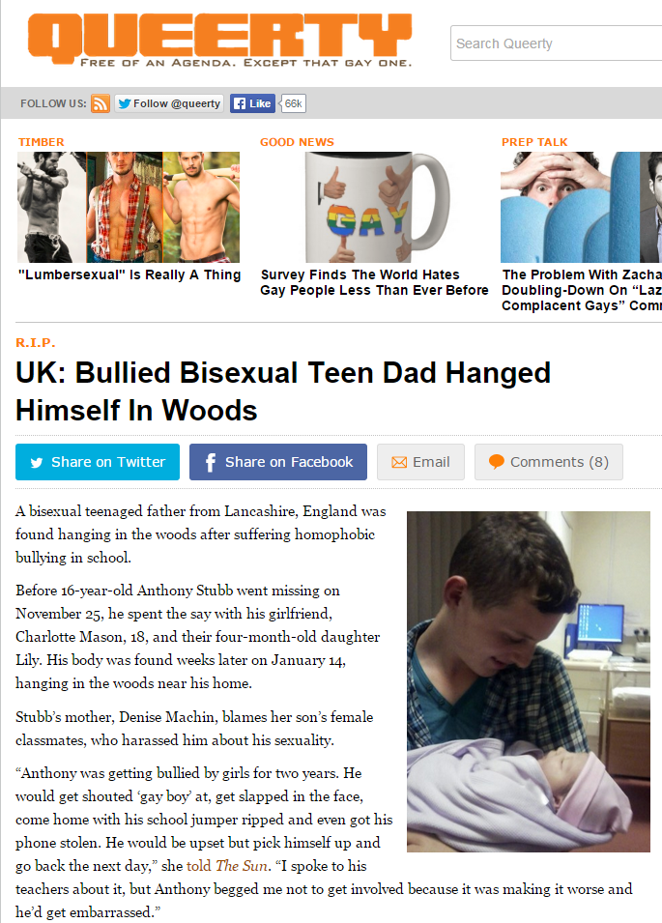
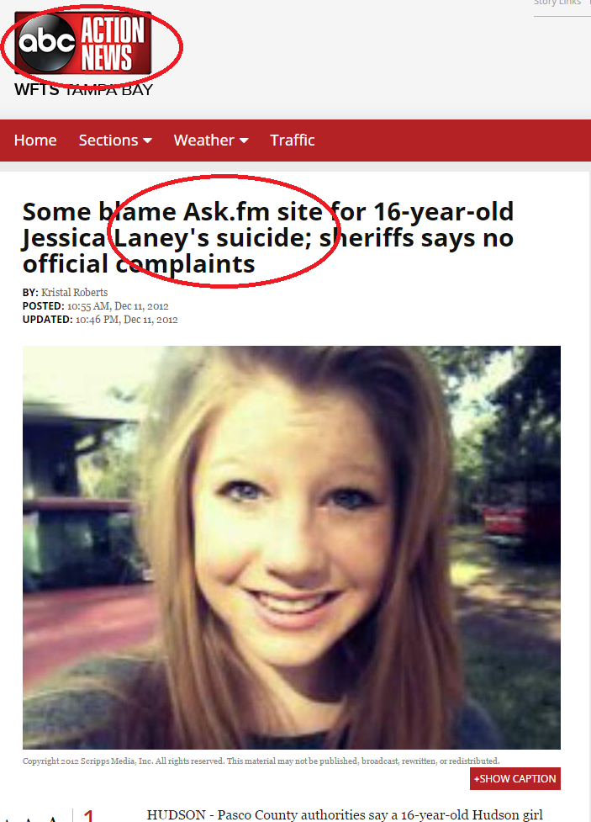
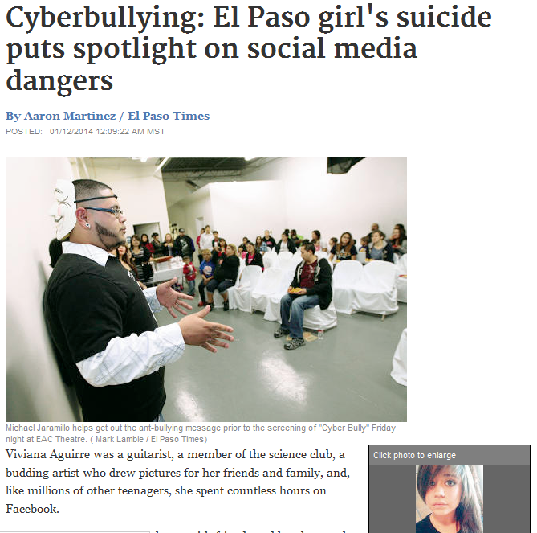
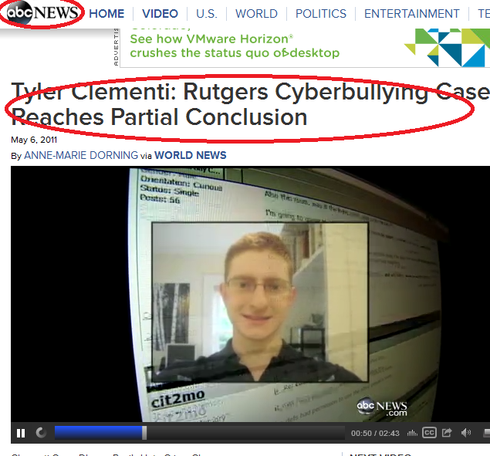
motivation
Notes:
. Although cyberbullying may not cause any physical damage initially, it has potentially devastating psychological effects like depression, low self-esteem, sui- cide ideation, and even suicide (Hinduja and Patchin 2010; E. Menesini 2009).
Incidents of cyberbullying with extreme consequences such as suicide are now routinely reported in the popular press.

Slide 4
Cyberbullying Annual Survey 2013
Facebook, 54%
Twitter, 21%
YouTube, 28%
Ask.fm, 26%
Instagram, 24%
BEBO, 14%

Slide 5
cyberaggression and cyberbullying
Cyberaggression is broadly defined as using digital media to intentionally harm another person
Cyberbullying is one form of cyberaggression:
  imbalance of power between the individuals involved
  repeated over time
Distinguish between cyberbullying and cyberaggression

Slide 6
Related works …
Text-based cyberagression
    Improvement with more features
Detecting bullies
Anonymity and cyberagression
Detecting author’s roles
Cyberbullying across social networks
Key limitation:
  Proper definition of cyberbullying is not considered
  Low reported accuracies
Notes:
, i.e.
neither the frequency of negativity
nor the imbalance of power between the victim and bully is considered when labeling comments.
It is more accurate to say that most of the prior work on cyberbullying or on cyberaggression

Slide 7
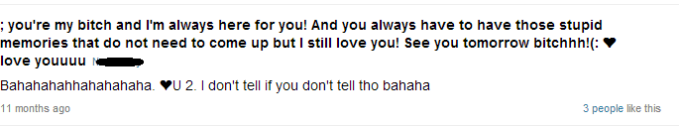
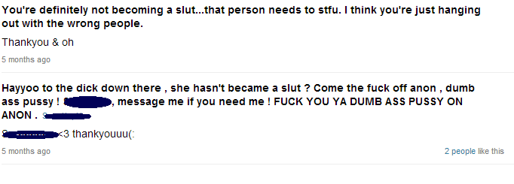
Looking at sample comments
Friendly talks
Aggressive towards bullies

Slide 8
Labeling cyberbullying
Measure imbalance of power
  Ratio of cyberaggressive comments directed at a victim compared to the number of supportive comments
    Threshold
  Factor in the victim's reaction
    Vigorously defends him/herself
    Provides no self-defense or express indifference
    Express hurt feelings
Frequency of occurrence
  How many cyberaggressive comments?
  Over what time period?

Slide 9
Research outline
Proposed research
  Definition, Ground truth labeling and Data collection
  Characterization and analysis
  Automated detection and prediction

Slide 10
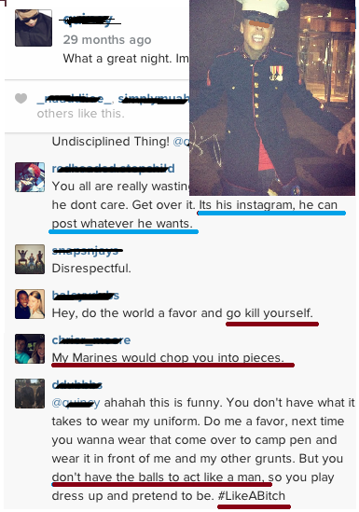
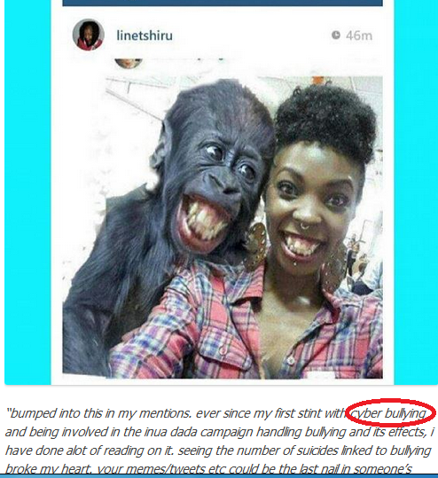
Why Instagram?
Ranked 5th
Image based

Slide 11
Collected data
Snowball sampling, 41K Instagram user ids
61% or about 25K public profiles
Collected data:
  The media objects/images that the user has posted
  The associated comments plus posted times
  User id of each user followed by this user
  User id of each user who follows this user
  User id of each user who commented on or liked the media objects shared by the user

Slide 12
media session
Media session: media object/image and its associated comments
697K media sessions
We select images using the following two criteria:
  at least 15 comments
  more than 40% of the comments by users other than the profile owner have at least one negative word
Notes:
In order to make the labeling of cyberbullying more manageable, we sought to label a smaller subset of these media sessions. We focused on those media sessions that have a high percentage of negativity in their associated comments, since we reasoned that this should give us a higher likelihood of identifying cyberbullying once the data was properly labeled.
Using these criteria, we were able to reduce the number of media sessions to a more tractable group of about 1, 000 images and their associated comments for labeling.

Slide 13
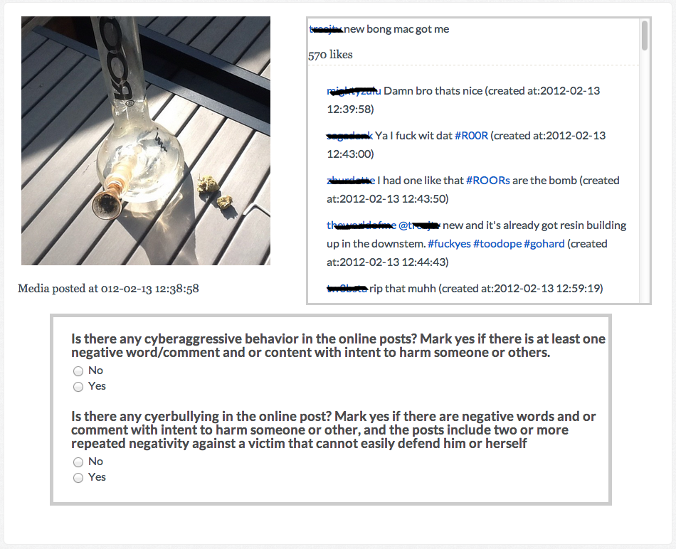
Survey Design

Slide 14
Labeled data statistics
Fraction of media sessions that have been voted k times as cyberagression (left) or cyberbullying (right).

Slide 15
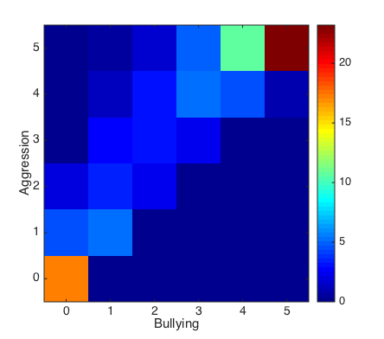
Labeled data statistics
Notes:
In order to understand the relationship between labeled cyberaggression and labeled cyberbullying media sessions, we plotted in Figure 6 a two-dimensional heat map that shows the distribution of media sessions as a function of the number of votes each media session received for cyber- aggression and cyberbullying.
We observe that a significant fraction of the sessions exhibit strong agreement in terms of both receiving high numbers of votes for both cyberbully- ing and cyberaggressions, or both receiving low numbers of votes, i.e. the session is neither cyberbullying nor cyberag- gression.
This is shown by the high energy in the upper right and lower left along the diagonal. In addition, it is promising that the area below the diagonal is essentially zero, meaning no sessions have received more votes for cyberbullying than cyberaggression. This conforms with the definition that cy- berbullying is a subset of cyberaggression.

Slide 16
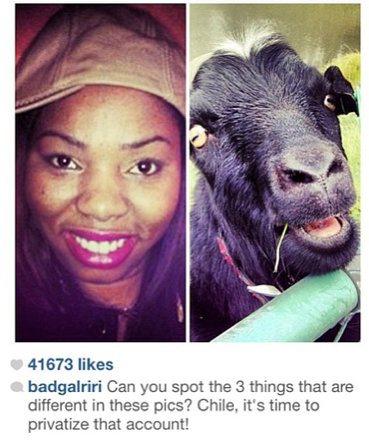
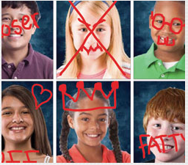
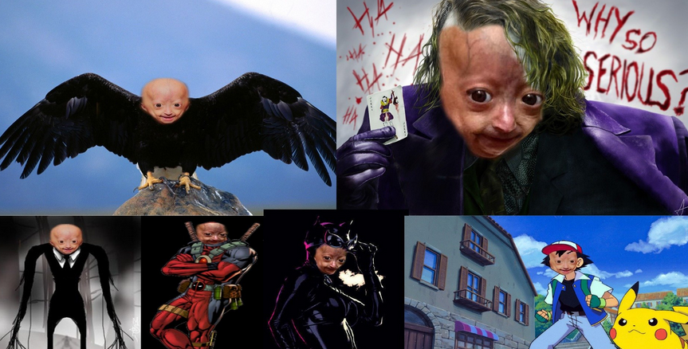
Labeling images
Content (Selfie, Scene, Pets, Group of people)
Photoshopped images
Notes:
we would like to understand the relationship between image content and cyberbullying in a media session.

Slide 17
Labeling images
What content receive more negativity
  Person/people
  Tattos
  Drugs
  etc.
Notes:
we would like to understand the relationship between image content and cyberbullying in a media session.

Slide 18
Distribution of image categories
Distribution of image categories given the media sessions have been voted for k times for cyberaggression.
Notes:
Distribution of image categories given the media sessions have been voted for k times for cyberbullying. As some images belong to more than one category, the bars will sum up to more than one.

Slide 19
Distribution of image categories
Distribution of image categories given the media sessions have been voted for k times for cyberbullying.
Notes:
Distribution of image categories given the media sessions have been voted for k times for cyberbullying. As some images belong to more than one category, the bars will sum up to more than one.
First, we observe that among the media sessions with the highest negativity, the most common la- bels for the image content in these media sessions are Per- son/People, Text, Sports, and perhaps Tattoo, for most values of support for cyberbullying. Second, there is some skew in distributions for certain labels such as Person/People, Tat- too and Sports, as the amount of support for cyberbullying varies.

Slide 20
Classifier Design
Weighted version of the majority voting
Media sessions with weighted trust-based metric equal to or greater than 60%
52% belonged to the “bullying” group
48% were not deemed to be bullying
Notes:
(90%)
Further, Crowd- Flower provides us with a degree of trust for each labeler based on the percentage of correctly answered quiz and test questions during the labeling session. This trust value is incorporated by CrowdFlower into a weighted version of the majority voting method called a “confidence level”. We decided to employ this weighted trust-based majority voting metric as the basis for our classifier design. Media sessions whose weighted trust-based metric was equal to or greater than 60% were deemed to be strong enough sup- port for cyberbullying. Actually, 90% of the original pure majority-vote based media sessions wound up in this higher- confidence cyberbullying-labeled group.

Slide 21
TEMPORAL DATA

Slide 22
Cyberbullying detection’s classifier performance
 | accuracy | precision | recall
Followed by | 61.66% | 0.595 | 0.896
Follows | 68.89% | 0.707 | 0.722
Comments | 68.33% | 0.732 | 0.649
Person/text/tattoo | 68.89% | 0.707 | 0.721
Notes:
Cyberbullying detection’s classifier performance using user/media session features

Slide 23
Cyberbullying detection’s classifier performance
 | accuracy | precision | recall
Unigaram | 69.44% | 0.738 | 0.610
Bigaram | 70.0% | 0.712 | 0.721
3-gram | 69.0% | 0.660 | 0.890
Notes:
Cyberbullying detection’s classifier performance using text features

Slide 24
Labeling
Young undergraduate college students
Crowd-sourced sites
  CrowdFlower and
  Amazon Mechanical
Craft a survey with sufficient information to declare occurrence
  Sequence of comments
  Imbalance of power
  Frequency of cyberaggression

Slide 25
Future Works
Labeling 1000 images selected randomly from the rest of media sessions.
Extracting features from images directly instead of using labeled data
Using temporal information

