Slide 1
Image Captioning
Deep Learning and Neural Nets
Spring 2015

Slide 2
Three Recent Manuscripts
Deep Visual-Semantic Alignments for Generating Image Descriptions
  Karpathy & Fei-Fei (Stanford)
Show and Tell: A Neural Image Caption Generator
  Vinyals, Toshev, Bengio, Erhan (Google)
Deep Captioning with Multimodal Recurrent Nets
  Mao, Xu, Yang, Wang, Yuille (UCLA, Baidu)
Four more at end of class…

Slide 3
Tasks
Sentence retrieval
  finding best matching sentence to an image
Sentence generation
Image retrieval
Image-sentence correspondence

Slide 4
Karpathy
  CNN for representing image patches (and whole image)
  recurrent net for representing words in sentence
    forward backward connections
  alignment of image patches and sentence words
  MRF to parse N words of sentence into phrases that correspond to the M bounding boxes
  Elman-style predictor of next word from context and whole image

Slide 5
Vinyals et al.
LSTM RNN sentence generator
  P(next word | history, image)
CNN image embedding serves as initial input to LSTM
Beam search for sentence generation
  consider k best sentences up to time t

Slide 6
Deep Captioning
With Multimodal Recurrent NN
(Mao et al.)
Language model
  dense feature embedding for each word
  recurrence to store semantic temporal context
Vision model
  CNN
Multimodal model
  connects language and vision models

Slide 7
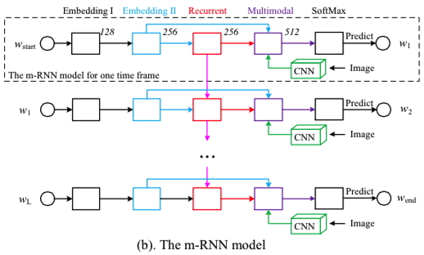

Slide 8

Some Model Details
Two layer word embedding
  Why? They claim [p 10] 2-layer version outperforms 1-layer version
CNN
  Krizhevsky et al. (2012) and Simonyan & Zisserman (2014) pretrained models
  fixed during training
Activation function
  ReLU on recurrent connections
  claim that other activation functions led to problems
Error function
  log joint likelihood over all words given image
  weight decay penalty on all weights

Slide 9
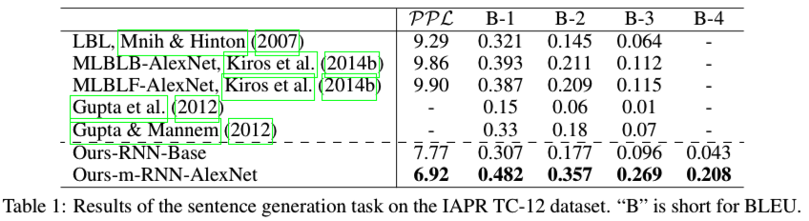
Sentence Generation Results
BLEU score (B-n)
  fraction of n-grams in generated string that are contained in reference (human generated) sentences
Perplexity
  neg log likelihood of ground truth test data
no image representation
Notes:
RNN-base : no image representation. note it doesn’t do too bad on some measures

Slide 10
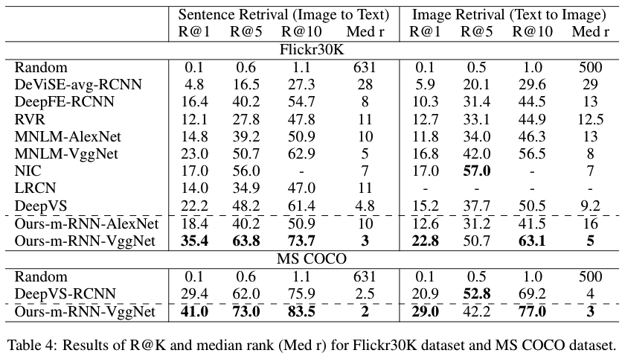
Retrieval Results
R@K: recall rate of ground truth sentence given top K candidates
Med r: median rank of the first retrieved ground trhuth sentence

Slide 11
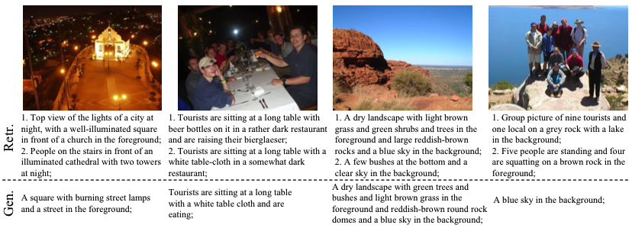
Examples in paper

Slide 12
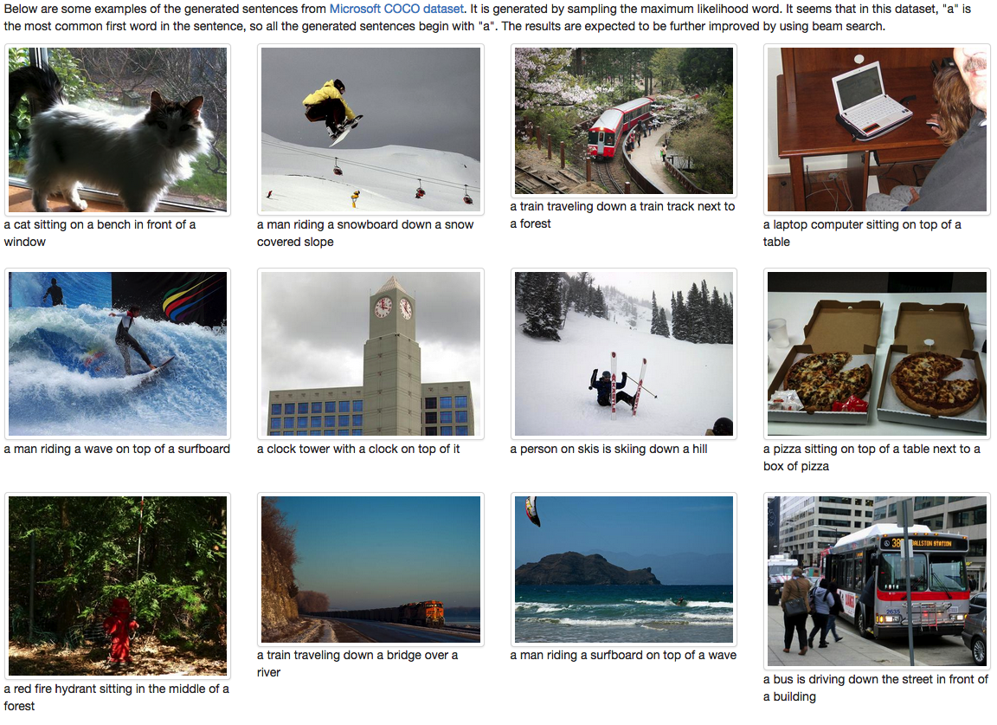

Slide 13
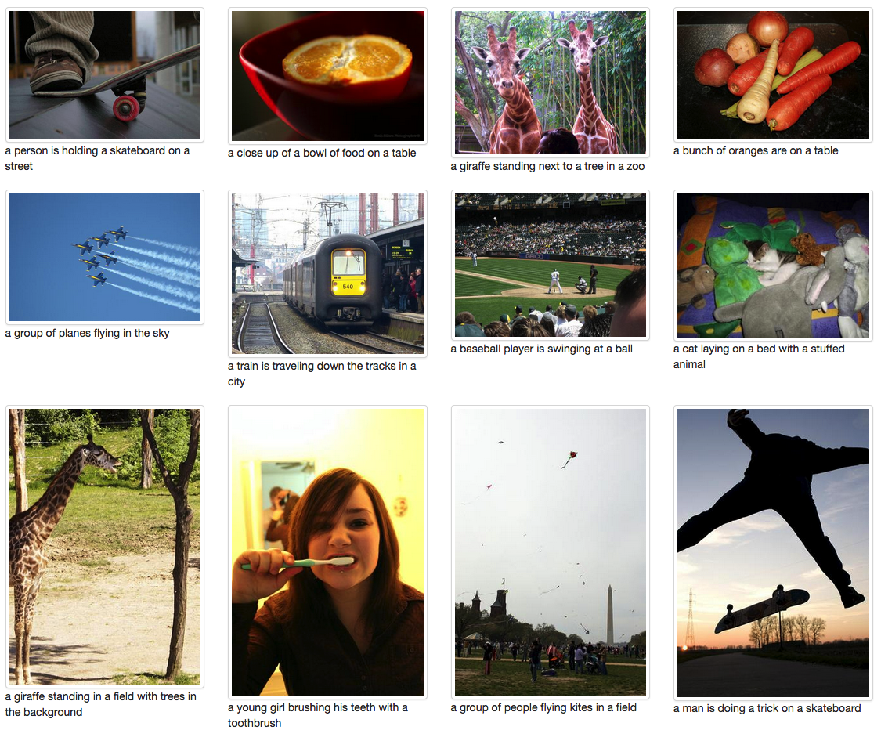

Slide 14
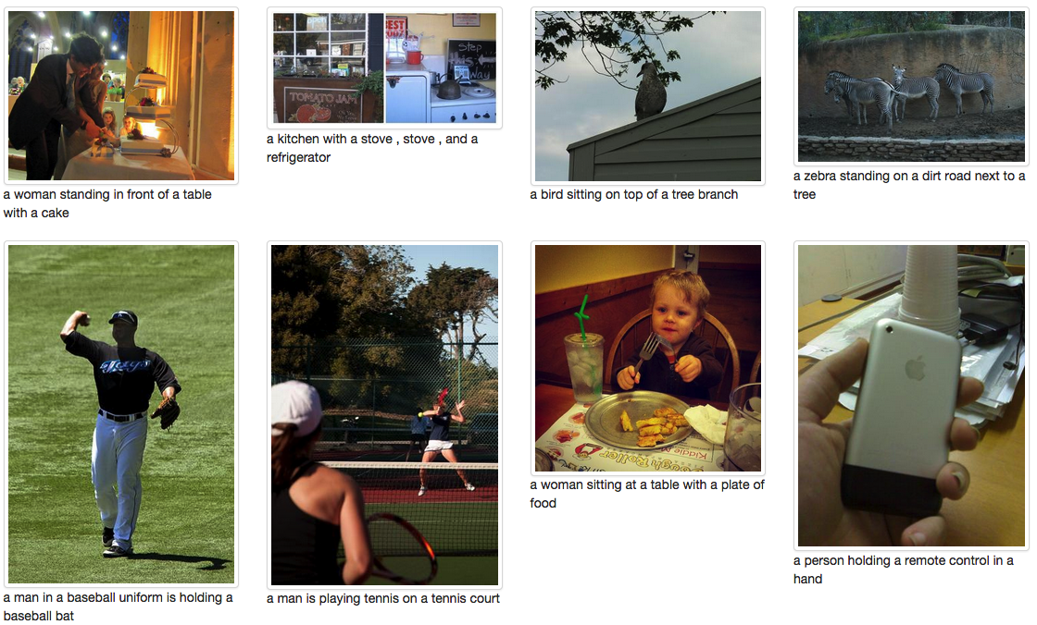
Failures

Slide 15
Common Themes
  Start and stop words
  recurrent nets
  softmax for word selection on output
  Use of ImageNet classification model (Krizhevsky) to generate image embeddings
  Joint embedding space for images and words

Slide 16
Differences Among Models
How is image treated?
  initial input to recurrent net (Vinyals)
  input every time step – in recurrent layer (Karpathy) or after recurrent layer (Mao)
  Vinyals (p. 4): feeding image at each time step into recurrent net yields inferior results
How much is built in?
  semantic representations?
  localization of objects in images?
Local-to-distributed word embeddings
  one layer (Vinyals, Karpathy) vs. two layers (Mao)
Type of recurrence
  fully connected ReLU (Karpathy, Mao), LSTM (Vinyals)
Read out
  beam search (Vinyals) vs. not (Mao, Karpathy)
Decomposition (Karpathy) vs. whole-image processing (all)

Slide 17
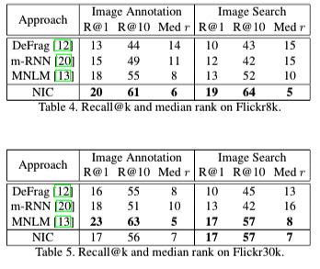
Comparisons (From Vinyals)
NIC = Vinyals
DeFrag = Karpathy
mRNN = Mao
MNLM = Kiros
[not assigned]

Slide 18
Other Papers
Kiros, Ryan, Salakhutdinov, Ruslan, and Zemel, Richard S. Unifying visual-semantic embeddings with multimodal neural language models. arXiv preprint arXiv:1411.2539, 2014a.
Donahue, Jeff, Hendricks, Lisa Anne, Guadarrama, Sergio, Rohrbach, Marcus, Venugopalan, Subhashini, Saenko, Kate, and Darrell, Trevor. Long-term recurrent convolutional networks for visual recognition and description. arXiv preprint arXiv:1411.4389, 2014.
Fang, Hao, Gupta, Saurabh, Iandola, Forrest, Srivastava, Rupesh, Deng, Li, Dollár, Piotr, Gao, Jianfeng, He, Xiaodong, Mitchell, Margaret, Platt, John, et al. From captions to visual concepts and back. arXiv preprint arXiv:1411.4952, 2014.
Chen, Xinlei and Zitnick, C Lawrence. Learning a recurrent visual representation for image caption generation. arXiv preprint arXiv:1411.5654, 2014.

