Slide 1
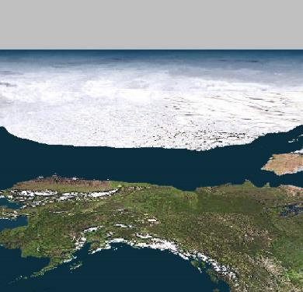
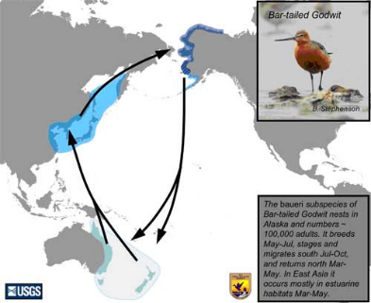
Catrin Mills
catrin.mills@colorado.edu
About me
Atmospheric Scientist
Postdoc fellow working with John Cassano
In CIRES (Cooperative Institute for Research in Environmental Sciences)
Auditing class to learn more about neural networks and to find out new ways to use them in my research
From John from D. Perovich
How daily weather in the Arctic affects sea ice
How sea ice changes affect United States weather
Extreme bird migration
Notes:
http://www.youtube.com/watch?v=cx0ktOh4DjE
http://www.youtube.com/watch?v=qLeiPQudAJc

Slide 2
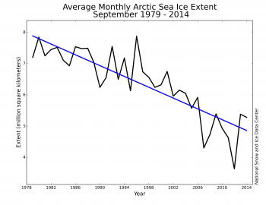
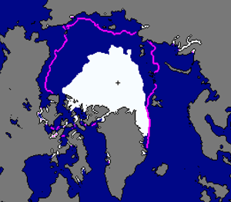
Climate Change in the Arctic
The Arctic (North Pole) has experienced a rapid reduction of sea ice in recent decades, especially during summer months
Sea ice minimum occurs in September
2012 Sep Arctic Ice Extent
September Arctic Ice Extent
1979 – 2000 median
Huge implications for native communities, native flora and fauna, stakeholders, oil industries, and even weather where we live

Slide 3
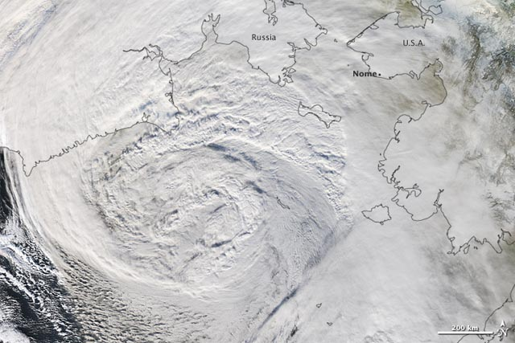
Motivations
Coastal inundation due to strong winds
  http://www.youtube.com/watch?v=cx0ktOh4DjE
MODIS image acquired 8 Nov 2011
taken from NASA.
Notes:
In recent years, storms have battered the Alaskan coastline causing more damage than in previous years, according to many
A big difference between now and, say, in the 1970s, is that when these fall storms used to occur, there was usually some shore-fast ice to protect the coastline from inundation of water and ice floes and erosion
86% of coastal Alaskan villages are discussing or already starting the process of relocation (NPRB and)
Communities and stakeholders increasingly need information on how sea ice activity and storm activity may affect their area now and in a future climate

Slide 4
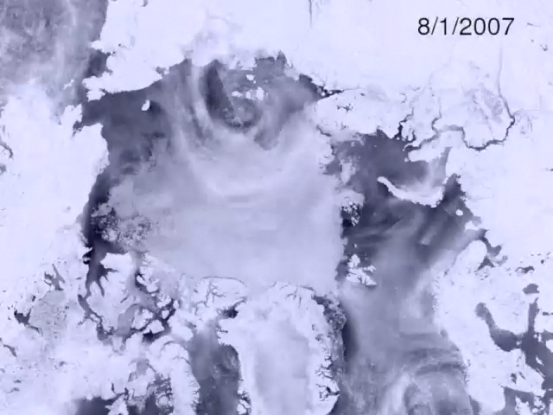
Motivations
  The atmosphere is the primary “mover” of sea ice
  Sea ice is also thinner → more mobile
  Sea ice is becoming more sensitive to day-to-day weather
    Like storms!
  What role is daily weather playing in determining year-to-year changes of sea ice?
Notes:
****explain how ice reacts to SLP gradients
****The atmospheric circulation is the primary driver of ice motion
Within one week, the ice edge is eroded away
So it is important to look at what effect smaller scale atmospheric circulation may have on the ice

Slide 5
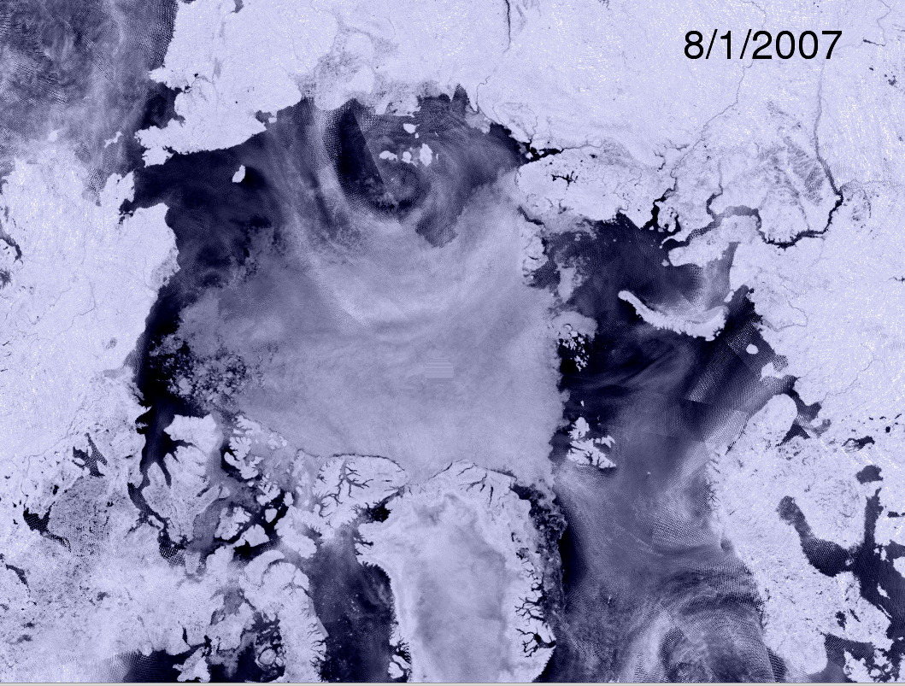
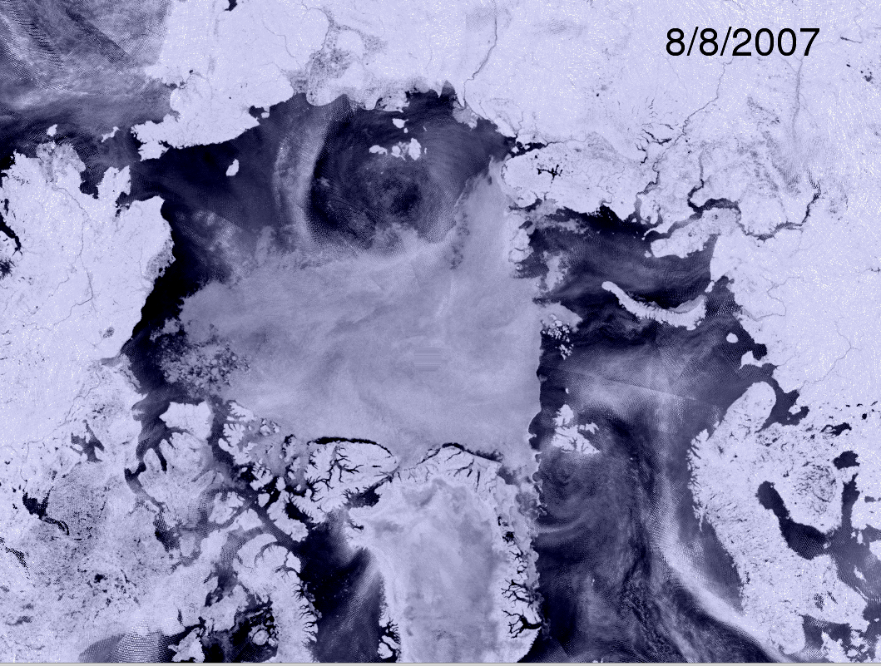
Motivations
  The atmosphere is the primary “mover” of sea ice
  Sea ice is also thinner → more mobile
  Sea ice is becoming more sensitive to day-to-day weather
    Like storms!
  What role is daily weather playing in determining year-to-year changes of sea ice?
Notes:
---IF THE PREVIOUS SLIDE DOESN’T LOAD

Slide 6
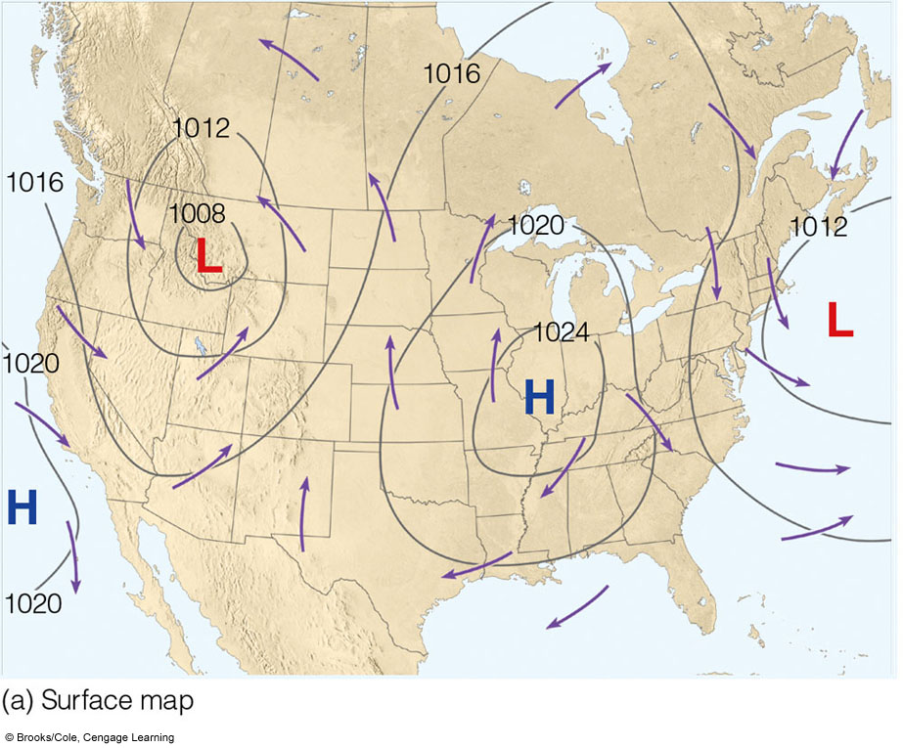
Background
Sea Level Pressure, an important variable
You’ve probably seen something like this on the Weather Channel
Pressure gradients → why the wind blows!
Air flows into and CCW around Lows
Air flows out of and CW around Highs
In the Arctic…
Notes:
Discuss how air flows from H to L
http://www.youtube.com/watch?v=qLeiPQudAJc

Slide 7
Background
Scientists have been evaluating the relationships between Arctic weather and sea ice variability
May-June-July SLP (colors) and surface wind stress (vectors)
Yr-to-yr change in Sep ice extent
H
Δ Ice Extent (10⁶ km²)
L
Greenland
Screen et al. (2011)
Ice loss years: 2007, 1997, 1993, 1995, 1990, 2002
Ice gain years: 1996, 1992, 1994, 2009, 1980
Notes:
Yr-to-yr changes in sea ice extent signal show the loss of multi-year ice → ice that’s survived at least one melt season
MJJ composite of SLP (colors) and SFC wind stress (vectors) → shows that during ice loss years there are fewer cyclones over the Central Arctic Ocean and wind stress conducive to outflow via the TDS

Slide 8
Background
Scientists have been evaluating the relationships between Arctic weather and sea ice variability
Certain weather patterns favor year-to-year ice loss or ice gain
This could have predictive power, but…
I can’t look at ~12,000 days of weather maps!
Self-organizing maps (SOMs) will offer an efficient way to make sense of a large amount of data
May-June-July SLP (colors) and surface wind stress (vectors)
H
L
Greenland
Screen et al. (2011)
Notes:
You’ll see another way to analyze to synoptic activity
We’ll concentrate on the whole synoptic picture not just cyclones
It’s winds associated with strong pressure gradients, not just storms that mechanically moves sea ice
SOMs offer a way to categorize patterns that may be averaged out of these composites…
Patterns that may be important to ice loss/gain, esp. since it’s becoming more sensitive to transient—or synoptic—forcing

Slide 9
Research Goals Using SOMs
Objectively categorize observed daily weather patterns over the Arctic
  Are there trends in time series?
Determine relationships between weather pattern occurrences and how much Arctic sea ice exists in September
  Do sea ice metrics correlate to any of the weather patterns?
September Arctic Ice Extent

Slide 10
Research Goals Using SOMs
Compare the real world data to global climate model output
  If we are going to use models to simulate present and future ice loss
    Models must get daily weather patterns correct
Some studies show that the loss of Arctic ice may impact U.S. weather
  More persistent weather patterns
    Can NNs ID weather that will last longer?
Notes:
If we are going to use models to simulate present and future ice loss
Models must get synoptic patterns correct
Atmospheric circulation determines ice motion, temperature advection, upwelling
They have trouble simulating the observed ice loss

Slide 11
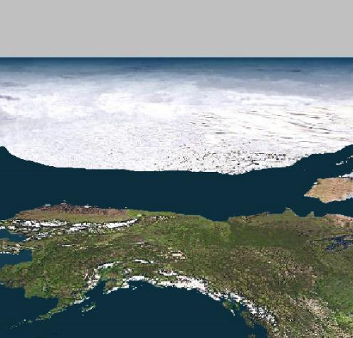
THANKS!
Questions?
Suggestions?
From John from D. Perovich

