Slide 1

The Online Revolution:
Education for Everyone
Daphne Koller & Andrew Ng
Stanford University & Coursera
Notes:
I’m a Stanford professor, and Co-founder of Coursera. Most people today will never have access to a Stanford class. But we’re changing that.

Slide 2

Courses from Top Universities
Notes:
Working with such schools as Princeton, Stanford, Caltech, HKUST [Hong Kong University of Science and Technology] and Columbia, we’re taking courses from these top universities, and putting them online, free for anyone to take. We’re using technology to offer high quality education, at scale.

Slide 3
400
100,000
Notes:
Let me share with you my story. I normally teach a 400 student Stanford class. Last year, I put my class online, and it reached an audience of 100,000 students. To put that number in context, in order to reach a comparable size audience, I would otherwise have had to teach my normal Stanford class for… 250 years.
Who were the students?

Slide 4

Coming from a middle class family from a small town in India. Never had the luck and guidance to reach Stanford for education. Guess what? God has sent the opportunity right across my door step! Heartfelt thanks to the great team and teachers who made this happen! (Akash Goswami)
Notes:
It was students like Akash, who write to say that coming from a middle class family in India, he would otherwise never have had access to a Stanford class.

Slide 5
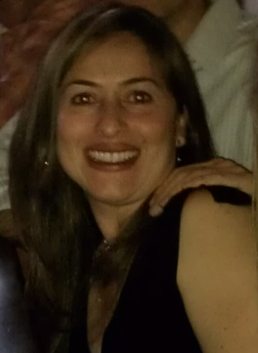
I'm a single mom 39 years old with two college boys... I've been trying to get back to college for my masters and want to learn more about computers. Looking forward to this class!
(Jenny Ramirez)
Notes:
Or Jenny… 39 year old single mother of two, who’s been wanting to go back to college, and for whom an online class allowed here to take the first step.
Since launching the first three classes a year ago, we’ve grown significantly, and now have almost 200 courses, across a range of disciplines. Let me show you some of our classes.

Slide 6

Education at Scale

Slide 7
190 countries
Discussion forum
33 Universities
Video lectures
1.25 million
208 courses
Community
6.9 million enrollments
2 million students
Assessments
Notes:
Having 33 university partners allows us to be a hub of innovation, where we and our partners are working together to invent best pedagogy and technology for teaching these massive online courses, and quickly sharing this knowledge with each other.
We reached our first million users faster than facebook. [[Jenny: Will people in China know what facebook is, or only renren?]] With almost 200 courses, and 1.6 million student today, we are by far the largest MOOC, or Massive Open Online Courses, platform.
So… why do all these students want to take our classes?

Slide 8
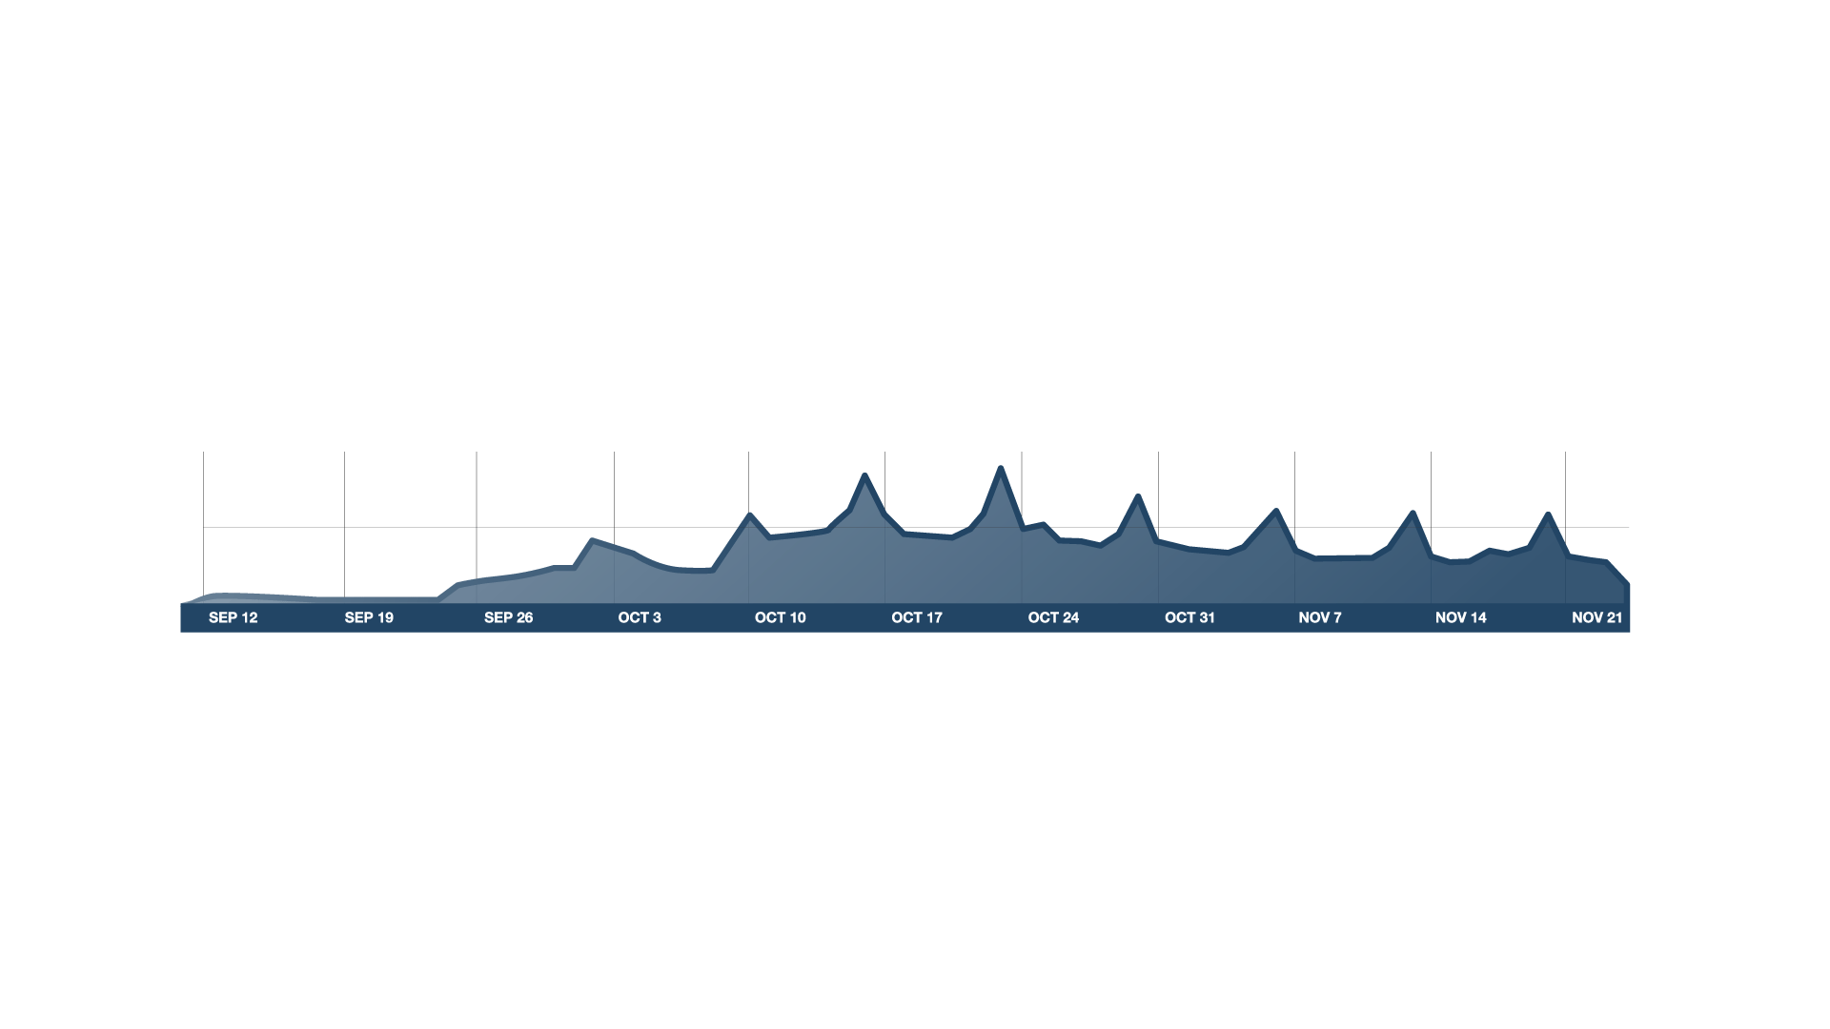

Course Begins
100K
# users on site
50K
v
Timeline
Real Course
Notes:
Well, I think that first and foremost, it’s that these are real courses.
It begins on a certain day. And runs for a fixed period of time—10 weeks in the case of my class—with weekly lectures and homeworks. The figure above is a plot of our web traffic over time. This peaks in the figure---those “heartbeats”---correspond to homework deadlines. Predictably… the 24 hours before a homework deadline, web traffic spikes… thus proving that procrastination is a global phenomenon.
Finally, at the end of the class, if the students completed the homeworks and meet our high grading bar, they also receive from us a certificate or similar, that they can put in their resume, and use to find a better job.
Let me show you what our courses look like.

Slide 9
video-based instruction
Notes:
Like many others, we used video-based instruction. Here’s what a typical lecture video in our class looks like.

Slide 10
Video-Based Instruction
Notes:
Notice the accelerated playback—the student is watching the video at 1.5x speed.
We also have english captioning, which is useful for non-native speakers of english.
And also crowd-sourced foreign language captioning. Only some of the courses have Chinese captions, since the captions are written by student volunteers.

Slide 11
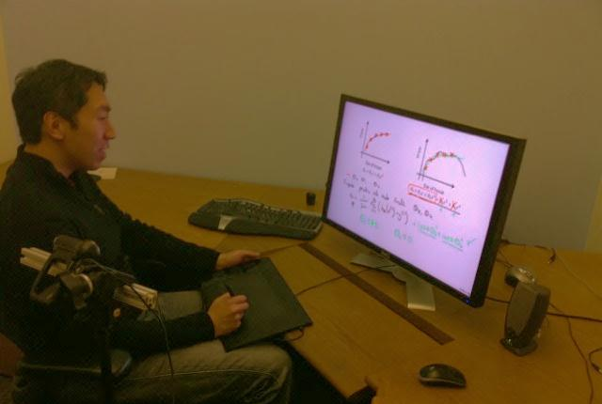
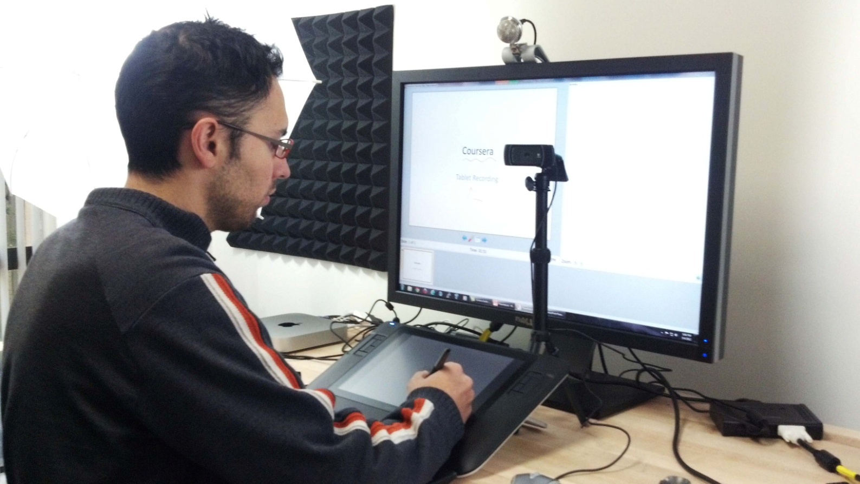
Writing on tablet appears on monitor
Webcam to record instructor
Lecture Recording

Slide 12
Basic Genetics
Refresher (OPTIONAL)
Modern Genomics
Genes and alleles (7 min)
Modern sequencing methods (9 min)
Commercial Genomics
(OPTIONAL)
Mendelian
inheritance
(10 min)
History: The Human Genome Project (7 min)
Genetic testing in the commercial world (8 min)
What is DNA?
(8 min)
Genomic economics
(9 min)
Protecting privacy (10 min)
Personalized medicine (7 min)
Case study: direct-to-consumer genetics (9 min)
Case study: family planning
(6 min)
Personalized Learning
Notes:
Rather that posting online hour long lectures, we also encourage our instructors to take their content, and break it up into 10 minute chunks. This enables the student to watch the content in bite sized pieces.
The instructor can also post optional prerequisite material, for students that need the extra help, and also post optional advanced material. This format allows the student to navigate the content in their own ordering and at their own pace, thus moving us away from the one-size-fits-all model of education.

Slide 13
ASSESSMENTS
Notes:
But a course is much more than just lectures. Our courses have homeworks and assessments as well.
When we as instructors talk about assessments, we often talk about “assessment” or “evaluating” student performance. But the far more important purpose of homeworks isn’t to “assess” students, it’s often the homework that causes the learning to take place.

Slide 14
Retrieval Practice Improves Learning
"Retrieval Practice Produces More Learning than Elaborative Studying with Concept Mapping."
J. Karpicke, J. Blunt. Science (2011).
Study
Repeated Study
Retrieval
Practice
Practice is Critical
Notes:
We know that students learn best not by passively listening, but by practicing with the material.
In this study, which appeared in Science last year, retrieval practice---that is, being tested on the material—was what resulted in by far the best student performance, more so than just study or even repeated study.
Because of this, we pervasively built into our courses many opportunities for students to practice with the material. Let me show you one example, the “in-video” quiz, where right in the middle of the lecture video, the student is asked a question by the instructor.

Slide 15
Interactive Video
Notes:
Here’s what it looks like to a student watching a lecture video.
The video pauses, and the student is asked a question. The student gets to submit an answer… it’s not quite right… so they try again, and get it right. They can also see an optional explanation before the class moves on.
I want to contrast this with my large lecture classes. When I asked a question in my on-campus Stanford class, usually half the students are still madly scribbling away, trying to write down the last thing I said. I find that in my class… about 10% of the students are zoned out on facebook. And invariably, there’s that one smarty pants, sitting on the first row, that just blurts out the answer. Then I feel really good that someone answered my question, and the class moves on.
So… only one student got to attempt an answer. In contrast, in our online courses, the video pauses, the question pops up, and every students gets to attempt an answer. Every student get instant feedback on whether or not they’re understanding the material. I think it’s ironic that a website can therefore be actually more interactive than a large lecture class.

Slide 16
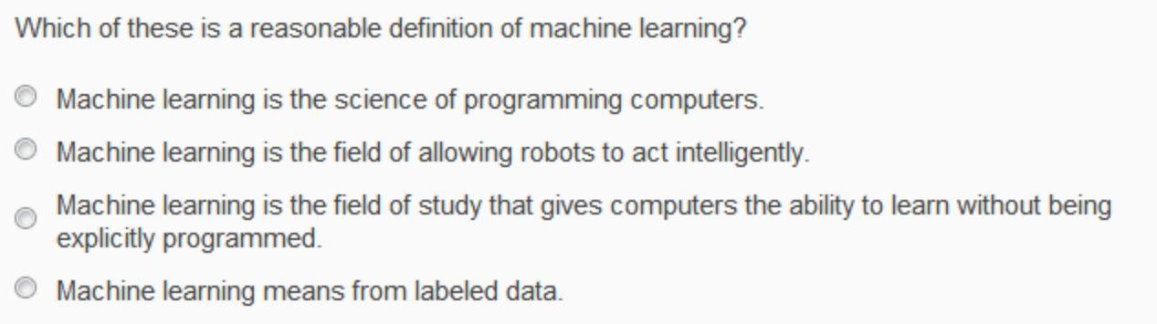
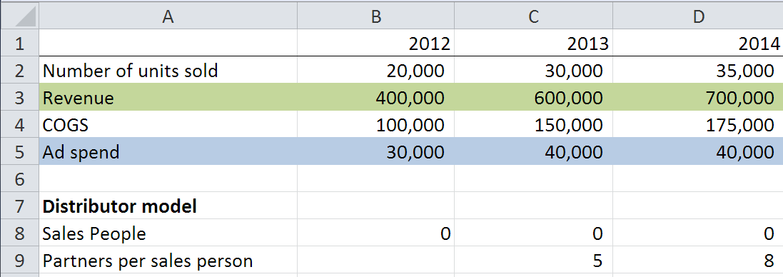
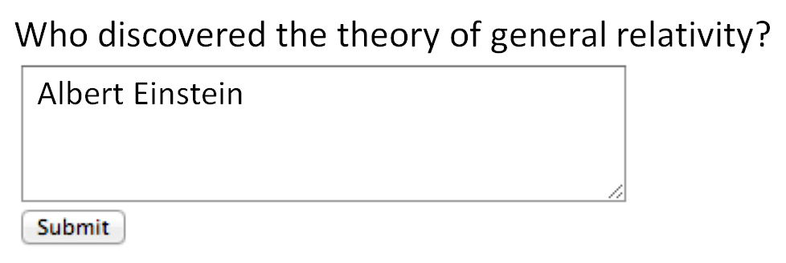
Multiple choice
Short answer (regular expression)
Autograded Homeworks and Exercises
Notes:
Beyond the in-video quizzes, our courses also have longer homeworks and exercises—usually serious weekly homeworks—which let the students engage more deeply with the material. This includes the obvious multiple choice questions, as wel as short anwer questions. So… you can ask here… who discovered the theory of general relativity, and check that the answer has the right keywords.

Slide 17
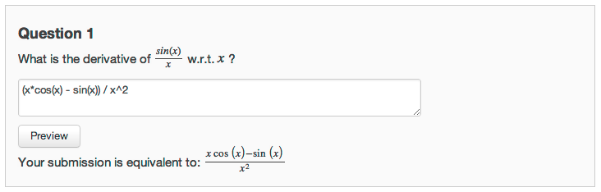
Autograded Homeworks and Exercises
Notes:
Beyond that, we also have math grading functionality. For example, here the student is asked what is the derivative of sin(x) over x, and our system understands all the different variations of how you might write an answer.

Slide 18
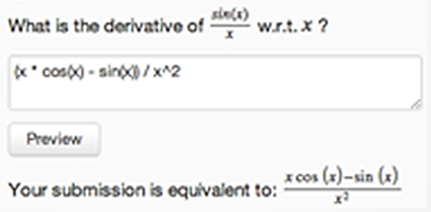
Multiple choice
Short answer (regular expression)
Math expressions
Autograded Homeworks and Exercises

Slide 19
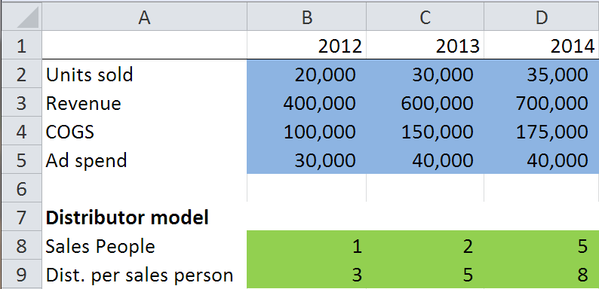
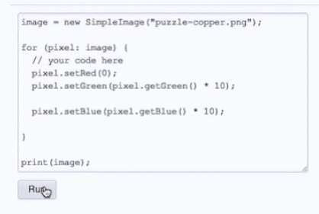
Structured data
Computer programs
Autograded Homeworks and Exercises
Notes:
We also have Open APIs, that allows instructors to grade arbitrary structured data. An example of structured data is a spreadsheet. So, for example, in a finance class you might have an exercise where you ask the students to build a financial model. Because the spreadsheet is a piece of structured data, we can grade it automatically for correct functionality. And similarly, we can ask the student to build models in biology, engineering, and so on as well.
Finally, we also have auto-grading of computer programs, where we test a program or algorithm provided by the student for correctness. Let me show you an example of that.

Slide 20
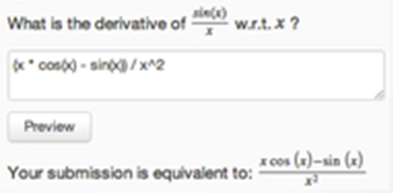
Autograded Homeworks and Exercises

Slide 21
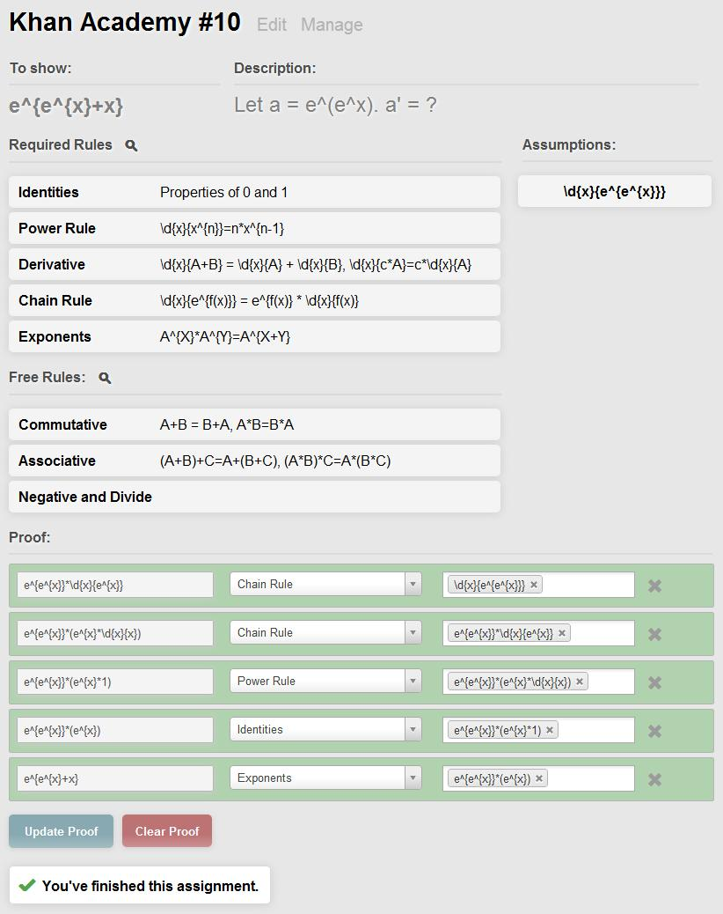
Colleen Lee, Ethan Fast, Alex Aiken
Autograded Homeworks and Exercises

Slide 22
In-Depth Exercises
Notes:
Here, the student is asked to write a program to do a color correction exercise. He writes the program and hits “run.”
It’s not quite right---the statue of liberty looks a little green.
He edits the program… runs again… and at the bottom it says “Output correct.”
So, this is the level of interactivity of our website.
So far… we’e only talked about homeworks that can be auto-graded. But not everything can be auto-graded. We wanted to be able to offer more open-ended exercises as well—for example, a business class, where a student may be asked to write a 300 word business plan. Or a poetry class, where she writes an essay critiquing a poem. An instructor cannot read 50,000 essays. So, what we did was develop a sophisticated pipeline for peer-grading, in which students can grade each others’ work.

Slide 23
Which of the following statements are true? Check all that apply.
Archduke Franz Ferdinand of Austria started WWII.
The allied troops landed in Normandy on D-Day.
WWII started in 1939
Trench warfare was invented during WWII.
Mastery Learning

Slide 24
Which of the following statements are true? Check all that apply.
WWII started in 1939
The allied troops landed in Normandy on D-Day.
Archduke Franz Ferdinand of Austria started WWII.
Trench warfare was invented during WWII.
Which of the following statements are true? Check all that apply.
Correct options:
WWII started in 1939
WWII lasted about 6 years
Many troops from the UK fought in WWII.
The allied troops landed in Normandy on D-Day.
Incorrect options:
WWII ended in 1944
Many troops from Switzerland fought in WWII.
Archduke Franz Ferdinand of Austria started WWII.
Trench warfare was invented during WWII.
Which of the following statements are true? Check all that apply.
Many troops from the UK fought in WWII.
WWII ended in 1944
The allied troops landed in Normandy on D-Day.
Trench warfare was invented during WWII.
Which of the following statements are true? Check all that apply.
Many troops from Switzerland fought in WWII.
WWII started in 1939
WWII lasted about 6 years
Archduke Franz Ferdinand of Austria started WWII.
Randomization and Mastery

Slide 25
Which of the following statements are true? Check all that apply.
WWII started in 1939
The allied troops landed in Normandy on D-Day.
Archduke Franz Ferdinand of Austria started WWII.
Trench warfare was invented during WWII.
Which of the following statements are true? Check all that apply.
Many troops from the UK fought in WWII.
WWII ended in 1944
The allied troops landed in Normandy on D-Day.
Trench warfare was invented during WWII.
Which of the following statements are true? Check all that apply.
Many troops from Switzerland fought in WWII.
WWII started in 1939
WWII lasted about 6 years
Archduke Franz Ferdinand of Austria started WWII.
Randomization and Mastery

Slide 26
“The Impact of Self-and Peer-Grading on Student Learning”.
P. Sadler, E. Good. Educational Assessment (2006).
Student Grade
Peer Grade
Self Grade
Teacher Grade
Open-Ended Work
Notes:
Peer grading has been well studied in the education literature, in small classes of say 50 students, where it has been shown that it gives accurate grades. It turns out that self-grades---where students grade their own work---is also very accurate, if you set up the incentives right.
What we did was combine the ideas of peer-grading—which had previously been done in small classes of 50 students—with the idea from computer science of crowdsourcing, and now we’ve run the largest peer-graded exercises in the history of education, with peer-grading in classes of 50,000.
As a student in a class with peer grading, your experience would be that you’d first do the homewok--say, write a 300 word essay on some topic, or whatever. Then, you’d be shown an instructor supplied grading rubric [grading guideline], which teaches you how to grade other students’ work. You’d be asked to demonstrate proficiency in grading—say, by showing that you can assign accurate grades to a small number of homeworks that the instructor had also graded. And finally, you’d be asked to grade say 5 other students’ work, and in exchange, you get feedback from 5 other students about your own work.

Slide 27
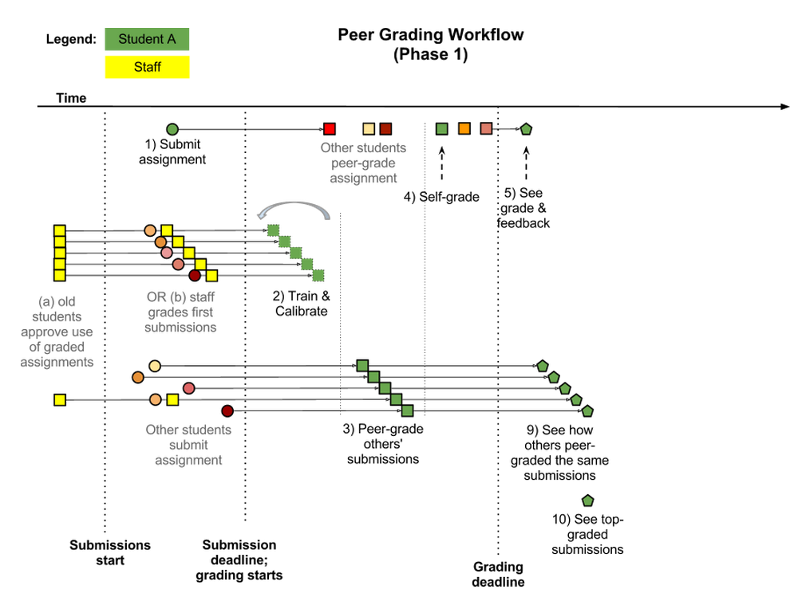
Cf. Calibrated Peer Review™
(Chapman, 2001)
Peer Grading Workflow

Slide 28
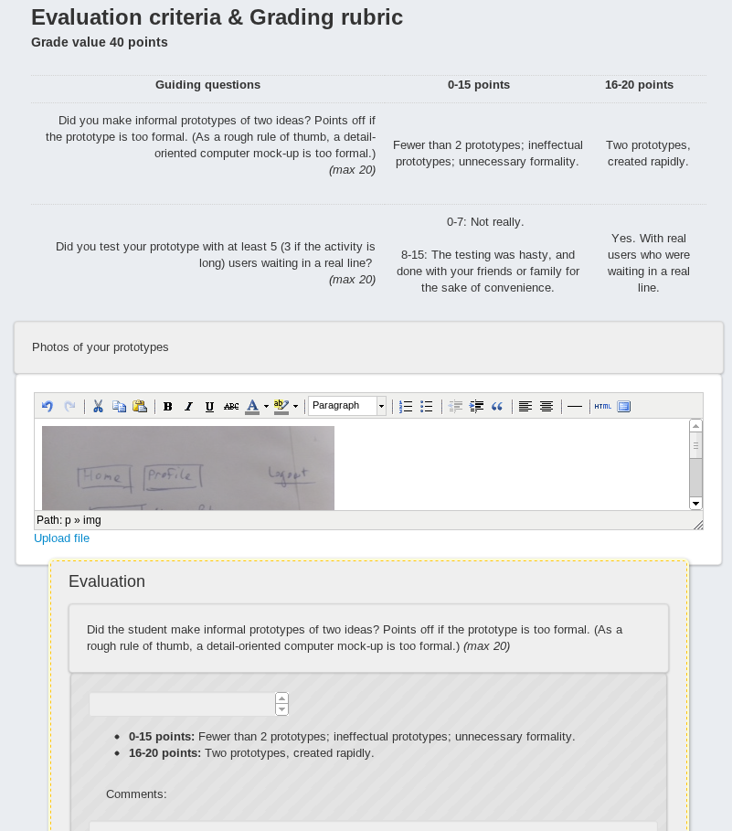
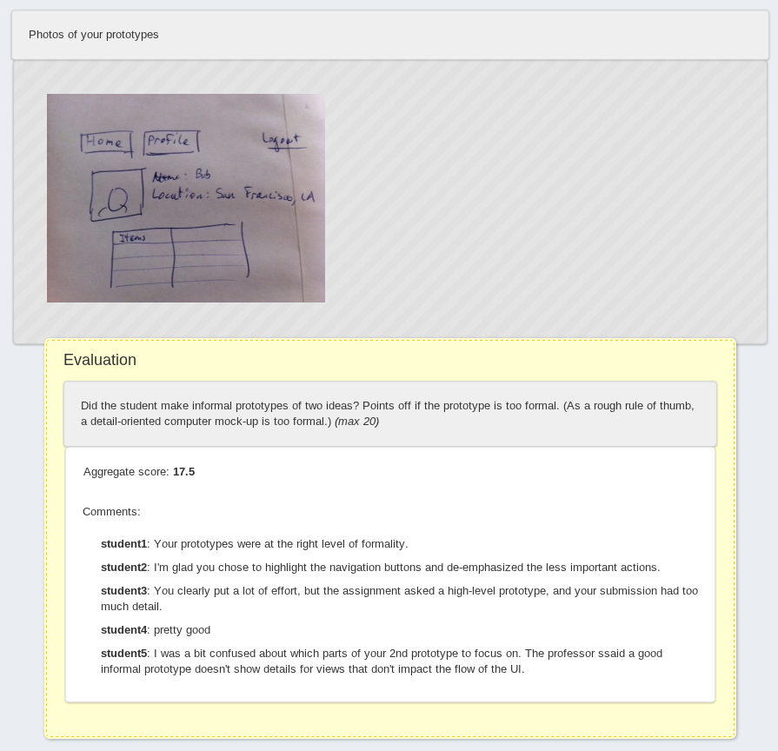
Peer Grading

Slide 29
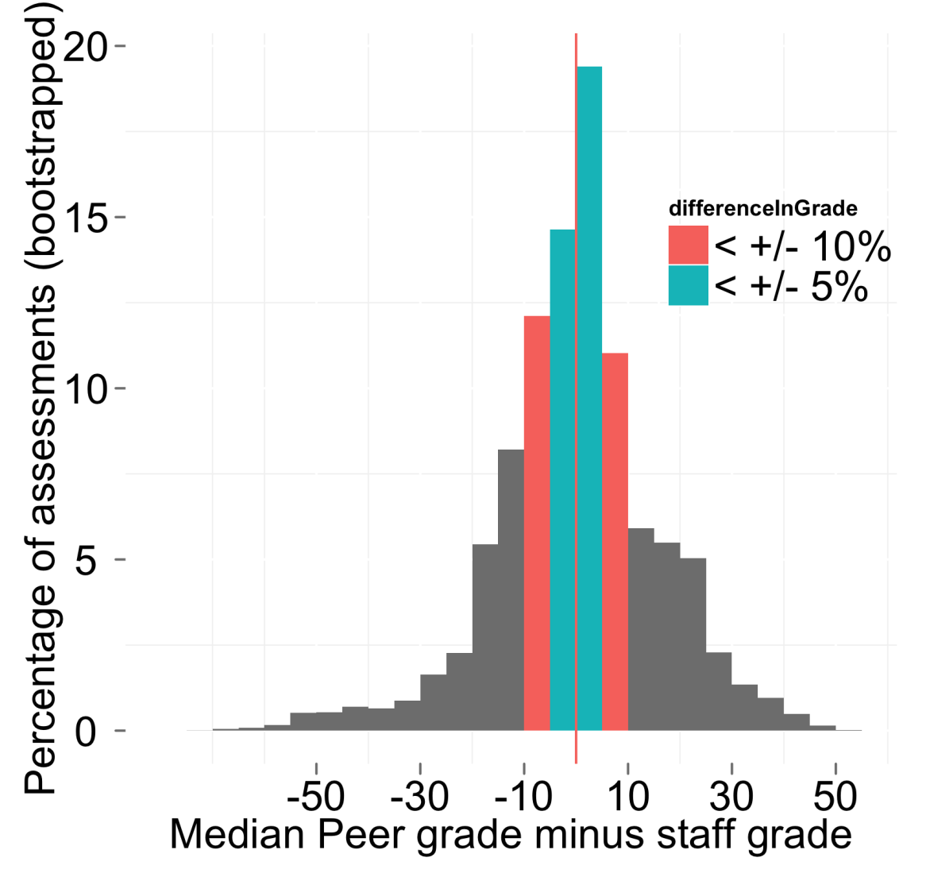
60% within
10% of score
Peer Grading Accuracy (HCI)
Notes:
In the 7-8 classes that have used peer grading so far, we’ve been able to show that this process is giving highly accurate grades; and this is giving good feedback to students about their work.
Peer grading has been key to enabling us to offer more open-ended exercises. Including design classes where, say, students are asked to draw a design on a piece of paper, take a picture with their cellphone and have that be uploaded to the website for feedback, and other classes with open-ended homeworks.
This, together with our different auto-grading options, has been key to enabling us to offer a broad range of courses…

Slide 30
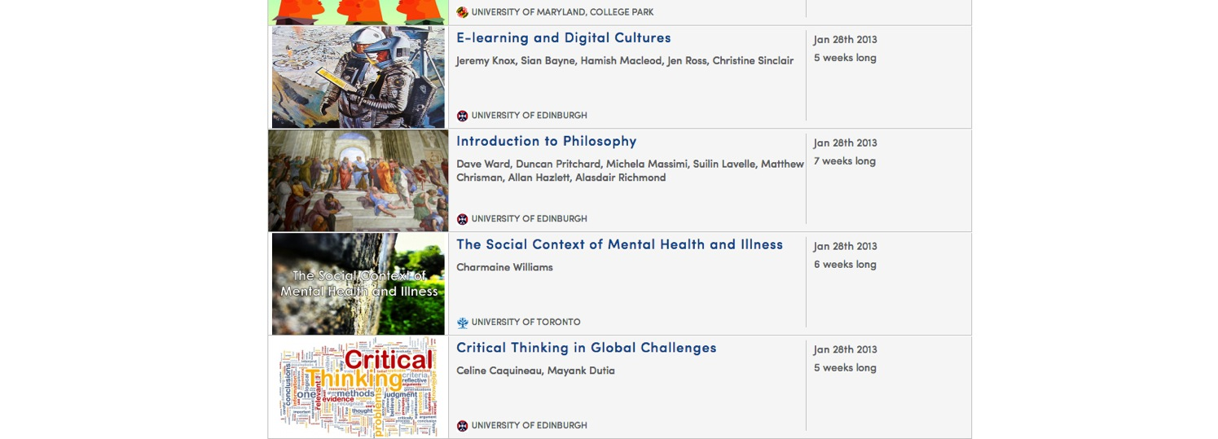
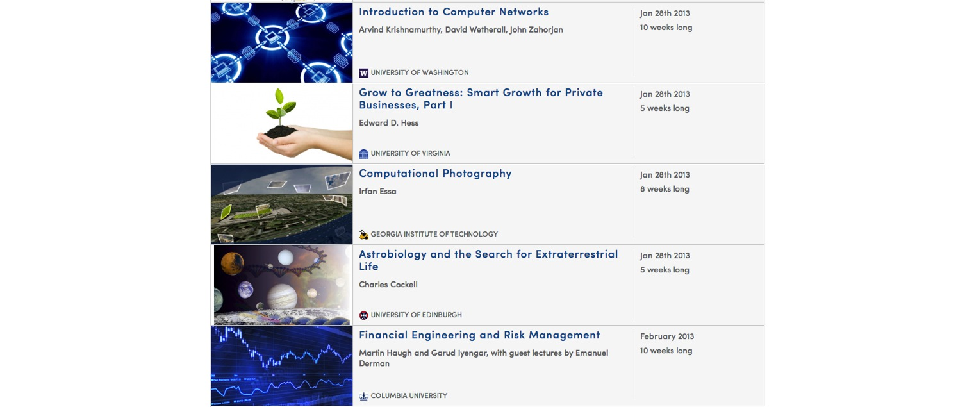
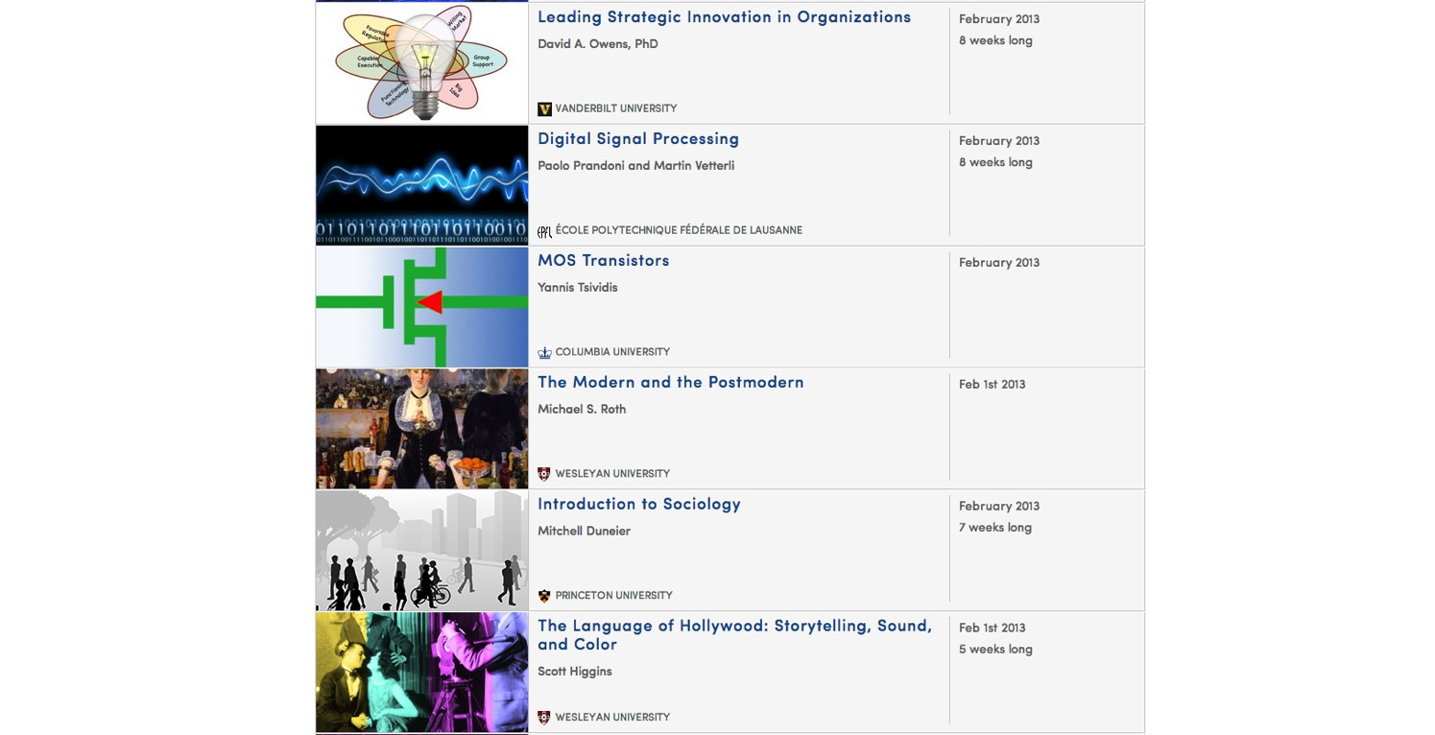
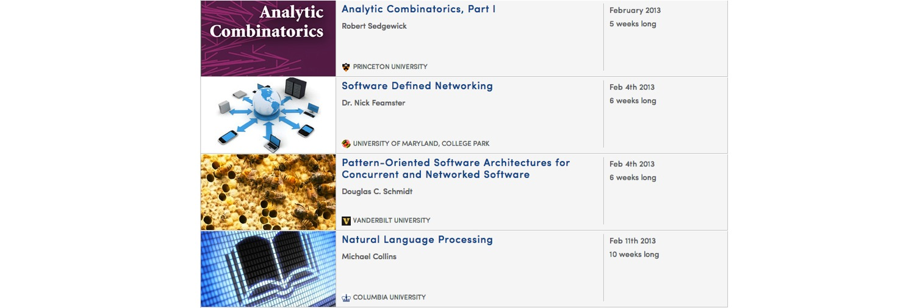
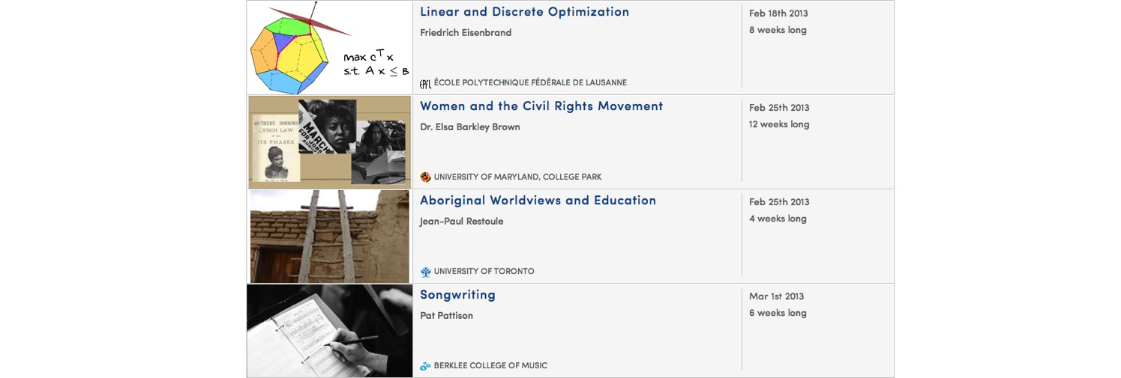
The Humanities, Sciences, Engineering, Business, ….
Notes:
… spanning the humanities, the social sciences, the basic sciences, engineering, computer science, business, law, finance, and other areas.

Slide 31
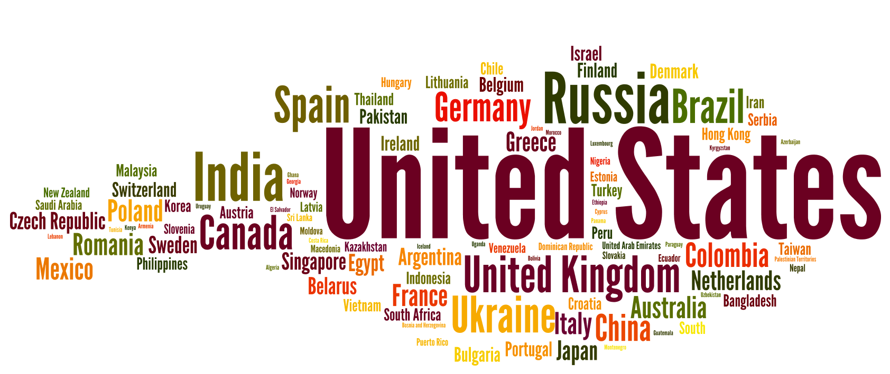
Community
Notes:
So far, we’ve talked about the lecture videos, and the homeworks.
The third major component of the student experience is the community. Students learn best not by studying isolation, but by having other students with whom to discusse the material.

Slide 32
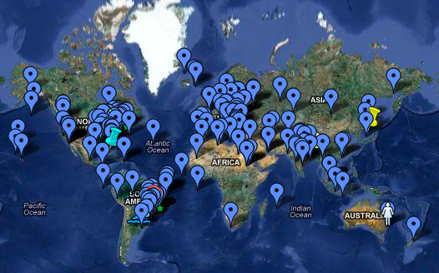
Sociology 101 Student Map
Global community of learners
Notes:
Here’s a map showing the students in the Princeton Sociology 101 class. It turns out that with 100,000 students in a class, it’s much easier to form a community than if you have “only” 100 students. Having 100,000 students also means that no matter what time of day you’re awake thinking about some problem, there’ll be someone in some timezone who’s awake thinking about the same thing as you are, who can talk about it with you.

Slide 33
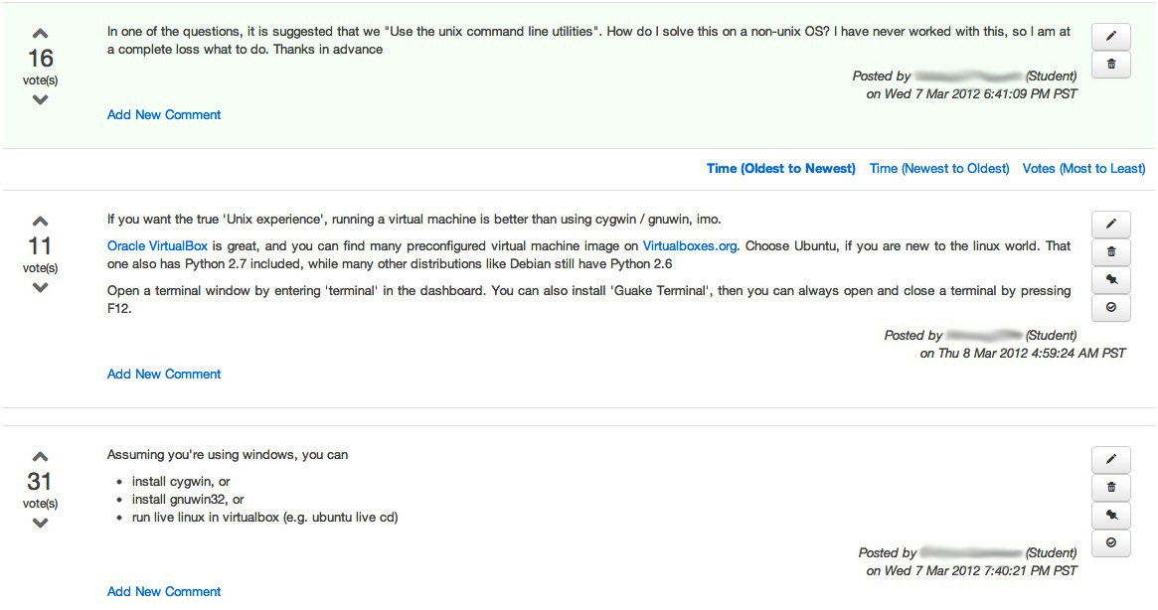
Students
Discussions
Notes:
We designed a discussion forum in which students can pose questions and also answer each others’ questions, and questions and answers get voted up or down. Notice here, that the answers are written by other students. Last year, in my class, the median response time to a question posted on the discussion forum—that is, how long you had to wait to get a response—was 22 minutes.
This 22 minute response time was a frankly a far better letter of service than I was ever able to offer my Stanford students.

Slide 34
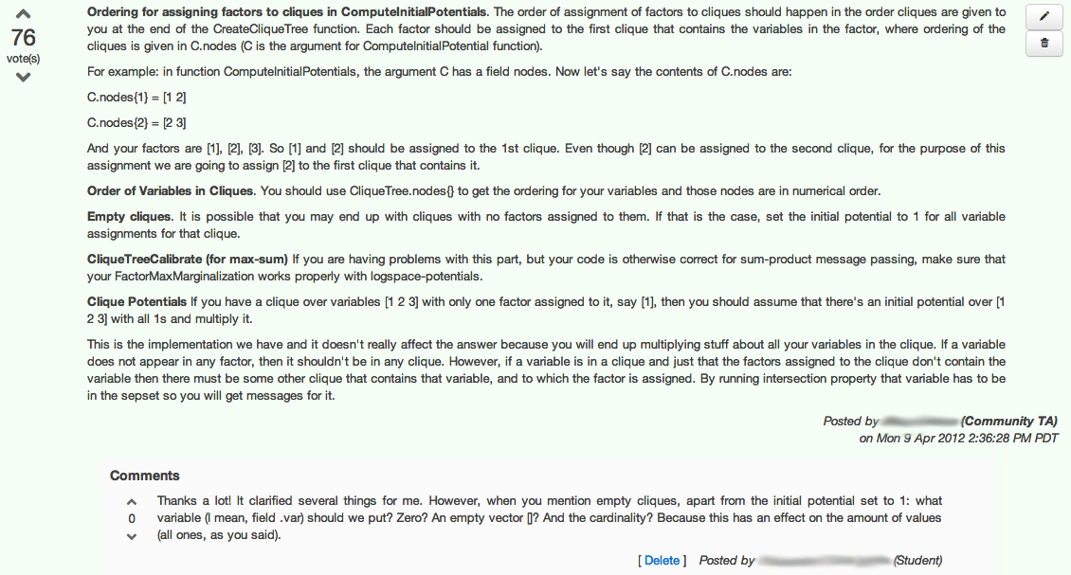
Community TA
Community TAs

Slide 35
San Francisco HCI-Class Study Group
Student Study Groups

Slide 36
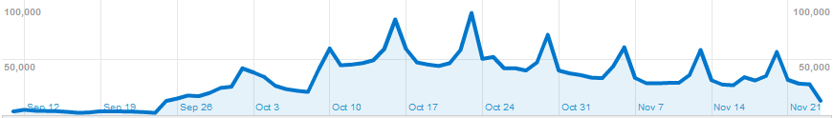
STATISTICS
& Analytics
First lectures
posted
Notes:
One of the nice things about teaching a massive online class is the data you can collect.
In a typical education study, you might have an experiment group of 20 students, and a control group of 20 students. If it’s a really large study, you might have 200 and 200. In a MOOC, if you have an idea in pedagogy, we can deliver an experiment group of 20,000 students, and a control group of 20,000 students.
But we have more than that: we log every mouse click, every homework submission—correct or incorrect—every discussion forum post, every view. We know when a student played back part of a video at 1.5x speed, what parts they watched twice, and so on.
The detail and magnitude of data we can collect is unprecedented in education. Using this data, I hope to analyze student learning, and do to education what Baidu, Amazon and Netflix have done to e-commerce. Only I think education is an even better cause than e-commerce.
Let me share with you just one example of something we’ve done.

Slide 37
Identify the forum discussion thread which is most likely to cause a student to correct misconception.
Experimental setup:
“incorrect” submission
“incorrect” submission
Final “correct” submission
Submission timeline
Forum visits
[Jon Huang]
New Window into Human Learning

Slide 38
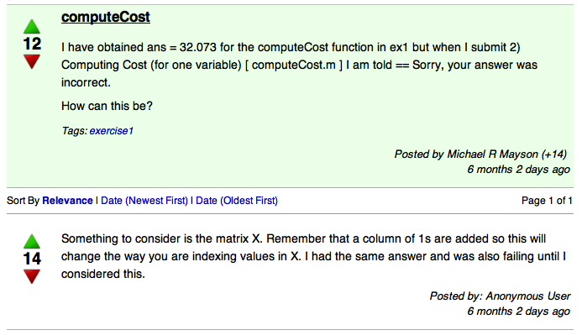
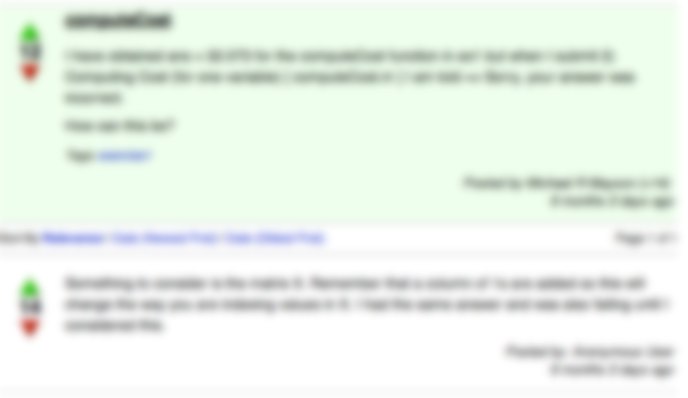
Most helpful forum discussion thread:
- Chance of correcting misconception if not viewed: 34%
- Chance of correcting misconception if viewed: 64%
- Improvement by viewing: 30%
[Jon Huang]
What helped the most?

Slide 39
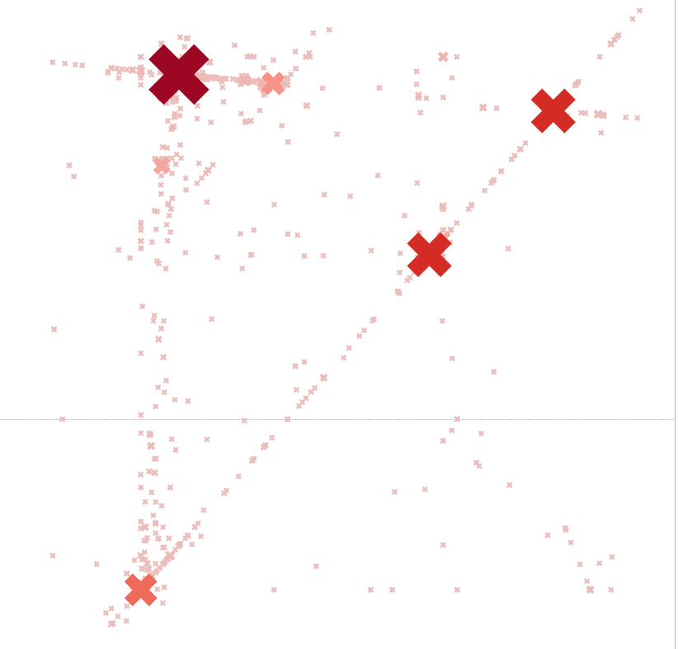
Wrong answers submitted for machine learning class
programming assignment
New Window into Human Learning
Notes:
A funny thing happened to me last year. I assigned a homework problem, and 2,000 students submitted the exact same wrong answer. This has never happened to be before.
The students were asked to write a program to do a calculation, and the big X in the upper left [of the figure] shows the 2,000 nearly identical solutions.
We manually looked at a sample of 15 of the 2,000 wrong answers, and found that every one of the students had exchanged two steps in a mathematical algorithm. This allowed us to generate a custom error message so that when the 2001st student submitted the same wrong answer, they got a custom error message saying “consider the order in which these two steps should be done”, and this allowed them to correct their conceptual mistake much more quickly.
In contrast, if in a Stanford class 2 students out of 100 had submitted the same wrong answer, you probably won’t even have noticed. But when 2,000 out of 100,000 students submit the same wrong answer, that’s a very strong signal to the instructor that there’s something to be looked at there.
I think it’s ironic that in order to achieve this level of personalization—of the custom error message—what was needed was being able to teach a massive online class, because that was what gave us the data that made this personalization possible.

Slide 40
Purple – tokens common to both implementations
Red/Blue – tokens distinct to one of the implementations
Deep Analysis of Code submissions
Notes:
A funny thing happened to me last year. I assigned a homework problem, and 2,000 students submitted the exact same wrong answer. This has never happened to be before.
The students were asked to write a program to do a calculation, and the big X in the upper left [of the figure] shows the 2,000 nearly identical solutions.
We manually looked at a sample of 15 of the 2,000 wrong answers, and found that every one of the students had exchanged two steps in a mathematical algorithm. This allowed us to generate a custom error message so that when the 2001st student submitted the same wrong answer, they got a custom error message saying “consider the order in which these two steps should be done”, and this allowed them to correct their conceptual mistake much more quickly.
In contrast, if in a Stanford class 2 students out of 100 had submitted the same wrong answer, you probably won’t even have noticed. But when 2,000 out of 100,000 students submit the same wrong answer, that’s a very strong signal to the instructor that there’s something to be looked at there.
I think it’s ironic that in order to achieve this level of personalization—of the custom error message—what was needed was being able to teach a massive online class, because that was what gave us the data that made this personalization possible.

Slide 41
Individual
Tutoring
Mastery Learning
Lecture
Achievement Score
"The 2 Sigma Problem: The Search for Methods of Group Instruction as Effective as One-to-One Tutoring." B. Bloom, Educational Researcher (1984).
The 2 Sigma Problem

Slide 42
The mind is not a vessel that
needs filling, but wood that
needs igniting.
—Plutarch
from Ian Kidd's translation of Essays
Notes:
I’ve often been asked: If anyone can now take online Princeton courses for free, why would anyone still pay for a Princeton degree? I think the value of a Princeton education isn’t just the content—instead it’s the interactions with the professors and with other equally bright students. To quote Plutarch: The mind is not a vessel that needs filling, but wood that needs igniting. Using what’s come to be called the “flipped classroom,” many of our partner universities are using the online courses to give their on-campus students a better education as well. By moving the lecture, or the content conveyal onto a website that the students can watch from home, this preserves the classroom time for deeper professor-student and student-student interactions, which I think is the real value of attending a top university.

Slide 43
College is a place where a professor’s lecture notes go straight to the students’ lecture notes, without passing through
the brains of either.
—Mark Twain
The mind is not a vessel that
needs filling, but wood that
needs igniting.
—Plutarch
from Ian Kidd's translation of Essays

Slide 44
"Improved Learning in a Large-Enrollment Physics Class."
L. Deslauriers, E. Schelew, and C. Wieman. Science (2011).
Lecture
Active
Learning
Attendance
Engagement
Learning
Igniting Minds

Slide 45
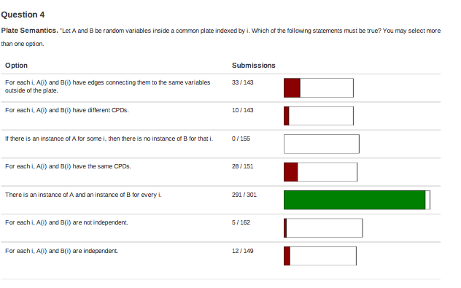
Just-in-time teaching
Small group problem solving
Using the flipped classroom

Slide 46
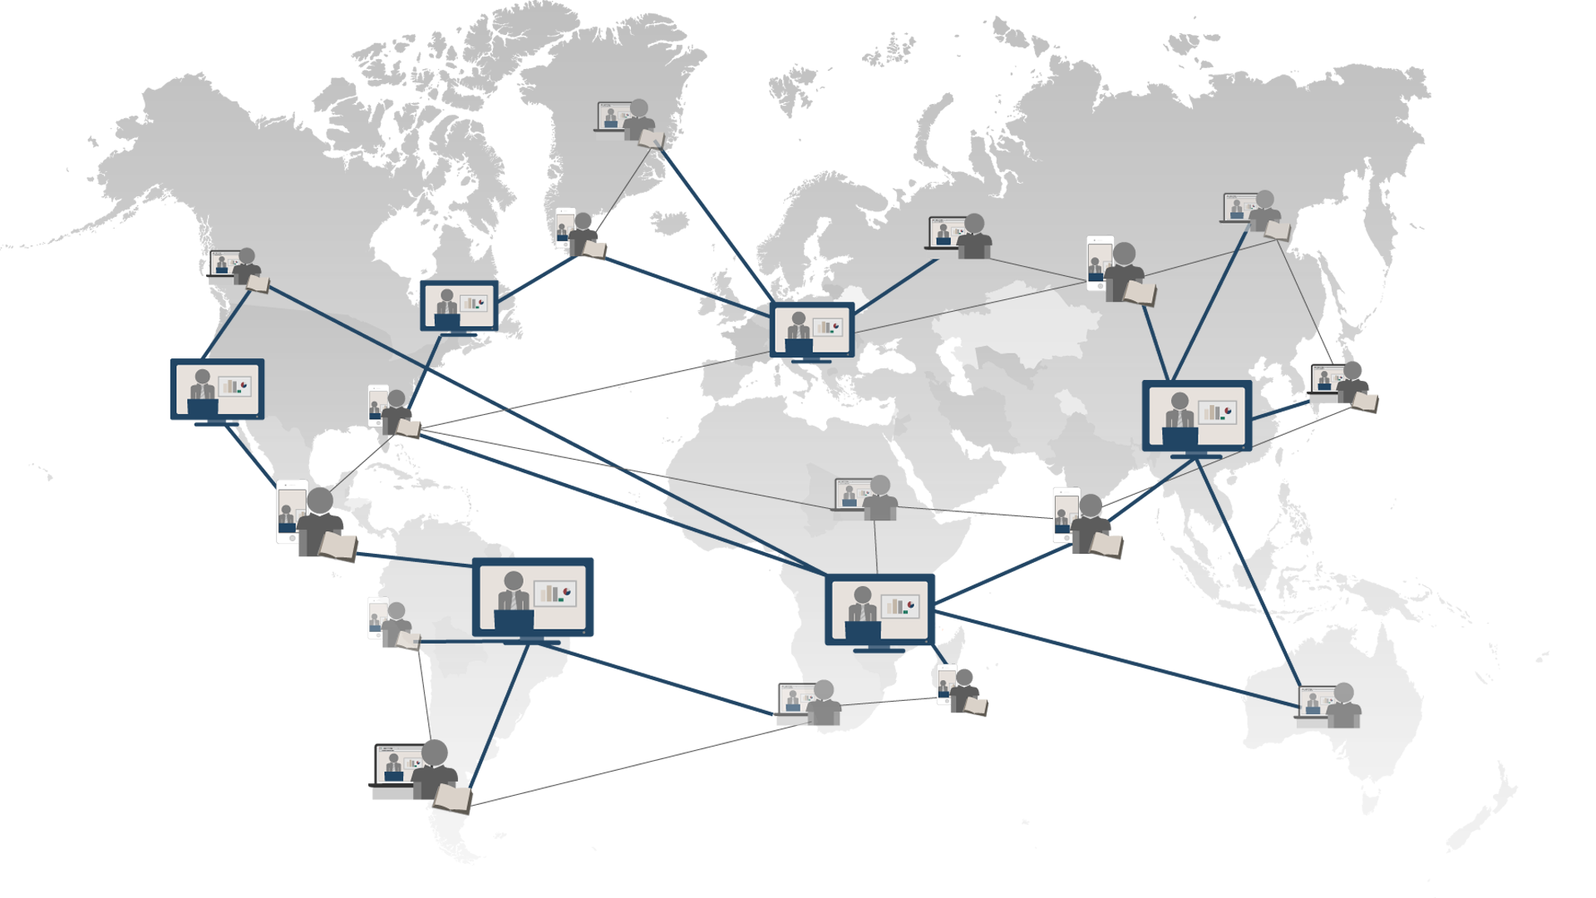
Universal Access to Education
Notes:
Over the last year or so, I’ve visited a lot of countries, and talked to a lot of people about education.
I find that even today…
A lot of people say that a high quality education… is only for the elite.
A lot of people say that a high quality education… is only for the priviledged.
I say that a high quality education… is a fundamental human right.
With technology, we’re working to bring this to everyone.

