Slide 1
CSCI 2824, Discrete Structures
Spring 2018
Alexandra Kolla
Lecture 22: Cryptography -
Public Key Encryption and RSA

Slide 2
Announcements and reminders
HW 7 (Moodle) is due TODAY at 12 PM.
HW 8 (written) is available for download, linked from course calendar and on Piazza
If you have concerns about how your exam was graded:
Check the solutions first.
Put in writing what specifically you want me to look at.
Bring this note and your exam to me today (9 March)

Slide 3
What did we do last time?
Solving systems of congruences: Chinese Remainder Theorem, Back Substitution
Shift (+) and Affine (+, x) Ciphers
Today:
Putting a ton of number theory stuff together: RSA!

Slide 4
Cryptography
Last time we talked about shift ciphers and affine ciphers
Shift Encrypt: C = F(M) = (M + k) mod 26
Shift Decrypt: M = F⁻¹(C) = (C - k) mod 26
Affine Encrypt: C = F(M) = (aM + b) mod 26
Affine Decrypt: M = F⁻¹(C) = (C - b) mod 26
Both of these ciphers are examples of private key encryption
The sender and receiver both need to know the keys (k or a and b)

Slide 5
Cryptography
Obviously, this poses some problems to implement on a large scale.
The solution to this: Public Key Encryption
Allows senders and receivers to determine secret keys by transferring public information completely in the open
RSA is the most common Public Key Encryption system
Developed by Rivest, Shamir and Adleman in 1977
… but first discovered by Clifford Cocks in 1973 (working for British government)

Slide 6
Cryptography
RSA builds on a bunch of topics we have seen before:
Fast modular exponentiation
The Euclidean algorithm
Bezout’s theorem
Modular inverses
Fermat’s Little Theorem
The Chinese Remainder Theorem

Slide 7
Cryptography - RSA
Basic idea:
Alice wants to send a message M to Bob that she doesn’t want anyone else to read
In a public key system, Bob will send Alice (or anyone!) his public key and Alice will use it to encrypt the message M as a cipher C
When Bob receives the message, he decrypts it using his private key
Anyone in the world could intercept the public key and use it to encrypt message…
… but nobody could decrypt messages without Bob’s private key

Slide 8
Cryptography - RSA
Implementation in practice:
We want to create a one-way function F that, given a message M and publicKey, encrypts M as C = F(M, publicKey)
The function F is called “one-way” because
Given M and publicKey, it is easy to compute C = F(m, publicKey) to encrypt M
But if someone intercepts C and publicKey, it is extremely difficult to invert F and compute M = F⁻¹(C, publicKey)
If it’s so hard to invert F, how is it that Bob can do it?
Using the privateKey, Bob has a function G that will allow him to compute M = G(C, privateKey) quickly

Slide 9
Implementation in practice:
So our scheme should give us function F and G such that
F is easy to compute (using publicKey) but very difficult to invert, unless…
… you know privateKey, then G is easy to compute and inverts F
RSA uses a huge number n that is the product of two huge primes, p and q (~200 digits)
Encryption:
The public key is a pair of numbers (e, n)
Each message M is assumed to be a number between 0 and n-1
We encrypt a message by computing C = M e mod n
… which we can do quickly with fast modular exponentiation
Decryption:
The private key is another pair of numbers (d, n) that relies on knowing p and q
We decrypt a message by computing M = C^{d} mod n,
where d is inverse of c (mod (p-1)(q-1))

Slide 10
Implementation in practice:
So our scheme should give us function F and G such that
F is easy to compute (using publicKey) but very difficult to invert, unless…
… you know privateKey, then G is easy to compute and inverts F
RSA uses a huge number n that is the product of two huge primes, p and q (~200 digits)
Encryption:
The public key is a pair of numbers (e, n)
Each message M is assumed to be a number between 0 and n-1
We encrypt a message by computing C = M e mod n
… which we can do quickly with fast modular exponentiation
Decryption:
The private key is another pair of numbers (d, n) that relies on knowing p and q
We decrypt a message by computing M = C^{d} mod n,
where d is inverse of e (mod (p-1)(q-1))

Slide 11
Cryptography - RSA
Example: Let’s make up our own RSA scheme to send messages!
Public keys

Slide 12
Cryptography - RSA
Example: Let’s take the message M = 1098 and encrypt it using the key e = 13 and n = 17947 = 131 · 137
We compute: C= M e mod 17947 = 1098¹³ mod 17947

Slide 13
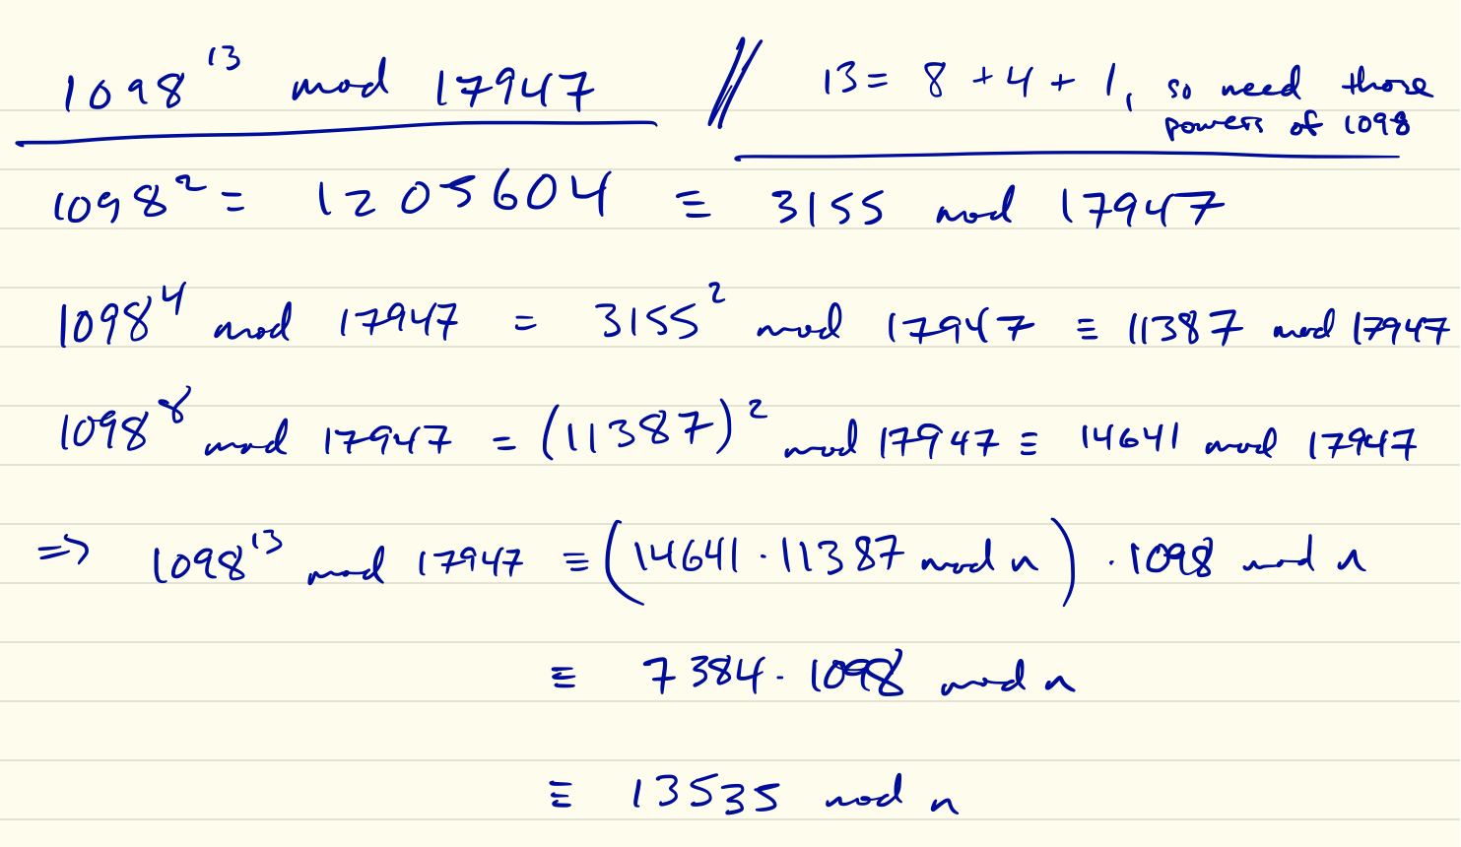
Cryptography - RSA
Example: Let’s take the message M = 1098 and encrypt it using the key e = 13 and n = 17947 = 131 · 137
We compute: C= M e mod 17947= 1098¹³ mod 17947

Slide 14
Cryptography - RSA
Example: Let’s take the message M = 1098 and encrypt it using the key e = 13 and n = 17947 = 131 · 137
We compute: C= M e mod 17947= 1098¹³ mod 17947
(in the wild, you’d make a computer do this…)

Slide 15
Cryptography - RSA
If an unintended recipient sees the encoded message C and the public key (e, n), it would be extremely difficult for them to find M
So far we have identified the function F: F(M, (e,n)) = M e mod n
Now the idea is to find a private key (d, n) that decrypts the message via: C ^{d} mod n = M
This is our inversion function G: G(C, (d,n)) = C ^{d} mod n
To do this, we need to find e and d that satisfy: C ^{d} mod n = (M e)^{d} mod n = M
Which means we need e and d such that: M ^{ed} mod n = M
And we need to figure out how to find such a pair (e, d), where it’s hard to discover d if you know (e, n)...

Slide 16
Cryptography - RSA
Let’s make some assumptions about our keys (public and private), and see how they can lead to an unbreakable cryptosystem (at least by today’s standards)
Assumptions:
n = pq , where p and q are very large primes (~200+ digits)
e is a number that is relatively prime to (p-1)(q-1)
d is the inverse of e (mod (p-1)(q-1)) (which must exist from #2, above)
Let’s see why these assumptions are helpful.
First, notice that since de ≡ 1 (mod (p-1)(q-1)) there exists an integer k such that de = 1 + k (p-1)(q-1)

Slide 17
Cryptography - RSA
Now this means that for some integer k, we have that
C ^{d} ≡ (M e)^{d} ≡ M de ≡ M ^{1+k(p-1)(q-1)} ≡ M · ((M ^{(p-1)})^{(q-1)}) ^{k} (mod n)
In order to get our decryption function G, we need to show that this implies that
C ^{d} ≡ M (mod n)
Assume that gcd(M, p) = 1 and gcd(M, q) = 1.
Then Fermat’s Little Theorem tells us that
M ^{p-1} ≡ 1 (mod p) and M ^{q-1} ≡ 1 (mod q)
Which gives (modulo p):
C ^{d} ≡ M · ((M ^{(p-1)})^{(q-1)}) ^{k} ≡ M · 1^{(q-1) k} ≡ M (mod p)
This is valid except when your message M is a multiple of p or q, which is very rare.

Slide 18
Which gives (modulo p):
C ^{d} ≡ M · ((M ^{(p-1)})^{(q-1)}) ^{k} ≡ M · 1^{(q-1) k} ≡ M (mod p)
And similarly (modulo q):
C ^{d} ≡ M · ((M ^{(q-1)})^{(p-1)}) ^{k} ≡ M · 1^{(p-1) k} ≡ M (mod q)
So we have:
C ^{d} ≡ M (mod p) x ≡ M (mod p)
C ^{d} ≡ M (mod q) ⇒ (which looks awfully familiar) ⇒ x ≡ M (mod q)
where x = C ^{d} is a solution to a system of congruences.
Since p and q are relatively prime (actually, both are prime), the Chinese Remainder Theorem tells us that it is a unique solution modulo pq = n. Thus:
C ^{d} ≡ M (mod n)

Slide 19
Cryptography - RSA
Getting back to practical application: What does Bob need to do?
Choose two very large primes p and q, and form n = pq
Note: Large primes p and q can be found quickly with probabilistic guess-and-checking.

Slide 20
Cryptography - RSA
Getting back to practical application: What does Bob need to do?
Choose two very large primes p and q, and form n = pq
Note: Large primes p and q can be found quickly with probabilistic guess-and-checking.
Find an e that is relatively prime to (p-1)(q-1)

Slide 21
Cryptography - RSA
Getting back to practical application: What does Bob need to do?
Choose two very large primes p and q, and form n = pq
Note: Large primes p and q can be found quickly with probabilistic guess-and-checking.
Find an e that is relatively prime to (p-1)(q-1)
Find d, the inverse of e modulo (p-1)(q-1)

Slide 22
Cryptography - RSA
Getting back to practical application: What does Bob need to do?
Choose two very large primes p and q, and form n = pq
Note: Large primes p and q can be found quickly with probabilistic guess-and-checking.
Find an e that is relatively prime to (p-1)(q-1)
Find d, the inverse of e modulo (p-1)(q-1)
Save privateKey (d, n) and send Alice publicKey (e, n)
Note: This only enables Alice to send Bob secure messages! If Bob wants to send Alice secure messages, then Alice needs to do the same.

Slide 23
Cryptography - RSA
Example: Encrypt and decrypt the message M = 1819 using a Public Key Encryption based on p = 43, q = 59 and e = 13

Slide 24
Cryptography - RSA
Example: Encrypt and decrypt the message M = 1819 using a Public Key Encryption based on p = 43, q = 59 and e = 13
We have n = 43 · 59 = 2537 and (p-1)(q-1) = 42 · 58 = 2436
Note that
2436 = 13·187 + 5
13 = 5·2 + 3
5 = 3·1 + 2
3 = 2·1 + 1
So gcd(2436, 13) = 1, which means e = 13 works as a public key. Good!

Slide 25
Cryptography - RSA
Example: Encrypt and decrypt the message M = 1819 using a Public Key Encryption based on p = 43, q = 59 and e = 13
We have n = 43 · 59 = 2537 and (p-1)(q-1) = 42 · 58 = 2436
Now we need to find the private key, d, which is the inverse of e = 13 modulo 2436
2436 = 13·187 + 5
13 = 5·2 + 3
5 = 3·1 + 2
3 = 2·1 + 1

Slide 26
Cryptography - RSA
Example: Encrypt and decrypt the message M = 1819 using a Public Key Encryption based on p = 43, q = 59 and e = 13
We have n = 43 · 59 = 2537 and (p-1)(q-1) = 42 · 58 = 2436
Now we need to find the private key, d, which is the inverse of e = 13 modulo 2436
2436 = 13·187 + 5
13 = 5·2 + 3
5 = 3·1 + 2
3 = 2·1 + 1
So, by Bezout’s Theorem and “climbing back up” the Euclidean algorithm, we find that the inverse of e = 13 modulo 2436 is d = 937
1 = 3 - 1·2
= 3 - 1·(5 - 1·3) = 2·3 - 1·5
= 2·(13 - 2·5) - 1·5 = 2·13 - 5·5
= 2·13 - 5·(2436 - 187·13) = 937·13 - 5·2436

Slide 27
Cryptography - RSA
Example: Encrypt and decrypt the message M = 1819 using a Public Key Encryption based on p = 43, q = 59 and e = 13
We have n = 43 · 59 = 2537 and (p-1)(q-1) = 42 · 58 = 2436
We now have our public and private keys:
publicKey = (e, n) = (13, 2537)
privateKey = (d, n) = (937, 2537)
Encryption: C = M e mod n =
Decryption: M = C ^{d} mod n =

Slide 28
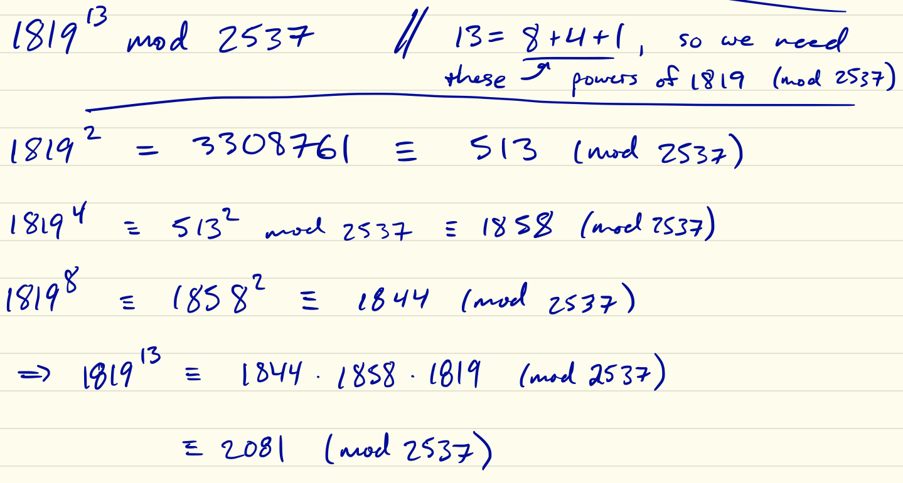
Cryptography - RSA
Example: Encrypt and decrypt the message M = 1819 using a Public Key Encryption based on p = 43, q = 59 and e = 13
We have n = 43 · 59 = 2537 and (p-1)(q-1) = 42 · 58 = 2436
We now have our public and private keys:
publicKey = (e, n) = (13, 2537)
privateKey = (d, n) = (937, 2537)
Encryption: C = M e mod n = 1819¹³ mod 2537 = (using fast mod. exp.) = 2081
Decryption: M = C ^{d} mod n = 2081⁹³⁷ mod 2537 = (using fast mod. exp.) = 1819 (Yeah, I’m not doing that one by hand…)

Slide 29
Cryptography - RSA
Getting back to practical application: Okay, so why can’t we break RSA?
If we know (e, n), couldn’t we do a brute-force attack to determine d ?
Well, technically yes. But d is the inverse of e modulo (p-1)(q-1)
Without knowing how n is factored into n = pq, we have no idea that we have to look for an inverse modulo (p-1)(q-1)
So we need to factor n first…
… and it turns out that factoring large products of primes is hard. There’s only one answer and a s***load lots of numbers to sift through.
⇒ There is no known polynomial time solution

Slide 30
Cryptography - RSA
Getting back to practical application: Okay, so why can’t we break RSA?
The best-known factoring method is estimated to have complexity ~ 2^{number of bits in n}
In 2009, researchers successfully factored a 232 decimal digit product of two primes
It took two years running in parallel on hundreds of machines.
The equivalent of 2000 years running on a single-core machine.
⇒ Factoring large numbers is difficult!

Slide 31
Cryptography - RSA
Getting back to practical application: Okay, so why can’t we break RSA?
That being said… A lock is only secure if you actually use it properly
Some company generated keys in a way such that the private key was practically computable from the public key. Not great.
Links: [1], [2]
[1]
[2]

Slide 32
Cryptography - more tidbits
Block ciphers
When we translate our message M into a number, we need to be careful that the numerical representation of M does not exceed n
Question: Why?
Answer: If M exceeds n, then we would be unable to distinguish between M and any other message that is congruent to M mod n
Typically, we break the message up into blocks (hence, block cipher), then encode the blocks as digits, and then encrypt the blocks
Example: S’pose we wanted to send the message HELP

Slide 33
Cryptography - more tidbits
Example: S’pose we wanted to send the message HELP
First, separate into blocks: HE LP
Second, encode: 0704 1115 ← note the padding with 0s
Blocks of 2 letters works for n ≥ 2525 (first “25” represents first letter, …)
Blocks of 3 letters would work with n ≥ 252525
And so on…
Let’s encrypt HELP using the keys from the previous example (e = 13, d = 937, n = 2537)

Slide 34
Cryptography - more tidbits
Example: Encrypt HELP using the keys from the previous example (e = 13, d = 937, n = 2537)
Our public key was (e, n) = (13, 2537), so we have:
HE = 0704¹³ mod 2537 ≡ (FYOG: fast mod. exp.) ≡ 981 (mod 2537)
LP = 1115¹³ mod 2537 ≡ (FYOG: fast mod. exp.) ≡ 461 (mod 2537)
So the encrypted message would be sent out as 0981 0461

Slide 35
Cryptography - more tidbits
Example: Decrypt C = 1188 1346 using the keys from the previous example (e = 13, d = 937, n = 2537)
1188⁹³⁷ mod 2537 ≡ (fast mod. exp.) ≡ 1814 (mod 2537) → SO
1346⁹³⁷ mod 2537 ≡ (fast mod. exp.) ≡ 1823 (mod 2537) → SX
So the decrypted message in characters would be SOSX
Convention: If your message doesn’t fit perfectly into your block size, then you pad the end of the last block with X’s
⇒ So this message is likely SOS

Slide 36
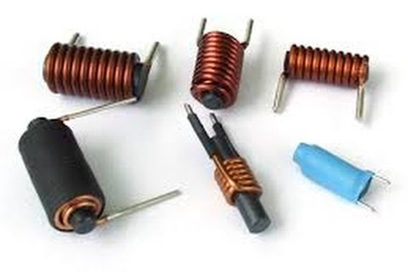
Cryptography - more tidbits
Recap:
RSA public key encryption:
You give everyone your publicKey (e, n) so they can encrypt messages to you
You know what the 2 primes p and q such that n = pq…
… So you know what d is (the inverse of e modulo (p-1)(q-1)) …
… So you can invert the encrypted messages without spending >thousands of years throwing CPUs at it
Next time:
We get inductive!

Slide 37
FYOG: hints!
0704¹³ mod 2537 ≡ … ≡ 981 (mod 2537)
13 = 2³ + 2² + 2⁰ , so 704¹³ = 704⁸·704⁴·704¹, so we need to calculate these powers of 704 (modulo 2537)
704¹ = 704 (modulo 2537)
704² = 495616 ≡ 901 (mod 2537)
704⁴ = (704²)² ≡ 901² = 811801 ≡ 2498 (mod 2537)
and 704⁸ = (704⁴)² ≡ 2498² = 6240004 ≡ 1521 (mod 2537)
⇒ 704¹³ = 704⁸·704⁴·704¹ ≡ 1521·2498·704 (mod 2537) ≡ 981 (mod 2537)

