Slide 1
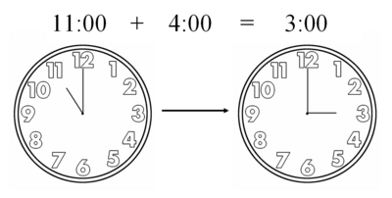
CSCI 2824, Discrete Structures
Spring 2018
Alexandra Kolla
Lecture 18: Modular Exponentiation

Slide 2
Announcements and Reminders
HW6 (written) is due Friday at 12 PM. Go do it!

Slide 3
What did we do last time?
We learned what it means for a number to divide another number
And how to do modular arithmetic (aside from mod 12, which you use all the time)
Reflect on where else in your life modular arithmetic sneaks in…
This makes arithmetic with numbers easier, but also means we can store big numbers in a computer as a combo of only a few small numbers.
Today:
Modular exponentiation - let’s calculate large numbers like champions. (and see how we would teach a computer to do it…)

Slide 4
Binary numbers and modular exponentiation
We traditionally represent numbers in base-10
Example: The number 123 expressed in base-10 is
123 = 1·100 + 2·10 + 3·1 = 1·10² + 2·10¹ + 3·10⁰
We can also represent things in other bases. Like base-2! That is, binary. (cue channeling yourself from the first two days of this course…) (link to those notes)
We could go through our DecToBin(...) program and find: 123₁₀ = 1111011₂
But we are older and wiser than ourselves from back in August...

Slide 5
Example: The number 123 expressed in binary is: 123₁₀ = 1111011₂
This means:
123₁₀ = 1·2⁶ + 1·2⁵ + 1·2⁴ + 1·2³ + 0·2² + 1·2¹ + 1·2⁰
= 64 + 32 + 16 + 8 + + 2 + 1
Note that the right-most bit, 1, is the remainder when we divide by 2 123 = 2 · 61 + 1
And the second bit, 1, is the remainder when we divide the previous quotient by 2 61 = 2 · 30 + 1
And the third bit, 0, is the remainder when we divide the previous quotient by 2 30 = 2 · 15 + 0
And so on…

Slide 6
Binary numbers and modular exponentiation
Example: The number 123 expressed in binary is: 123₁₀ = 1111011₂
We can successively divide the quotients by 2 and keep the remainders

Slide 7
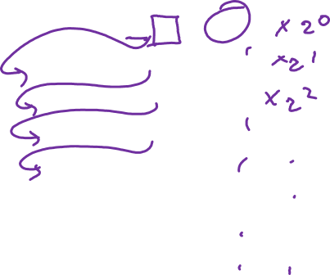
Binary numbers and modular exponentiation
Example: The number 123 expressed in binary is: 123₁₀ = 1111011₂
We can successively divide the quotients by 2 and keep the remainders
123 = 2·61 + 1
61 = 2·30 + 1
30 = 2·15 + 0
15 = 2·7 + 1
7 = 2·3 + 1
3 = 2·1 + 1
1 = 2·0 + 1
Result: 121₁₀ = 1111011₂

Slide 8
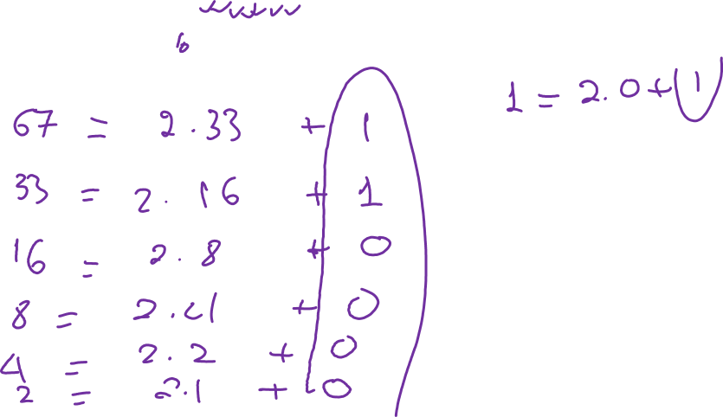
Binary numbers and modular exponentiation
Example: Show that 67 is 1000011₂
Solution:

Slide 9
Binary numbers and modular exponentiation
Example: Show that 67 is 1000011₂
Solution:
67 = 2·33 + 1
33 = 2·16 + 1
16 = 2·8 + 0
8 = 2·4 + 0
4 = 2·2 + 0
2 = 2·1 + 0
1 = 2·0 + 1
Result: 67₁₀ = 1000011₂ FYOG: Convert 45 and 70 from decimal to binary.

Slide 10
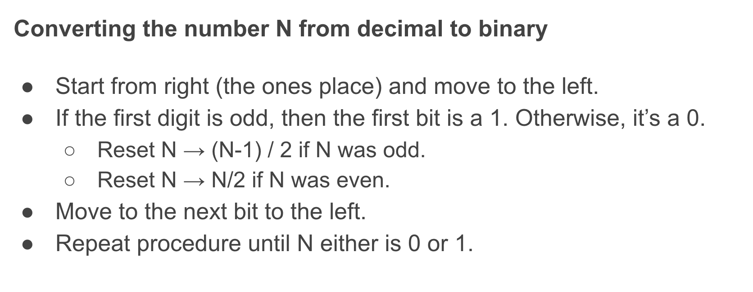
Remember this? We can do better now! def newAndImproved_DecToBin(n):
q = n
k = 0
binary_out = []
while (q != 0):
Add q mod 2 at the “front” of the binary_out list q = q div 2 k = k+1 return (binary_out)
FYOG: Do a timing test of this version of DecToBin(...) against the old one.

Slide 11
Binary numbers and modular exponentiation
In Cryptography (for example) we often need to compute a^{n} mod m
This can be super expensive for large a, n and m
Naively computing powers is expensive
a^{n} for large a and/or n might need large data types
⇒ Binary representations to the rescue!
First, we’ll use a binary representation of n to help us compute a^{n}
Then, we’ll show how it can be done quickly modulo m

Slide 12
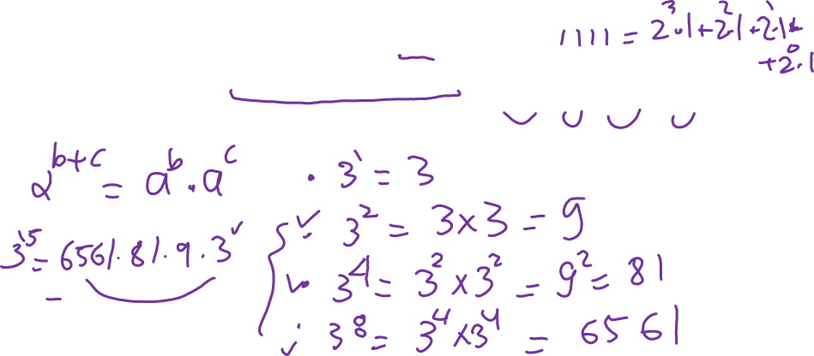
Binary numbers and modular exponentiation
Example: Compute 3¹⁵ using a binary representation of 15
Note that the binary representation of 15 is 1111₂ , so

Slide 13
Binary numbers and modular exponentiation
Example: Compute 3¹⁵ using a binary representation of 15
Note that the binary representation of 15 is 1111₂ , so
Now we (or a computer) can compute 3² = 3 x 3 = 9 pretty easily
Armed with 3², we can compute 3⁴ = (3²)² = 9² = 81
And armed with 3⁴ , we can compute 3⁸ = (3⁴)² = 6561
Finally, with all of the powers-of-powers-of-2 computed, we can multiply:

Slide 14
Binary numbers and modular exponentiation
Example: Compare the number of multiplications used:
… vs …
Now we (or a computer) can compute 3² = 9 pretty easily
Armed with 3², we can compute 3⁴ = (3²)² = 9² = 81
And armed with 3⁴ , we can compute 3⁸ = (3⁴)² = 6561
Finally, with all of the powers-of-powers-of-2 computed, we can multiply:
In general: # multiplications is O(log₂ n) multiplications

Slide 15
Binary numbers and modular exponentiation
Now we can remember that we’re doing this mod m
… and we remember that you can distribute mod across multiplications!
Let n = (b_{k-1}, b_{k-2}, b_{k-3}, … , b₁, b₀)₂ (some binary number). Then
… which means we can mod-out as we go! So let’s have another look at that last example, modulo 11… because toting around 6561 was a real chore.

Slide 16
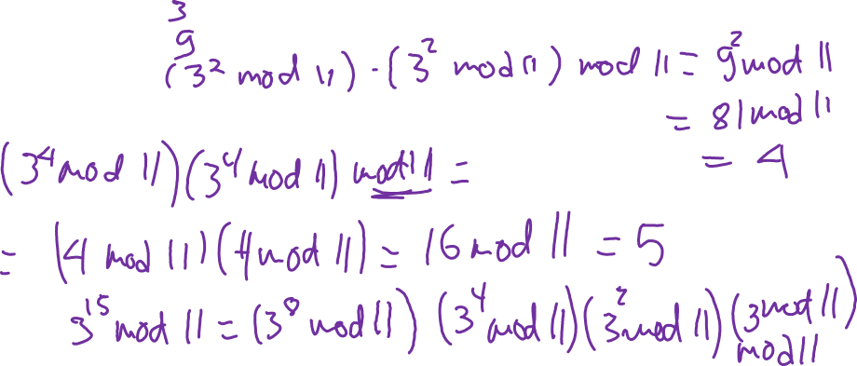
Example: Compute 3¹⁵ mod 11
Recall that 3¹⁵ = 3⁸ · 3⁴ · 3² · 3¹
3¹ mod 11 =
3² mod 11 =
3⁴ mod 11 =
3⁸ mod 11 =

Slide 17
Example: Compute 3¹⁵ mod 11
Recall that 3¹⁵ = 3⁸ · 3⁴ · 3² · 3¹
3¹ mod 11 = 3
3² mod 11 = (3 mod 11)² mod 11 = 9
3⁴ mod 11 = (3² mod 11)² mod 11 = 9² mod 11 = 81 mod 11 = 4
3⁸ mod 11 = (3⁴ mod 11)² mod 11 = 4² mod 11 = 16 mod 11 = 5
Thus, we have
3¹⁵ mod 11 = (3⁸ · 3⁴ · 3² · 3¹) mod 11 = (3⁸ · 3⁴ · 3² mod 11)(3¹ mod 11) mod 11
= (((3⁸ · 3⁴ mod 11) · 3² mod 11) · 3 mod 11) mod 11
= (((( 3⁸ mod 11) · 3⁴ mod 11) · 9 mod 11) · 3 mod 11) mod 11
= (((5 · 4 mod 11) · 9 mod 11) · 3 mod 11) mod 11
= … = 1

Slide 18
Binary numbers and modular exponentiation
The modular exponentiation algorithm, pseudocode to find: a^{n} mod m
def modularExp(a, n=[b[k-1], b[k],...,b[0]], m):
x_out = 1
power = a mod m
for (i in range(0,len(b)):
if (b[i]==1): x_out = (x_out*power) mod m
power = (power*power) mod m
return (x_out)

Slide 19
Binary numbers and modular exponentiation
FYOG: Compute…
3¹¹ mod 7
3²² mod 11
4¹³ mod 5

Slide 20
Binary numbers and modular exponentiation
Recap:
We learned about binary representations of numbers…
… particularly, large numbers....
… and looked at how binary representations and modular arithmetic/exponentiation can help us to calculate things more efficiently!
We like modular arithmetic/exponentiation.
Next time:
Prime numbers and greatest common divisors
Prime Numbers → Optimus

Slide 21
Bonus material!

Slide 22
FYOG: hints!
FYOG: Compute 3¹¹ mod 7, 3²² mod 11 and 4¹³ mod 5
Note that 11 = 1011₂
So we can use modularExp(a=3, b=[1,1,0,1], m=7):
Initialize ⇒ x = 1, power = 3 mod 7 = 3
i = 0 ⇒ b[0] = 1, so x = (x · power) mod 7 = 1 · 3 mod 7 = 3 and power = (power · power) mod 7 = 3 · 3 mod 7 = 2
i = 1 ⇒ b[1] = 1, so x = (x · power) mod 7 = 3 · 2 mod 7 = 6 and power = (power · power) mod 7 = 2 · 2 mod 7 = 4
i = 2 ⇒ b[2] = 0, so power = (power · power) mod 7 = 4 · 4 mod 7 = 2
i = 3 ⇒ b[3] = 1, so x = (x · power) mod 7 = 6 · 2 mod 7 = 5
So 3¹¹ mod 7 = 5. (the other two proceed the same way, and yield 9 (mod 11) and 4 (mod 5), resp.)

